Slide 1
8. Money, Inflation and Economic Growth
Athens University of Economics and Business
Dynamic Macroeconomics
Prof. George Alogoskoufis
alogoskoufisg.com

Slide 2
The Nature and the Role of Money
In the models we have presented so far there is no role for money. Yet money performs very important functions in an economy. Money is a unit of account, in terms of which prices are defined, a means of payments, which reduces transaction costs, and a liquid store of value (asset), which pays no interest.
In this lecture we allow for the role of money in the growth models we have analyzed so far. We first present a representative household model, in which real money balances enter the utility function of households, and then analyze a corresponding model of overlapping generations.
In models with money, one can draw the distinction between real variables, as the ones we have analyzed so far, and nominal variables, such as the stock of money, the price level, inflation and nominal output, nominal wages and nominal interest rates. All nominal variables are expressed in terms of money prices.

Slide 3
The Demand for Money
By assuming that money enters the utility function of households, we derive a money demand function from microeconomic foundations, as a result of the solution of an inter-temporal optimization problem by households.
Based on this particular approach to money demand, we show that the demand for real money balances is proportional to aggregate consumption, and depends negatively on the nominal interest rate. Since money is a nominal asset that pays no interest, the nominal interest rate measures the opportunity cost of holding real money balances.
The demand for nominal money balances is proportional to the price level, a property which implies the neutrality of money. The stock of nominal money balances does not affect any real variables in these models, but only the price level.
We also analyze the determination of inflation, the nominal interest rate and other nominal variables, and the inter-temporal effects of the rate of growth of the money supply on the path of economic growth.

Slide 4
Models of Economic Growth with Money
In the representative household model, the growth path of all real variables, with the exception of the stock of real money balances, is independent of the rate of growth of the money supply, which affects inflation and nominal interest rates. The demand for real money balances, which depends negatively on the nominal interest rate, is the only real variable that is affected by the rate of growth of the money supply. This is because the rate of growth of the money supply affects nominal interest rates, and therefore the opportunity cost of holding real money balances.
To put it differently, the rate of growth of the money supply imposes an inflation tax on the real money balances held by households. The independence of the growth path of all other real variables from the rate of growth of the money supply is known as the super neutrality of money.
In overlapping generations models, the rate of growth of the money supply affects the growth path of all real variables, as it affects the aggregate savings rate, the accumulation of capital and the balanced growth path. The reason is that in overlapping generations models, holdings of real money balances differ among generations. Thus, when there is an increase in the rate of growth of the money supply, older generations, which hold higher real money balances, reduce their asset holdings and their consumption more than younger generations, since they pay a higher inflation tax. As a result, aggregate consumption falls, and aggregate savings rise. This leads to a higher accumulation of capital, which affects the growth path.

Slide 5
The Super-Neutrality of Money and Ricardian Equivalence
The differences in the effects of the rate of growth of the money supply between representative household and overlapping generations models arise for the same reason that government debt has no real effects in representative household models, while it has real effects in overlapping generations models.
Ricardian equivalence and the super neutrality of money are closely linked, as the rate of growth of the money supply is essentially an inflation tax on real money balances. In overlapping generations models this inflation tax, and government debt, have different effects on current and future generations, and thus affect aggregate savings.
In the representative household model, neither government debt nor the growth rate of the money supply redistributes the tax burden among generations. In overlapping generations models, both result in a redistribution of the tax burden among generations, and thus affect the aggregate savings of current generations.

Slide 6
Private Consumption and Money Demand in a Representative Household Model
Assume, as in the Ramsey model, a competitive economy in which all households are identical. Households are indexed by $j$, where $j$ is uniformly distributed between zero and 1. Thus, $j∈[0,1]$. We therefore focus on the behavior of only one of them, the representative household.
The number of members of each household is equal to $L(t)$, and is growing at an exogenous rate $n$, which is also the rate of growth of population $L(t)$. Labor supply and employment is equal to $L(t)$ and the efficiency of labor $h(t)$ grows at an exogenous rate of technical progress $g$.
The instantaneous utility function of households depends on consumption of goods and services, and holdings of real money balances.

Slide 7
Money in the Utility Function of Households
Household $j$ selects a path of consumption and real money balances in order to maximize the following intertemporal utility function.
$U_{j}=∫_{t=0}^{∞}e^{-ρt}u\left(c_{j}(t),m_{j}(t)\right)L(t)dt$
The maximization takes place under the instantaneous budget constraint,
${\overset{·}{a}}_{j}(t)=\left(r(t)-n\right)a_{j}(t)+w(t)h(t)-τ(t)h(t)-c_{j}(t)-\left(r(t)+π(t)\right)m_{j}(t)$
and the transversality condition,
$\lim_{t→∞}e^{-\overset{t}{\underset{s=0}{∫}}\left(r(s)-n\right)ds}a_{j}(t)=0$
where, $ρ$ is the pure rate of time preference of households and $u$ is a quasi concave instantaneous utility function that depends on consumption and real money balances (assumed positive). $c_{j}(t)$ denotes average consumption per person of household $j$ at time $t$, $m_{j}(t)$ denotes average per person real money balances of household $j$ at time $t$, $a_{j}(t)$ denotes average assets per person (non-human wealth) of household $j$ at time $t$, $w(t)$ denotes the real wage per efficiency unit of labor at time $t$, $h(t)$ denotes labor efficiency per worker, and $τ(t)$ denotes average taxes (minus transfers) per efficiency unit of labor at time $t$. $r(t)$ is the real interest rate at time $t$, $n$ is the population growth rate, equal to the growth rate of members per household, and $π(t)$ is inflation, which is equal to expected inflation.

Slide 8
Nominal and Real Interest Rates and the Opportunity Cost of Real Money Balances
Unlike other assets held by households, such as capital or government bonds, the nominal yield of money is equal to zero, because money balances do not pay interest. Moreover, when there is a positive inflation rate $π(t)$, real (inflation adjusted) money balances depreciate at the inflation rate $π(t)$. Therefore the opportunity cost of holding real money balances is equal to the sum of the real return of interest yielding assets, plus the expected inflation rate. This is defined as the nominal interest rate $i(t)$, which is determined by,
$i(t)=r(t)+π(t)$
This relationship between nominal and real interest rates is called the Fisher equation, as it was first highlighted by Irving Fisher in 1896.
In this version of the Fisher equation it its assumed that there is perfect foresight, and actual and expected inflation rates coincide.

Slide 9
First Order Conditions of Representative Household Model with Money
The instantaneous utility function is assumed to take the form,
$u_{j}(t)=u\left(c_{j}(t),m_{j}(t)\right)=γ\frac{c_{j}{(t)}^{1-θ}}{1-θ}+(1-γ)\frac{m_{j}{(t)}^{1-θ}}{1-θ}$
where, $1/θ$ is the intertemporal elasticity of substitution of consumption and real money balances, and $γ$ the share of consumption in the utility of the household. This utility function, which is a generalization of the CEIS utility function we have used previously, is additively separable, in that the elasticity of substitution between consumption and real money balances is equal to unity.
From the first-order conditions for the maximisation of the intertemporal utility function it follows that,
$γc_{j}(t)^{-θ}=λ_{j}(t)$
$(1-γ)m_{j}(t)^{-θ}=λ_{j}(t)\left(r(t)+π(t)\right)$
${\overset{·}{λ}}_{j}(t)=-\left(r(t)-ρ\right)λ_{j}(t)$
The asset accumulation constraint and the transversality condition must also be satisfied.
$λ_{j}(t)$ is the current value multiplier of the relevant current value Hamilton function, and its economic interpretation is that it measures the shadow value of marginal savings (assets) of the household.

Slide 10
Interpretation of the First Order Conditions
From the first order conditions (FOC), $λ_{j}(t)$, which is the shadow value of marginal savings, is equal to the current marginal utility of consumption. At the optimum the marginal value of savings must be equal to the marginal utility of consumption, and the household must be indifferent between consumption and savings.
From the second FOC, the current marginal utility of real money balances is equal to the marginal utility of consumption $λ_{j}(t)$ times the opportunity cost of holding real money balances, $r(t)+π(t)$. Money pays no interest and loses its value because of inflation. At the optimum the marginal value of holding real money balances must be equal to this opportunity cost of holding money, evaluated in terms of the marginal utility of consumption. Thus, at the optimum, the household should be indifferent between substituting consumption for the utility services of money.
Finally, from the third FOC, the marginal utility of consumption falls at a rate which is equal to the difference between the real interest rate and the pure rate of time preference. This is another way of saying that the expected real return on savings, including capital gains on assets, is equal to the pure rate of time preference of the household. This can be seen by re-arranging the third FOC as,
$r(t)+\frac{{\overset{·}{λ}}_{j}(t)}{λ_{j}(t)}=ρ$
One can use the first-order conditions to derive the money demand function and the Euler equation for consumption.

Slide 11
The Demand for Real Money Balances per Efficiency Unit of Labor
Dividing the first FOC by second, and solving for real money balances, we can derive a function for the demand for real money balances by the representative household.
$m_{j}(t)={\left(\frac{γ}{1-γ}(r(t)+π(t))\right)}^{-\frac{1}{θ}}c_{j}(t)$
We can use the above to deduce aggregate money demand. Multiplying both sides by $L(t)$ we get,
$\frac{M(t)}{P(t)}={\left(\frac{γ}{1-γ}(r(t)+π(t))\right)}^{-\frac{1}{θ}}C(t)$
where $M(t)$ is the aggregate nominal money supply, $P(t)$ is the price level, and $C(t)$ is aggregate real consumption of goods and services.
This describes the aggregate money demand function in this model. Aggregate money demand is proportional to the price level and aggregate real consumption, and depends negatively on the nominal interest rate, $r(t)+π(t)$. Put differently, the elasticity of aggregate money demand with respect to the price level and aggregate private consumption is equal to one, while the elasticity of aggregate money demand with respect to the nominal interest rate is equal to $-1/θ$, the elasticity of intertemporal substitution.
Aggregate money demand characterized by homogeneity of degree one with respect to the price level, because households demand money for its purchasing power. Doubling the money supply, for given aggregate real consumption and nominal interest rates, would cause a doubling of the price level. This property results in the neutrality of money.
Expressing real money balances per efficiency unit of labor, one gets,
$m(t)={\left(\frac{γ}{1-γ}(r(t)+π(t))\right)}^{-\frac{1}{θ}}c(t)$
where, $m=(M/P)/hL$ and $c=C/hL$. $h$ is the efficiency of labor.

Slide 12
The Rate of Growth of the Money Supply and Inflation
One can use the demand for money function to determine the price level and inflation, under the assumption that the aggregate nominal money supply and its rate of growth $μ$ are determined by the government, or a government agency such as a central bank. From the money demand function and the Fisher equation it follows that,
$\frac{M(t)}{P(t)C(t)}={\left(\frac{γ}{1-γ}i(t)\right)}^{-\frac{1}{θ}}$
For given aggregate real consumption and nominal interest rates, the level of the nominal money supply determines the level of prices.
It also follows from the aggregate money demand function that,
$\left(μ-π(t)-\frac{\overset{·}{C}(t)}{C(t)}\right)=-\frac{1}{θ}\frac{\overset{·}{i}(t)}{i(t)}$
Thus, inflation is determined as,
$π(t)=μ-\frac{\overset{·}{C}(t)}{C(t)}+\frac{1}{θ}\frac{\overset{·}{i}(t)}{i(t)}$
For a given rate of growth in private consumption and fixed nominal interest rates, the inflation rate $π(t)$ is determined by the rate of growth of the money supply. For example, in a steady state where the growth rate of consumption in equal to $g+n$, and inflation and nominal interest rates are constant, inflation would be determined by,
$π=μ-g-n$
Thus, the money demand function is the basis of the monetary approach to the determination of inflation. In the long run, inflation is determined by the difference between the rate of growth of the money supply and the long-run growth rate of aggregate output and consumption.

Slide 13
The Euler Equation for Consumption and Money Demand in the Representative Household Model
Turning to the first-order conditions for consumption, from the first and the third FOC, it follows that,
${\overset{·}{c}}_{j}(t)=\frac{1}{θ}\left(r(t)-ρ\right)c_{j}(t)$
This is the standard Euler equation for consumption in a representative household model. It does not differ in this monetary model from the corresponding equation in the model without money.
It is straightforward to show that the evolution of aggregate consumption and consumption per efficiency unit of labor are given by,
$\overset{·}{C}(t)=\frac{1}{θ}\left(r(t)-ρ+θn\right)C(t)$
$\overset{·}{c}(t)=\left(r(t)-ρ-θg\right)c(t)$
where $g$ is the rate of exogenous technical progress.
From these Euler equations, it follows that the rate of growth of aggregate consumption or consumption per efficiency unit of labor only depends on real variables and not the money supply or its rate of growth.

Slide 14
Production, Competitive Markets and the Determination of the Real Interest Rate and Real Wages
We assume as in the previous models that output per efficiency unit of labor is determined by,
$y(t)=Af(k(t))$
where $Af(k(t))$ is a neoclassical production function, with all the usual properties. Once the capital stock per efficiency unit of labor is determined, output is determined through the production function.
In a competitive equilibrium, assuming that firms maximize profits, the real interest rate $r(t)$ and the real wage per efficiency unit of labor $w(t)$ will be determined by the usual marginal productivity conditions,
$r(t)=Af^{′}(k(t))-δ$
$w(t)=Af(k(t))-k(t)Af^{′}(k(t))$
Thus, both the real interest rate and the real wage are determined by real factors, and independently of monetary conditions.

Slide 15
The Inflation Tax and the Accumulation of Household Assets
We shall assume that the assets of households consist of capital, government bonds and money.
$a_{j}(t)=k_{j}(t)+d_{j}(t)+m_{j}(t)$
where $k_{j}$, $d_{j}$ and $m_{j}$ denote physical capital, real government bonds and real money balances held by the average member of household $j$.
Aggregating the asset accumulation equations of households, this results in an accumulation equation for total household assets of the form,
$\overset{·}{K}(t)+\overset{·}{D}(t)+\overset{·}{\left(\frac{M(t)}{P(t)}\right)}=r(t)\left(K(t)+D(t)+\frac{M(t)}{P(t)}\right)+w(t)h(t)L(t)-T(t)-C(t)-(r(t)+π(t))\frac{M(t)}{P(t)}$
The rate of growth of real money balances is given by $μ-π(t)$. Thus, it will hold that,
$\overset{·}{\left(\frac{M(t)}{P(t)}\right)}=(μ-π(t))\frac{M(t)}{P(t)}$
Substituting in the asset accumulation equation we get that,
$\overset{·}{K}(t)+\overset{·}{D}(t)=r(t)K(t)+w(t)h(t)L(t)+r(t)D(t)-T(t)-μ\frac{M(t)}{P(t)}-C(t)$
The aggregate accumulation of capital and real government bonds by households depends on the difference between aggregate household disposable income from aggregate household consumption. The disposable income of households consists of their total asset and labor income, minus taxes $T(t)$ and the inflation tax imposed by the government through the rate of growth of the money supply. Government revenue from the monopoly of issuing money, usually referred to as seigniorage or inflation tax (on the real money balances held by households), is given by,
$μ\frac{M(t)}{P(t)}$

Slide 16
The Accumulation of Government Debt and the Inflation Tax
The government budget constraint in an economy in which the government has the monopoly of money creation is described by,
$$\overset{·}{D}(t)=C_{g}(t)+r(t)D(t)-T(t)-μ\frac{M(t)}{P(t)}$$
The government accumulates government debt to the extent that primary government expenditure $C_{g}$, plus the real interest expenditure on existing debt $rD$, exceeds the sum of total taxes (minus transfers) $T$, plus the inflation tax $μ(M/P)$.

Slide 17
From the Budget Constraint of Households and the Government to the Economy Wide Budget Constraint
Substituting the government debt accumulation equation in the household accumulation equation, we end up with the well known equation for aggregate capital accumulation,
$\overset{·}{K}(t)=r(t)K(t)+w(t)h(t)L(t)-C_{g}(t)-C(t)$
Only primary government expenditure, and not the way it is financed, appears in the aggregate capital accumulation equation. Debt, taxes and seigniorage revenue do not affect the accumulation of capital.
Expressing both sides per efficiency unit of labor, i.e., dividing by $h(t)L(t)$, we get,
$\overset{·}{k}(t)=r(t)k(t)+w(t)-c(t)-c_{g}(t)-(n+g)k(t)$
Using the marginal productivity conditions for the determination of the real interest rate and the real wage, we finally get,
$\overset{·}{k}(t)=Af(k(t))-c(t)-c_{g}(t)-(n+g+δ)k(t)$
The economy accumulates capital per efficiency unit of labor when total savings per efficiency unit of labor exceed the investment required to maintain a constant capital stock per efficiency unit of labor. This is the same as the capital accumulation equation in the Ramsey model without money. The existence of money and money demand does not affect the accumulation of real capital either.

Slide 18
The Representative Household Model with Money
The evolution of real variables in the Ramsey model with money is determined by the Euler equation for consumption and the capital accumulation equation. These two are the sole determinants of the paths of private consumption and the capital stock.
$\overset{·}{c}(t)=\left(r(t)-ρ-θg\right)c(t)$
$\overset{·}{k}(t)=Af(k(t))-c(t)-c_{g}(t)-(n+g+δ)k(t)$
All other real variables are functions of the capital stock (per efficiency unit of labor) and/or private consumption. Output is determined by the production function and the real interest rate and the real wage are determined by the marginal productivity conditions. Thus, they are determined by,
$y(t)=Af(k(t))$, $r(t)=Af^{′}(k(t))-δ$, $w(t)=Af(k(t))-k(t)Af^{′}(k(t))$
The demand for real money balances, the nominal interest rate and inflation are determined by,
$m(t)={\left(\frac{γ}{1-γ}i(t)\right)}^{-\frac{1}{θ}}c(t)$, $i(t)=r(t)+π(t)$, $π(t)=μ-\frac{\overset{·}{c}(t)}{c(t)}-n-g+\frac{1}{θ}\frac{\overset{·}{i}(t)}{i(t)}$

Slide 19
The Determination of Consumption and the Capital Stock
We shall assume that the government chooses a constant level of primary expenditure ${\overline{c}}_{g}$ and government debt $\overline{d}$ per efficiency unit of labor, and uses taxes to satisfy the government budget constraint. The government also chooses, through the central bank, a constant rate of growth $μ$ for the money supply. All seigniorage revenue accrues to the government budget.
The evolution of consumption and the capital stock in the Ramsey model with money is thus determined by,
$\overset{·}{c}(t)=\left(r(t)-ρ-θg\right)c(t)$
$\overset{·}{k}(t)=Af(k(t))-c(t)-{\overline{c}}_{g}-(n+g+δ)k(t)$
Neither the stock of money, nor the rate of growth of the money supply affects the evolution of private consumption (savings) or the accumulation of capital (investment). The determination of consumption and the capital stock takes place in the same way as in a model without money. The only government policy variable that appears to affect the economy is real primary government expenditure.
The model is exactly the same as the Ramsey model without money. The rate of growth of the money supply affects inflation, nominal interest rates and the demand for money, but no other real variables, such as output, consumption, the capital stock, real wages and real interest rates.

Slide 20
The Determination of the Balanced Growth Path in the Representative Household Model with Money
As in the Ramsey model without money, it is straightforward to prove that the economy possesses a unique balanced growth path and a unique saddle path leading to the balanced growth path. On the balanced growth path, all variables that have been defined per efficiency unit of labor will remain constant, and the same applies to interest rates (real and nominal) and inflation.
Capital per efficiency unit of labor on the balanced growth path is determined by,
$Af^{′}(k^{*})=ρ+θg+δ$
Private consumption per efficiency unit of labor on the balanced growth path is determined by,
$c^{*}=Af(k^{*})-{\overline{c}}_{g}-(n+g+δ)k^{*}$
Real output per efficiency unit of labor on the balanced growth path is determined by,
$y^{*}=Af(k^{*})$
The steady state real interest rate and the real wage per efficiency unit of labor are determined by the marginal productivity conditions as,
$r^{*}=ρ+θg$
$w^{*}=Af(k^{*})-k^{*}Af^{′}(k^{*})$
The above equations determine the evolution of all real variables on the balanced growth path, with the exception of real money balances. Capital, output, the real wage and consumption per efficiency unit of labor are constant on the balanced growth path, as is the real interest rate. All per capita variables grow at the exogenous rate of technical progress g. In this model, neither the method of financing government expenditure, nor the money stock or the rate of growth of the money supply affect the balanced growth path. Thus, both Ricardian equivalence and the neutrality as well as the so called super-neutrality of money hold in a representative household model.

Slide 21
The Super-neutrality of Money in a Representative Household Model
The super neutrality of money was first analyzed by Sidrauski (1967), who demonstrated that, in a representative household model, the growth rate of the money supply does not affect real variables on the balanced growth path, but only nominal variables and the demand for money.
On the balanced growth path, the inflation rate is determined by the difference between the growth rate of the money supply from the long-term growth rate $n+g$. This can be seen from the inflation determination equation. Assuming a constant rate of growth of the money supply $μ$, the inflation rate on the balanced growth path equals,
$π^{*}=μ-(n+g)$
From the Fisher equation, the steady state nominal interest rate is constant and equal to,
$i^{*}=r^{*}+π^{*}=ρ+(θ-1)g-n+μ$
In a representative household model, real money balances is the only real variable affected by the growth rate of the money supply on the balanced growth path. It is determined by,
$m^{*}={\left(\frac{1-γ}{γ}\frac{1}{i^{*}}\right)}^{\frac{1}{θ}}c^{*}={\left(\frac{1-γ}{γ}\frac{1}{ρ+(θ-1)g-n+μ}\right)}^{\frac{1}{θ}}c^{*}$
Note that the elasticity of money demand with respect to the nominal interest rate is equal to the elasticity of intertemporal substitution $1/θ$.
The higher the growth rate of the money supply, given the other structural parameters of the model, the higher the rate of inflation and the nominal interest rate, and the lower the stock of real money balances on the balanced growth path. A permanent increase in the growth rate of the money supply by 5 percentage points causes an increase in inflation by 5 percentage points, and an increase in nominal interest rates by 5 percentage points as well. It also causes a decrease in the demand for real money balances. In a representative household model, real money balances is the only real variable affected by the growth rate of the money supply on the balanced growth path. This is what has been termed as the super-neutrality of money.

Slide 22
The Welfare Costs of Inflation in the Ramsey Model
Does the super-neutrality of money mean that inflation does not matter in a representative household model? Far from it. Inflation implies a distortion in that the demand for real money balances, and, therefore, the liquidity services of money, are lower the higher the rate of inflation and nominal interest rates. Hence, the welfare of the representative household goes down with the rate of inflation, as the representative household economizes on real money balances and enjoys lower liquidity services.
In the diagram we compare two equilibria. In one of them inflation is zero, and the nominal interest rate is equal to the real steady interest rate $ρ+θg$. In the second there is a positive inflation rate $π$. The welfare cost of inflation is measured by the area of the gray triangle, which is the loss of consumer surplus that does not translate into a higher inflation tax. This is the net welfare cost of inflation, which measures the reduction in the welfare of the representatitve household that does not translate into higher government revenue from inflation. One can easily show that the higher the inflation rate, the higher the welfare cost of inflation.
Hence, inflation matters in the representative household model, in that it causes a reduction in the demand for real money balances, and thus lower liquidity services from money. To the extent that the liquidity services of money yield utility, this implies a welfare cost.

Slide 23
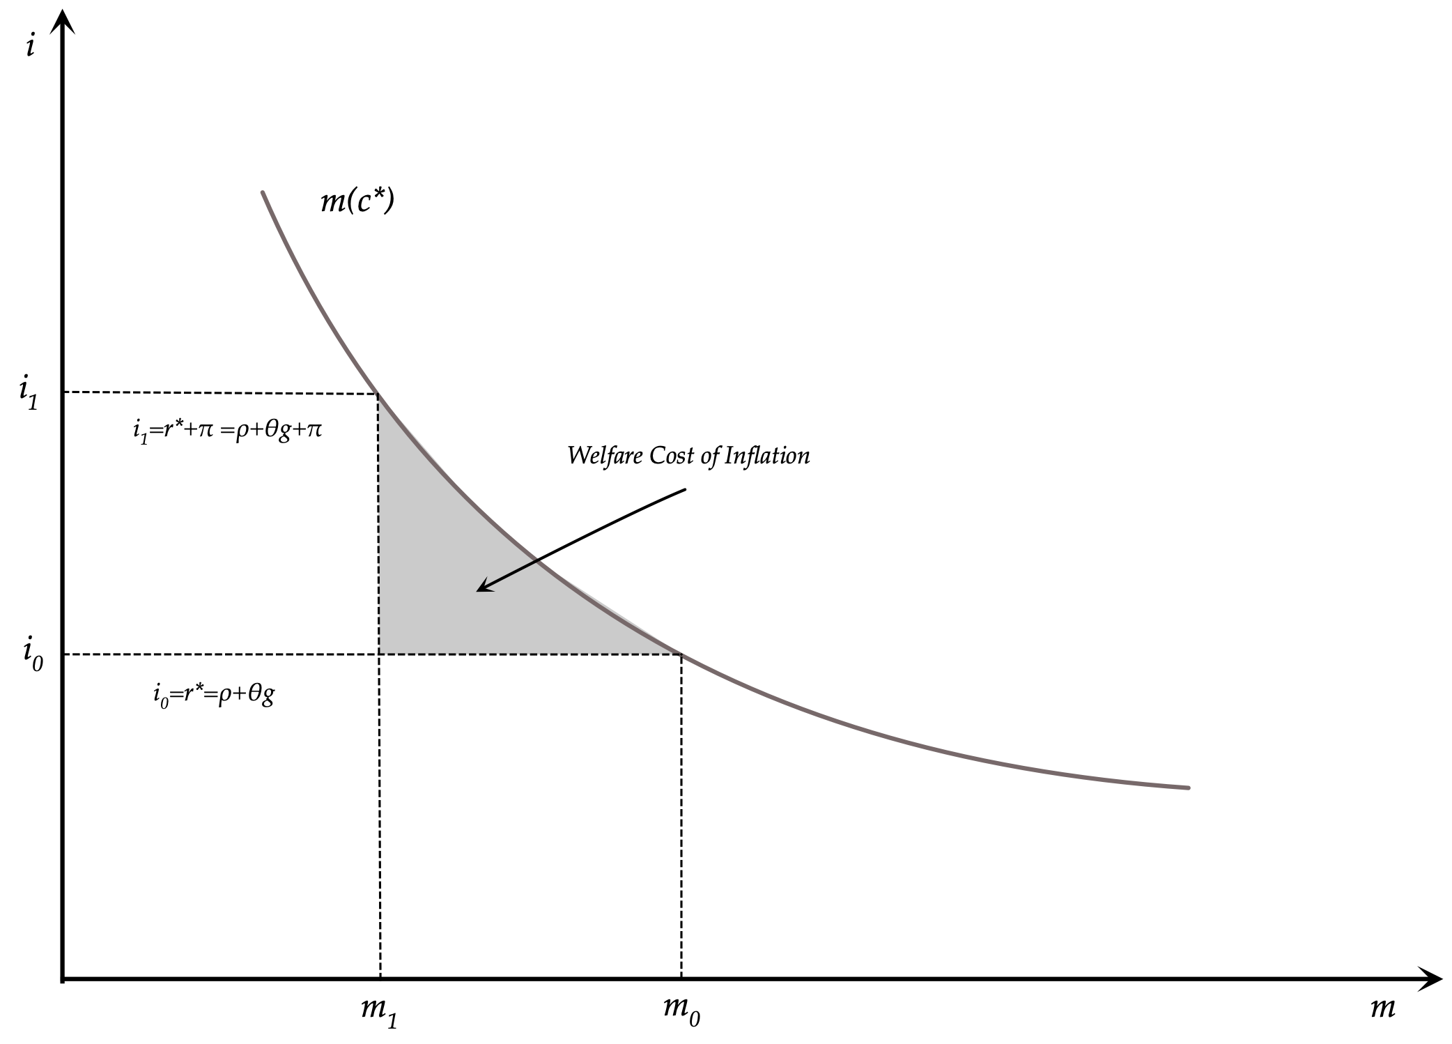
The Welfare Costs of Inflation and the Demand for Money

Slide 24
The Overlapping Generations Model with Money
In the Blanchard-Weil overlapping generations model with money, the demand for money (per efficiency unit of labor) is given by,
$m(t)=\frac{1-γ}{γ}\frac{1}{r(t)+π(t)}c(t)$
The Euler equation for consumption is given by,
$\overset{·}{c}(t)=\left(Af^{′}(k(t))-δ-ρ-g-\right)c(t)-nργ\left(k(t)+\overline{d}+m(t)\right)$
Using the demand for money function to substitute for the stock of real money balances per efficiency unit of labor, and the marginal productivity condition to substitute for the real interest rate in the Euler equation for consumption, we get,
$\overset{·}{c}(t)=\left(Af^{′}(k(t))-δ-ρ-g-\frac{nρ(1-γ)}{Af^{′}(k(t))-δ+π(t)}\right)c(t)-nργ\left(k(t)+\overline{d}\right)$
The capital accumulation equation is given by,
$\overset{·}{k}(t)=Af(k(t))-c(t)-{\overline{c}}_{g}-(n+g+δ)k(t)$
The last two equations can be used to analyze both the balanced growth path and the adjustment path in terms of the exogenous parameters of the model and the policy variables describing government expenditure, government debt and the rate of growth of the money supply.

Slide 25
The Balanced Growth Path in the Overlapping Generations Model with Money
On the balanced growth path we shall have,
$c^{*}=\frac{nργ}{Af^{′}(k^{*})-δ-ρ-g-\frac{nρ(1-γ)}{Af^{′}(k^{*})-δ+μ-(n+g)}}\left(k^{*}+\overline{d}\right)$
$c^{*}=Af(k^{*})-{\overline{c}}_{g}-(n+g+δ)k^{*}$
These jointly determine real private consumption and real capital per efficiency unit of labor on the balanced growth path, as a function of parameters of technology, household preferences, the population growth rate and the rate of exogenous technical progress, as well as the parameters describing fiscal and monetary policy.
The balanced growth path, and the relevant unique saddle path, are shown diagrammatically in the diagram that follows. $\overset{·}{c}=0$ is the steady state consumption function and $\overset{·}{k}=0$ is the steady state capital accumulation function.

Slide 26
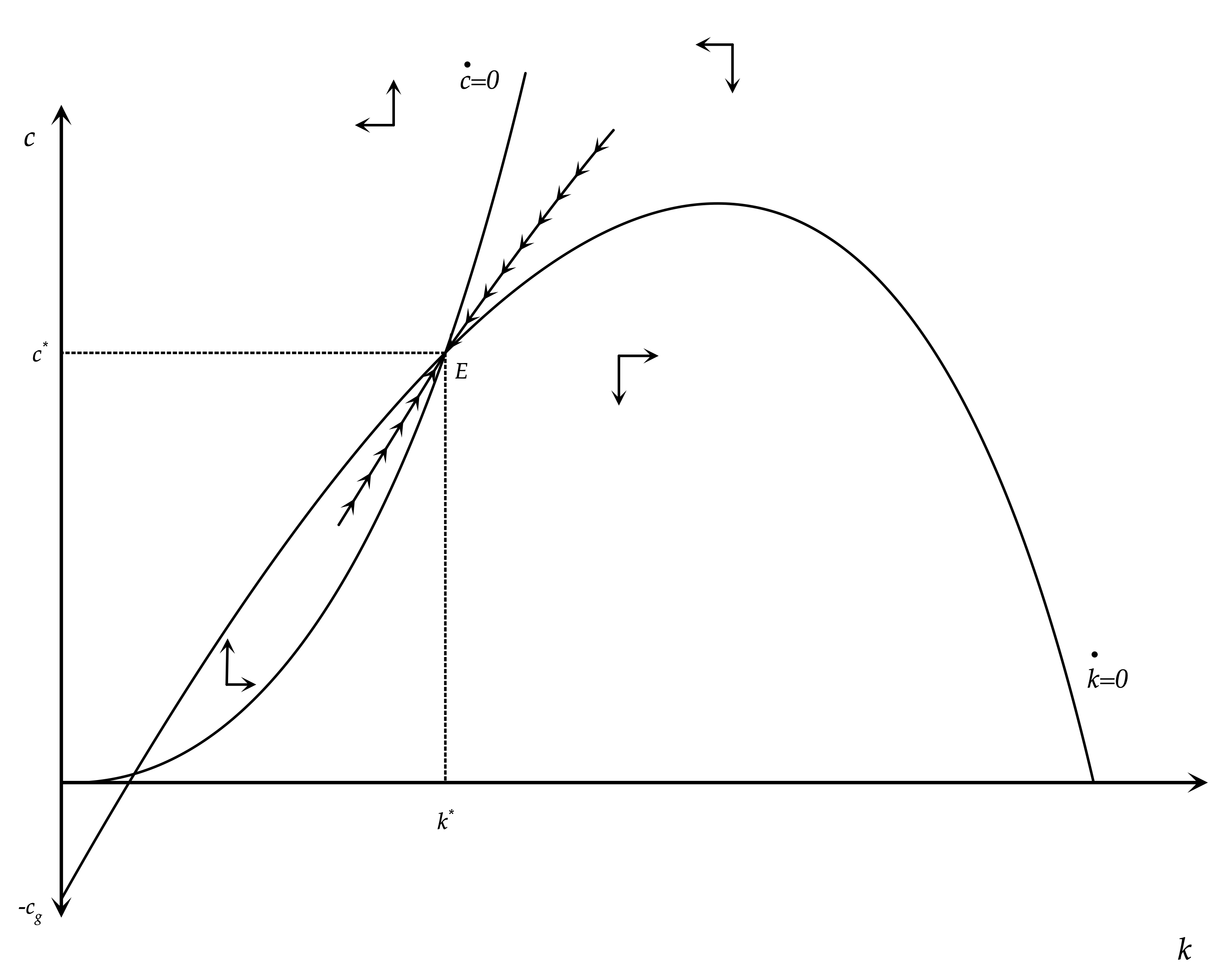
The Steady State and the Adjustment Path in the Blanchard-Weil Model

Slide 27
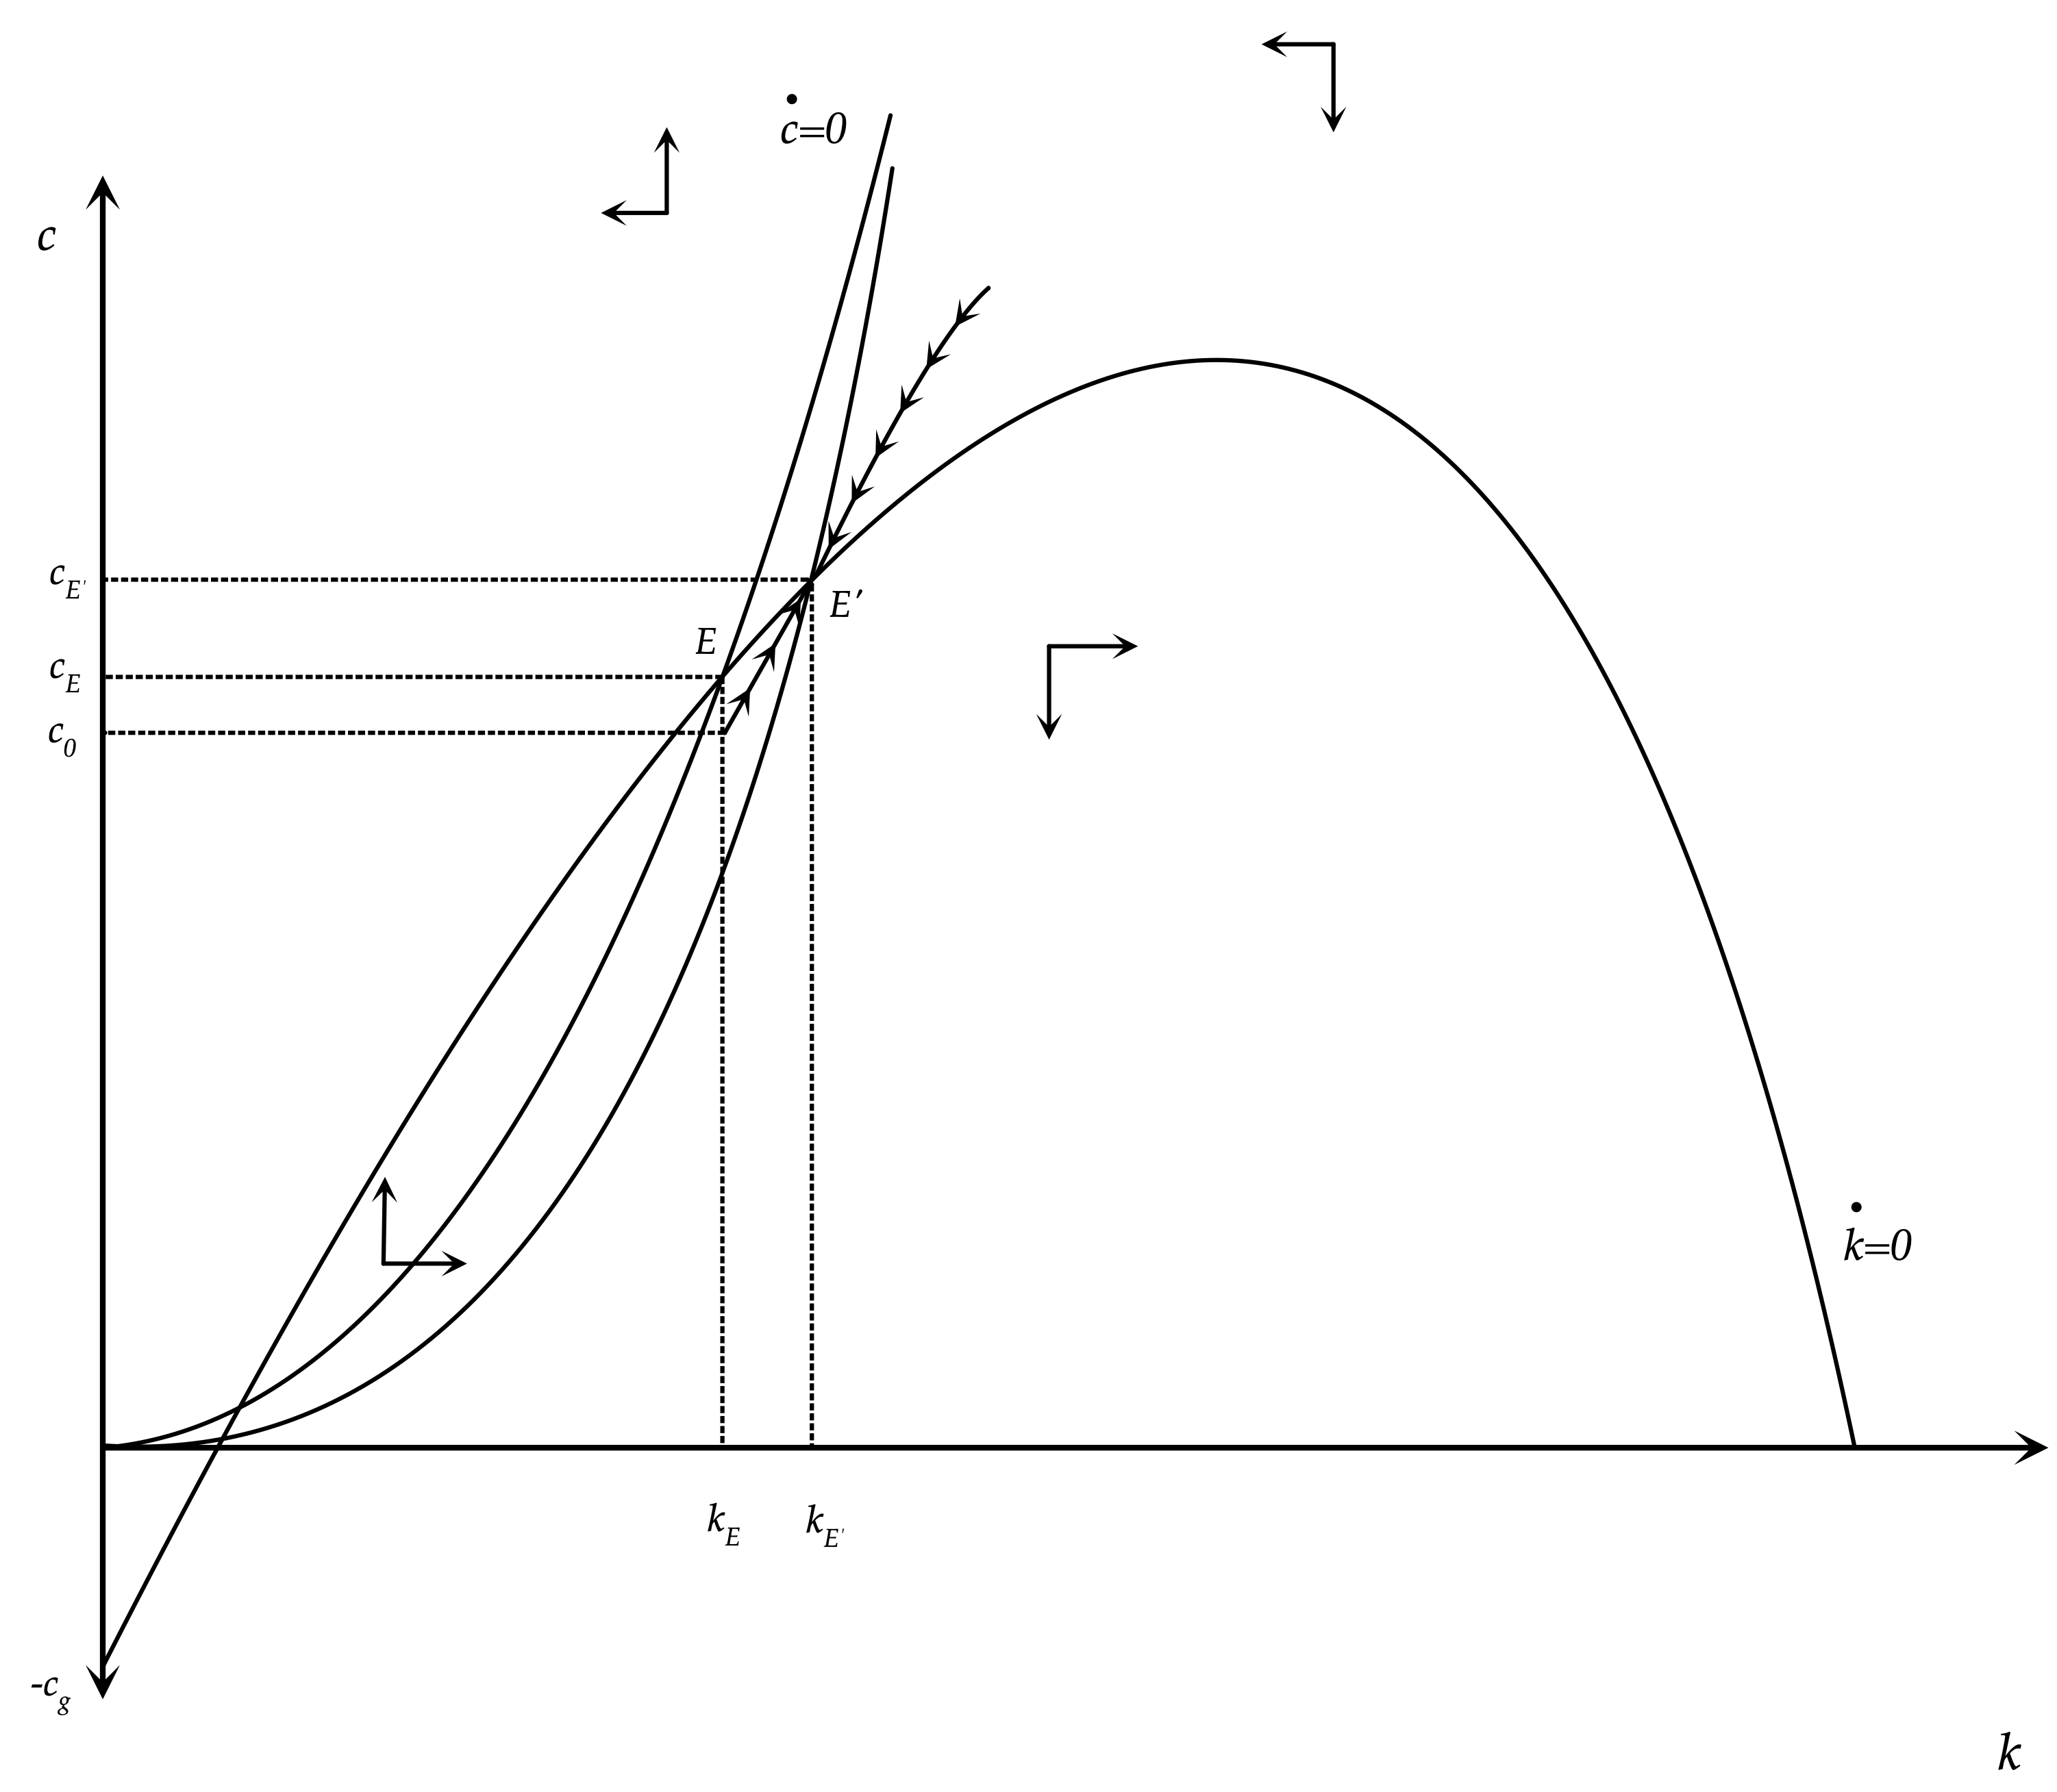
Implications of a Permanent Increase in the Rate of Growth of the Money Supply in the Blanchard-Weil Overlapping Generations Model

Slide 28
Implications of a Permanent Increase in the Rate of Growth of the Money Supply in the Overlapping Generations Model
A permanent increase in the growth rate of the money supply, which leads to an increase in inflation, results in a heavier inflation tax for the current generations, who hold higher real money balances compared to future generations who do not hold real money balances.
This causes a reduction in current consumption, an increase in total savings and the initiation of a process of accumulation of physical capital. The economy adjusts towards a new balanced growth path, which implies higher capital, output and consumption per efficiency unit of labor, due to the substitution towards physical capital caused by higher inflation.
In this model, the super neutrality of money does not apply, because the inflation tax impacts different generations differently, and the redistribution it causes in favor of future generations reduces current consumption and increases savings by current generations.

Slide 29
A Dynamic Simulation of the Effects of the Doubling of the Rate of Growth of the Money Supply from 5% to 10%
We simulate the model assuming a Cobb Douglas production function using the following parameter values:
A=1, α=0.333, ρ=0.02, n=0.01, g=0.02, δ=0.03, γ=0.975.
With regard to fiscal policy we assume ${\overline{c}}_{g}=0.5$ and $\overline{d}=0.5$,
We investigate a permanent, previously unexpected, rise in μ from 5% to 10%. We assume that this change is accompanied by corresponding reductions in taxes, which are continuously equal to the increase in the inflation tax on real money balances. There is thus no impact on primary government expenditure or government debt.

Slide 30
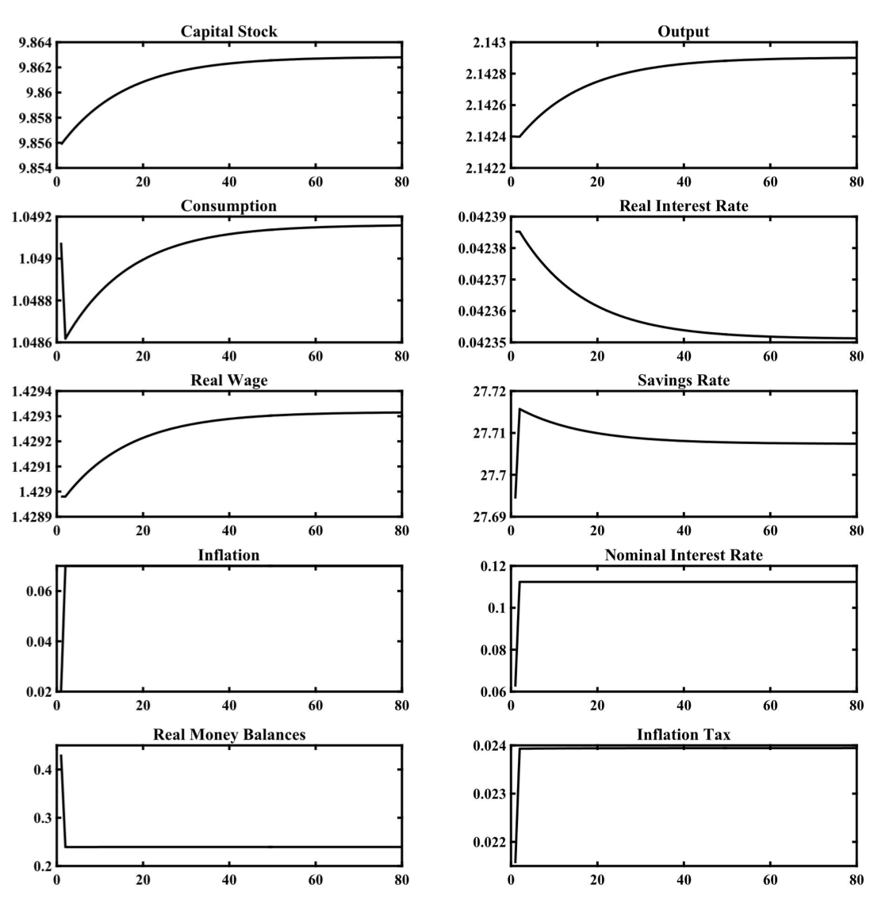
A Dynamic Simulation of the Effects of the Doubling of the Rate of Growth of the Money Supply from 5% to 10%

Slide 31
Results of the Dynamic Simulation of the Increase in Monetary Growth
The change in the growth rate of the money supply by five percentage points, from 5% to 10%, reduces private consumption expenditure immediately, due to the higher inflation tax on current generations. This causes an increase in savings and initiates a process of capital accumulation that leads the economy towards a new balanced growth path, with a higher capital stock, higher output, higher private consumption and higher real wages per efficiency unit of labor. On the other hand, the real interest rate falls. Inflation rises by five percentage points, the same as the rise in the rate of growth of the money supply, and roughly the same happens to nominal interest rates.
However, it is worth noting that the impact of a change in the growth rate of the money supply on the real economy is extremely small. A doubling of the growth rate of the money supply from 5% to 10%, leads to an increase in steady state real per capita income (and real wages) by only 0.02%, and a reduction in the real interest rate by only 0.005 percentage points (i.e from 4.239% to 4.234%). The overall savings rate in the balanced growth path rises from 27.69% to 27.70%, again a very slight increase. On the other hand, inflation rises by five percentage points, from 2% to 7%, and nominal interest rates from 6.24% to 11.24%. The rise in the nominal interest rate is due to the rise in inflation as the fall in the real interest rate in negligible.

Slide 32
Why are Deviations from the Super-neutrality of Money so Small?
As with deviations from Ricardian equivalence, deviations from the super-neutrality of money in models of overlapping generations, such as the Blanchard-Weil model, are quantitatively limited.
This is due to the fact that these deviations depend on the product of two quantitatively small parameters: the rate of growth of population, which determines the rate of entry of new generations in the economy, and the pure rate of time preference of households, which determines the percentage of total household wealth that is consumed.
With the assumptions we have made, for a population growth rate of 1% per year and a pure rate of time preference of 2%, their product is equal to just 0.02%.

Slide 33
Conclusions on the Effects of the Rate of Growth of the Money Supply
In the representative household model, the growth rate of the money supply has no real effects, apart from reducing the demand for real money balances, since money does not pay interest. The balanced growth path of all other real variables is independent of the growth rate of the money supply, which only affects inflation, nominal interest rates and the demand for real money balances by households. This result is known as the super neutrality of money.
In a model of overlapping generations, the growth rate of the money supply has real effects, as it has a different impact on the holdings of real money balances and on the level of consumption of different generations. When there is an increase of the growth rate of the money supply, older generations, which hold higher real money balances, pay a higher inflation tax than younger generations. Therefore, current aggregate consumption falls, and savings increase. This leads to a higher accumulation of capital and a transition to a balanced growth path with higher capital per efficiency unit of labor. However, it is worth noting that dynamic simulations suggest that these deviations from the super neutrality of money are quantitatively small for plausible parameter values.

