Slide 1
7. Fiscal Policy and Economic Growth
Athens University of Economics and Business
Dynamic Macroeconomics
Prof. George Alogoskoufis
alogoskoufisg.com

Slide 2
The Government Budget Constraint
The government budget constraint is defined in a way which is similar to the inter-temporal budget constraint of a household that can borrow and lend freely at the market interest rate.
The government budget constraint requires the equality of the present value of current and future tax revenue to the sum of the current stock of government debt and the present value of current and future primary government expenditure.
Primary government expenditure is defined as government expenditure excluding interest payments on government debt, and present values are calculated using the market interest rate.

Slide 3
The Government Budget Constraint in a One Period Model
Assume a one period economy in which the representative household is endowed with one unit of capital and one unit of labor. Its endowment of capital and labor can be rented to private firms, at a competitive rental price of capital $r$, and a competitive real wage $w$. Capital and labor are used by competitive firms in the production of a single good $y$. The household can use the income from the rental of its capital and labor endowments for consumption, and it can also consume its capital endowment at the end of the period.
The government can tax the representative household and spend the proceeds on buying the single good $y$ itself. Government expenditure is denoted by $c_{g}$. Since this is a one good economy, government expenditure is on goods that yield utility to the representative household and are perfect substitutes for private consumption. The government pays for government expenditure by imposing lump sum tax on the representative household, which is denoted by $τ$.
Since the economy lasts for only one period, the value of taxes must be equal to government expenditure. In this one period model, the government cannot spend more than its tax revenue, as it would not have the ability to pay, and it will not spend less, as this would imply a waste of resources. Its budget constraint is thus given by,
$c_{g}=τ$

Slide 4
Consumption and Taxes in a One Period Model
The problem of the representative household is to maximize its utility function $u$, which depends on the volume of both private and public consumption, subject to its budget constraint and the choice of government expenditure and taxes by the government. Thus, the representative household chooses private consumption $c$ in order to maximize,
$u(c+c_{g})$
subject to,
$c=1+rk+wl-τ=1+r+w-τ$
The last equality is the result of imposing that the household commits to production its full endowments of capital and labor, each of which is equal to unity. This, as we have already shown, follows from the assumption of non-satiation.
From the first-order conditions for a maximum, and after taking account of the optimal behaviour of the representative firm, equilibrium private consumption is given by,
$\overline{c}=1+\overline{y}-τ=1+A-c_{g}$
where $A$ denotes total factor productivity. In equilibrium, because taxes are equal to government expenditure, government expenditure displaces private consumption one for one, without affecting any other real variables.
Equilibrium aggregate output is given by,
$\overline{y}=\overline{c}+c_{g}-1=A$
which is the same as in the model without a government expenditure and taxes. Hence, the only real effect of government expenditure and taxes in this economy would be a one for one substitution of public for private consumption, without any other real effects. Aggregate output and employment are the same as in the case where government expenditure and taxes are equal to zero.

Slide 5
Government Expenditure, Taxes and Debt in a Two Period Economy
We next turn to an analysis of fiscal policy in a two period model. Both the representative household and the government have to make intertemporal decisions. The most important such decision for the household is the savings and investment decision in the first period. For the government, the most important intertemporal decision is whether to finance government expenditure in the first period through taxes or borrowing (government debt).
We assume a government that wishes to finance a stream of primary government expenditure $c_{g1}$, $c_{g2}$ over two periods. The sequence of government budget constraints is as follows,
$d_{1}=c_{g1}-τ_{1}$
$-d_{1}=c_{g2}+r_{2}d_{1}-τ_{2}$
To the extent that government expenditure is higher than taxes in the first period, the government runs a budget deficit equal to $d_{1}$. This deficit is financed by one period bonds, i.e., government debt, equal to $d_{1}$. If the government has run a deficit in the first period, in the second period it has to run a surplus, equal to the deficit of the first period, as the second is the last period and the government has to repay its debt. Thus, tax revenue $τ_{2}$ must be sufficient to cover period 2 government expenditure and repayment of the debt. Period 2 government expenditure consists of two elements. First, interest payments on government debt from period 1, plus period 2 primary government expenditure $c_{g}$. Primary government expenditure is defined as government expenditure other than interest payments on existing government debt.
As in the case of the representative household, the sequence of budget constraints can be combined into a single intertemporal budget constraint. Using the first-period budget constraint to substitute for government debt in the second period one, after a simple rearrangement, we get,
$c_{g1}+\frac{c_{g2}}{1+r_{2}}=τ_{1}+\frac{τ_{2}}{1+r_{2}}$
This is the government intertemporal budget constraint. The present value of primary government expenditure in the two periods, must be equal to the present value of tax revenue in the two periods. Thus, in an intertemporal setting, the government does not have to balance the government budget in every period, as long as its intertemporal budget constraint is satisfied.

Slide 6
The Representative Household Intertemporal Budget Constraint in the Presence of Taxes and Government Debt
What are the implications of the government intertemporal budget constraint for the behaviour of the economy. Does the method of financing first period primary expenditure matter?
To consider this question, let us consider the intertemporal budget constraint of the representative household in this case. In the presence of government expenditure and taxes, the intertemporal budget constraint of the representative household is affected by the taxes that have to be paid, and is given by,
$$c_{1}+\frac{1}{1+r_{2}}c_{2}=1+(r_{1}+w_{1}-τ_{1})+\frac{1}{1+r_{2}}(w_{2}-τ_{2})$$
Substituting for the present value of taxes from the government intertemporal budget constraint into the household intertemporal budget constraint, we get that the household intertemporal budget constraint is given by,
$$c_{1}+\frac{1}{1+r_{2}}c_{2}=1+(r_{1}+w_{1}-c_{g1})+\frac{1}{1+r_{2}}(w_{2}-c_{g2})$$
It is clear that it is only the present value of primary government expenditure that affects the intertemporal budget constraint of the representative household. The method of financing primary government expenditure, i.e., tax versus debt finance, has no effect on the household intertemporal budget constraint.

Slide 7
Optimal Private Consumption and Ricardian Equivalence between Taxes and Government Debt
The intertemporal utility function of the representative household, in the presence of government expenditure, is given by,
$U=\frac{{\left(c_{1}+c_{g1}\right)}^{1-θ}}{1-θ}+\frac{1}{1+ρ}\frac{{\left(c_{2}+c_{g2}\right)}^{1-θ}}{1-θ}$
We have assumed that government expenditure is not wasteful. In fact it affects the utility of the representative household in the same way as private consumption. The representative household chooses private consumption, in order to maximize this intertemporal utility function, subject to its intertemporal budget constraint.
Note that the method of financing primary government expenditure does not appear either in the utility function of the representative household or in its intertemporal budget constraint. Hence, the only fiscal policy parameters that can affect the optimal decisions of the representative household and the behaviour of the economy are related to the path of primary government expenditure. The method of financing the path of government expenditure cannot affect the optimal savings and investment decisions of the representative household. Debt and tax finance are equivalent.
This result, which was first alluded to by Ricardo (1817), is called Ricardian equivalence between debt and tax finance of government expenditure. In effect, the representative household realizes that debt finance is nothing more than a postponement of taxes for the future. Lower current taxes will result in higher future taxes with the same present value. Hence, the only thing that matters for the optimal savings and investment decisions of the representative household is the present value of primary government expenditure that needs to be financed, and not the distribution of financing between the two periods. At the end of the two periods the representative household will need to pay taxes with present value equal to the present value of the stream of primary government expenditure.

Slide 8
Proving Ricardian Equivalence
The first-order conditions for the maximisation of the inter temporal utility of the representative household, subject to its intertemporal budget constraint, are given by,
${\left(c_{1}+c_{g1}\right)}^{-θ}=λ$, $\frac{1}{1+ρ}{\left(c_{2}+c_{g2}\right)}^{-θ}=\frac{λ}{1+r_{2}}$
$λ$ is the Lagrange multiplier, measuring the marginal value of household wealth.
Eliminating $λ$ we get the familiar Euler equation for consumption. Consumption is now the sum of private and government consumption.
$\frac{1}{1+ρ}{\left(\frac{c_{2}+c_{g2}}{c_{1}+c_{g1}}\right)}^{-θ}=\frac{1}{1+r_{2}}$
Taking into account the behaviour of the representative firm, which is not affected by government expenditure and taxes, the product market equilibrium conditions in the two periods require that output is equal to the sum of private and public consumption plus investment in every period. This implies that,
$y_{1}=A=c_{1}+c_{g1}+\left(k_{2}-1\right)$, $y_{2}=A(1+g)k_{2}^{α}=c_{2}+c_{g2}-k_{2}$
Furthermore, from the marginal productivity condition of the second period, we shall have that,
$r_{2}=αAk_{2}^{α-1}$
Using the last three equations to substitute for the sum of private and public consumption in the two periods, and the period 2 real interest rate in the Euler equation, we get that the equilibrium period 2 capital stock will be determined by solving,
$\frac{1}{1+ρ}{\left(\frac{1+A-{\overline{k}}_{2}}{{\overline{k}}_{2}+A(1+g){\overline{k}}_{2}^{α}}\right)}^{θ}=\frac{1}{1+αA(1+g){\overline{k}}_{2}^{α-1}}$, which is independent of government expenditure and taxes. QED

Slide 9
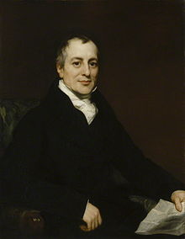
David Ricardo (1772-1823)
David Ricardo (18 April 1772 – 11 September 1823) was a British political economist, one of the most influential of the classical economists along with Thomas Malthus, Adam Smith and James Mill. His major contribution was the theory of comparative advantage.
Ricardian equivalence, an argument suggesting that in some circumstances a government's choice of how to pay for its spending (i.e., whether to use tax revenue or issue debt and run a deficit) might have no effect on the economy is also associated with Ricardo. This is based on the pretext that the public saves to pay for expected future tax increases that will be used to pay off the debt. Ricardo notes that the proposition is theoretically implied in the presence of intertemporal optimisation by rational tax-payers: but that since tax-payers do not act so rationally, the proposition fails to be true in practice. Thus, while the proposition bears his name, he does not seem to have believed it. Robert Barro of Harvard University is responsible for its modern prominence.

Slide 10

Robert J. Barro (1944-)
Robert Joseph Barro (born September 28, 1944) is an American macroeconomist and the Paul M. Warburg Professor of Economics at Harvard University. He is considered one of the founders of new classical macroeconomics, along with Robert Lucas, Jr. and Thomas J. Sargent.
He is associated with important contributions to the analysis of monetary and fiscal policy, economic growth.
In his 1974 paper, "Are Government Bonds Net Wealth?”, published in the Journal of Political Economy, he argued that under certain assumptions, present governmental borrowing would be matched by increased bequests to future generations to pay future taxes expected to pay down the government bonds; thus a lowering of current taxes, financed by the issuance of government bonds, would have no effect on the public's spending on consumption. This reflected similar ideas put forward by David Ricardo, and has sparked a large literature on so called Ricardian Equivalence.

Slide 11
The Nature and Limitations of Ricardian Equivalence
The only effect of the path of government expenditure in this two period model is the displacement of an equal amount of private consumption. Since, government consumption is assumed to be a perfect substitute for private consumption, neither aggregate savings and investment, nor the evolution of real output are affected by the path of government expenditure, debt or taxes.
This is a striking result. It is due to the assumption that government expenditure is a perfect substitute for private consumption, and that taxes are lump sum, i.e., they do not distort the savings and investment decisions of households.
This result would not hold if either government expenditure was an imperfect substitute for private consumption, or if taxes were distortionary and affected the real interest rate faced by households.
It does not hold in overlapping generations models either, or in models with borrowing constraints and different interest rates faced by households and the government.

Slide 12
The Government Budget Constraint and Government Debt with an Infinite Horizon
The budget constraint of a government with an infinite horizon does not prevent it from having debt, or even from increasing the level of its debt.
It means, however, that the limit of the present value of government debt, as time tends to infinity, cannot be positive.
For example, if the real interest rate is positive, a positive but constant real government debt - which means that the government never repays it - satisfies the government budget constraint.
Even if government debt increases continuously, the government budget constraint is satisfied to the extent that the real interest rate exceeds the growth rate of real government debt.

Slide 13
The Infinite Horizon Government Budget Constraint
Assume a government with an infinite horizon that chooses a stream of primary government expenditure $C_{g}(t)$, a stream of taxes $T(t)$ and has a stock of outstanding government debt $D(t)$. Government expenditure can be financed by either taxes, or the accumulation of government debt. Government debt accumulates according to,
$\overset{·}{D}(t)=r(t)D(t)+C_{g}(t)-T(t)$
where $r(t)$ is the real interest rate at time $t$. Time is continuous.
The solution of the differential equation for the accumulation of government debt, gives us the government intertemporal budget constraint, in the form,
$\lim_{t→∞}e^{-R(t)}D(t)+∫_{t=0}^{∞}e^{-R(t)}C_{g}(t)dt=-D(0)+∫_{t=0}^{∞}e^{-R(t)}T(t)dt$
where, $R(t)=∫_{s=0}^{t}r(s)ds$.
The intertemporal budget constraint of the government states that at any initial time 0, as time goes to infinity, the present value of primary government expenditure, plus the present value of government debt, must be equal to the present value of tax revenues, minus the initial level of government debt. Clearly, a solvent government cannot maintain a government debt with a positive present value as time goes to infinity. The present value of its debt should be tending to zero, or even become negative. Hence, the condition for a solvent government is that the first term of on the left tends to a non positive number, i.e., that,
$\lim_{t→∞}e^{-R(t)}D(t)≤0$
The last equation is the transversality condition that any solvent government must satisfy. The present value of government debt cannot be positive, as time goes to infinity. It denotes the limits to the accumulation of government debt.

Slide 14
Implications of the Transversality Condition for the Accumulation of Government Debt and Government Solvency
Using the transversality conditon, the intertemporal government budget constraint for a solvent government can thus be written as,
$∫_{t=0}^{∞}e^{-\overline{r}(t)t}C_{g}(t)dt≤-D(0)+∫_{t=0}^{∞}e^{-\overline{r}(t)t}T(t)dt$
where $\overline{r}(t)=\frac{1}{t}∫_{s=0}^{t}r(s)ds=\frac{1}{t}R(t)$.
$\overline{r}(t)$ is the average real interest rate between time 0 and time $t$.
The government budget constraint does not stop the government from having debt continuously, or even from increasing the stock of its debt. However, the present value of future government debt as time goes to infinity cannot possibly be positive.
The transversality condition can be rewritten as,
$\lim_{t→∞}e^{-R(t)}D(t)=\lim_{t→∞}e^{-\overline{r}(t)t}D(t)≤0$
For example, if the real interest rate is positive, a positive constant stock of real government debt - something which means that the government never pays it back - satisfies the transversality condition and therefore the government budget constraint. Even if the stock of real government debt is increasing over time, the budget constraint of the government and the transversality condition are satisfied, as long as the growth rate of real government debt does not exceed the average real interest rate. Thus, the transversality condition solvency (or sustainability) criterion for fiscal policy. To the extent that it is satisfied, a government is solvent, and its fiscal policy is sustainable.

Slide 15
The Concepts of the Primary Deficit and the Primary Surplus
Apart from the overall government deficit, it is also worth defining another measure of fiscal policy, which is,
$C_{g}(t)-T(t)$
This is called the primary government deficit. It measures the extent to which current taxes fall short of primary government expenditure, which excludes interest payments on outstanding debt. Negative primary deficits are called primary surpluses, which are defined as,
$T(t)-C_{g}(t)$
The primary deficit is a very informative index of the contribution of fiscal policy to the evolution of government debt. For example, we can write the intertemporal government budget constraint as,
$∫_{t=0}^{∞}e^{-\overline{r}(t)t}\left[T(t)-C_{g}(t)\right]dt≥D(0)$
Expressed in this form, the government budget constraint requires that the current stock of government debt must be smaller than or equal to the present value of current and future primary surpluses (negative primary deficits). A government that has a positive level of debt, must be committed to a policy of future primary surpluses, that, in present value terms, are at least as high as its current stock of debt. Otherwise, it does not satisfy its intertemporal budget constraint and its fiscal policy is not sustainable.

Slide 16
Introducing the Government in the Ramsey Model
We shall now introduce the government in the Ramsey model of a representative household. We shall assume that the government engages in primary spending and finances this primary spending through a combination of debt and taxes that satisfies the intertemporal government budget constraint.
When there are taxes and a stock of government debt, the intertemporal budget constraint of the representative household implies that the present value of its (private) consumption cannot exceed the value of its current assets (capital plus government bonds), plus the present value of its disposable labor income, i.e., its after-tax labor income. Thus, the intertemporal budget constraint of the representative household is given by,
$∫_{t=0}^{∞}e^{-\overline{r}(t)t}C(t)dt≤K(0)+D(0)+∫_{t=0}^{∞}e^{-\overline{r}(t)t}\left[W(t)-T(t)\right]dt=K(0)+D(0)+∫_{t=0}^{∞}e^{-\overline{r}(t)t}W(t)dt-∫_{t=0}^{∞}e^{-\overline{r}(t)t}T(t)dt$
$C(t)$ is the real consumption of the representative household at time $t$ and $W(t)$ is its real labor income at time t. $K(0)$ is its initial stock of capital and $D(0)$ the initial stock of government bonds, held as assets by the representative household.
Assuming that the government satisfies its intertemporal budget constraint exactly, in the sense that the present value of future taxes minus its initial debt is equal to the present value of primary government expenditure, we get that,
$∫_{t=0}^{∞}e^{-\overline{r}(t)t}C(t)dt≤K(0)+∫_{t=0}^{∞}e^{-\overline{r}(t)t}W(t)dt-∫_{t=0}^{∞}e^{-\overline{r}(t)t}C_{g}(t)dt$
This suggests that we can express the intertemporal budget constraint of the representative household as a function of the present value of primary government expenditure, without any reference to the method of financing it. Since the path of tax revenue or the original debt does not affect the preferences of the representative household either, the path of tax revenue or the level of government debt cannot possibly affect private consumption. Only the path of primary government expenditure matters. Hence, Ricardian equivalence can be shown to hold in the Ramsey model.

Slide 17
The Ramsey Growth Model with Primary Government Expenditure, Taxes and Government Debt
The Euler equation for consumption is not affected by introducing the government in the Ramsey model. It is given by,
$\overset{·}{c}(t)=\frac{1}{θ}[Af^{′}(k(t))-δ-ρ-θg]c(t)$
Total savings are now defined by the difference between total income and total consumption (private and public).The capital accumulation equation thus takes the form,
$\overset{·}{k}(t)=Af(k(t))-c(t)-c_{g}(t)-(n+g+δ)k(t)$
Finally, government debt per efficiency unit of labor evolves according to,
$\overset{·}{d}(t)=[c_{g}(t)-τ(t)]+[Af^{′}(k(t))-δ-(n+g)]d(t)$

Slide 18
Constant Primary Government Expenditure and Debt
(per efficiency unit of labor)
We shall examine policies with exogenous and constant primary government expenditure per efficiency unit of labor. Thus, we shall assume that the government stabilizes primary government expenditure at,
$$c_{g}(t)={\overline{c}}_{g}$$
We shall further assume that the government adusts taxes continuously to stabilize government debt per efficiency unit of labor at a target level $\overline{d}$. From the government debt accumulation equation, this requires a tax policy of the form,
$$τ(t)={\overline{c}}_{g}+\left[Af^{′}(k(t))-δ-n-g\right]\overline{d}$$
This rule implies that taxes are equal to the level of primary government expenditure, plus the part of the interest payments on government debt that must be financed by taxes, so that debt per efficiency unit of labor remains constant.
Since in the representative household model the real interest rate converges to $ρ+θg$, taxes per efficiency unit of labor converge to the steady state value,
$$\overline{τ}={\overline{c}}_{g}+\left[ρ-n-(1-θ)g\right]\overline{d}≥{\overline{c}}_{g}$$
Steady state taxes are equal to the level of primary government expenditure, plus the part of the interest payments on government debt that must be financed by taxes, so that debt per efficiency unit of labor remains constant. This part is equal to the difference between the steady state real interest rate and the steady state growth rate. If the target debt level is positive, then steady state taxes are higher than steady state primary government expenditure, in order to finance interest payments on government debt. Thus, with a positive level of steady state government debt, the government runs a primary surplus on the balanced growth path in the Ramsey model.

Slide 19
The Ramsey Model with Constant Primary Government Expenditure and Debt
(per efficiency unit of labor)
The Ramsey Model with constant primary government expenditure and debt (per efficiency unit of labor) can be analysed by using the Euler equation for consumption and the capital accumulation equation below.
$\overset{·}{c}(t)=\frac{1}{θ}[Af^{′}(k(t))-δ-ρ-θg]c(t)$
$\overset{·}{k}(t)=Af(k(t))-c(t)-{\overline{c}}_{g}-(n+g+δ)k(t)$
It can easily be shown that it possesses a unique steady state that satisfies the saddle point property.
The steady state is exactly the same as in the absence of government, with one exception. Primary government expenditure displaces private consumption one for one. The method of financing government expenditure is irrelevant, as government debt and taxes do not affect either the Euler equation for consumption, or the capital accumulation equation.

Slide 20
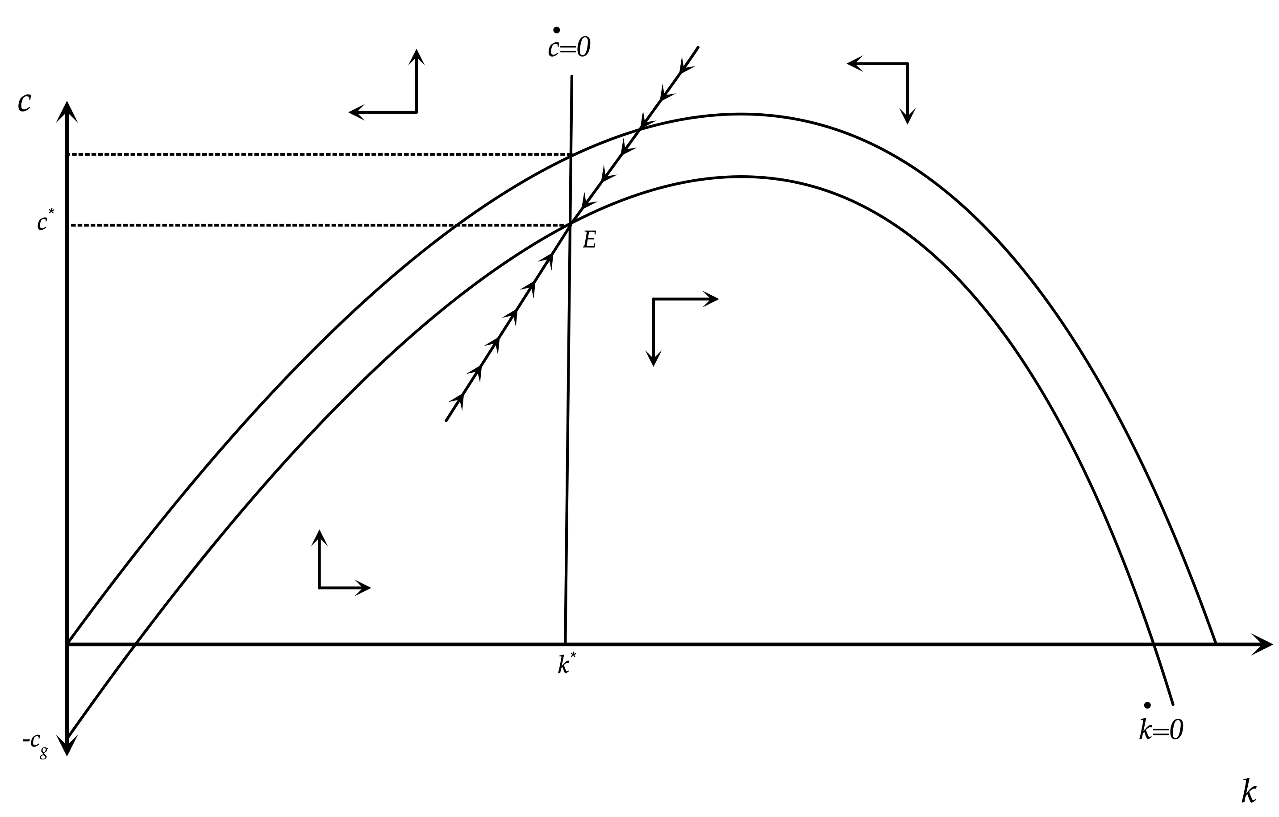
Primary Government Expenditure in the Ramsey Model

Slide 21
Primary Government Expenditure and Debt in an Overlapping Generations Model
In overlapping generations models, both the stock of real government debt and real primary government expenditure affect private and total savings, and the accumulation of capital. Ricardian equivalence does not hold.
Rises in real government debt or real primary government expenditure reduce savings and capital accumulation, and have negative effects on the steady state capital stock, output, private consumption and real wages.
This is because current generations know that part of the increase in future tax revenues in order to finance a higher level of primary government expenditure and/or interest payments on the increased debt, will be shouldered by future generations. Private savings are thus affected negatively by an increase in real government debt, and total savings, private and government, are affected negatively by an increase in real primary government expenditure.

Slide 22
The Blanchard Weil Model with Primary Government Expenditure, Debt and Taxes
The Blanchard-Weil model with constant government expenditure and government debt per efficiency unit of labor, as assumed in the case of the Ramsey model, is described by the following two differential equations:
$$\overset{·}{c}(t)=[Af^{′}(k(t))-δ-ρ-g]c(t)-nρ[k(t)+\overline{d}]$$
$$\overset{·}{k}(t)=Af(k(t))-c(t)-{\overline{c}}_{g}-(n+g+δ)k(t)$$
All variables are expressed in terms of efficiency units of labor. The only difference from the Ramsey model is in the equation for the adjustment of private consumption. Since newly born generations do not have accumulated savings in the form of either capital $k$ or government bonds $d$, the change in private consumption depends negatively on $k+d$, multiplied by the product of the proportion of new entrants in total population $n$, and their propensity to consume out of wealth $ρ$. $ρ(k+d)$ measures the difference between the average consumption of the old generations and the new generation born at $t$. It is a reflection of the fact that current generations do not internalize the welfare of future generations in this model, as in the representative household model.

Slide 23
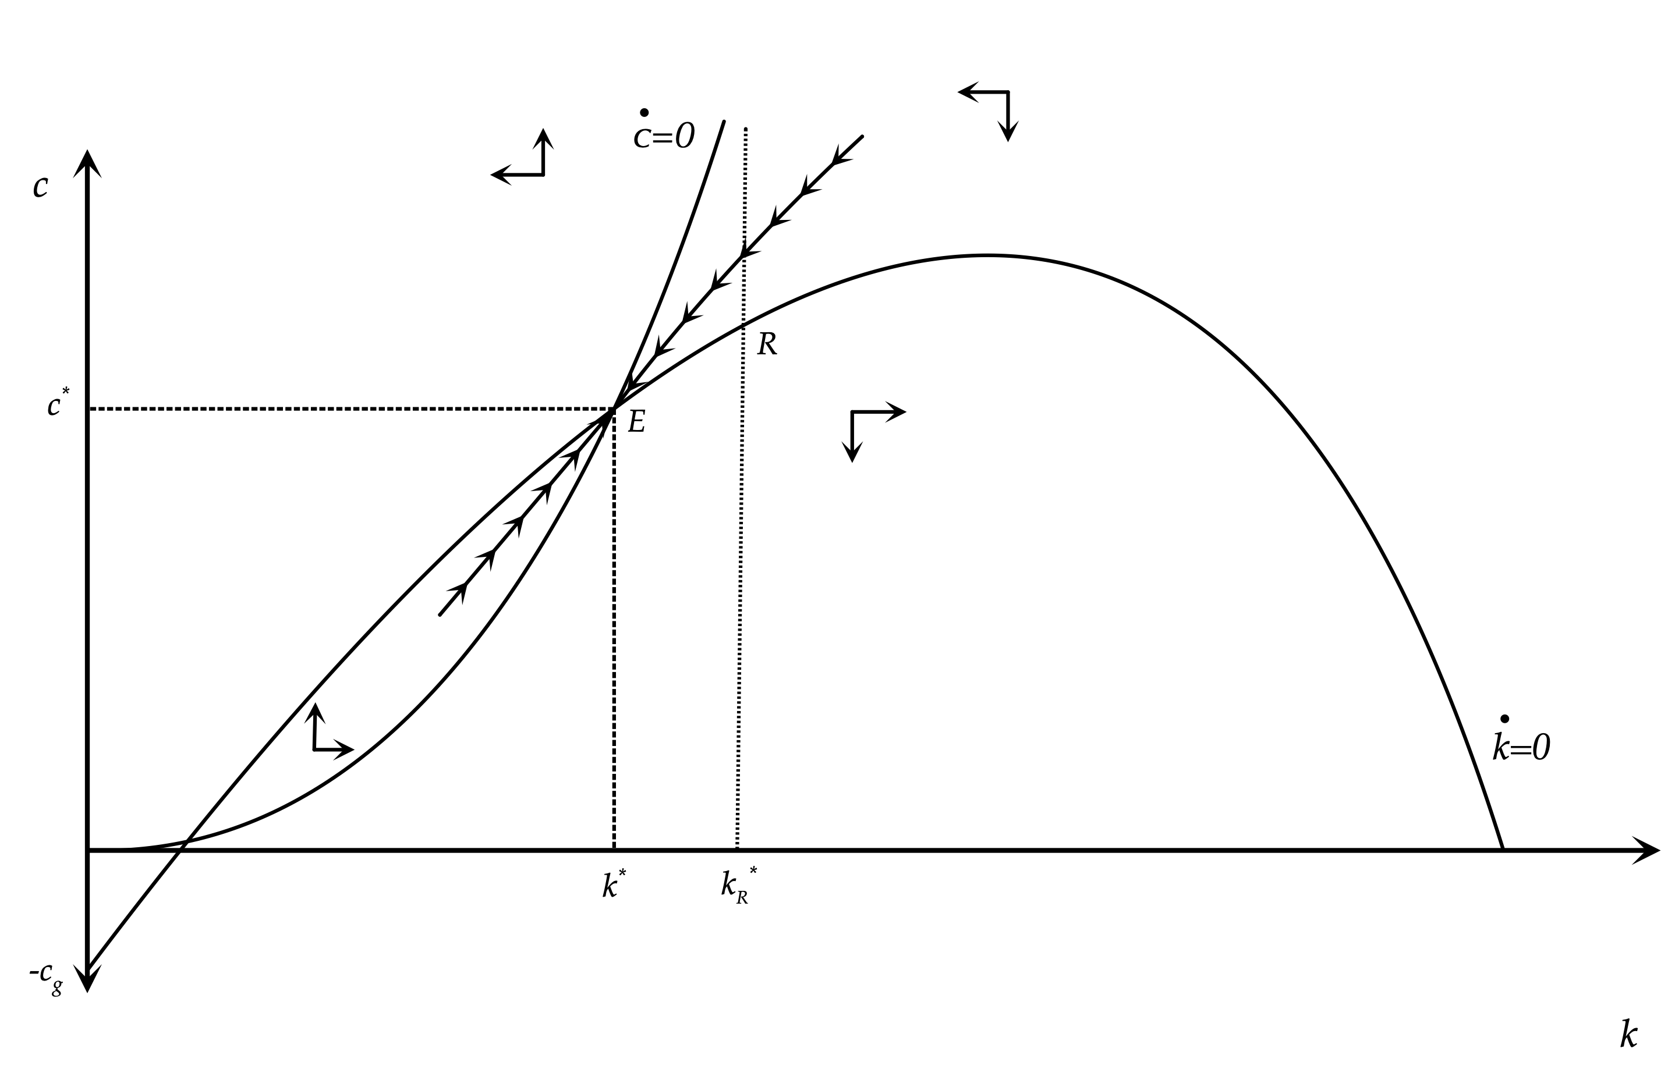
Primary Government Expenditure and Debt in the Blanchard Weil Model

Slide 24
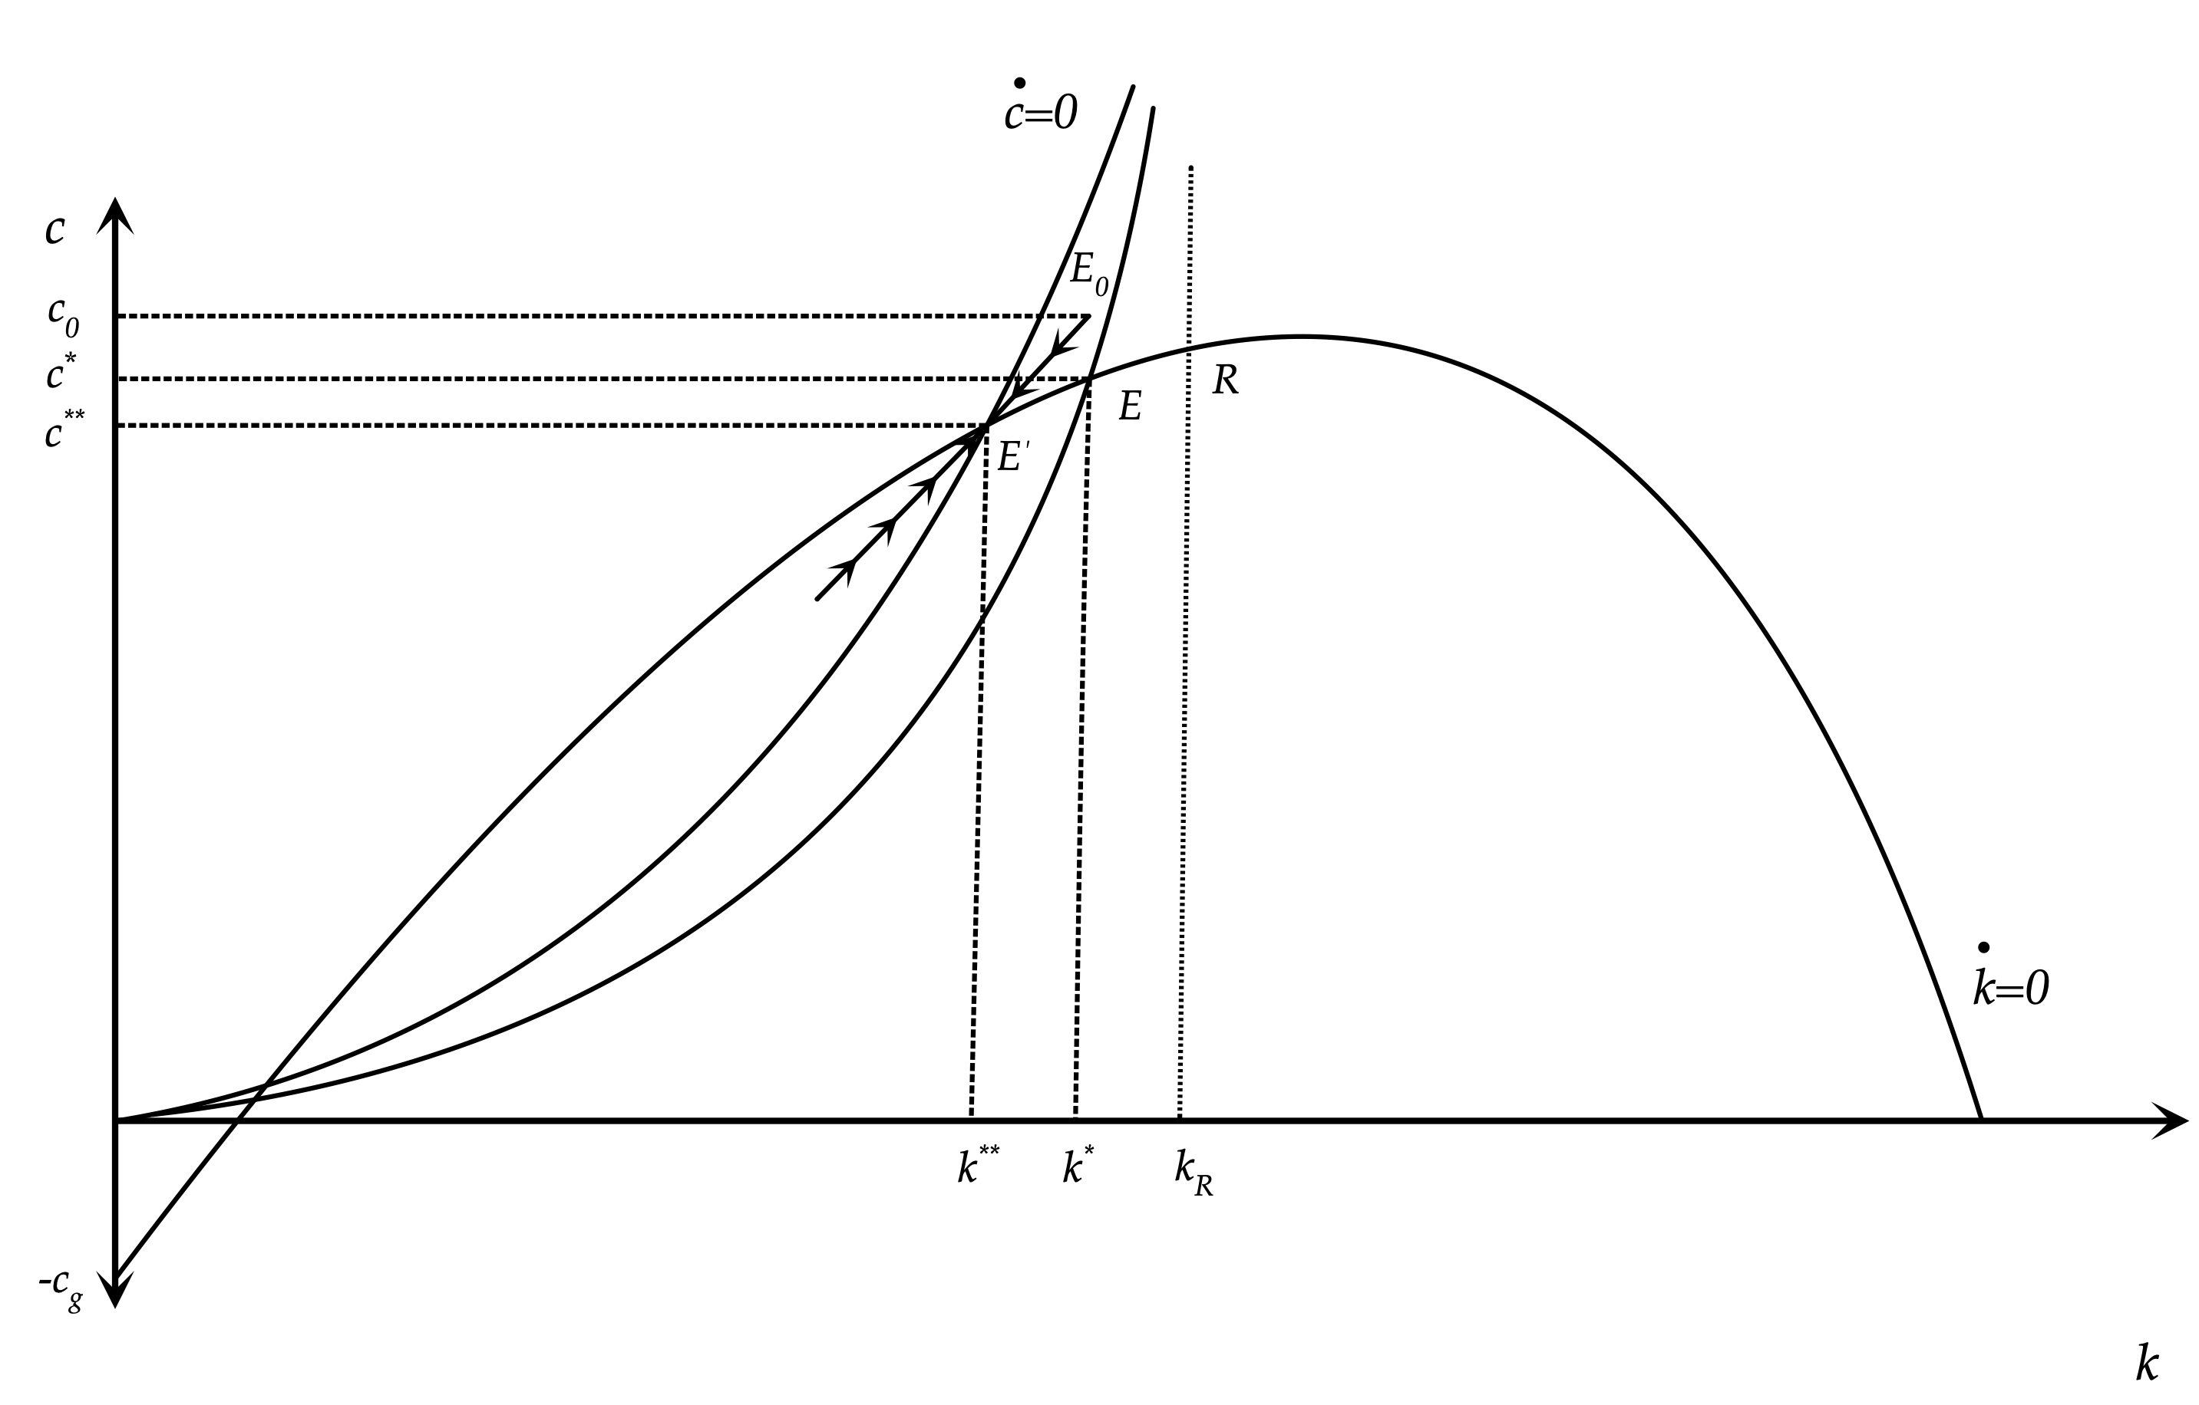
An Increase in Real Government Debt in the Blanchard Weil Model

Slide 25
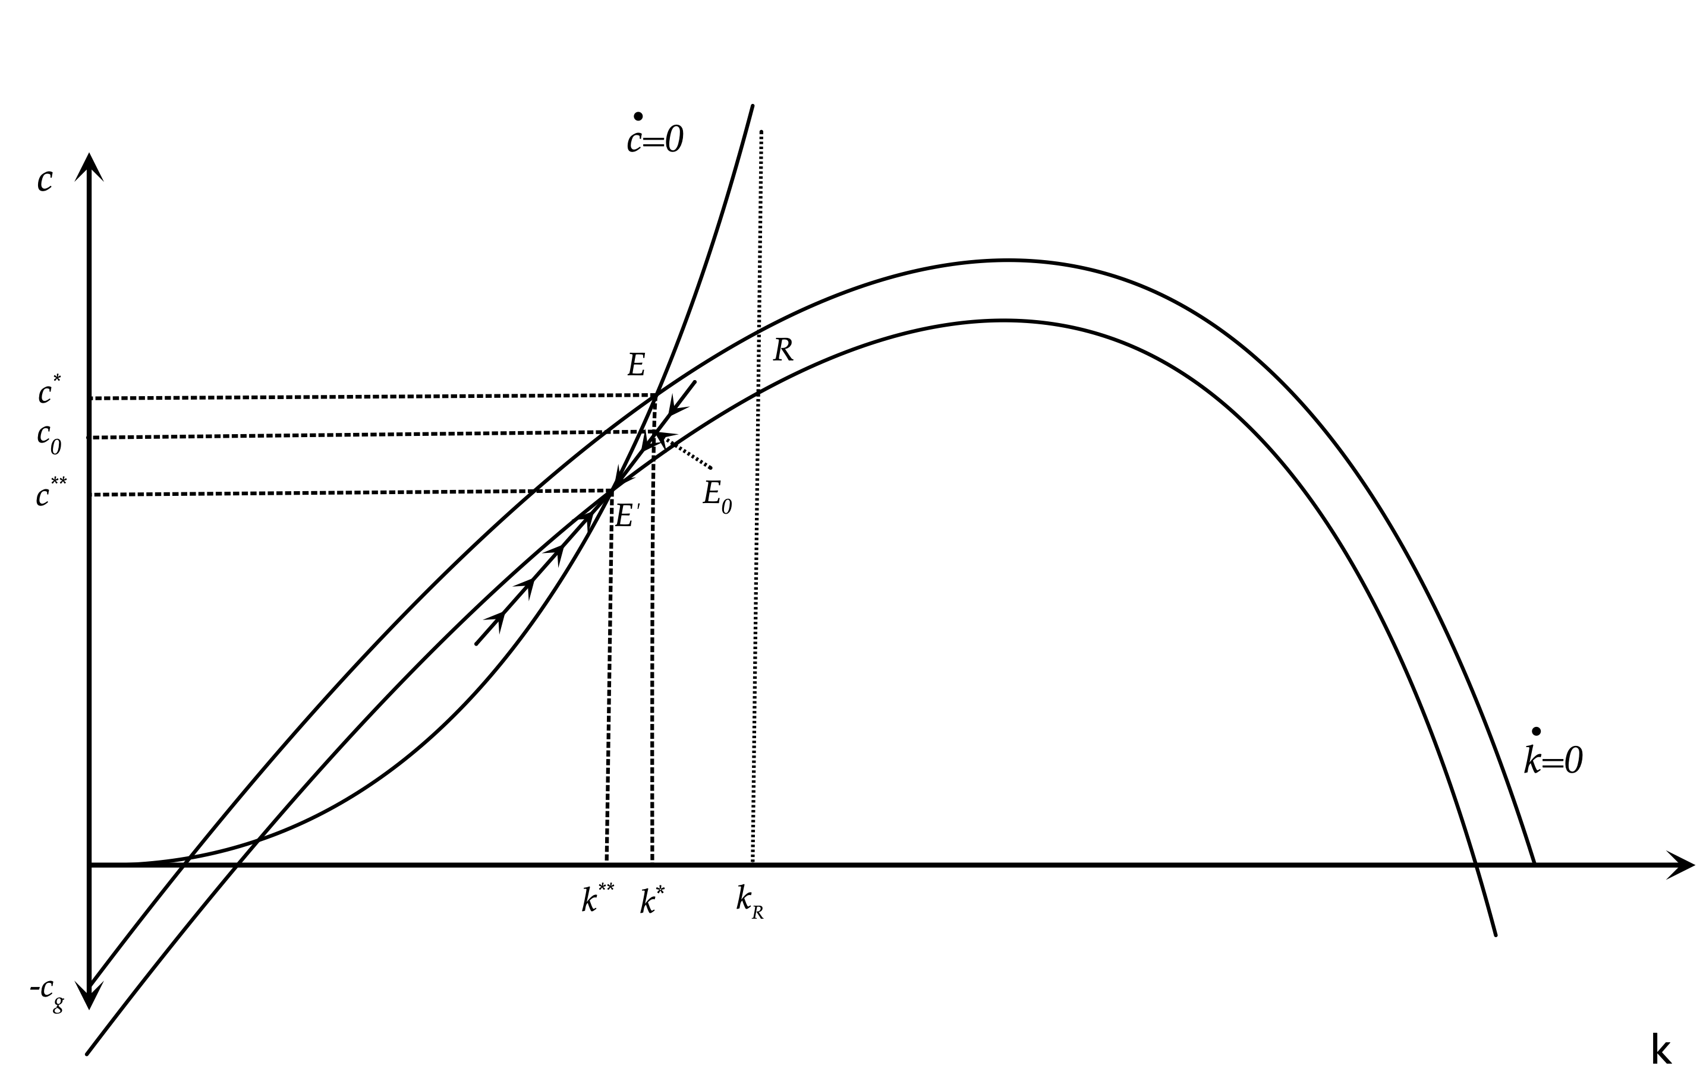
An Increase in Primary Government Expenditure in the Blanchard Weil Model

Slide 26
Increases in Real Government Debt and Real Primary Government Expenditure in the Blanchard Weil Model
A previously unanticipated permanent one off increase in government debt leads to a reduction of both steady state capital and steady state private consumption. When government debt rises in a one off fashion, consumption rises to put the economy on the new saddle path, as current generations treat their higher bond holdings as an increase in their wealth. This initiates a process of decumulation of capital and declining private consumption, that leads the economy towards the new balanced growth path with lower steady state capital, output and consumption per effective unit of labor.
A previously unanticipated permanent increase in primary government expenditure, financed by a rise in autonomous taxes, also leads to lower steady state capital and private consumption. When the increase in government expenditure occurs, private consumption falls, as current generations react to the increase in the present value of their taxes. However, the anticipated increase in the present value of taxes for current generations is lower than the increase in the present value of primary government expenditure. This is because part of the future tax burden will be shouldered by future generations. Thus, private consumption falls by less than the increase in primary government expenditure, and total savings fall relative to equilibrium investment. This starts a process capital decumulation and declining consumption on the new saddle path, which leads the economy to a new balanced growth path with lower steady state capital, output and consumption per effective unit of labor.
In an overlapping generations model, both the level of government debt and taxes, and primary government expenditure, affect the balanced growth path. Ricardian equivalence does not hold, as current generations know that part of the increase in the present value of taxes required to finance an increase in government debt, or primary government expenditure, will be borne by future generations. Thus there are effects on total savings and capital accumulation, as government debt and expenditure policies essentially redistribute wealth across generations.

Slide 27
A More General Characterization of Fiscal Policies in the Blanchard-Weil Model
The fiscal policies we have considered so far are restricted to one off permanent increases in either primary government expenditure or government debt, per efficiency unit of labor. This has allowed us to eliminate the dynamics of government debt accumulation, and keep our model simple and analytically tractable, in that it consisted of two differential equations, with one state and one control variable.
We shall now examine a more realistic description of fiscal policy in the Blanchard-Weil model, where the government chooses a level of primary government expenditure and autonomous taxes, and then allows taxes and government debt to adjust gradually, in a way that satisfies the government budget constraint.
We shall again assume that the government has a fixed target ${\overline{c}}_{g}$ for primary government expenditure (per efficiency unit of labor). However, we shall now assume that the government changes taxes to stabilize government debt per efficiency unit of labor only gradually and not immediately. For this it uses a tax smoothing policy of the form,
$τ(t)=\overline{τ}+ψd(t)$
where ${\overline{c}}_{g}≥\overline{τ}>0$, and $ψ>r_{E}-n-g>0$. $\overline{τ}$ denotes autonomous taxes per efficiency unit of labor), and $ψ>0$ the induced stabilizing reaction of taxes to the level of government debt. $r_{E}$ is the steady state real interest rate in the Blanchard-Weil model. As the government accumulates debt, taxes increase gradually in order to stabilize government debt per efficiency unit of labor. Taxes have two components: an autonomous component, and a debt induced component, which serves to stabilize government debt. This is a more realistic depiction of the actual response of taxes to government debt and is consistent with the tax smoothing observed in most economies.
From the debt accumulation equation, government debt thus evolves according to,
$\overset{·}{d}(t)=[{\overline{c}}_{g}-\overline{τ}]+[r(t)-(n+g)-ψ]d(t)$

Slide 28
The Blanchard Weil with a Cobb Douglas Production Function, Constant Primary Government Expenditure and Endogenous Debt Accumulation of Government Debt
$y(t)=Ak(t)^{α}$
$\overset{·}{c}(t)=[r(t)-ρ-g]c(t)-nρ[k(t)+d(t)]$
$\overset{·}{k}(t)=Ak(t)^{α}-c(t)-{\overline{c}}_{g}-(n+g+δ)k(t)$
$\overset{·}{d}(t)=[{\overline{c}}_{g}-\overline{τ}]+[r(t)-(n+g)-ψ]d(t)$
$r(t)=αAk(t)^{α-1}-δ$
$w(t)=(1-α)Ak(t)^{α}$
$τ(t)=\overline{τ}+ψd(t)$

Slide 29
Fiscal Policy Simulations of the Blanchard-Weil Model
We simulate the model assuming the following parameter values: $A=1$, $α=0.333$, $ρ=0.02$, $n=0.01$, $g=0.02$, $δ=0.03$. These values are the same as the ones we used in previous simulations.
As for the parameters of fiscal policy, we shall assume that, $\overline{c_{g}}=0.5$, $\overline{τ}=0.45$ and $ψ=0.075$.
We consider three alternative fiscal policy shocks.
First, a 10% tax financed increase in primary government expenditure, from 0.5 to 0.55. This policy results in an immediate corresponding increase in autonomous taxes, but does not result in an increase in government debt.
Second, a 10% debt financed increase in primary government expenditure, from 0.5 to 0.55. This policy results in an increase in government debt, but also eventually taxes, through the induced stabilizing reaction of taxes to the rise in government debt.
Third, a debt financed cut in autonomous taxes by 0.05. This last shock amounts to a temporary tax cut equivalent to a 10% increase in governement expenditure. This tax reduction causes an increase in government debt and eventually, through government debt accumulation causes an increase in total taxes, because of the induced stabilizing reaction of taxes to the rise in government debt.

Slide 30
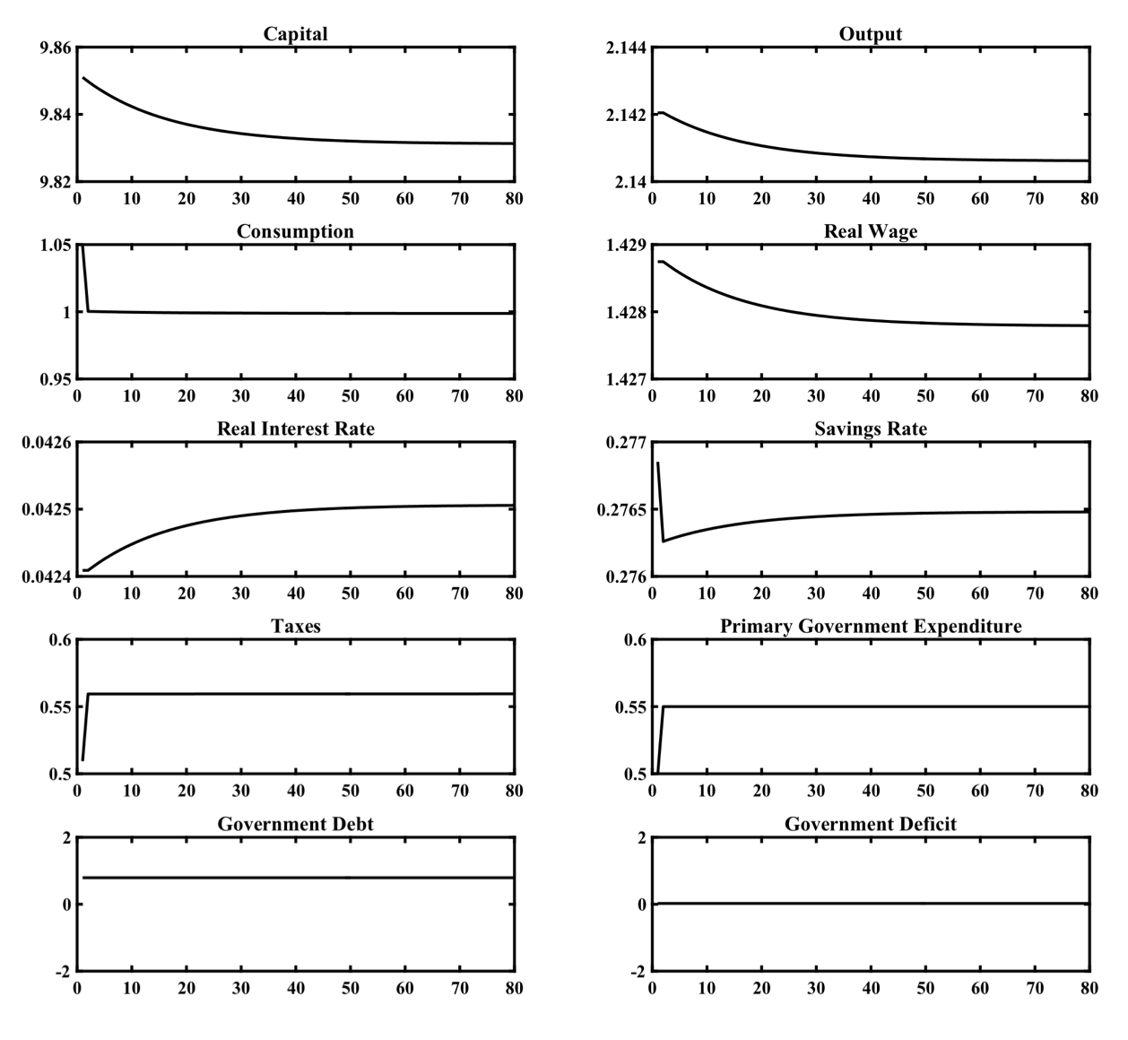
A Tax Financed Increase in Primary Government Expenditure

Slide 31
A Tax Financed Increase in Primary Government Expenditure
A permanent tax financed increase in primary government expenditure by 0.05 (10% of its original level) reduces private consumption expenditure immediately, because of the increase in autonomous taxes.
However, as part of the future autonomous taxes will be paid by future generations, the reduction of private consumption by current generations is lower than the increase in primary government expenditure, and total savings fall.
This starts a process of decumulation of capital that leads the economy to a new steady state, with lower capital, output, private consumption and real wages per efficiency unit of labor, as well as a higher real interest rate.
A 10% increase in real primary government expenditure, as the one we have considered, reduces steady state real per capita output (and real wages) by only 0.07% and increases the steady state real interest rate by only 0.01 percentage points (i.e from 5.24% to 5.25%). The steady state aggregate savings rate is reduced from 27.7% to 27.6%, again a very small decline.

Slide 32
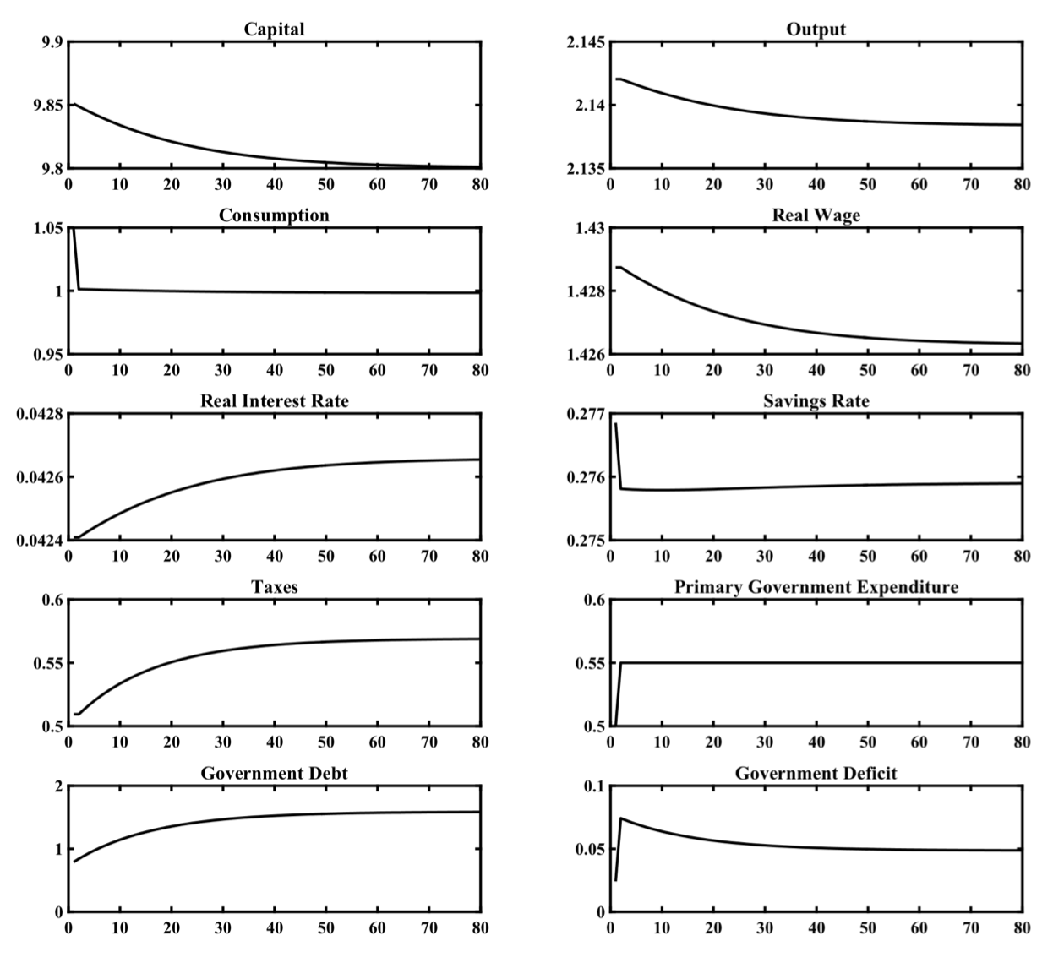
A Debt Financed Increase in Primary Government Expenditure

Slide 33
A Debt Financed Increase in Primary Government Expenditure
A debt financed increase in primary government expenditure by 0.05 (10% of its original level) also reduces private consumption expenditure immediately, because of the anticipated future increase in taxes that will be required for debt to be eventually stabilized.
However, as part of the future taxes will be paid by future generations, the reduction of private consumption by current generations is lower than the increase in primary government expenditure, and total savings fall.
This starts a process of decumulation of capital that leads the economy to a new steady state, with lower capital, output, private consumption and real wages per efficiency unit of labor, as well as a higher real interest rate. Government debt is also increasing in the process, and ends up at more than double its initial level.
Although the real effects of a debt financed increase in primary government expenditure on per capita real output and the real interest rate are almost three times as high as the effect of an equivalent tax financed increase, they remain extremely small.

Slide 34
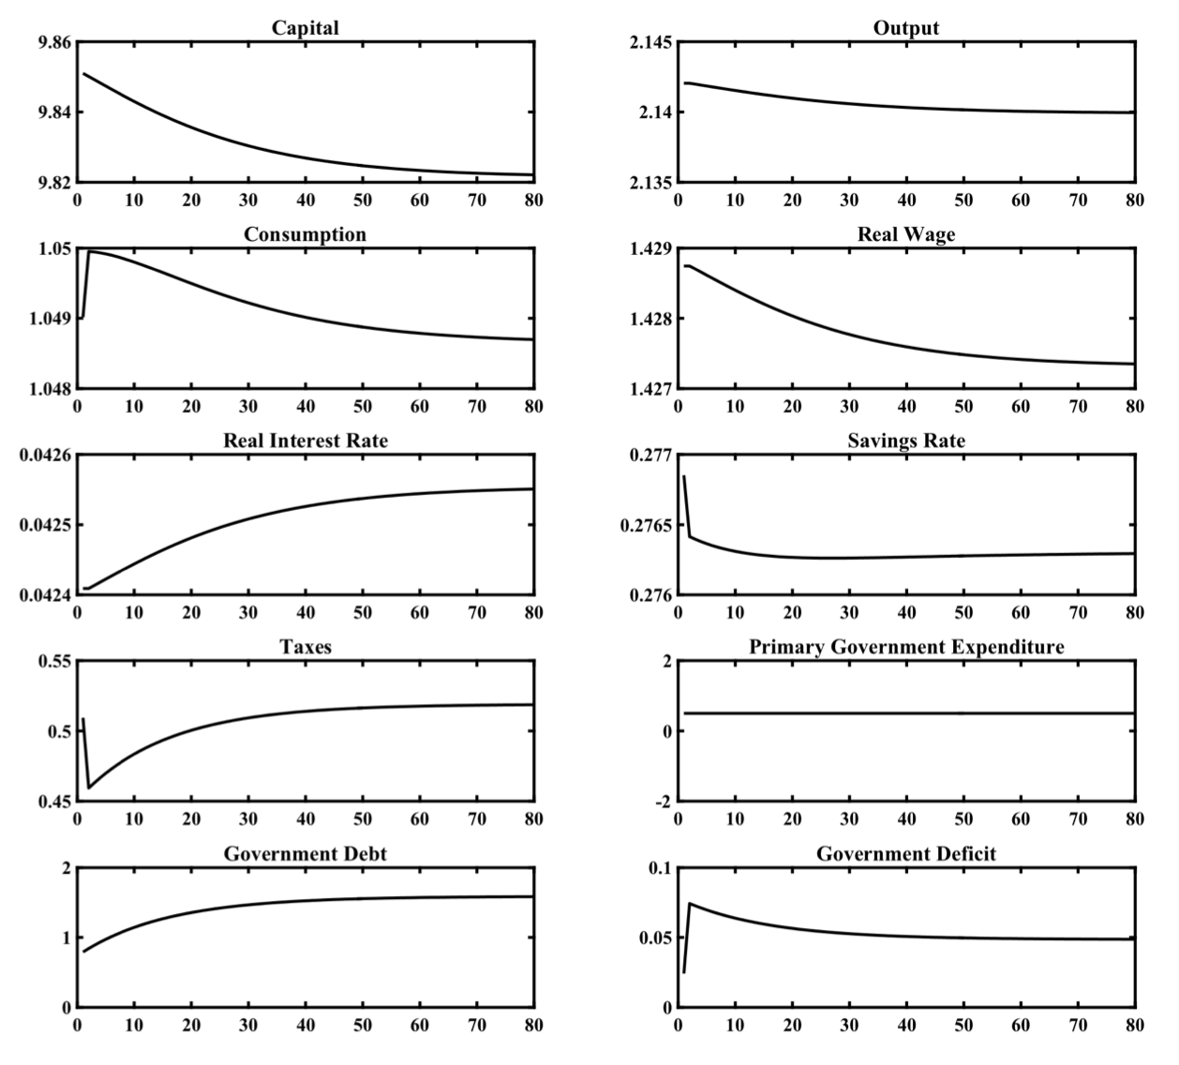
A Debt Financed Cut in Autonomous Taxes

Slide 35
A Debt Financed Cut in Autonomous Taxes
A debt financed cut in autonomous taxes by 0.045 (10% of their original level) increases private consumption expenditure immediately, because current generations anticipate that the future increases in taxes that will be required for debt to be stabilized will be paid in part by future generations.
The increase in private consumption and the associated reduction in savings starts a process of de-cumulation of capital that leads the economy to a new steady state, with lower capital, output, private consumption and real wages per efficiency unit of labor, as well as a higher real interest rate. Government debt is also increasing in the process, and ends up at more than double its initial level.
The real effects of a debt financed cut in autonomous taxes are extremely small, even smaller than a debt financed rise in primary government expenditure.

Slide 36
The Growth Effects of Distortionary Taxation
Taxes are rarely non-distortionary, as they affect incentives for savings, investment and labor supply.
In the representative household and overlapping generations models that we have considered, labor supply is exogenously given, and does not depend on net of tax real wages. Consequently, tax rates on labor income or (time invariant) consumption taxes do not cause distortions in labour supply and savings, and do not affect either the adjustment path or the balanced growth path.
In contrast, capital income taxation and taxes on business earnings before interest and depreciation, have a negative impact on savings and investment. Such taxes affect savings and capital accumulation negatively, and, as a result, have a negative impact on the steady state capital stock, steady state output and income, steady state real wages and steady state private consumption.

Slide 37
The Government Budget Constraint with Distortionary Taxation
To keep things simple, we will assume a government which runs a continuously balanced budget and has no government debt.
The government engages in primary government expenditure and transfers to households, and levies taxes on income from capital and labor, business profits before interest and depreciation payments, and on the consumption of households. Thus, in every instant, the government budget constraint per efficiency unit of labor is given by,
$c_{g}(t)+v(t)=τ_{w}w(t)+τ_{k}r(t)k(t)+τ_{c}c(t)+τ_{f}\left(f(k(t))-w(t)\right)$
where, $c_{g}$ is primary government expenditure, $v$ real transfers to households and firms, $τ_{w}$ the tax rate on labor income, $τ_{k}$ the tax rate on capital income, $τ_{c}$ the tax rate on consumption and $τ_{f}$ the tax rate on firms profits, before interest and depreciation. All variables, apart from tax rates and the real interest rate $r$ are defined per efficiency unit of labor.

Slide 38
The Effects of Taxes on Business Profits (before interest and depreciation) and Capital Income in the Ramsey Model
The existence of income and consumption tax rates and government transfers affects the intertemporal budget constraints of both households and firms, and thus their optimal savings and investment decisions. The first order condition for the maximization of profits by firms now takes the form,
$(1-τ_{f})Af^{′}(k(t))=r(t)+δ$
Firms now equate the post tax marginal product of capital with the pre-tax user cost of capital $r+δ$, since taxes are levied on profits before interest and depreciation.
The Euler equation for consumption of the representative household now takes the form,
$\overset{·}{c}(t)=\frac{1}{θ}[(1-τ_{k})r(t)-ρ-θg]c(t)$
Since income from capital is taxed, it is the net of tax real interest rate that drives savings decisions.
Combining the two expressions, we get that,
$\overset{·}{c}(t)=\frac{1}{θ}[(1-τ_{k})\left((1-τ_{f})Af^{′}(k(t))-δ\right)-ρ-θg]c(t)$
The accumulation equation for capital is not affected by the existence of distortionary taxes, as, from the government budget constraint the revenue from distortionary taxes minus transfers, is equal to primary government expenditure. Thus, the accumulation of capital (per efficiency unit of labor) is determined by the usual accumulation equation of the form,
$\overset{·}{k}(t)=Af(k(t))-c(t)-{\overline{c}}_{g}-(n+g+δ)k(t)$
The behavior of the economy is determined by the Euler equation for consumption and the accumulation equation. The only distortionary taxes that enter these two equations are the tax rate on interest income $τ_{k}$ and the tax rate on the profits of firms before interest and depreciation $τ_{f}$. The other tax rates do not create distortions, as labor supply is assumed inelastic in the Ramsey model.

Slide 39
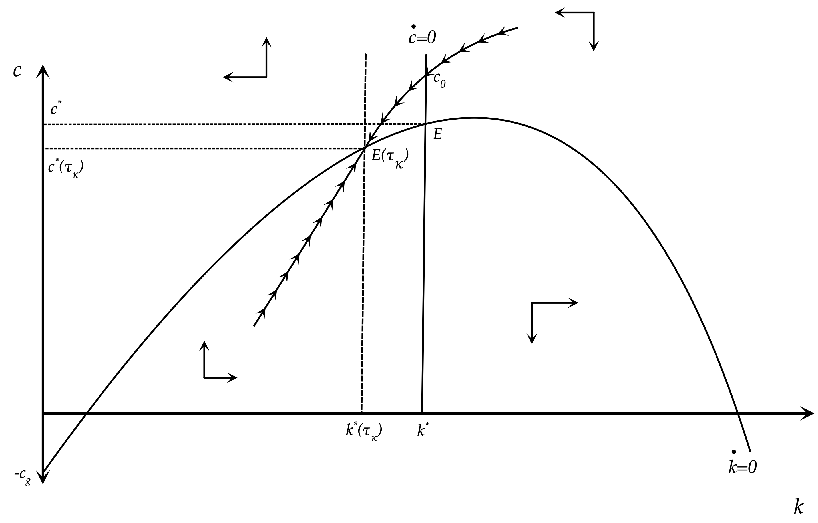
An Increase in Capital Income Taxation in the Ramsey Model

Slide 40
A Dynamic Simulation of the Introduction of a 10% Capital Income Taxation in the Ramsey Model
In order to quantitatively examine the dynamic effects of an increase in capital income taxation in the Ramsey model, we can simulate, for the specific values of the parameters of the model assumed so far, the transition from a balanced growth path without capital income taxation to a balanced growth path after the introduction of capital income taxation.
In the simulation it is assumed that the economy is on its original balanced growth path, without capital income taxation. In period 1 the government imposes a previously unanticipated 10% tax on interest income (increase of τk). This increase, as predicted theoretically, leads to a decrease in the net real interest rate enjoyed by households. This causes an increase in consumption and a fall in the savings rate, which initiate a process of capital decumulation, a gradual decline in real output and real wages, and a gradual increase in the pre-tax real interest rate.
The reduction in real wages and the increase in the pre-tax real interest rate is a result of the declining capital stock, which causes a falling marginal product of labor and a rising marginal product of capital. The economy gradually converges to a new balanced growth path. In this, capital per efficiency unit of labor is lower by approximately 8.9% compared to the original balanced growth path, output and real wages are lower by 3.0%, consumption is lower by 0.7% (due to the decline in the saving rate), while the (pre-tax) real interest rate has increased by 0.44 percentage points, or approximately 10%. The steady state savings rate, which is endogenous in this model, falls from 28.5% to 26.8%.
The dynamic real effects of a 10% tax on on business profits before interest and depreciation are exactly the same. The only real variable that has a different behavior is the pre-tax real interest rate, which initially falls, and then gradually returns to its original steady state value through the decumulation of capital.
As one can deduce from these simulations, even a relatively low rate of capital income taxation or taxation of business income, before interest and depreciation, causes relatively large declines in per capita output and income, as it leads to a significant reduction of savings and capital accumulation.

Slide 41
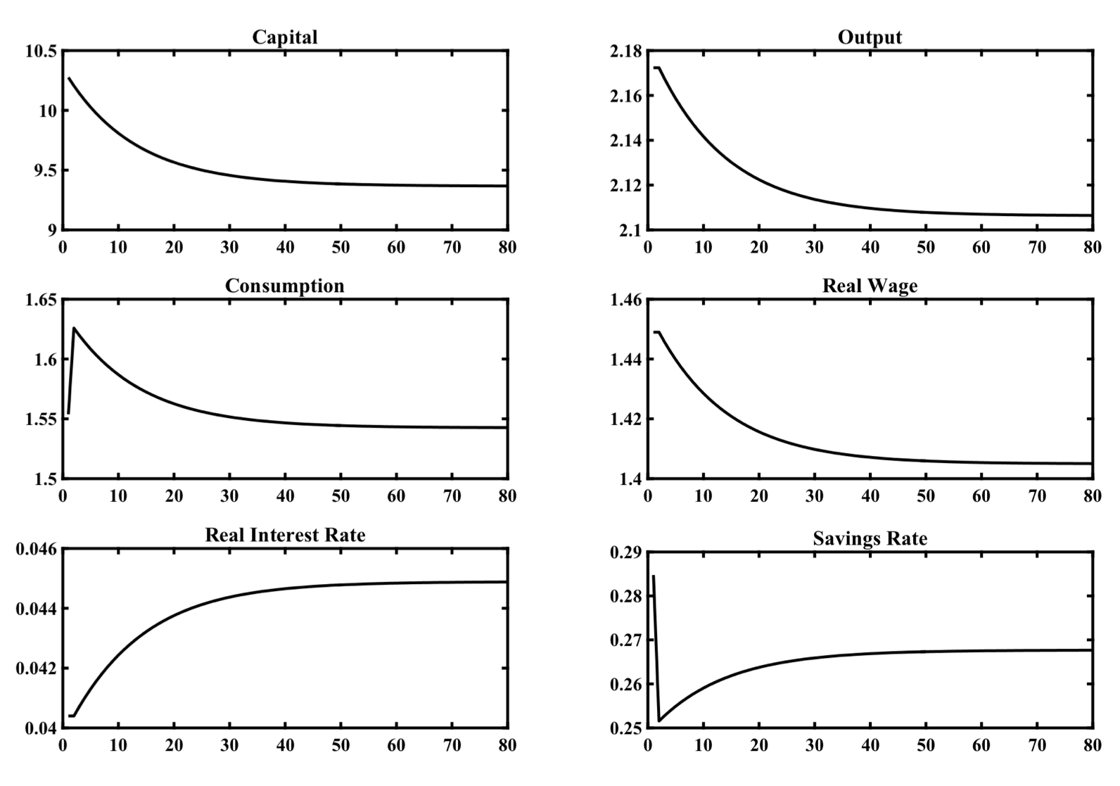
Dynamic Effects of the Introduction of a 10% Capital Income Taxation in the Ramsey Model

Slide 42
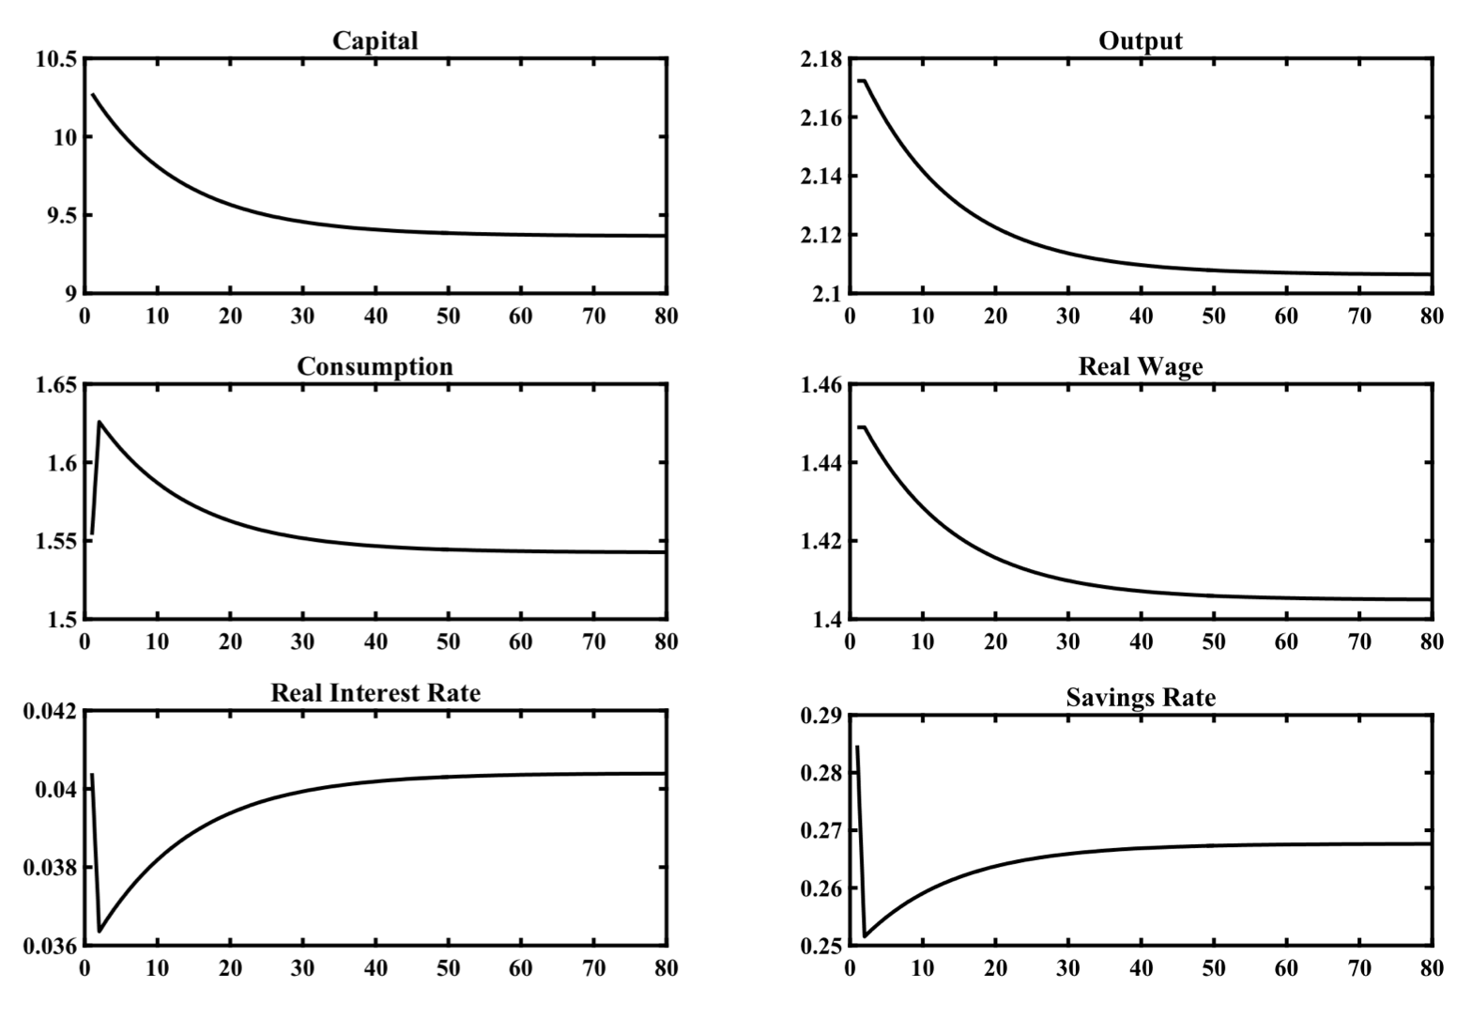
Dynamic Effects of the Introduction of a 10% Tax on Business Profits before Interest and Depreciation in the Ramsey Model

Slide 43
Conclusions on the Growth Effects of Government Expenditure, Debt and Taxes in the Representative Household Model
Ιn the representative household model without distortionary taxes, fiscal policy has no effects on either the convergence process or the balanced growth path. The only fiscal variable that matters for the path of private consumption is the present value of primary government expenditure, which reduces the present value of private consumption by exactly the same amount.
The method of financing primary government expenditure, such as government debt and (non-distortionary) taxes does not affect private consumption, or the adjustment and balanced growth path of all other real variables.
This result is known as Ricardian equivalence between lump sum taxes and government debt. Holdings of government bonds by the representative household are not considered as wealth, and do not affect household consumption, since the representative household realizes that government bonds will be financed by future taxes of equal present value.

Slide 44
Conclusions on the Growth Effects of Government Expenditure, Debt and Taxes in Overlapping Generations Models
The Ricardian equivalence result does not apply to overlapping generations models. The levels of government debt, and primary government expenditure affect both the balanced growth path and the adjustment path.
This is because current generations realize that part of the future taxes that will finance either primary government expenditure, or interest on the government debt, will be shouldered by future generations. Consequently, both primary government expenditure and government debt lead to a reduction in aggregate savings, and lead to a reduction of steady state capital and private consumption.
A dynamic simulation of the Blanchard Weil model of overlapping generations suggests however that the effects of deviations from Ricardian equivalence are relatively small in this model.

Slide 45
Conclusions on Distortionary Taxation
In the representative household and overlapping generations that we have considered, labor supply is exogenous. Consequently, tax rates on income from employment or constant consumption tax rates do not affect employment and savings, with the result that they do not affect either the adjustment path or the balanced growth path.
On the other hand, tax rates on capital income or business earnings before interest and depreciation are distortionary, and have negative effects on private savings and investment, the accumulation of capital, real output, real wages and real interest rates. A dynamic simulation of the Ramsey model, for plausible parameter values, suggests that these effects of capital income taxation may be quantitatively significant.

