Slide 1
6. Models of Overlapping Generations
Athens University of Economics and Business
Dynamic Macroeconomics
Prof. George Alogoskoufis
alogoskoufisg.com

Slide 2
Models of Overlapping Generations
The representative household model is based on the assumption that all households are identical.
An alternative class of models allows for households to differ. As young households are being born and old households die, there is a succession of overlapping generations. At any given time, households represent different generations.
The savings behavior across generations generally differs, as households belonging to different generations may have differences in accumulated wealth and/or different time horizons. Thus, such models do not necessarily imply the homogeneity or economic efficiency that characterizes the basic representative household model.

Slide 3
The Diamond Model
In each time period two types of households coexist. The young, who are in the first period of their lives, and the old, who are in the second and last period of their lives.
Young households supply labor but own no capital. Thus, they only earn labor income. Old households are not working, and consume the income from the capital they accumulated during their first period of life, as well as their capital stock itself, since they live in the last period of life.
In the following period, the old households have passed away, young households have become old, and a new generation of young households has entered the economy.
There are many competitive firms, the technology of production is described by a neoclassical production function, capital and labor markets are competitive, and capital and labor are paid their marginal product.

Slide 4

Peter Diamond (1940-)
Peter Arthur Diamond (born April 29, 1940) is a prominent American economist known for his analysis of overlapping generations models and search models of the labor market. He was awarded the Nobel Memorial Prize in Economic Sciences in 2010 (along with Dale T. Mortensen and Christopher A. Pissarides). He is an Institute Professor at the Massachusetts Institute of Technology.
Diamond (1965) extended the Ramsey–Cass–Koopmans model, with a representative infinitely-lived agent, to a setup where new individuals are continually being born and old individuals are continually dying. He built on a framework developed by Paul Samuelson, who had termed it "an exact consumption-loan model.

Slide 5
Differences from the Representative Household Model
Savings behavior in overlapping generations models is not characterized by social efficiency, as in the representative household model.
Moreover, in economies without a representative household, comparing utility across households is largely arbitrary.
Furthermore, in overlapping generations models, it is theoretically possible that the competitive equilibrium is not even Pareto efficient, as the possibility of dynamic inefficiency cannot be ruled out a priori.
In any case, in models of overlapping generations, policy interventions that can improve social efficiency can be justified, since the competitive equilibrium is not necessarily optimal.

Slide 6
Technology and the Production Function
The technology of production is described by a neoclassical production function, analogous to the one we assumed in the Solow and Ramsey models. The production function has all the properties of the neoclassical production function assumed in the Solow model. The marginal product of all inputs is positive but decreasing, there are constant returns to scale and the Inada conditions are satisfied.
$Y_{t}=AF(K_{t},h_{t}L_{t})$
Because of the assumption of constant returns to scale, the production function can be rewritten as,
$y_{t}=Af(k_{t})$
where, $y=Y/hL$ is output per efficiency unit of labor, $k=K/hL$ is capital per efficiency unit of labor, and $f(k)=F(k,1)$ is the production function per efficiency unit of labor. A is total factor productivity.
George Alogoskoufis, Dynamic Macroeconomics, 2019

Slide 7
The Intertemporal Utility Function of Households
In period $t$, $L_{t}$ households are being born, and population grows at an exogenous rate $n$. Thus,
$L_{t}=(1+n)L_{t-1}$
The “young”, i.e., those in the first period of life, work, while the “old”, those in the second period of life, do not work. Thus, each household supplies a unit of labor when “young” and allocates labor income between consumption of the first period and savings. In the second period of life, “old” households consume their savings, plus interest on their savings. Thus, each generation chooses savings to solve a Fisherian problem.
The utility function of a household born in period $t$ is defined by,
$U_{t}=\frac{c_{{}_{1t}}^{1-θ}}{1-θ}+\frac{1}{1+ρ}\frac{c_{{}_{2t+1}}^{1-θ}}{1-θ}$
where, $0<θ<1$ , $ρ>-1$ , and $c_{1t},c_{2t+1}$ denote consumption in the first and second period of life respectively.
This is a constant elasticity of intertemporal substitution (CEIS) utility function. $θ$ is the coefficient of constant relative risk aversion, and $1/θ$ is the constant elasticity of intertemporal substitution of consumption.

Slide 8
Markets and the Behavior of Households
Production takes place by many competitive firms, each with the same production function. Output, capital and labor markets are competitive. Capital and labor are paid their marginal products, and, because of constant returns to scale, firms make zero profits. The real interest rate and the real wage are determined by,
$r_{t}=Af^{′}(k_{t})-δ$
$w_{t}=Af(k_{t})-k_{t}Af^{′}(k_{t})$
where $Af^{′}(k_{t})$ is the marginal product of capital.
Each ‘young’ household allocates its labor income $w_{t}h_{t}$ between consumption and savings. As a result, the capital stock of period t+1 is equal to the aggregate savings of period t.
$K_{t+1}=L_{t}(w_{t}h_{t}-c_{1t})$
This capital stock is combined in production with the labor supplied by the generation born in period t+1, and the economy continues from period to period.
In the second period of life, the household born in period t, consumes all its interest income, plus the savings it has accumulated in the first period of life. Thus, consumption in the second period of life, of a household born in period t, is given by,
$c_{2t+1}=(1+r_{t+1})(w_{t}h_{t}-c_{1t})$
This can be rewritten in the form of the usual intertemporal budget constraint, that the present value of consumption is equal to household wealth, which is none other than first period labor income.
$c_{1t}+\frac{c_{2t+1}}{1+r_{t+1}}=w_{t}h_{t}$

Slide 9
The Euler Equation for Consumption
The household born in period t, maximises,
$U_{t}=\frac{c_{{}_{1t}}^{1-θ}}{1-θ}+\frac{1}{1+ρ}\frac{c_{{}_{2t+1}}^{1-θ}}{1-θ}$
subject to the inter temporal budget constraint,
$c_{1t}+\frac{c_{2t+1}}{1+r_{t+1}}=w_{t}h_{t}$
From the first order conditions for a maximum,
$\frac{c_{2t+1}}{c_{1t}}={\left(\frac{1+r_{t+1}}{1+ρ}\right)}^{1/θ}$
This is the familiar Euler equation for consumption. Consumption in the second period of life is higher or lower than consumption in the first period of life, depending on whether the real interest rate exceeds or falls short of the pure rate of time preference. $1/θ$, the elasticity of intertemporal substitution of consumption, determines the elasticity of the effect.
Solving for $c_{1t}$, using the inter temporal budget constraint, we get,
$c_{1t}=\frac{{\left(1+ρ\right)}^{1/θ}}{{\left(1+ρ\right)}^{1/θ}+{\left(1+r_{t+1}\right)}^{(1-θ)/θ}}w_{t}h_{t}$
Young households consume a share of their labor income that depends on their preferences and the real interest rate.

Slide 10
The Savings Rate of Young Households
The consumption function of the young can be rewritten as,
$$c_{1t}=\left(1-s\left(r_{t+1}\right)\right)w_{t}h_{t}$$
where $s$ is the savings rate of the young, defined as,
$$s(r)=\frac{{(1+r)}^{(1-θ)/θ}}{{(1+ρ)}^{1/θ}+{(1+r)}^{(1-θ)/θ}}$$
The savings rate is a positive function of the real interest rate $r$ only if $θ$ is lower than unity, i.e., if the elasticity of intertemporal substitution of consumption $1/θ$ is higher than unity. Only in this case does the substitution effect dominate the negative income effect. If $θ$ is greater than unity, the savings rate is a negative function of $r$, as the income effect dominates. In the special case that $θ$ is equal to one, i.e., logarithmic preferences, the savings rate is independent of the real interest rate, and is equal to $1/(2+ρ)$.

Slide 11
Accumulation of Capital per Efficiency Unit of Labor
The aggregate capital stock in each period is equal to the savings of the young households of the previous period, as the old households of the previous period consumed all their capital, and the young households of the current period own no capital. Thus,
$$K_{t+1}=s(r_{t+1})L_{t}w_{t}h_{t}$$
Expressing this in efficiency units of labor, dividing by $h_{t+1}L_{t+1}$, we get,
$$k_{t+1}=\frac{1}{(1+n)(1+g)}s(r_{t+1})w_{t}$$
Substituting for $r$ and $w$ from the marginal productivity conditions, we get,
$$k_{t+1}=\frac{1}{(1+n)(1+g)}s(Af^{′}(k_{t+1})-δ)\left(Af(k_{t})-k_{t}Af^{′}(k_{t})\right)$$
This non-linear difference equation determines the dynamic behavior of capital per efficiency unit of labor. Since output, the real interest rate, real wages and savings only depend on capital per efficiency unit of labor, it also determines the dynamic evolution of all the other endogenous variables.

Slide 12
Accumulation of Capital and the Balanced Growth Path
The capital accumulation equation in the Diamond model is thus given by,
$$k_{t+1}=\frac{1}{(1+n)(1+g)}s(Af^{′}(k_{t+1})-δ)\left(Af(k_{t})-k_{t}Af^{′}(k_{t})\right)$$
A steady state, or balanced growth path is defined by the condition that,
$$k_{t+1}=k_{t}=k^{*}$$
where $k^{*}$ is the particular solution of the capital accumulation equation for constant capital per efficiency unit of labor.
In general, the Diamond model can have many steady states (multiple equilibria).

Slide 13
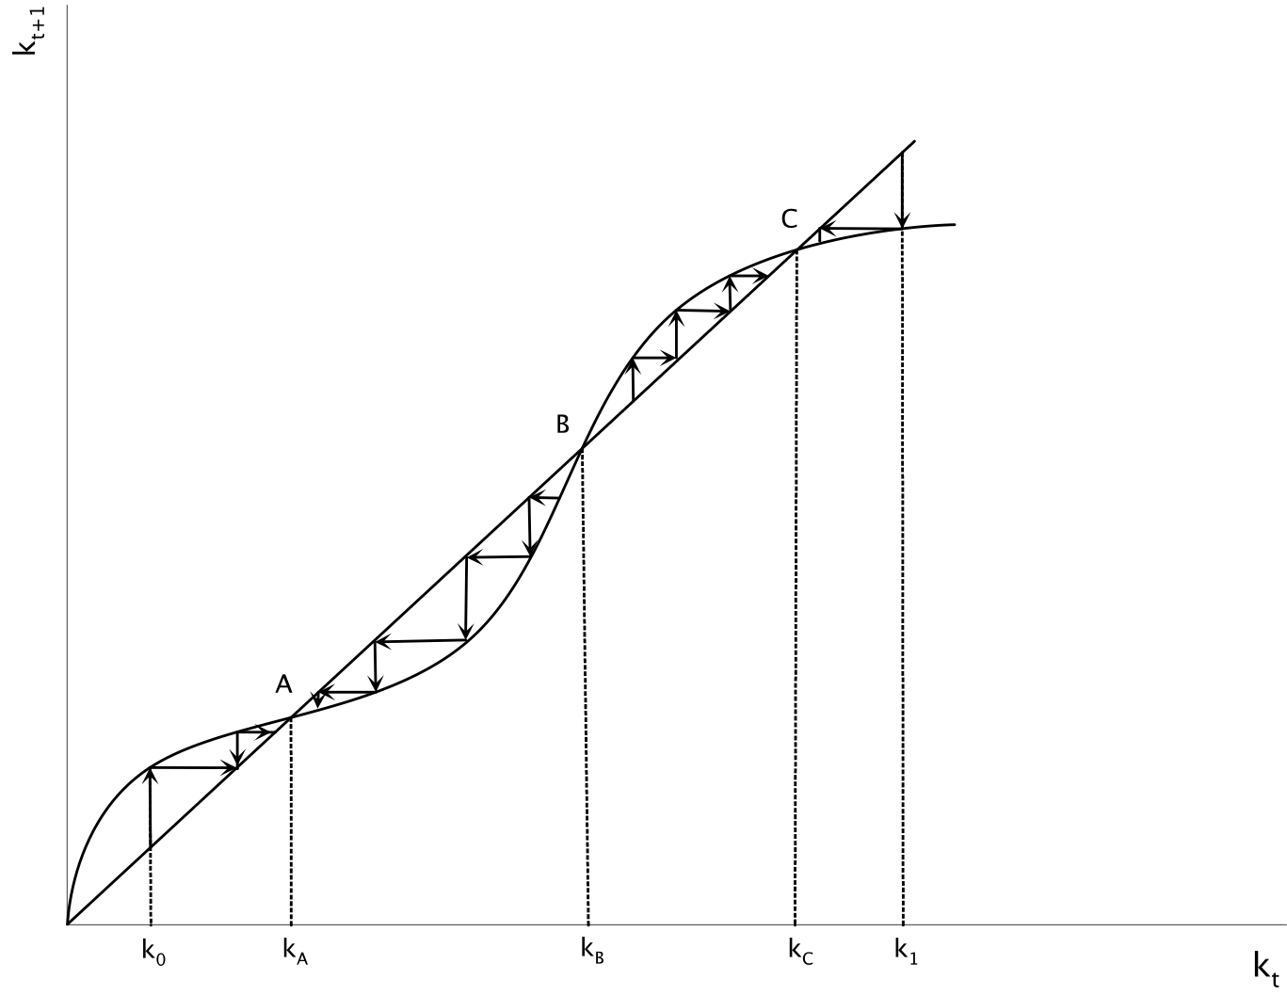
Multiple Equilibria in the Diamond Model

Slide 14
Logarithmic Preferences and a Cobb Douglas Production Function
The Diamond model can be simplified significantly if one assumes logarithmic preferences ($θ=1$) and a Cobb-Douglas production function ($Af(k)=Ak^{α}$). Then, labor income and the savings rate are determined by,
$$w_{t}=(1-α)Ak_{t}^{α}$$
$$s(r)=\frac{1}{2+ρ}$$
In this case, the real wage is a constant share of output and the savings rate is independent of the real interest rate. Substituting in the capital accumulation equation, the adjustment equation for capital per efficiency unit of labor takes the form,
$$k_{t+1}=\frac{1}{(1+n)(1+g)}\frac{1}{2+ρ}(1-α)Ak_{t}^{α}$$
One can show that in this case there is a unique balanced growth path, because of the constant savings rate and the properties of the Cobb-Douglas production function. This simplified Diamond economy converges to this unique balanced growth path $k^{*}$ independently of the initial conditions, as long as the initial capital stock is positive.

Slide 15
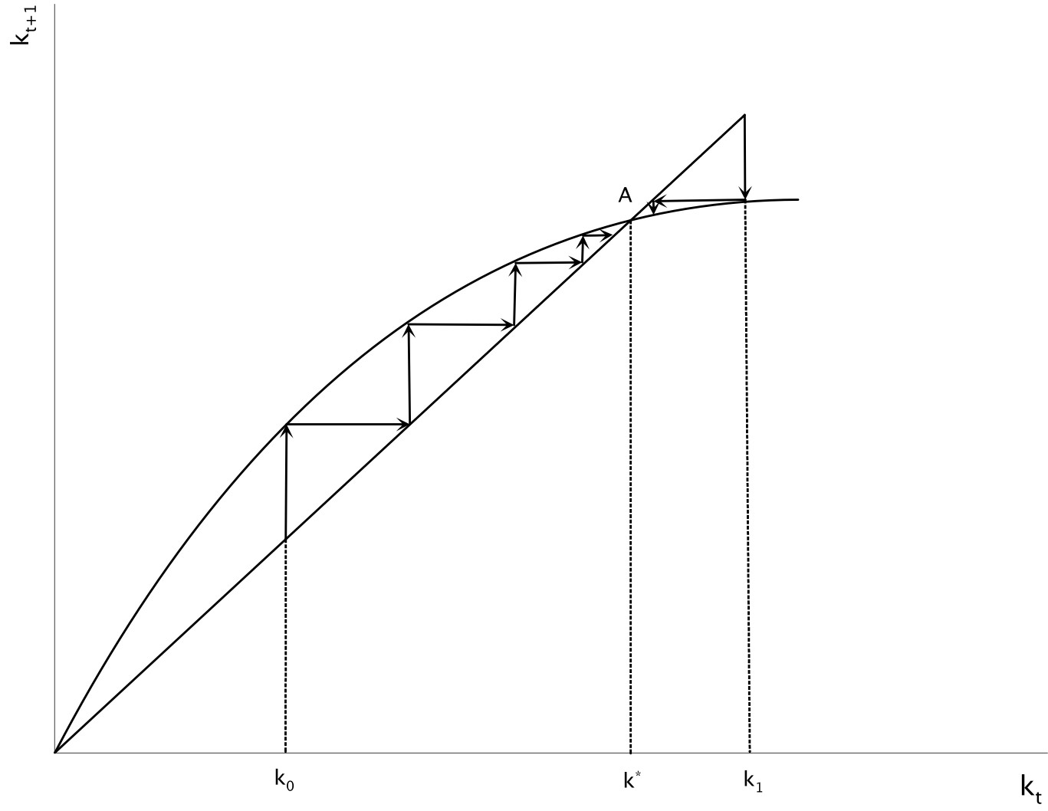
The Simplified Diamond Model
Logarithmic Preferences and Cobb Douglas Production Function

Slide 16
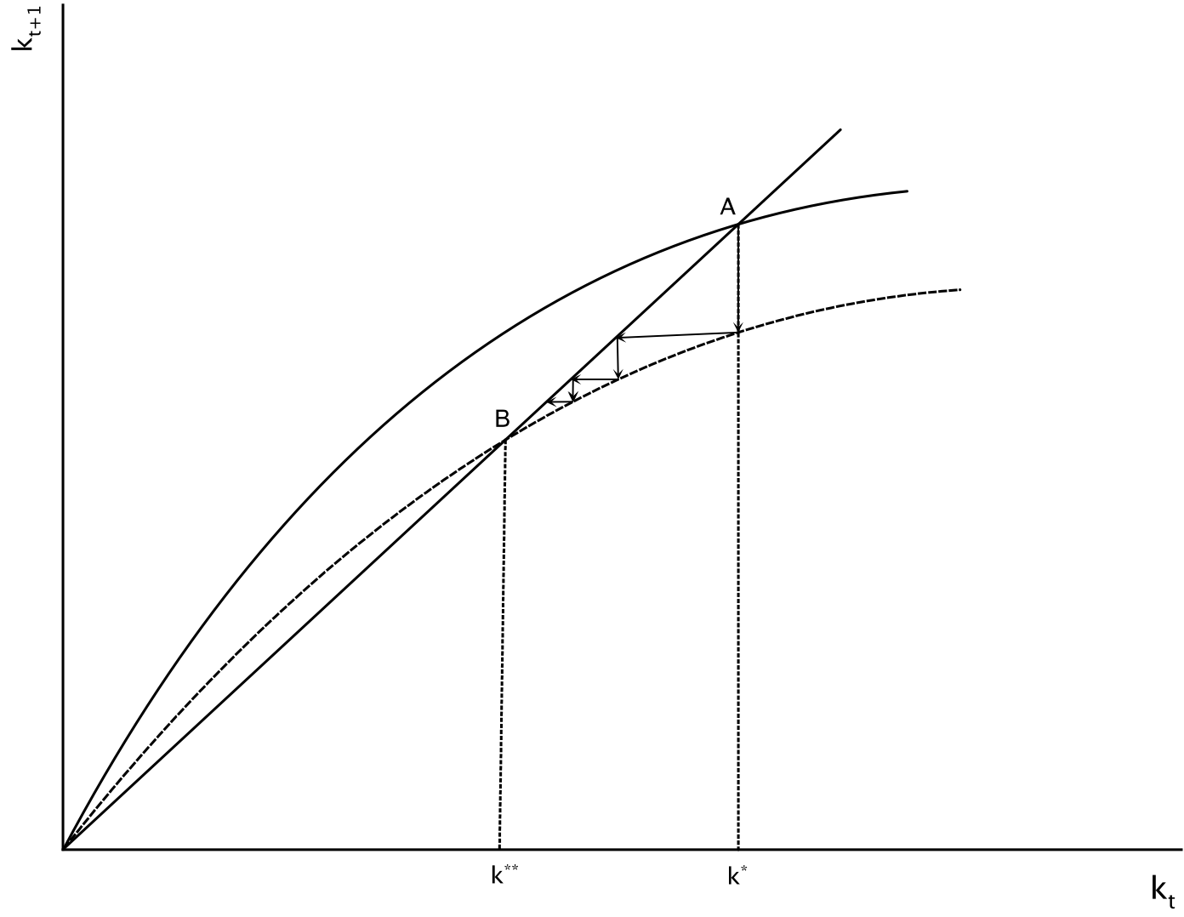
An Increase in the Pure Rate of Time Preference in the Simplified Diamond Model

Slide 17
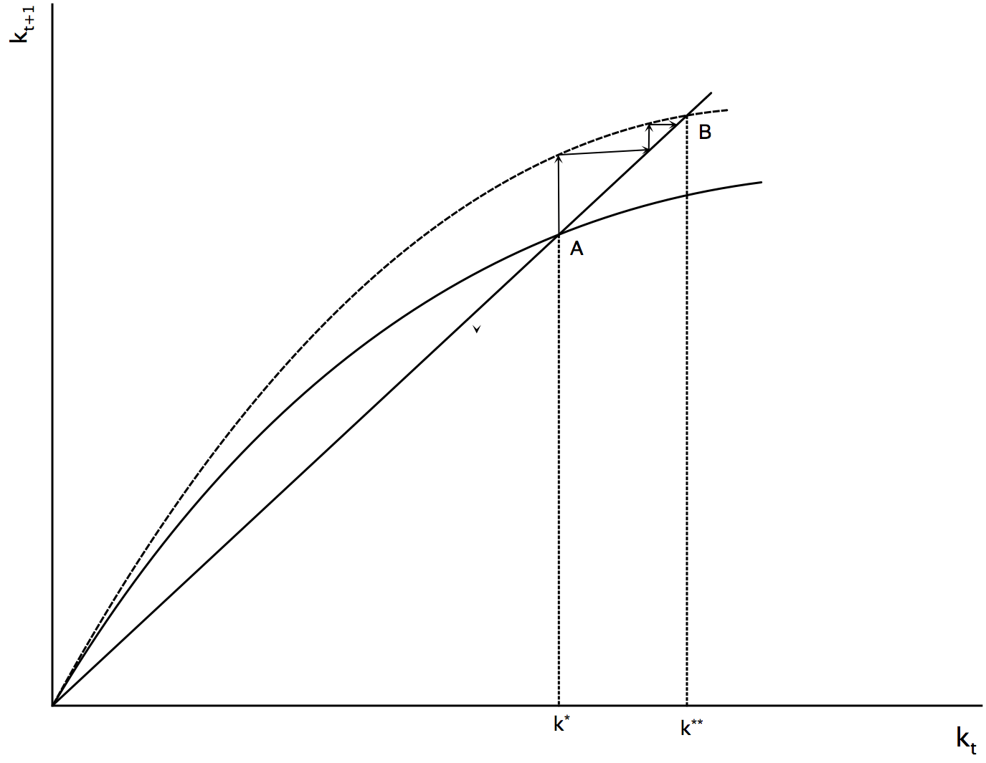
An Increase in Total Factor Productivity in the Simplified Diamond Model

Slide 18
The Possibility of Dynamic Inefficiency in the Diamond Model
The greatest difference between the representative household model and the overlapping generations model is perhaps related to its welfare implications and the efficiency of the equilibrium. We saw that in the Ramsey model competitive equilibrium leads to the maximization of welfare of the representative household. In overlapping generations models a representative household does not exist, and therefore it is not clear how we would evaluate the welfare implications of the competitive equilibrium. If we define social welfare as a weighted average of the welfare of the different generations, there is no reason to expect that the competitive equilibrium would lead to the maximization of that weighted average.
The minimum efficiency criterion we have in economics is Pareto efficiency. Namely that it is impossible to make someone better off, without making somebody else worse off. But even the simplified Diamond model does not necessarily satisfy this criterion. Theoretically, the capital stock on the balanced growth path can exceed that which satisfies Pareto efficiency, and which corresponds to the golden rule. Thus, the Diamond model may even be characterized by dynamic inefficiency. Therefore, a social planner could, if the economy ends up with more capital than the golden rule, theoretically increase the level of consumption and therefore the level of welfare of all generations, by reducing savings and the aggregate capital stock.
In any case, when Abel, Mankiw, Summers and Zeckhauser (1989) explored the possibility of dynamic inefficiency empirically for the US economy and six other developed economies, they concluded that the marginal product of capital comfortably exceeds the long run growth rate, a finding that rules out the possibility of dynamic inefficiency for the developed economies.

Slide 19
A Dynamic Simulation of the Diamond Model
The Diamond model with a Cobb Douglas production function is described by,
$y_{t}=A{k_{t}}^{α}$
$k_{t+1}=\frac{1}{(1+n)(1+g)}\frac{1}{2+ρ}(1-α)Ak_{t}^{α}$
$r_{t}=αA{k_{t}}^{α-1}-δ$
$w_{t}=(1-α)Ak_{t}^{α}$
The evolution of total private consumption can be derived from the consumption functions of young and old households.

Slide 20
Details on the Dynamic Simulation of the Diamond Model
Assumptions about parameters
Α=1, α=0.333, ρ=0.811, n=0.348, g=0.811 δ = 1.427
Unlike the previous models, where we assumed that the time period is a calendar year, here we assume that the time period is thirty years, the half life of a generation. An annual rate of 1% is converted into a thirty-year rate of 34.8%, an annual rate of 2% is converted into a thirty-year rate of 81.1% and an annual rate of 3% is converted into a thirty year rate of 142.7%.
Two alternative scenarios
An increase in the pure rate of time preference ρ by 1% (from 0.811 to 0.819)
An increase in total factor productivity Α by 1% (from 1 to 1.01)

Slide 21
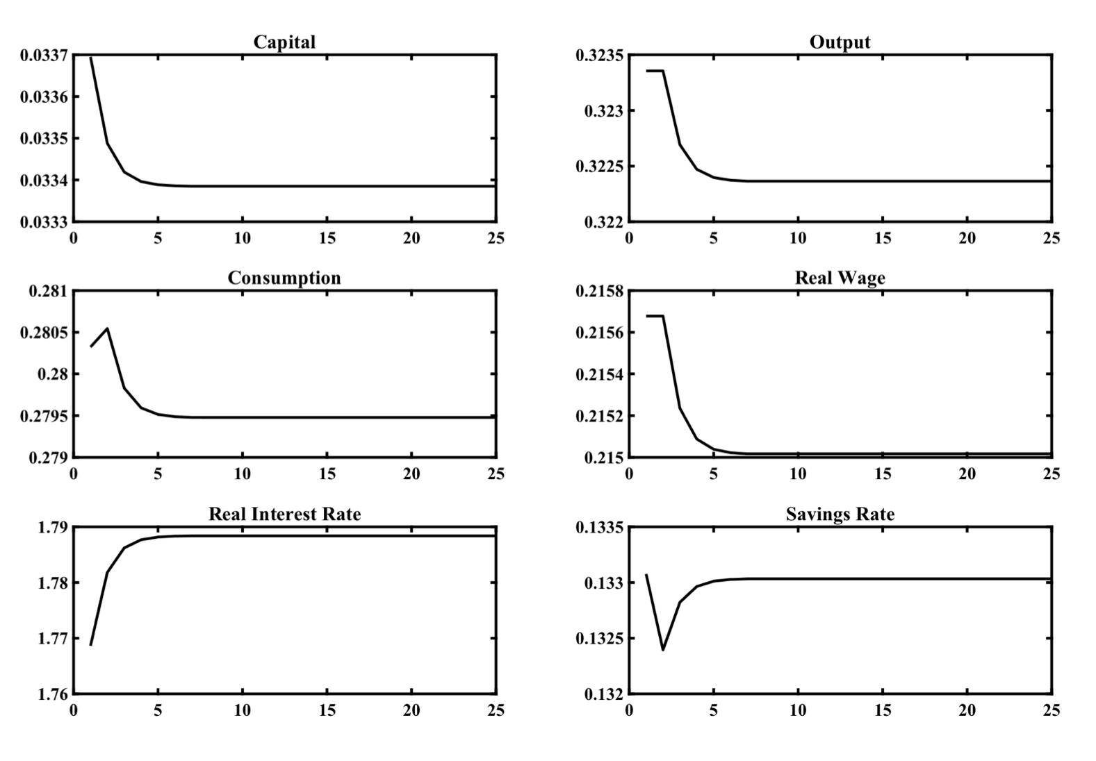
An increase in the Pure Rate of Time Preference ρ by 1%

Slide 22
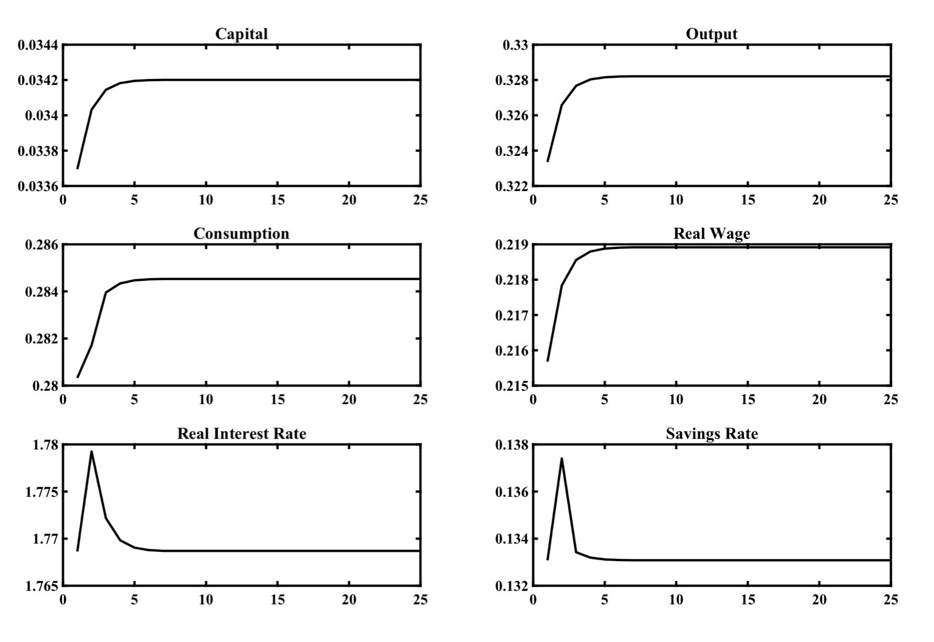
An increase in Total Factor Productivity by 1%

Slide 23
The Blanchard Weil Model
In the Blanchard-Weil model it is assumed that new households are being born continuously, with each household having an infinite time horizon. All generations of households supply labor and have the same efficiency of labor, regardless of their date of birth.
In the original version of this model by Blanchard (1985), at any instant there is a constant probability of death, which is independent of the age of households. In the model of Weil (1989), the probability of death is zero.
Technology and market structure in this model is similar to the previous models we have analyzed so far. We have competitive markets and a neoclassical production function with constant returns to scale.

Slide 24
Savings Behavior in the Blanchard Weil Model
What emerges from the model of perpetual youth is that the main differences of the predictions of overlapping generations models from representative household models result from differences in the age of different households, and not the possibility of death.
Savings behavior in the Blanchard Weil model implies lower savings compared to a comparable representative household model, as current generations are not concerned about the welfare of future generations.
Thus, the capital stock and per capita income is lower than that implied by the modified golden rule.

Slide 25
The Blanchard-Weil Model
In the Blanchard-Weil model time is assumed continuous. Households have an infinite time horizon (i.e., they are dynasties), but differ in their birth date. Each instant, $nL$ new households are born. New households have no connection with old households whatsoever. The typical household born at time $j$ chooses the path of its current and future consumption in order to maximize the intertemporal utility function,
$U_{j}=∫_{t=j}^{∞}e^{-ρt}u\left(c(j,t)\right)dt$
where, $c(j,t)$, consumption of household j at instant t, u, he instantaneous concave utility function, $ρ$, pure rate of time preference.
The instantaneous utility function is assumed logarithmic,
$u\left(c(j,t)\right)=lnc(j,t)$
All households have a constant number of members (assumed to be equal to one), with each supplying one unit of labor. All households, irrespective of their date of birth, can borrow and lend freely at the market determined real interest rate r.
Moreover, we assume that there is a large number of competitive firms, each with a production function which, in terms of efficiency units of labor takes the form,
$y(t)=Af(k(t))$
Markets are competitive and therefore the real interest rate and the real wage defined by the marginal productivity conditions,
$r(t)=Af^{′}(k(t))-δ$
$w(t)=Af(k(t))-k(t)Af^{′}(k(t))$

Slide 26
The Optimisation Problem of Households
Household j maximizes its intertemporal utility function,
$U_{j}=∫_{t=j}^{∞}e^{-ρt}u\left(c(j,t)\right)dt$
under the constraint,
$\overset{·}{k}(j,t)=r(t)k(j,t)+w(t)h(t)-c(j,t)$
where $k(j,j)=0$.
From the first-order conditions for a maximum, we get the Euler equation for consumption,
$\overset{·}{c}(j,t)=(r(t)-ρ)c(j,t)$
Integrating the Euler equation over time, and using the fact that the present value of consumption is equal to initial assets plus the present value of labor income for all households, we get the consumption function,
$c(j,t)=ρ(k(j,t)+W(j,t))$
where, $W(j,t)=∫_{v=t}^{∞}e^{-∫_{x=t}^{v}r(x)dx}w(v)h(v)dv=\overset{̂}{W}(t)$ is the present value at time t of labor income (human capital).
We can confirm that the present value of labor income is the same for all households, irrespective of their birth date, because the real wage is the same for all households, as is labor efficiency, while all households supply one unit of labor per instant.

Slide 27
Aggregation Across Generations
The aggregate variables $C(t)$, $K(t)$ and $W(t)$ will be determined by the integral of the variables that correspond to every generation of households at time t, i.e., for every $j≤t$. For every generation $j$ its size, equal to $ne^{nj}$, is taken into account. Obviously, younger generations are more numerous than older generations.
As a result, aggregate consumption and aggregate physical and human capital are given by,
$C(t)=∫_{j=-∞}^{t}ne^{nj}c(j,t)dj$, $K(t)=∫_{j=-∞}^{t}ne^{nj}k(j,t)dj$, $W(t)=∫_{j=-∞}^{t}ne^{nj}W(j,t)dj=e^{nt}\overset{_}{W}(t)$
From the the consumption function of individual households it follows that,
$$C(t)=ρ\left(K(t)+W(t)\right)$$
Differentiating with respect to time it follows that,
$$\overset{·}{C}(t)=ρ\left(\overset{·}{K}(t)+\overset{·}{W}(t)\right)$$
Since, $\overset{·}{K}(t)=r(t)K(t)+w(t)h(t)e^{nt}-C(t)$ and $\overset{·}{W}(t)=(r(t)+n)W(t)-w(t)h(t)e^{nt}$, it follows that,
$$\overset{·}{C}(t)=(r(t)+n-ρ)C(t)-nρK(t)$$
This describes the evolution of aggregate consumption over time. To the extent that the real interest rate exceeds the pure rate of time preference, all households accumulate capital which leads to an increase in their consumption. In addition, because of the addition of new households at a rate $n$, aggregate consumption increases because of the additional consumption of these households. Finally, since a proportion $n$ of households, the youngest generation born at $t$, own no capital, one has to subtract from their consumption, the part which corresponds to the possession of capital. This explains why the last term $nρK(t)$ enters with a minus sign. Generation $t$ consumes only $ρW(t)$ since it owns no capital.

Slide 28
The Adjustment of Capital and Consumption in the Blanchard Weil Model
Consumption and the capital stock per efficiency unit of labor are defined as,
$c(t)=\frac{C(t)}{h(t)L(t)}=C(t)e^{-(n+g)t}$ and $k(t)=\frac{K(t)}{h(t)L(t)}=K(t)e^{-(n+g)t}$
It then follows from the evolution of aggregate consumption that,
$\overset{·}{c}(t)=[r(t)-ρ-g]c(t)-nρk(t)$
Using the marginal productivity condition this can be rewritten as,
$\overset{·}{c}(t)=[Af^{′}(k(t)-δ-ρ-g]c(t)-nρk(t)$
From the accumulation equation for the capital stock and the marginal productivity conditions it follows that,
$\overset{·}{k}(t)=Af(k(t))-c(t)-(n+g+δ)k(t)$
The last two equations can be used to determine the evolution of consumption and capital (per efficiency unit of labor) in the Blanchard-Weil model.

Slide 29
The Balanced Growth Path
On the balanced growth path, we shall have that,
$$\overset{·}{c}(t)=\overset{·}{k}(t)=0$$
From the modified Euler equation for consumption, the condition that consumption per efficiency unit of labor is constant, is given by,
$$c(t)=\frac{nρk(t)}{Af^{′}(k(t))-δ-ρ-g}$$
From the capital accumulation equation, the condition that capital per efficiency unit of labor is constant, is given by,
$$c(t)=Af(k(t))-(n+g+δ)k(t)$$
The balanced growth path (steady state) is defined from the simultaneous satisfaction of these two conditions.

Slide 30
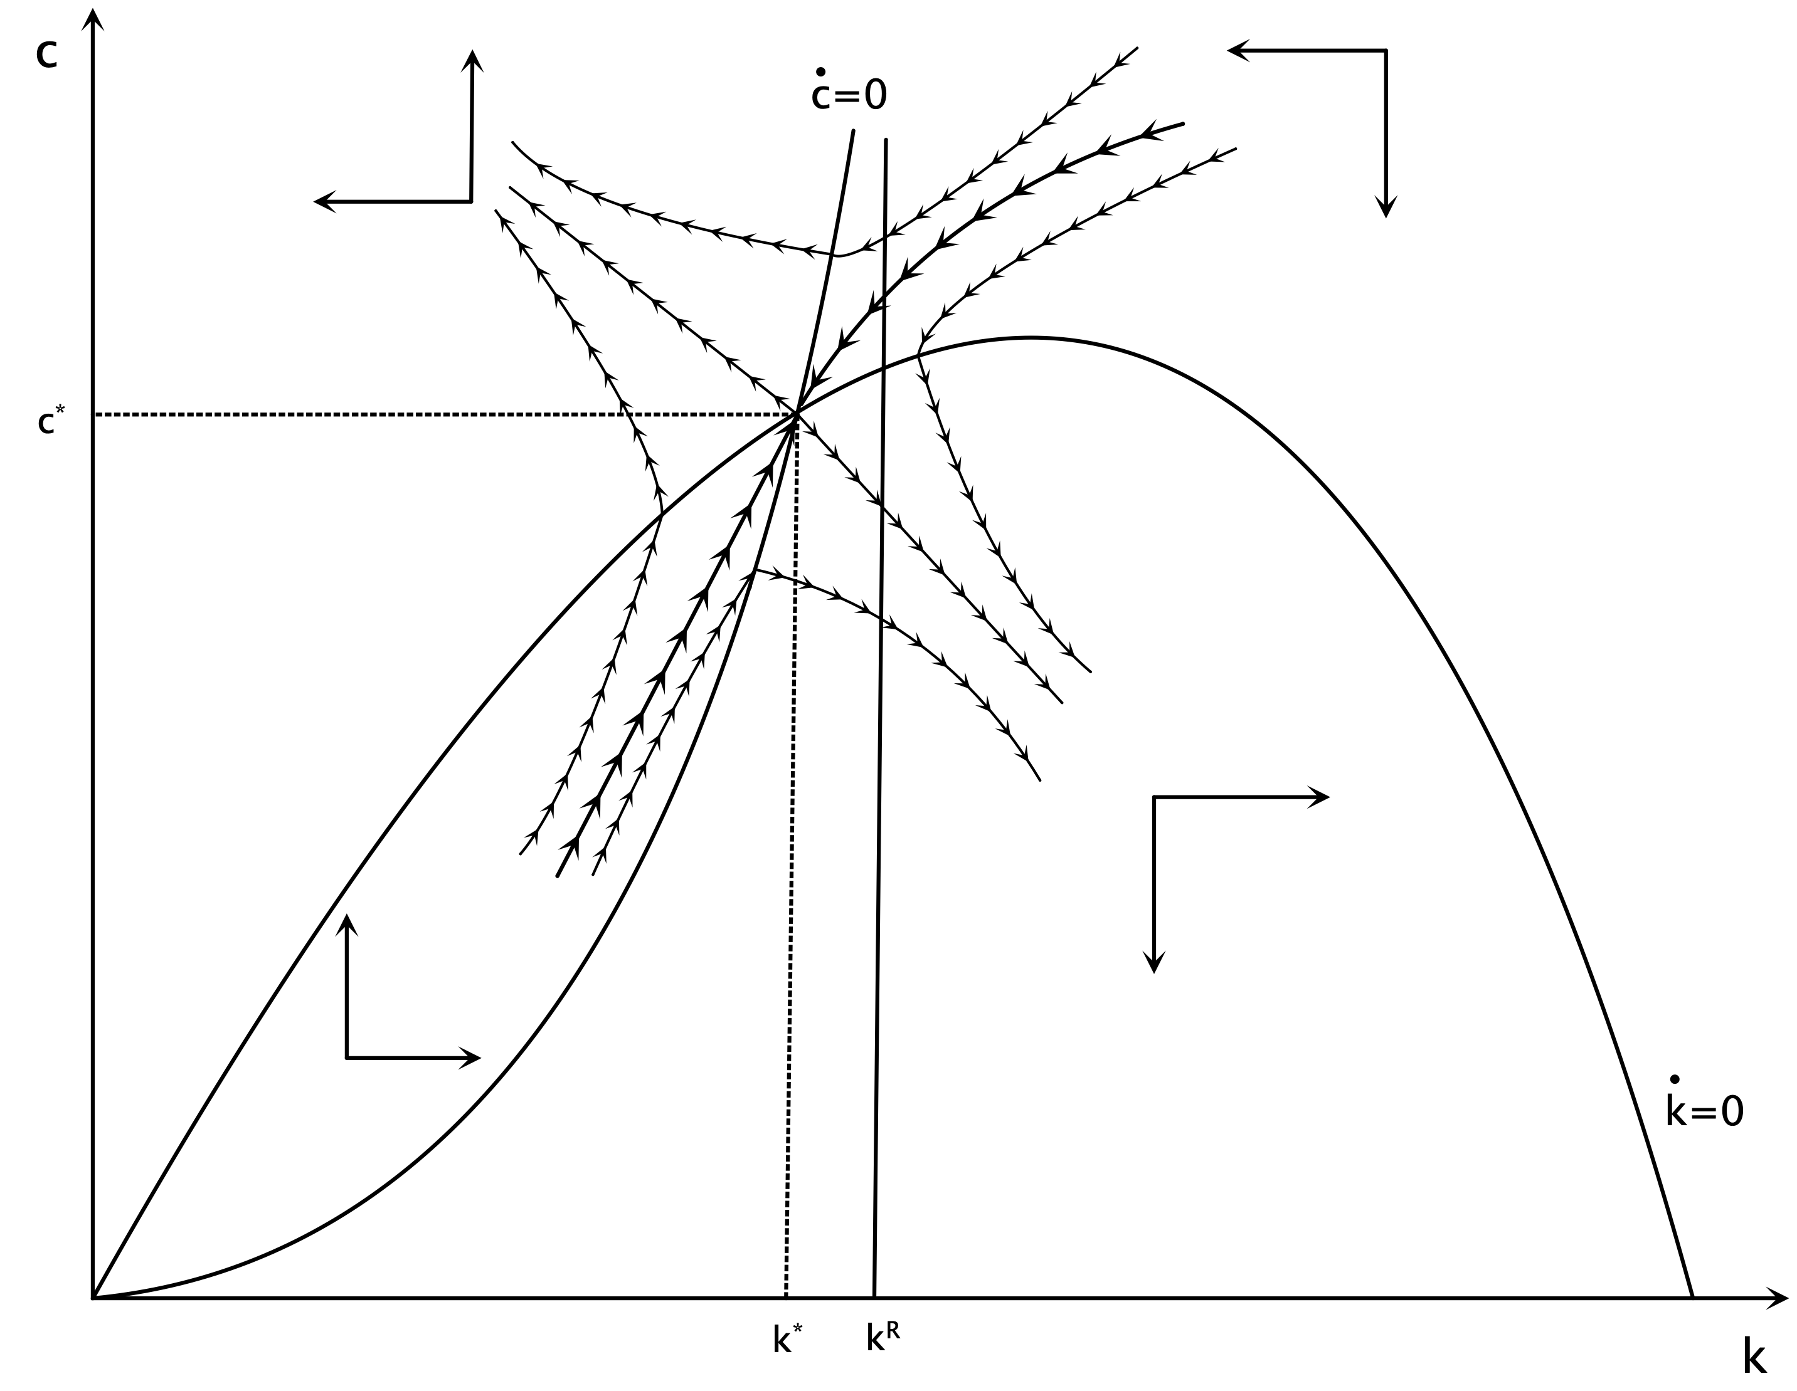
Dynamic Adjustment towards the Balanced Growth Path in the Blanchard Weil Model

Slide 31
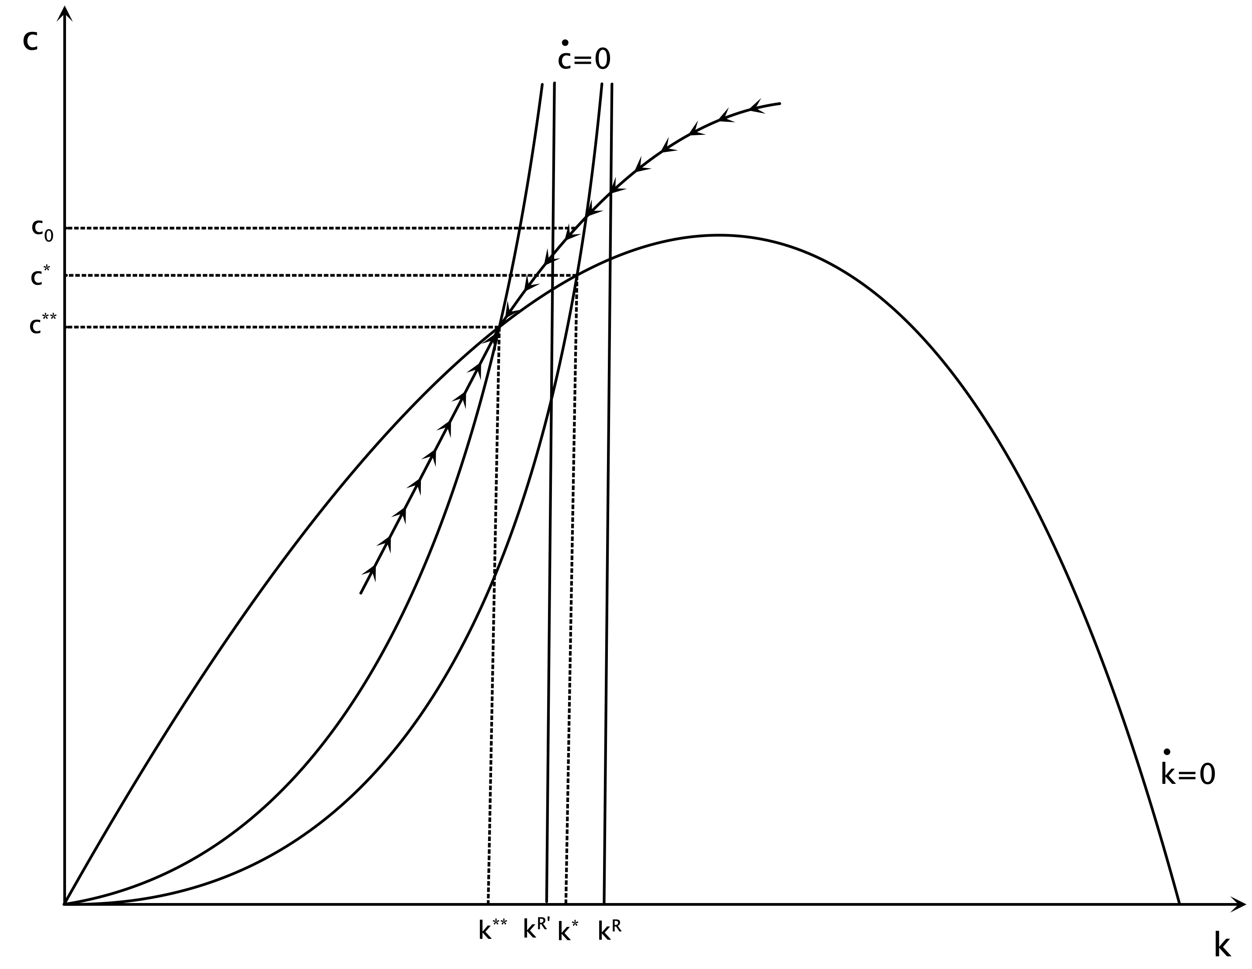
Effects on a Permanent Increase in the Pure Rate of Time Preference

Slide 32
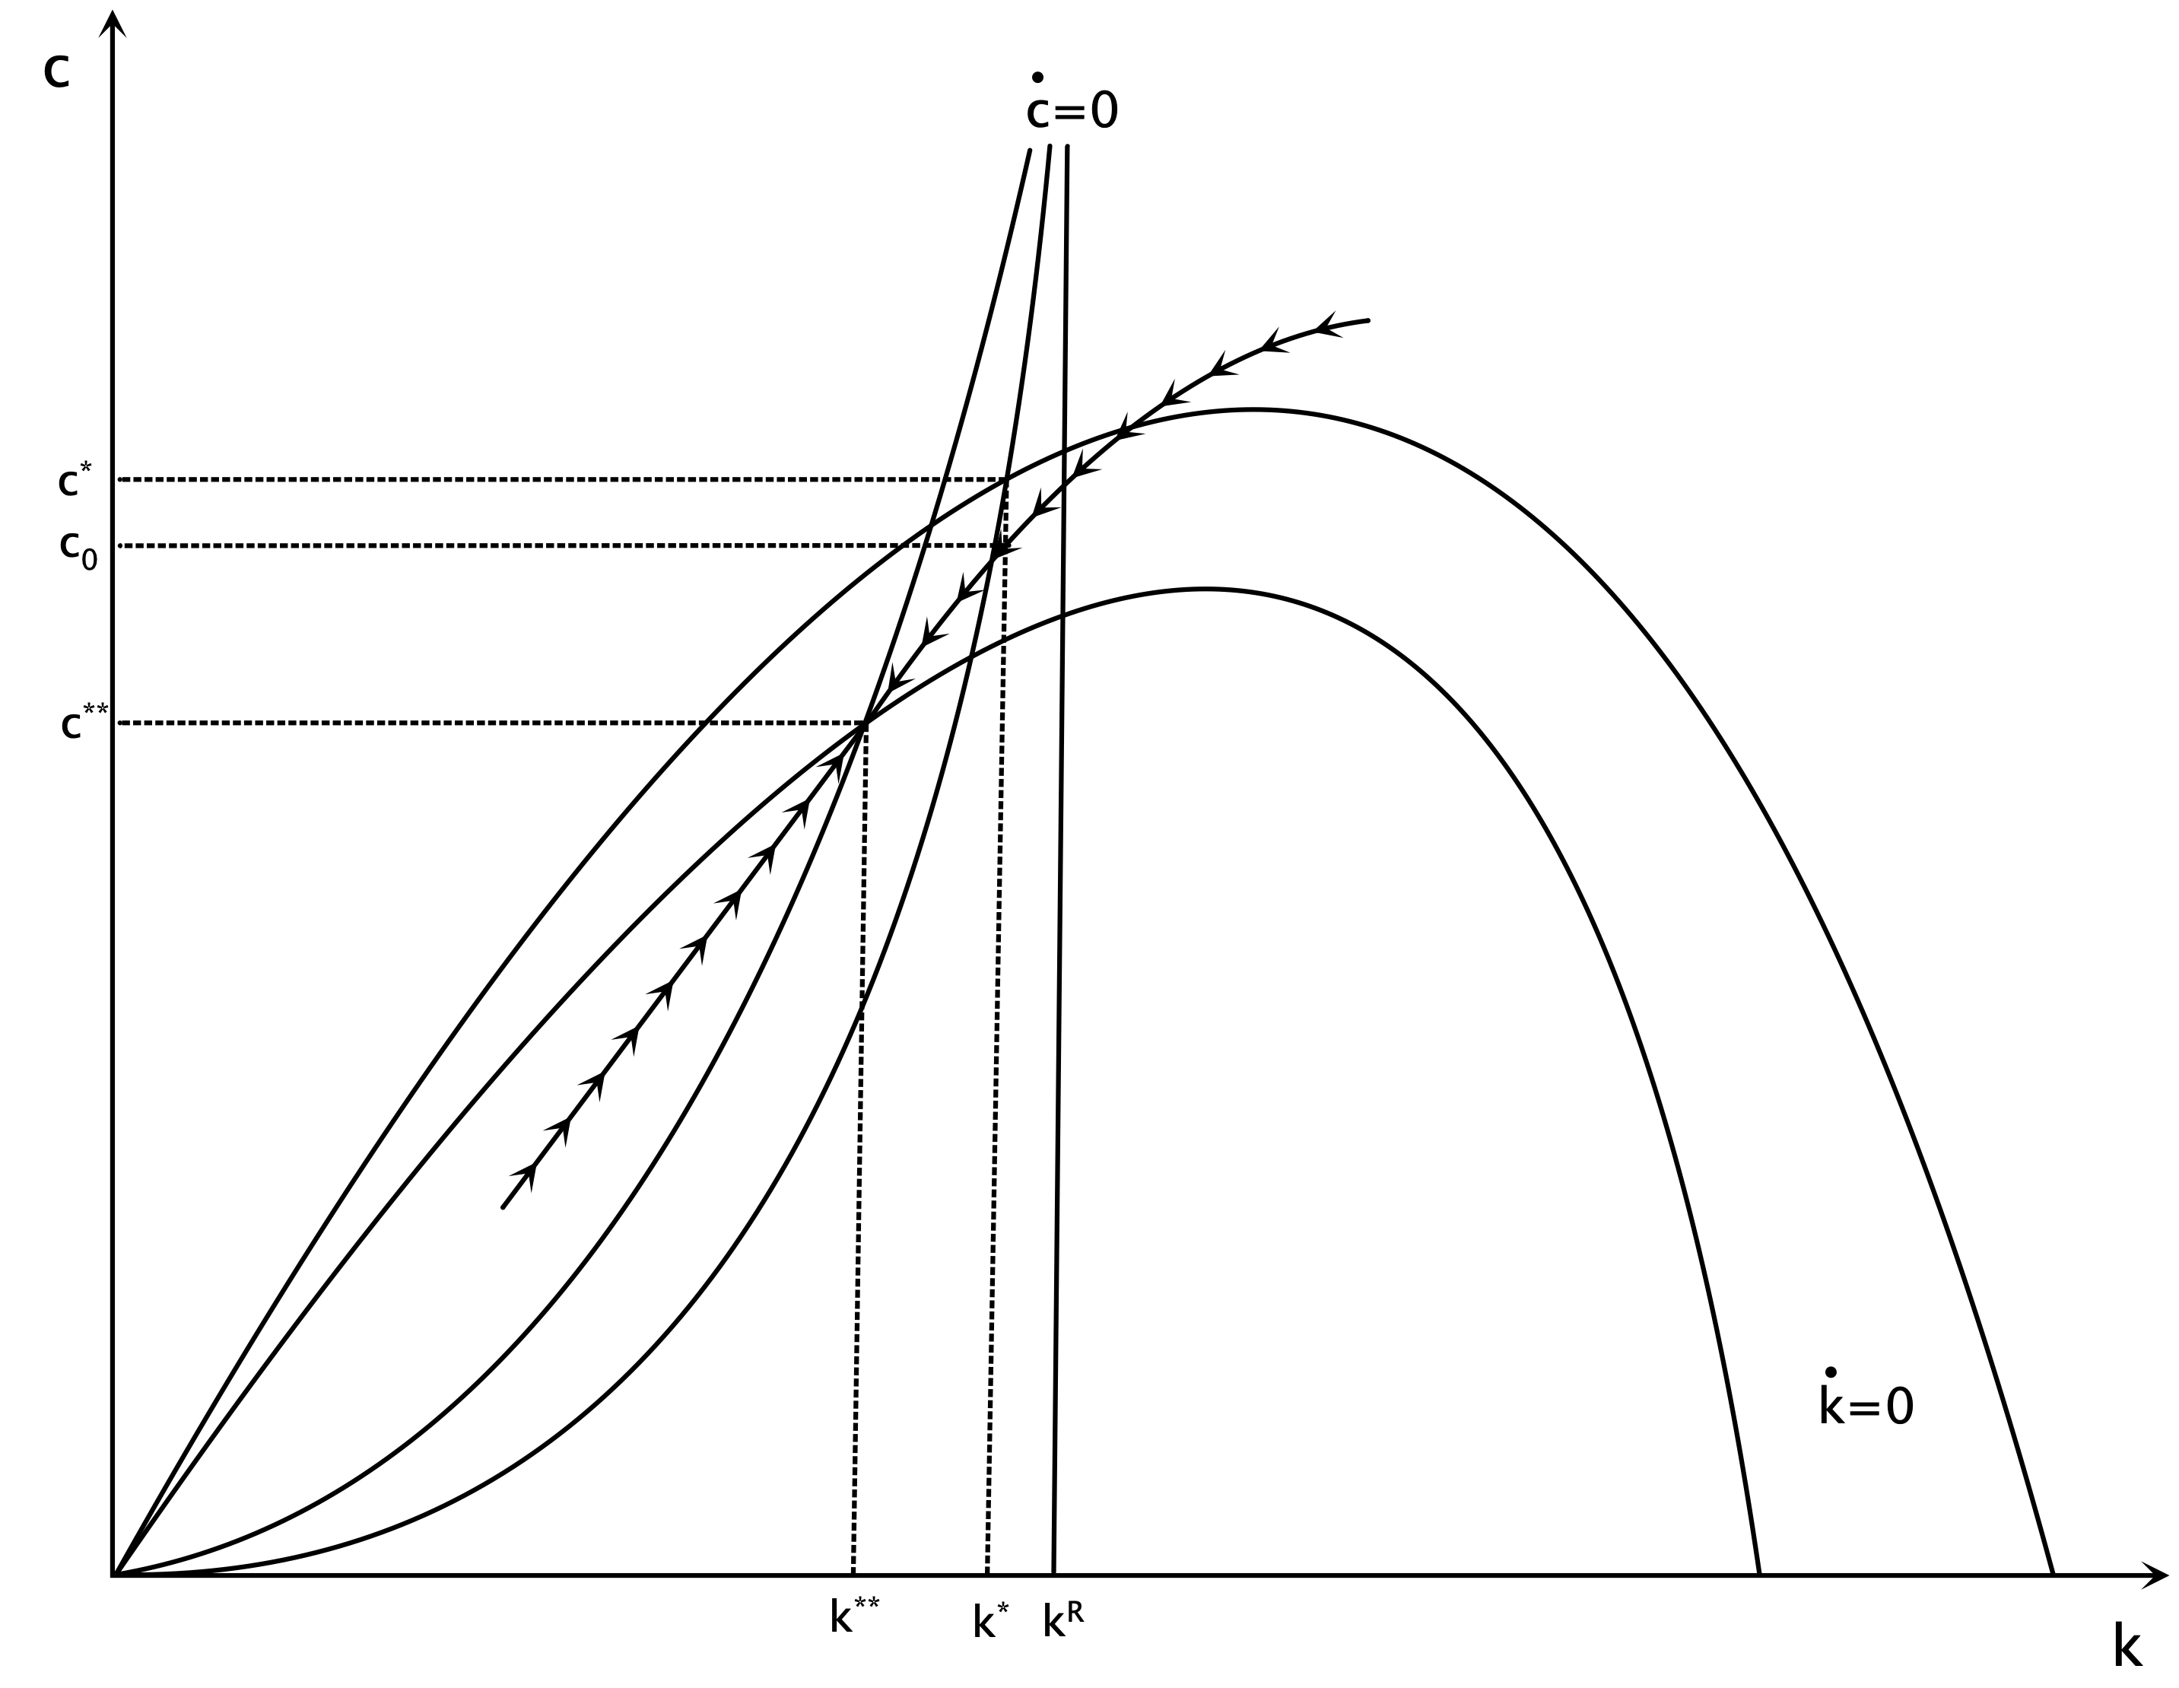
Effects on a Permanent Increase in the Rate of Population Growth

Slide 33
The Blanchard-Weil Model in Discrete Time
It is straigthforward to show that, in terms of efficiency units of labor, the discrete time versions of the consumption growth equation and the capital accumulation equation of the Blanchard-Weil model take the form,
$c_{t+1}=\frac{1+Af^{′}(k_{t+1})-δ}{(1+ρ)(1+g)}c_{t}-\frac{nρ}{(1+n)(1+g)(1+ρ)}k_{t}$
$k_{t+1}=\frac{1}{(1+n)(1+g)}\left(Af(k_{t})+(1-δ)k_{t}-c_{t}\right)$
For a Cobb-Douglas production function they take the form,
$c_{t+1}=\frac{1+αAk_{t+1}^{α-1}-δ}{(1+ρ)(1+g)}c_{t}-\frac{nρ}{(1+n)(1+g)(1+ρ)}k_{t}$
$k_{t+1}=\frac{1}{(1+n)(1+g)}\left(Ak_{t}^{α}+(1-δ)k_{t}-c_{t}\right)$
These last two equations can determine the adjustment path for consumption and capital per efficiency unit of labor. After we determine the adjustment path for these two variables, the path of real output can be calculated from the production function, and the paths of the real interest rate and the real wage from the marginal productivity conditions for capital and labor.

Slide 34
Details on the Dynamic Simulation
Assumptions about parameters
Α=1, α=0.333, ρ=0.02, n=0.01, g=0.02, δ=0.03
Three alternative scenarios
An increase in the pure rate of time preference ρ by 1% (from 0.02 to 0.0202)
An increase in the rate of population growth n by 1% (from 0.01 to 0.0101)
An increase in total factor productivity Α by 1% (from 1 to 1.01)

Slide 35
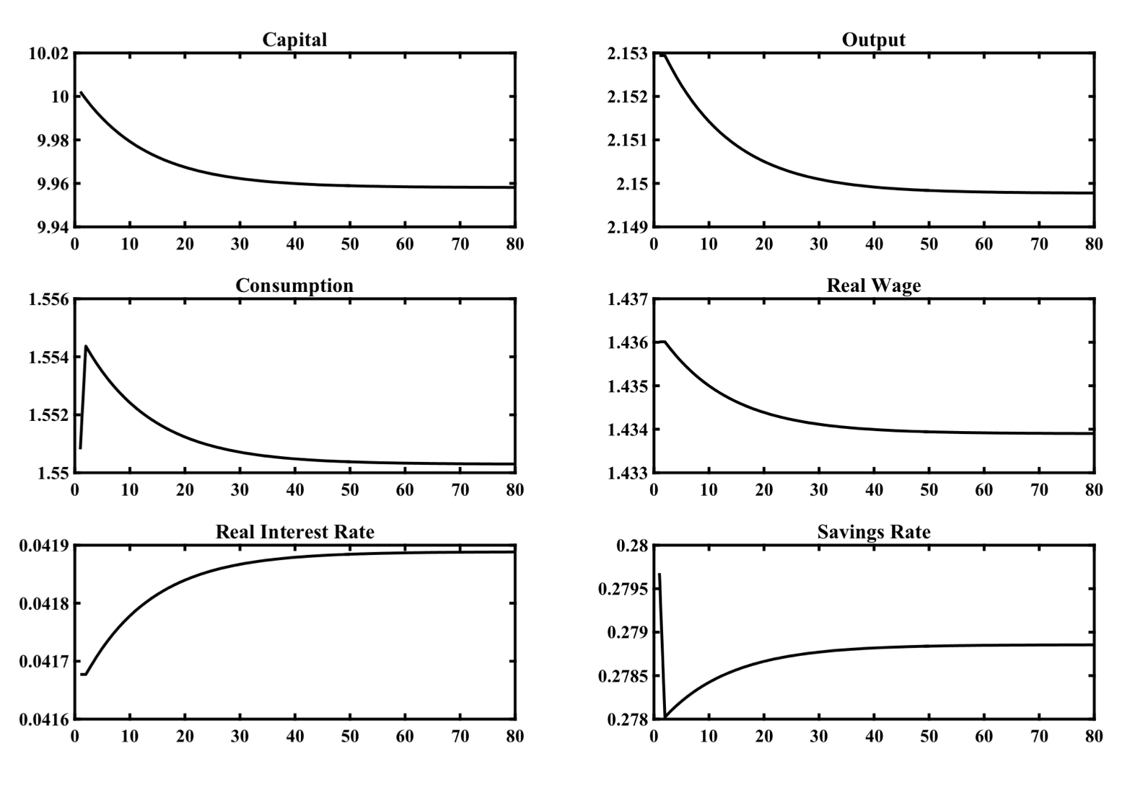
An Increase in the Pure Rate of Time Preference ρ by 1%

Slide 36
An Increase in the Pure Rate of Time Preference ρ by 1%
The economy is on its original balanced growth path, and after period 1 the pure rate of time preference of households $ρ$ rises permanently and unexpectedly by 1%, from 0.02 to 0.0202. This increase leads directly to an increase in consumption, a decline in the savings rate, a gradual decumulation of physical capital, a gradual decline in output, a gradual decline in real wages and a gradual increase in the real interest rate. The reason for declining real wages is the gradual reduction of the marginal product of labor caused by the falling capital stock, while the reason for the increasing real interest rate is that the marginal product of capital gradually increases because of the decumulation of capital. The economy gradually converges to a new balanced growth path. On the new balanced growth path, capital per efficiency unit of labor is lower by around 0.4%, output and real wages by 0.1%, consumption by 0.03% (due to the decline in the saving rate), while the real interest rate has increased by 0.02 percentage points, the same as the increase in the pure rate of time preference. The steady state savings rate, which is endogenous in this model, falls, from 28.0% to 27.9%.

Slide 37
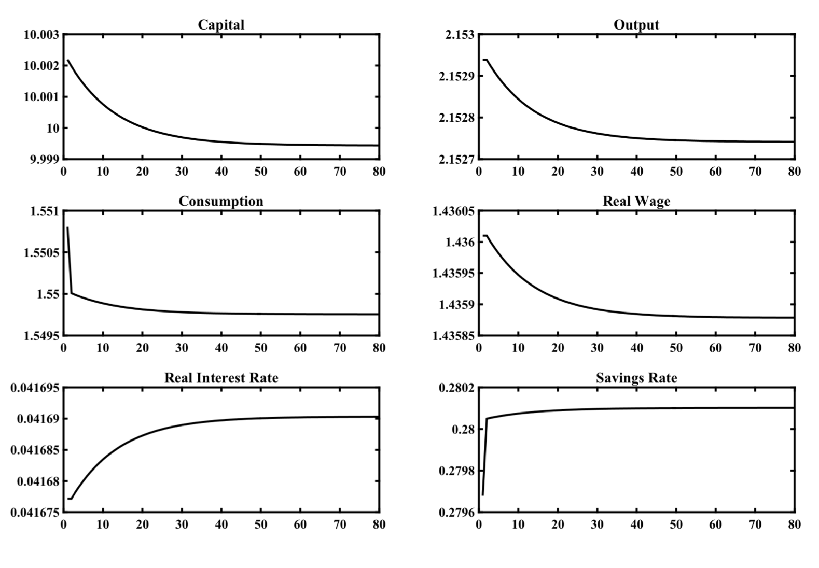
An Increase in the Rate of Population Growth n by 1%

Slide 38
An Increase in the Rate of Population Growth n by 1%
The economy is on its original balanced growth path, and after period 1 the rate of population growth $n$ rises permanently and unexpectedly by 1%, from 0.01 to 0.0101. This increase leads directly to a decline in consumption, an increase in the savings rate, but a gradual decumulation of capital, as the decline in consumption is smaller than the one required to keep capital per efficiency unit of labor constant. The gradual decline in capital leads to a gradual decline in output, a gradual decline in real wages and a gradual increase in the real interest rate. The reason for declining real wages is the gradual reduction of the marginal product of labor caused by the falling capital stock, while the reason for the increasing real interest rate is that the marginal product of capital gradually increases because of the decumulation of capital. The economy gradually converges to a new balanced growth path. On the new balanced growth path, capital per efficiency unit of labor is lower by around 0.03%, output and real wages by 0.01%, consumption by 0.07% (due to the increase in the saving rate), while the real interest rate has increased by 0.01 percentage points. The steady state savings rate, which is endogenous in this model, rises, from 27.97% to 28.01%.

Slide 39
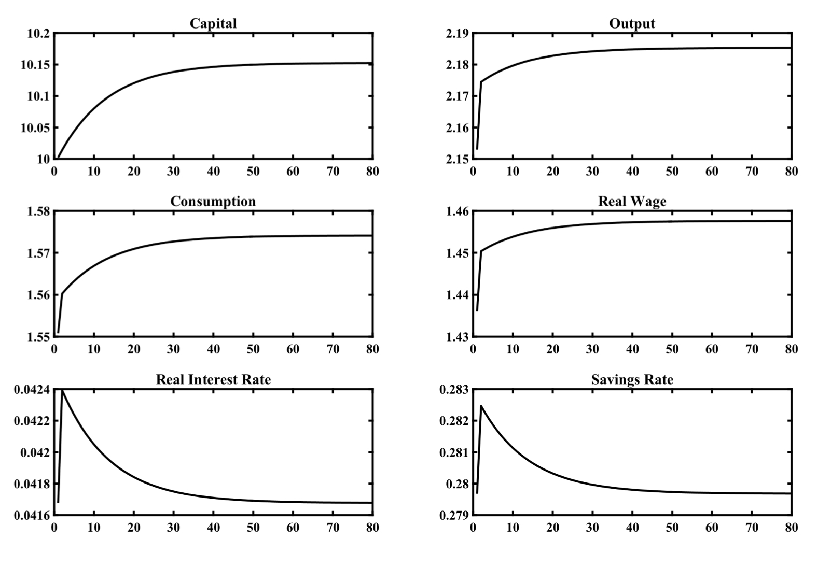
An Increase in Total Factor Productivity A by 1%

Slide 40
An Increase in Total Factor Productivity A by 1%
The economy is initially on its original balanced growth path. After period 1 total factor productivity $A$ rises permanently and unexpectedly by 1%, from 1 to 1.01. This increase leads to an immediate increase in production, consumption, savings and the marginal product of both labor (the real wage) and capital (the real interest rate). The increase in savings causes a gradual accumulation of capital, which leads to a further gradual increase in production and consumption, a further gradual increase in the real wage, but a gradual fall in real interest rates. The reason for the falling real interest rate is the gradual reduction of the marginal product of capital caused by the accumulation of capital. The economy gradually converges to a new balanced growth path. In this capital per efficiency unit of labor has increased by about 1.5%, output, consumption and real wages are also higher by 1.5%, while the real interest rate has returned to a level very near its original equilibrium. The reason why an increase in total factor productivity by 1% leads to an increase in real income by 1.5%, i.e., more than 1%, is that productivity growth causes a temporary increase in the savings rate and capital accumulation, which in turn causes additional induced increases in real incomes and consumption.

Slide 41
Conclusions
Aggregate savings behavior in overlapping generations models is not characterized by social efficiency, as in the representative household model. Besides in economies where there is no representative household, comparing welfare across different households is largely arbitrary.
In any case, although the dynamic behavior of models of overlapping generations is largely similar to the dynamic behavior of the representative household model, there is no guarantee of efficiency in overlapping generations models. Thus, in these models there is scope for policy interventions that would result in greater social efficiency as the competitive equilibrium does not necessarily lead to optimal results. Furthermore, in the Diamond model, there is the theoretical possibility of dynamic inefficiency, although empirical considerations suggest that this possibility is unlikely.
Because the competitive equilibrium does not result in an optimal savings behavior in overlapping generations models, such models also have different properties than the representative household model, regarding both the short run and the long run effects of budgetary (fiscal) policies and monetary policies that affect the rate of growth of the money supply.

