Slide 1
5. The Representative Household Model
Athens University of Economics and Business
Dynamic Macroeconomics
Prof. George Alogoskoufis
alogoskoufisg.com

Slide 2
The Ramsey Model of Optimal Growth
The Ramsey model was first published in The Economic Journal, in 1928, under the title A Mathematical Theory of Saving. It predates the Solow model by about 30 years. It involved "a strategically beautiful application of the calculus of variations" (Paul Samuelson) to determine the optimal amount an economy should invest (save) rather than consume so as to maximise future utility, or in Ramsey's words "how much of its income should a nation save?" (Ramsey, 1928).
Keynes described the article as "one of the most remarkable contributions to mathematical economics ever made, both in respect of the intrinsic importance and difficulty of its subject, the power and elegance of the technical methods employed, and the clear purity of illumination with which the writer's mind is felt by the reader to play about its subject. The article is terribly difficult reading for an economist, but it is not difficult to appreciate how scientific and aesthetic qualities are combined in it together."[16] The Ramsey model is today acknowledged as the starting point for optimal accumulation theory although its importance was not recognised until many years after its first publication.
The main contributions of the model were firstly the initial question Ramsey posed on how much savings should be and secondly the method of analysis, the intertemporal maximisation (optimisation) of collective or individual utility by applying techniques of dynamic optimisation. Tjalling C. Koopmans and David Cass modified the Ramsey model in 1965, incorporating the dynamic features of population growth at a steady rate and of Harrod-neutral technical progress again at a steady rate, giving birth to a the representative household growth model also known as the Ramsey–Cass–Koopmans model.

Slide 3

Frank Ramsey (1903-1930)
Frank Plumpton Ramsey (22 February 1903 – 19 January 1930) was a British philosopher, mathematician, and economist who made major contributions to all three fields before his death at the age of 26. Keynes and Pigou encouraged Ramsey to work on economics. Ramsey responded by writing three papers in economic theory all of which were of fundamental importance, though it was many years before they received their proper recognition by the community of economists.
Ramsey's three papers were on subjective probability and utility (1926), optimal allocation (1927) and optimal one-sector economic growth (1928). The economist Paul Samuelson described them in 1970 as "three great legacies – legacies that were for the most part mere by-products of his major interest in the foundations of mathematics and knowledge."

Slide 4
The Ramsey Representative Household Model
Assumptions about technology and market structure in the Ramsey model are similar to the assumptions of the Solow model.
Things differ in the determination of savings. Instead of the fixed and exogenous saving rate of the Solow model, in the Ramsey model savings are determined as a result of the optimal intertemporal behavior of a representative household. Consequently, savings behavior is determined endogenously.
The Ramsey representative household model is thus theoretically more satisfactory than the Solow model, as it is based in intertemporal optimization, and equilibrium paths depend solely on parameters related to the preferences of households, the technology of production, population growth, technical progress and market structure.
Moreover, as the typical form of the model assumes complete and competitive markets, and that all households are alike, the Ramsey model determines the socially optimal savings behavior in the sense of the maximization of social welfare.

Slide 5
Properties of the Ramsey Model
The savings rate in the Ramsey model is not constant, as in the Solow model, but a function of the state of the economy.
In the representative household model of Ramsey there is no possibility of dynamic inefficiency, in the sense of an excessively high savings rate that leads the economy to a level of capital beyond the “golden rule”. The representative household chooses its individually optimal level of savings, which, because of the assumption of full competitive markets, is also socially optimal.
As it turns out, the steady state capital stock in this model is below the golden rule capital stock, because of the assumption of a positive pure rate of time preference. This optimal steady state capital stock defines the so called modified golden rule.
However, this model is also an exogenous growth model, similar in this respect to the Solow model.

Slide 6
The Representative Household and the Optimal Intertemporal Path of Consumption
In order to introduce the problem of the optimal intertemporal choice of consumption we have so far assumed a household that lives only for two periods, and maximizes an intertemporal utility function which depends on the level of consumption in each of the two periods. We shall now extend the two period analysis to the problem of a household with a long time horizon equal to T. This is the problem posed and solved by Ramsey (1928). We shall assume that time is continuous and that the representative household has a finite time horizon equal to T.
The household supplies a unit of labor per instant, and has a exogenous flow of labor income equal to w. It can borrow and lend freely in the capital market, at a real interest rate r. The household has an initial endowment of an interest yielding asset equal to a(0). It is assumed to maximize the following intertemporal utility function,
$U=∫_{t=0}^{T}e^{-ρt}u(c(t))dt$
subject to,
$\overset{·}{a}(t)=ra(t)+w-c(t)$ $a(0)≥0$ $a(T)≥0$
$u$ is the instantaneous utility function of the household, which depends on consumption of goods and services. $u$ is twice differentiable and concave. $ρ$ is the pure rate of time preference, the rate at which the household discounts future utilities. The second equation is the asset accumulation equation. The initial assets of the household and the terminal assets of the household are non-negative. The household cannot end up with negative assets at the end of its horizon T. A condition such as this is called a transversality condition.

Slide 7
The Maximum Principle and the Hamilton Function
From the maximum principle, the first-order conditions for the maximization of the intertemporal utility of the household, subject to the accumulation constraint, are the same as the first-order conditions for the maximization of the current value Hamilton function, which for this problem is defined by,
$H(t)=u(c(t))+λ(t)\left(ra(t)+w-c(t)\right)$
where $λ(t)$ is the current value multiplier of the asset accumulation constraint. $λ(t)$ can be interpreted as the ‘shadow price’ of the marginal instantaneous change of household assets at t.
The Hamilton function is thus defined as the sum of the instantaneous utility of consumption, plus the ‘value’ of the change in the assets of the household, priced at the ‘shadow price’ $λ(t)$. An optimal plan must maximize the Hamilton function at each instant t, provided that the shadow value is chosen correctly. The first-order conditions for the maximization of the Hamilton function would coincide with the first-order conditions for the maximization of the intertemporal utility function, subject to the sequence of the accumulation equations.

Slide 8
The First Order Conditions for a Maximum
The first-order conditions for the maximization of the current value Hamilton function are given by,
$\frac{∂H(t)}{∂c(t)}=0⇒u^{′}(c(t))=λ(t)$
$-\frac{∂H(t)}{∂a(t)}=\overset{·}{λ}(t)-ρλ(t)⇒\overset{·}{λ}(t)=-(r-ρ)λ(t)$
$\frac{∂H(t)}{∂λ(t)}=\overset{·}{a}(t)⇒\overset{·}{a}(t)=ra(t)+w-c(t)$
The non-negativity constraints $a(0)≥0$ and $a(T)≥0$ must also hold.
From the first condition, on the optimal path, the multiplier $λ(t)$, which is the value of the marginal increase in assets, is equal to the marginal utility of consumption. Thus, the household is indifferent between one extra unit of consumption and one extra unit of savings. From the second, on the optimal path, the real interest rate plus the expected marginal increase in the value of assets (capital gain), is equal to the pure rate of time preference of the household. Finally, the third is the asset accumulation equation.
We can use the first-order conditions to characterize the behavior of consumption along the optimal path.

Slide 9
The Euler Equation for Consumption
Differentiating the first first-order condition with respect to time, we get,
$\overset{·}{λ}(t)=u^{′′}(c(t))\overset{·}{c}(t)$
Substituting this equation and the first first-order condition in the second first-order condition, we get,
$\overset{·}{c}(t)=-\frac{u^{′}(c(t))}{u^{′′}(c(t))}(r-ρ)$
This is the Euler equation for consumption in continuous time. It is nothing more than the expression in continuous time of the typical condition for optimality, that the marginal rate of intertemporal substitution of consumption is equal to the marginal rate of intertemporal transformation of current to future consumption. Its interpretation of is analogous to the interpretation of the Euler equation for the two period problem we have already analyzed. This interpretation is also known as the Keynes-Ramsey rule, as Ramsey attributed it to Keynes, then editor of the Economic Journal.
Since the second derivative of the instantaneous utility function is assumed negative, i.e., that the marginal utility is declining in consumption, the change in consumption will have the same sign as the difference between the real interest rate and the pure rate of time preference. If the real interest rate is higher than the pure rate of time preference, consumption will be continuously increasing. In the opposite case, consumption will be continuously decreasing. If the real interest rate is equal to the pure rate of time preference, consumption will be constant on the optimal path (full consumption smoothing).

Slide 10
The Euler Equation for the CEIS Utility Function
If we assume that the instantaneous utility function of the household has the CEIS form, with a constant elasticity of intertemporal substitution of consumption $1/θ$, then the Euler equation for consumption takes the form,
$\frac{\overset{·}{c}(t)}{c(t)}=\frac{1}{θ}(r-ρ)$
This again implies that the optimal consumption of the household increases, remains constant, or decreases, depending on whether the real interest rate exceeds, equals or falls short of the pure rate of time preference. It also highlights the role of the elasticity of intertemporal substitution $1/θ$. The higher the elasticity of intertemporal substitution, the easier it is for the household, in utility terms, to substitute consumption over time. So, the easier it is to substitute current for future consumption. Consequently, for a given difference between the real interest rate and the pure rate of time preference, the growth rate of per capita consumption is higher, the higher the elasticity of intertemporal substitution.
The Euler equation as an optimality rule is logical. The higher the real interest rate relative to the pure rate of time preference, the greater the incentive for the representative household to reduce current consumption and invest in assets with a rate of return $r$, in order to enjoy higher future consumption. So if the real interest rate is higher than the pure rate of time preference, consumption per capita will be growing along the optimal path. If the real interest rate is lower than the pure rate of time preference, consumption per capita will be declining along the optimal path. Finally, if the real interest rate is equal to the pure rate of time preference, consumption will be constant along the optimal path. In this latter case there will be full consumption smoothing.

Slide 11
The Ramsey Model of Economic Growth
As with the Solow model, in the Ramsey representative household model we shall focus on the following set of endogenous variables: $Y$, aggregate output (or $y$, output per efficiency unit of labor). $K$, aggregate stock of (physical) capital (or $k$, capital per efficiency unit of labor), $C$, aggregate consumption (or $c$, consumption per efficiency unit of labor), $r$, real interest rate, $\overset{̂}{w}$ real wage per worker (or $w$, real wage per efficiency unit of labor).
The exogenous variables and exogenous parameters in the model are defined as follows: $t$, time (a continuous exogenous variable), $L(t)=L_{0}e^{nt}$, aggregate population and employment (an exogenous variable that depends on time), $h(t)=h_{0}e^{gt}$, efficiency of labor (an exogenous variable that depends on time), $n$, rate of growth of population (exogenous parameter), $g$, rate of technical progress (exogenous parameter), $δ$, rate of depreciation of capital (exogenous parameter), $ρ$, pure rate of time preference of households (exogenous parameter).
Firms maximize profits, given the production technology (production function) and a competitively determined real interest rates and real wages, and households maximise their intertemporal utility function.

Slide 12
Production Function and Profit Maximization by Firms
At each instant, the economy has a stock of capital, a given labor force and given labor efficiency, which are combined to produce output. The production function in intensive form can be written as,
$y(t)=Af(k(t))$
Firms are competitive and maximise profits subject to competitively determined factor prices, $r(t),w(t)$. The first order conditions for profit maximisation imply,
$r(t)=Af^{′}(k(t))-δ$
$w(t)=Af(k(t))-k(t)Af^{′}(k(t))$
Households rent out capital and labor to firms at those factor prices, and choose the path of consumption in order to maximise their intertemporal utility. The asset accumulation equation for households is given by,
$\overset{∙}{k}(t)=r(t)k(t)+w(t)-c(t)-(n+g)k(t)$

Slide 13
Preferences of the Representative Household
All households in this economy are assumed identical. Thus, we shall eventually focus our attention on the behavior of only one of them, the representative household. Households are indexed by $j$, where $j$ is uniformly distributed between zero and 1. Thus, $j∈[0,1]$.
The utility function of household $j$ depends on the level of its per capita consumption. The representative household is assumed to have an infinite time horizon and to maximize the intertemporal utility function,
$U_{j}=∫_{t=0}^{∞}e^{-ρt}u(c_{j}(t))L_{j}(t)dt$
where, $c_{j}(t)$, denotes the per capita consumption of household $j$ at instant t, u, the instantaneous utility function of household $j$ and $ρ$, the pure rate of time preference of household $j$, an exogenous preference parameter.
The number of members of the household is given by $L_{j}(t)$ and is the same for all households. Thus, it follows that the relation between the members of individual households $j$ and total population is given by,
$L_{j}(t)=\frac{L(t)}{∫_{0}^{1}dj}=L_{0}e^{nt}$
We assume that the instantaneous utility function of the household takes the CEIS form,
$u(c_{j}(t))=\frac{c_{j}{(t)}^{1-θ}}{1-θ}$
where, $θ>0$ and $ρ-n-(1-θ)g>0$. The assumption that $ρ-n-(1-θ)g>0$ is sufficient in order to ensure that the intertemporal utility function is well defined and converges to a finite value. This assumption is also sufficient to ensure that the economy eventually converges to a steady state, or balanced growth path.

Slide 14
Maximization of Utility of the Representative Household
Since all households are the same, we shall henceforth drop the subscript $j$ and concentrate not on average household consumption, but on consumption per efficiency unit of labor. The intertemporal utility function of the representative household, expressed in terms of consumption per efficiency unit of labor, takes the form,
$U=B∫_{t=0}^{∞}e^{-βt}\frac{c{(t)}^{1-θ}}{1-θ}dt$
where, $B=h_{0}^{1-θ}L_{0}>0$ and $β=ρ-n-(1-θ)g>0$.
This is maximized subject to the constraint that household savings result in the accumulation of real assets, which take the form of physical capital. In terms of efficiency units of labor this takes the form,
$\overset{·}{k}(t)=r(t)k(t)+w(t)-c(t)-(n+g)k(t)$

Slide 15
First Order Conditions for a Maximum of the Representative Household and the Euler Equation for Consumption
In order to find the first-order conditions for the maximization of intertemporal utility under the accumulation equation for capital, we define the current value Hamilton function,
$H(t)=\left(\frac{c{(t)}^{1-θ}}{1-θ}\right)+λ(t)\left(r(t)k(t)+w(t)-c(t)-(n+g)k(t)\right)$
where $λ(t)$ is the multiplier of the Hamilton function. $λ(t)$ can be interpreted as the shadow price of the marginal instantaneous change of the capital stock at instant t (marginal savings).
The first-order conditions for the maximization of the Hamilton function are,
$\frac{∂H(t)}{∂c(t)}=0$, $\frac{∂H(t)}{∂λ(t)}=\overset{·}{k}(t)$, $-\frac{∂H(t)}{∂k(t)}=\overset{·}{λ}(t)-βλ(t)$
From these first order conditions we can derive the Euler equation for consumption,
$\frac{\overset{·}{c}(t)}{c(t)}=\frac{1}{θ}\left(r(t)-ρ-θg\right)=\frac{1}{θ}\left(r(t)-ρ\right)-g$
This is the Euler equation for consumption per efficiency unit of labor. The growth rate of consumption per capita is positive if the real interest rate exceeds the pure rate of time preference of the representative household. In addition, the higher the elasticity of intertemporal substitution of consumption, the higher the growth rate of consumption for a given difference in the real interest rate from the pure rate of time preference of the representative household. $g$ has a negative impact because $c(t)$ is consumption per efficiency unit of labor, and its denominator increases at a rate $g$, the exogenous rate of technical progress. This is why $g$ must be subtracted.

Slide 16
The Intertemporal Budget Constraint of the Representative Household
The Euler equation determines the rate of change of consumption on the optimal path. To determine the level of consumption on the optimal path, one must solve the Euler equation and the asset accumulation equation, which determine the optimal path of consumption and capital of the representative household.
Let us first solve the capital accumulation equation of the representative household. This is a first order linear differential equation with variable coefficients. As a result, its solution for any $T≥0$ takes the form,
$e^{-\left(∫_{v=0}^{T}r(v)dv-(n+g)T\right)}k(T)+∫_{t=0}^{T}e^{-\left(∫_{v=0}^{t}r(v)dv-(n+g)t\right)}c(t)dt=k(0)+∫_{t=0}^{T}e^{-\left(∫_{v=0}^{t}r(v)dv-(n+g)s\right)}w(t)dt$
This equation describes the intertemporal budget constraint of the representative household with horizon $T$. This intertemporal budget constraint implies that at time 0, the present value of labor income between time 0 and time $T$, plus the initial capital stock at time 0, must be equal to the present value of consumption between time 0 and time $T$, plus the present value of the capital stock at time $T$. The term that includes the integral of interest rates is a term that converts one unit of income, consumption or capital in time $t$, to its present value at time 0. If the real interest rate was fixed at $r$, the term would simplify to $-rt$.
We can define the average real interest rate between time 0 and time $t$ as,
$\overline{r}(t)=\frac{1}{t}∫_{v=0}^{t}r(v)dv$
With this definition of the average real interest rate, the inter temporal budget constraint can be written as,
$e^{-\left(\overline{r}(T)-n-g\right)T}k(T)+∫_{t=0}^{T}e^{-\left(\overline{r}(t)-n-g\right)t}c(t)dt=k(0)+∫_{t=0}^{T}e^{-\left(\overline{r}(t)-n-g\right)t}w(t)dt$

Slide 17
The Intertemporal Budget Constraint and the Transversality Condition
$e^{-\left(\overline{r}(T)-n-g\right)T}k(T)+∫_{t=0}^{T}e^{-\left(\overline{r}(t)-n-g\right)t}c(t)dt=k(0)+∫_{t=0}^{T}e^{-\left(\overline{r}(t)-n-g\right)t}w(t)dt$
We have shown that the intertemporal budget constraint of a representative household with horizon $T$ is given by,
If the horizon of the household was $T$, then the optimal capital stock at instant $T$ would be equal to zero. If the capital stock at $T$ was positive, the household could increase its utility by consuming the rest of its capital just before $T$, and hence the path would not be optimal. Thus, a positive capital stock at $T$ would not be optimal. If the capital stock at $T$ was negative, then the household would be accumulating unsustainable debts (negative capital) along the optimal path, which would be violating its intertemporal budget constraint. We should therefore assume that on the optimal path $k(T)=0$.
This type of condition is called a transversality condition, and ensures that the present value of consumption of the household cannot exceed, or fall short of, its total wealth. Total wealth consists of the initial capital stock of the household, plus the present value of its labor income. Thus, since we must have that $k(T)=0$, for a finite time horizon $T$, the intertemporal budget constraint of the representative household would take the form,
$∫_{t=0}^{T}e^{-\left(\overline{r}(t)-n-g\right)t}c(t)dt=k(0)+∫_{t=0}^{T}e^{-\left(\overline{r}(t)-n-g\right)t}w(t)dt$
Taking into account the transversality condition, the intertemporal budget constraint implies that at time 0, the present value of labor income between time 0 and time $T$, plus the initial capital stock at time 0, must be equal to the present value of consumption between time 0 and time $T$.

Slide 18
The Transversality Condition with an Infinite Time Horizon
If the time horizon of the household is infinite, as we have been assuming, then we should take the limit of the intertemporal budget constraint as $T$ tends to infinity. In this case the term on the left hand side of the intertemporal budget constraint should tend to zero. That is, we should have that,
$\lim_{T→∞}e^{-\left(\overline{r}(T)-n-g\right)T}k(T)=0$
If this condition is not satisfied, for example if the above limit is positive, then the household could along the optimal path increase its intertemporal utility by consuming a larger part of its capital. If the above limit is negative, then the household would be accumulating unsustainable debts (negative capital) along the optimal path, which is not consistent with its intertemporal budget constraint. Therefore, the only optimal path consistent with the intertemporal budget constraint of the representative household is the one that satisfies the condition above, which requires that the present value of its capital stock tends to zero as time tends to infinity.
Such a condition is the infinite horizon transversality condition. It is satisfied as long as the capital stock per efficiency unit of labor does not increase (or decrease) at a rate faster than $r-n-g$, which is the same as saying that the aggregate capital stock does not increase (or decrease) at a rate faster than $r$.
As we have already mentioned, and will prove explicitly below, the real interest rate on the balanced growth path is equal to $ρ+θg$. As a result, if the economy is on the balanced growth path, the transversality condition takes the form,
$\lim_{T→∞}e^{-βT}k(T)u^{′}\left(c(T)\right)=\lim_{T→∞}e^{-βT}k(T)=0$
given that $u^{′}(c(T))>0$. This is the transversality condition on the balanced growth path. The inter temporal budget constraint takes the form,
$∫_{t=0}^{∞}e^{-\left(\overline{r}(t)-n-g\right)t}c(t)dt=k(0)+∫_{t=0}^{∞}e^{-\left(\overline{r}(t)-n-g\right)t}w(t)dt$
The present value of consumption of a representative household with an infinite time horizon equals its total wealth.

Slide 19
The Consumption Function of the Representative Household with an Infinite Horizon
If we solve (integrate) the differential equation describing the Euler equation for consumption, then we find that consumption at time $t$ is defined by,
$c(t)=c(0)e^{\frac{1}{θ}\left(\overline{r}(t)-ρ-θg\right)t}$
Substituting in the infinite horizon intertemporal budget constraint and solving for $c(0)$,
$c(0)=γ(0)\left(k(0)+∫_{t=0}^{∞}e^{-\left(\overline{r}(t)-n-g\right)t}w(t)\right)$
where $γ(0)$ is the proportion of total wealth consumed in period 0 and is defined by,
$γ(0)={\left(∫_{t=0}^{∞}e^{\left(\frac{\overline{r}(t)(1-θ)-ρ+θn}{θ}\right)t}dt\right)}^{-1}$
The representative household consumes a share of its total wealth equal to $γ(0)$. This share depends on the evolution of the average future real interest rates, the pure rate of time preference rate $ρ$, the elasticity of intertemporal substitution of consumption $1/θ$, and the population growth rate $n$.
The impact of the average real interest rate on the proportion of total wealth that is consumed depends on the elasticity of intertemporal substitution of consumption $1/θ$. An increase in average real interest rates has two kinds of effects on the average consumption to total wealth ratio: an intertemporal substitution effect, and an income effect. The intertempora substitution effect induces the household to substitute current for future consumption, as it increases the cost of current consumption relative to future consumption. This tends to decrease current consumption. The income effect of an increase in real interest rates increases income from capital, and tends to increase both current and future consumption. This tends to increase current consumption. Which effect dominates depends on the intertemporal substitution elasticity $1/θ$.

Slide 20
Competitive Equilibrium in the Ramsey Model
The full Ramsey model is described by the production function, the profit maximisation conditions for firms (marginal productivity conditions for real interest rate and real wage), the utility maximisation condition for households (Euler equation for consumption), and the competitive equilibrium conditions in the product, capital and labor markets. In terms of efficiency units of labor, these are given by,
$y(t)=Af(k(t))$
$r(t)=Af^{′}(k(t))-δ$
$w(t)=Af(k(t))-k(t)Af^{′}(k(t))$
$\frac{\overset{·}{c}(t)}{c(t)}=\frac{1}{θ}\left(r(t)-ρ-θg\right)$
$\overset{∙}{k}(t)=r(t)k(t)+w(t)-c(t)-(n+g)k(t)$
Substituting the marginal productivity condition in the Euler equation for consumption and the capital accumulation equation (equilibrium condition in the product market), we get,
$\frac{\overset{·}{c}(t)}{c(t)}=\frac{1}{θ}\left(Af^{′}(k(t)-δ-ρ-θg\right)$
$\overset{·}{k}(t)=Af(k(t))-c(t)-(n+g+δ)k(t)$
These two non-linear differential equations in consumption and capital are the two fundamental differential equations of the Ramsey model. They can be used to determine the adjustment path of consumption and the capital stock per efficiency unit of labor. Once we determine the path of the capital stock and consumption, the paths of all other real variables, namely output, the real interest rate and the real wage, follow from the production function and the marginal productivity conditions, which only depend on capital per effective unit of labor.

Slide 21
Dynamic Adjustment towards the Balanced Growth Path
The capital stock (per efficiency unit of labor) which ensures $\overset{·}{c}(t)=0$, i.e., constant consumption per efficiency unit of labor, is determined by the Euler equation, from the equalization of the marginal product of capital with the pure rate of time preference, plus the depreciation rate$δ$, plus the rate of technical progress $g$ multiplied by $θ$. This defines the steady state real interest rate and the steady state capital stock in this model.
$$Af^{′}(k^{*})=ρ+δ+θg$$
This is depicted as the vertical line $\overset{·}{c}(t)=0$ in the figure of the next slide. We can call it the steady state consumption line, as along this line consumption per efficiency unit of labor is constant. If the capital stock is lower than $k^{*}$, then the real interest rate is higher than $ρ+θg$, and, from the Euler equation, consumption per efficiency unit of labor is rising. If the capital stock is higher than $k^{*}$, then the real interest rate is lower than $ρ+θg$, and from the Euler equation, consumption per efficiency unit of labor is falling.
From the capital accumulation equation, for $\overset{·}{k}(t)=0$, one can derive the relation between consumption and the capital stock (per efficiency unit of labor) which ensures a constant capital stock (per efficiency unit of labor). This is given by,
$c=Af(k)-(n+g+δ)k$
This is depicted as the $\overset{·}{k}(t)=0$ curve in the figure of the next slide. We shall call it the steady state capital curve, because along it, the capital stock per efficiency unit of labor is constant. Because of the properties of the production function $Af(k)$, it is upward sloping up to the point $Af^{′}(k)=n+g+δ$, and downward sloping after that point. Thus, it achieves its maximum at the golden rule capital stock for which the real interest rate is equal to the steady state growth rate $n+g$.
If consumption is higher than the level implied by the steady state capital curve, then savings are lower than the savings required to maintain a constant capital stock per efficiency unit of labor, and the capital stock per efficiency unit of labor is declining. If consumption is lower than the level implied by the steady state capital curve, then savings are higher than the savings required to maintained a constant capital stock per efficiency unit of labor, and the capital stock per efficiency unit of labor is increasing.
The balanced growth path is determined at the intersection of the steady state consumption line and the steady state capital curve.

Slide 22
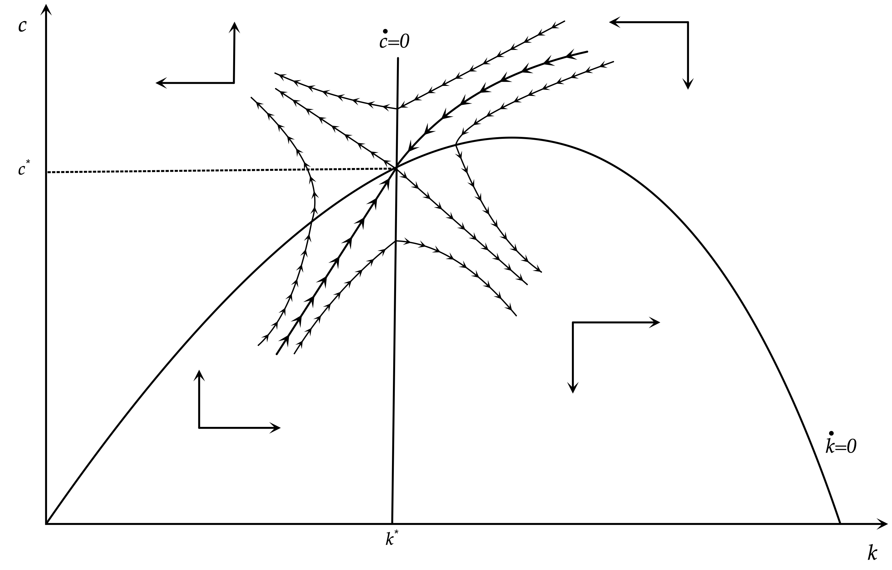
The Balanced Growth Path and Dynamic Adjustment in the Ramsey Model

Slide 23
The Balanced Growth Path and the Adjustment Path
The balanced growth path (steady state) in the representative household model is similar to the balanced growth path in the Solow model. The capital stock, output and consumption per efficiency unit of labor are constant. Consequently, the savings ratio (y-c)/y, is also constant on the balanced growth path.
The total capital stock, total output and total consumption are growing at a rate n+g. The per capita capital stock, per capita output and per capita consumption are growing at a rate g.
The steady state is a saddle point. There is a unique adjustment path, the saddle path, leading to this saddle point, as the capital stock $k$ is a predetermined (state) variable, and consumption $c$ is a non-predetermined (control) variable. The saddle path goes through the north east and the south west part of the diagram. For any initial value of $k$, consumption adjusts immediately to ensure that the economy is put on the unique saddle path leading to the balanced growth path. All the other adjustment paths, some of which are also depicted in the diagram, eventually diverge and lead the economy away from the balanced growth path, violating the transversality condition of the household.
On the adjustment path, if the capital stock (per efficiency unit of labor) is lower than $k^{*}$, consumption is also lower than $c^{*}$, and the economy accumulates capital at a rate higher than $n+g$. During this process, capital and consumption per efficiency unit of labor are rising. The opposite happens if the initial capital stock (per efficiency unit of labor) is higher than $k^{*}$. The capital stock and consumption per efficiency unit of labor are falling along the adjustment path.
Consequently, the behavior of the economy on the adjustment path resembles in many ways the behavior of the economy in the Solow model. There is convergence towards a unique long-run equilibrium (steady state or balanced growth path) regardless of initial conditions.

Slide 24
The Ramsey Model and the Golden Rule
In the representative household model, capital per efficiency unit of labor on the balanced growth path is always lower than the golden rule. This is because the representative household has a positive pure rate of time preference and discounts future utility. Thus, the representative household does not seek to maximize per capita consumption on the balanced growth path, as assumed in the golden rule, but an inter-temporal utility function which, given the positive pure rate of time preference, gives a greater weight to current consumption relative to future consumption.
Thus, the steady state capital stock in the Ramsey model is lower than the one that corresponds to the golden rule, as the steady state real interest rate is higher than n+g. The steady state in the Ramsey model, is often referred to as the modified golden rule.

Slide 25
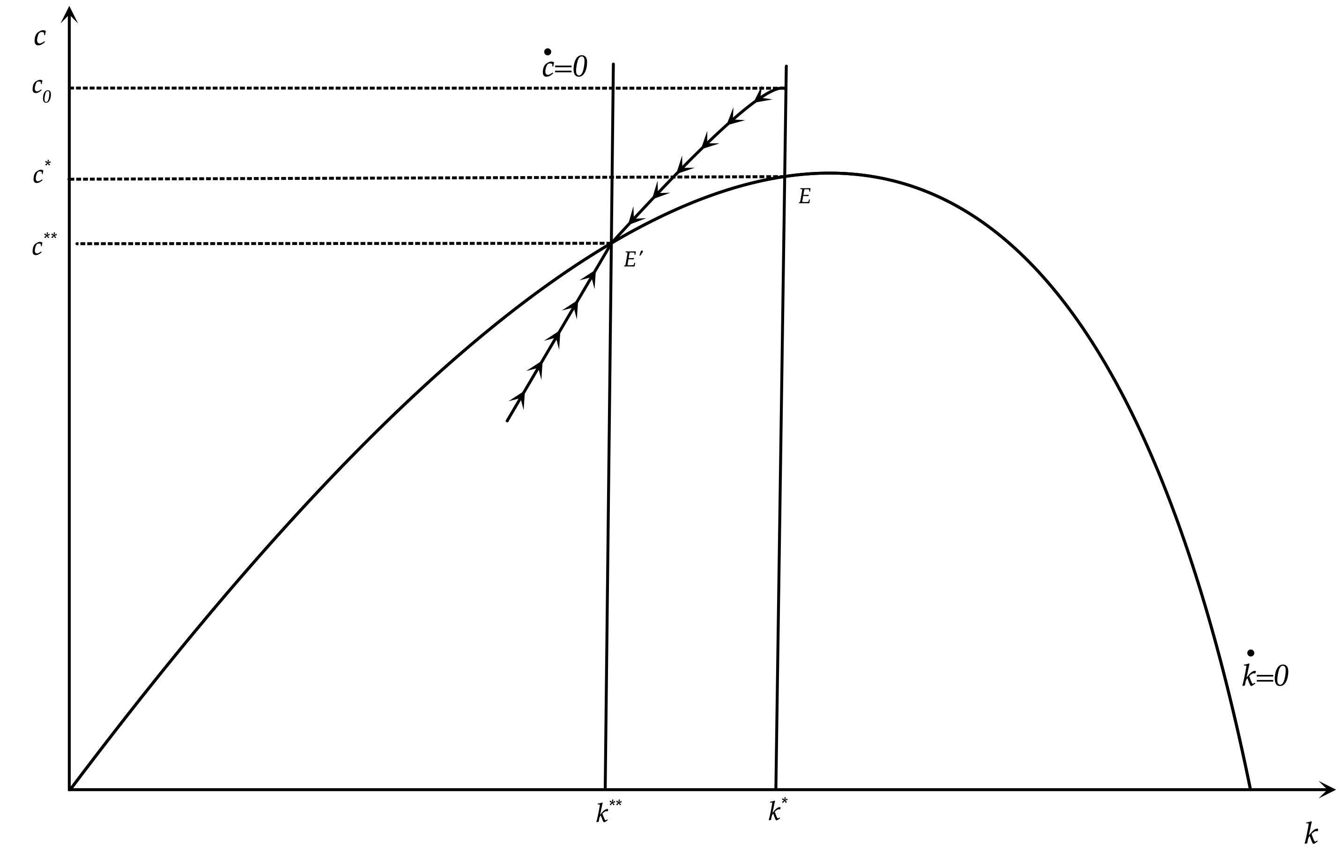
Effects of a Permanent Increase in the Pure Rate of Time Preference

Slide 26
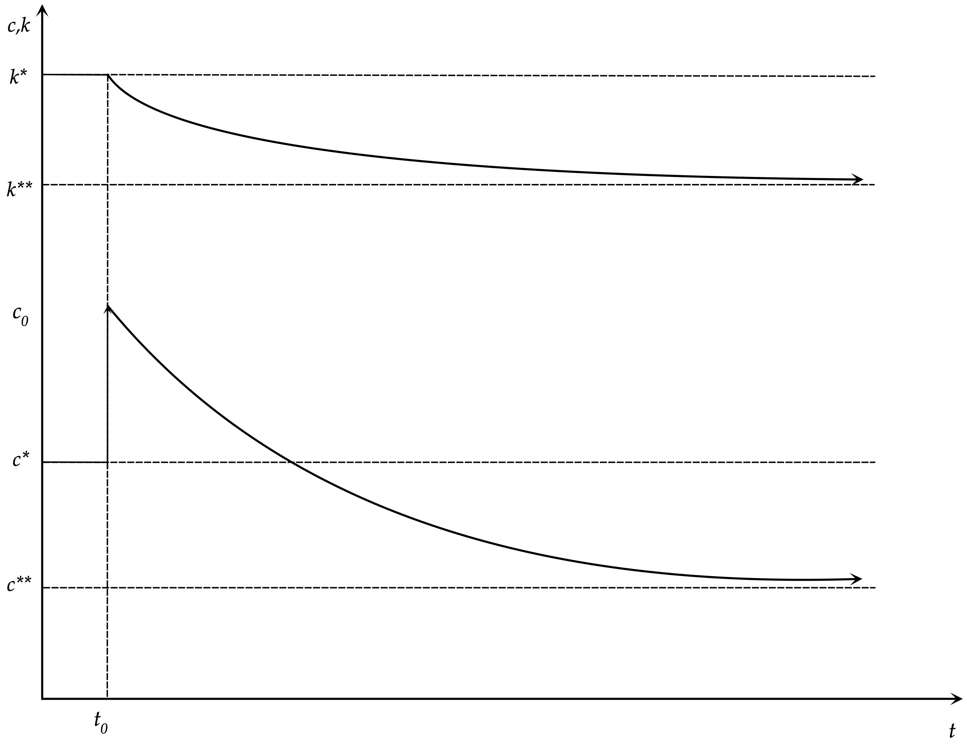
The Adjustment Path Following an Increase in the Pure Rate of Time Preference

Slide 27
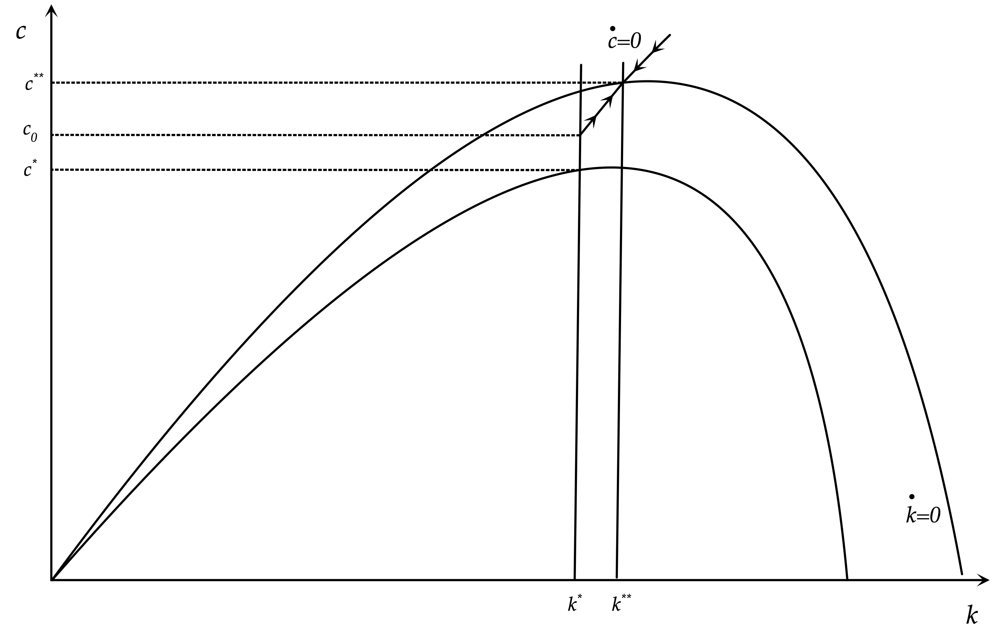
Effects of a Permanent Increase in Total Factor Productivity

Slide 28
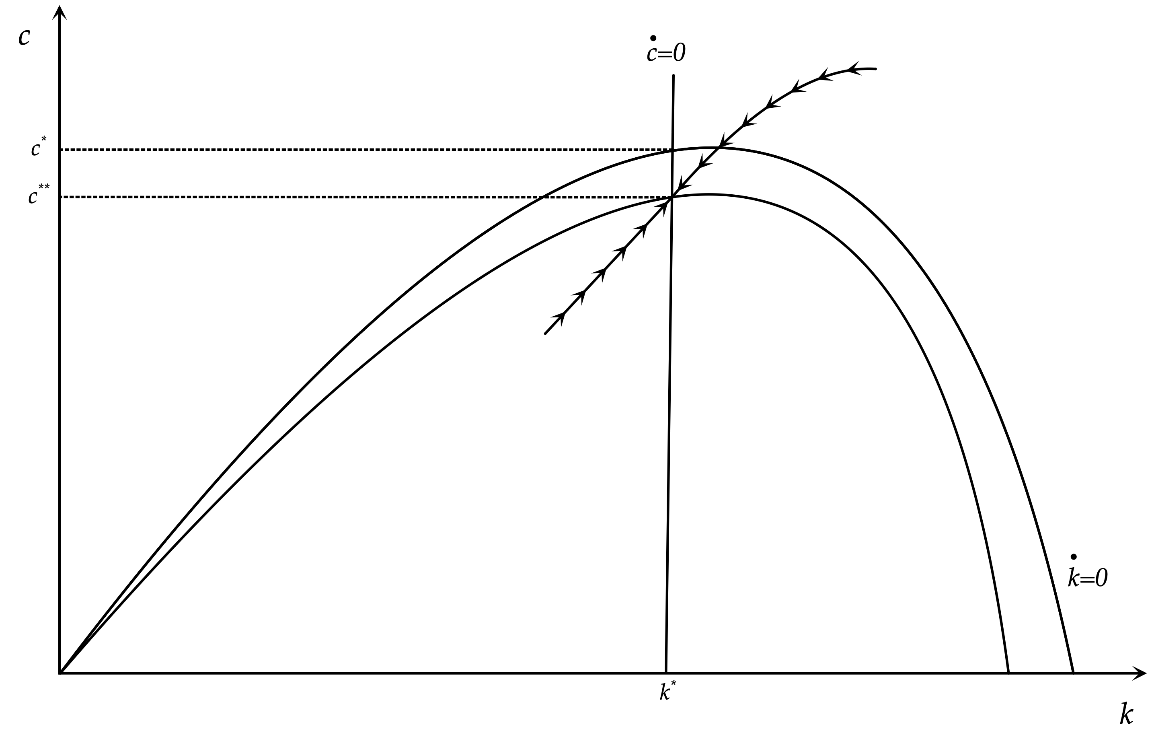
Effects of a Permanent Rise in the Rate of Growth of Population

Slide 29
The Efficiency of Competitive Equilibrium in the Ramsey Model
In this model, due to the assumption of competitive markets, maximizing the intertemporal utility function of a representative household is under the same constraint as the one that would be used by a social planner, i.e the economy wide budget constraint. Thus, the problem of the representative household is the same as the problem of the social planner.
A social planner would maximise the inter temporal utility of the representative household, given by,
$$U=∫_{t=0}^{T}e^{-ρt}u(c(t))dt$$
subject to the aggregate accumulation equation,
$$\overset{·}{k}(t)=Af(k(t))-c(t)-(n+g+δ)k(t)$$
From the first-order conditions for a maximum, the Euler equation for consumption would be,
$$\frac{\overset{·}{c}(t)}{c(t)}=\frac{1}{θ}\left(Af^{′}(k(t)-δ-ρ-θg\right)$$
This is exactly the same as the Euler equation when the household itself chooses the path of consumption, in a decentralised competitive equilibrium. Consequently, the competitive equilibrium in the model of the representative household would be fully efficient. A decentralized competitive equilibrium in which each household maximizes its own utility function over time, under its private budget constraint, would lead to the same outcome as that of the choice of a social planner who had as her objective the maximization of the intertemporal utility function of the representative household, under the appropriate aggregate budget constraint.
Thus, in the case of the representative household model with full and competitive markets, we have an application of the first theorem of welfare economics, which suggests that when markets are competitive and complete, and there are no externalities, the decentralized equilibrium is efficient as it maximizes social welfare.

Slide 30
The Ramsey Model in Discrete Time
(per efficiency unit of labor)
Cobb Douglas Production Function
$y_{t}=A{k_{t}}^{α}$
Euler Equation for Consumption
$\frac{c_{t+1}}{c_{t}}={\left(\frac{1+r_{t+1}}{1+ρ}\right)}^{\frac{1}{θ}}\frac{1}{1+g}$
Equilibrium Condition in the Goods Market
$y_{t}=c_{t}+(1+n)(1+g)k_{t+1}-(1-δ)k_{t}$

Slide 31
Population Growth and Technical Change
Population Growth
$L_{t}=L_{0}(1+n)^{t}$
Technical Change
$h_{t}=h_{0}(1+g)^{t}$

Slide 32
The Real Interest Rate and the Real Wage
The Real Interest Rate is determined by the condition that the user cost of capital r+δ is equal to the marginal product of capital. This implies that,
$r_{t}=αA{k_{t}}^{α-1}-δ$
The Real Wage is determined by the condition that the real wage per efficiency unit of labor w is equal to the marginal unit of labor. This implies that,
$w_{t}=(1-α)Ak_{t}^{α}$

Slide 33
Capital Accumulation and Consumption Growth per efficiency unit of Labor
Capital accumulation per efficiency unit of labor is given by,
$k_{t+1}=\frac{1}{(1+n)(1+g)}\left(Ak_{t}^{α}+(1-δ)k_{t}-c_{t}\right)$
The growth of consumption per efficiency unit of labor is given by the Euler equation for consumption, substituting $r_{t}=αA{k_{t}}^{α-1}-δ$. This implies,
$\frac{c_{t+1}}{c_{t}}={\left(\frac{1+αA{\left(k_{t+1}\right)}^{α-1}-δ}{1+ρ}\right)}^{\frac{1}{θ}}\frac{1}{1+g}$

Slide 34
Capital and Output on the Balanced Growth Path
Solving the system of the capital accumulation equation and the Euler equation for consumption for the steady state, we get,
$k*={\left(\frac{αA}{(1+ρ){(1+g)}^{θ}-(1-δ)}\right)}^{\frac{1}{1-α}}$
From the consumption function, steady state output is given by,
$y*=A{\left(\frac{αA}{(1+ρ){(1+g)}^{θ}-(1-δ)}\right)}^{\frac{α}{1-α}}$

Slide 35
Savings Rate on the Balanced Growth Path
The savings rate on the balanced growth path is given by,
$s*=a\left(\frac{(1+n)(1+g)-(1-δ)}{(1+ρ){(1+g)}^{θ}-(1-δ)}\right)$

Slide 36
Dynamic Simulations of the Ramsey Model
Assumptions about parameters
Α=1, α=0.333, ρ=0.02, θ=1, n=0.01, g=0.02, δ=0.03
Two Alternative Scenarios
A drop in the pure rate of time preference ρ by 1% (i.e. from 0.02 to 0.0198)
An Increase in total factor productivity Α by 1% (i.e. from 1 to 1.01)

Slide 37
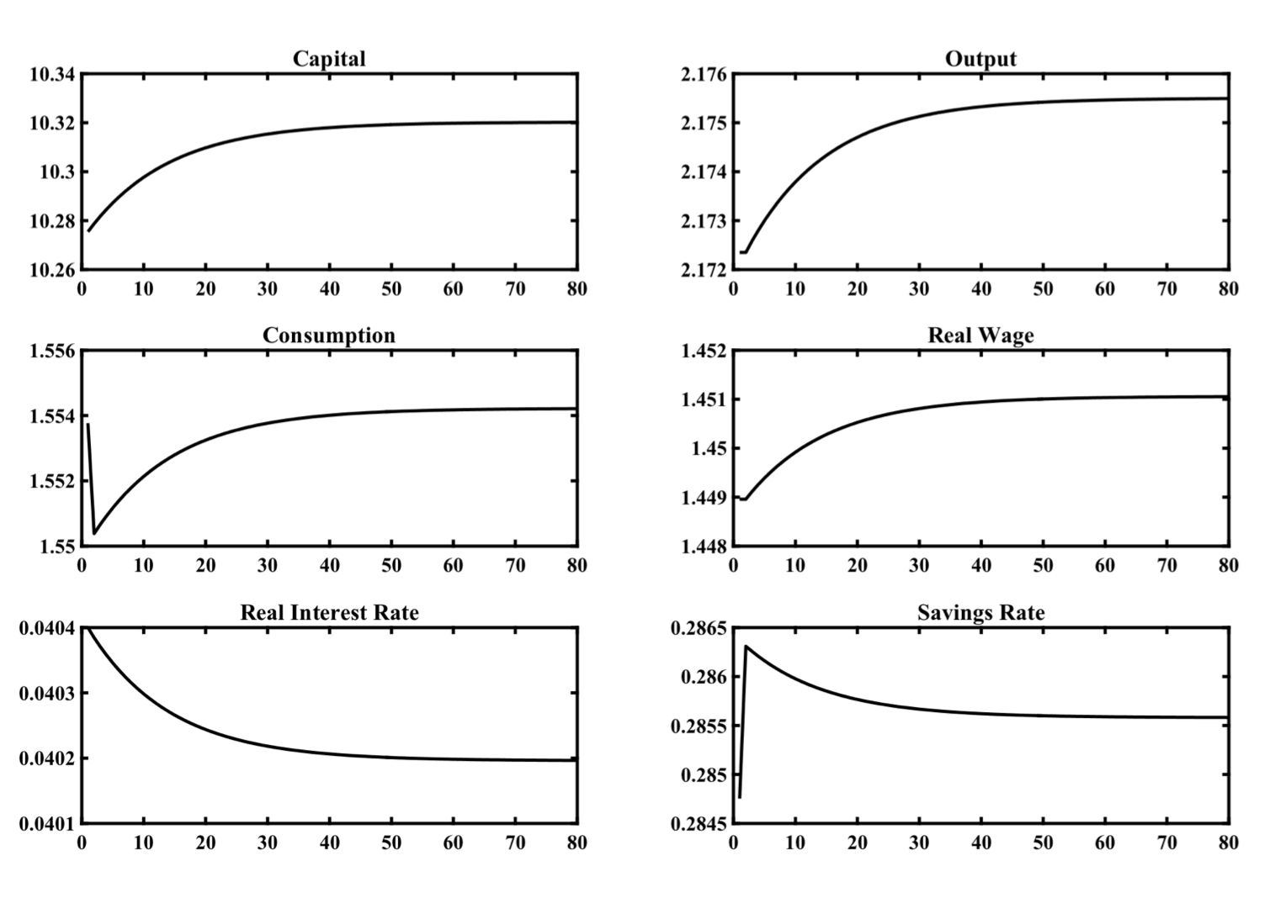
Impulse Response Functions of the Calibrated Ramsey Model
for a 1% Permanent Drop in the Pure Rate of Time Preference

Slide 38
Dynamic Effects of a 1% Permanent Drop in the Pure Rate of Time Preference
In the simulation the economy is on its original balanced growth path, and after period 1 the pure rate of time preference of the representative household ρ falls permanently and unexpectedly by 1%, from 0.02 to 0.0198. This leads directly to a drop in consumption, a rise in the savings rate, a gradual accumulation of physical capital, a gradual increase in output and real wages and a gradual decline in the real interest rate. The reason for rising real wages is the gradual increase of the marginal product of labor caused by the accumulation of capital, while the reason for the declining real interest rate is that the marginal product of capital gradually declines because of the accumulation of capital. The economy gradually converges to a new balanced growth path. On the new balanced growth path, capital per efficiency unit of labor is higher by around 0.4%, output and real wages by 0.15%, consumption by 0.03% (due to the decline in the saving rate), while the real interest rate has declined by 0.002 percentage points, the same as the increase in the pure rate of time preference. The steady state savings rate rises slightly, from 28.5% to 28.6%.

Slide 39
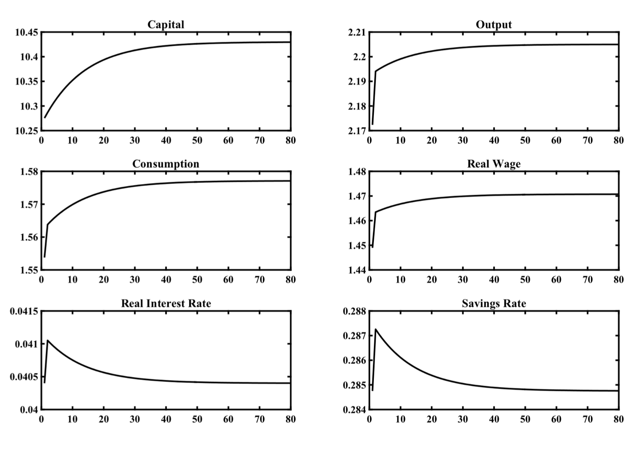
Impulse Response Functions of the Calibrated Ramsey Model
for a 1% Permanent Increase in Total Factor Productivity

Slide 40
Dynamic Effects of a 1% Permanent Rise in Total Factor Productivity
In the simulation the economy is initially on its original balanced growth path. After period 1 total factor productivity A rates rises permanently and unexpectedly by 1%, from 1 to 1.01. This increase leads to an immediate increase in production, consumption, savings and the marginal product of both labor (the real wage) and capital (the real interest rate).
The increase in savings causes a gradual accumulation of capital, which leads to a further gradual increase in production and consumption, a further gradual increase in the real wage, but a gradual fall in real interest rates. The reason for the falling real interest rate is the gradual reduction of the marginal product of capital caused by the accumulation of capital. The economy gradually converges to a new balanced growth path. In this capital per efficiency unit of labor has increased by about 1.5%, output, consumption and real wages are also higher by 1.5%, while the real interest rate has returned to its original equilibrium. The steady state real interest rate only depends on the pure rate of time preference of the representative household, the elasticity of intertemporal substitution and the rate of technical progress. The reason why an increase in total factor productivity by 1% leads to an increase in real income by 1.5%, i.e., more than 1%, is that the increase in total factor productivity causes a temporary rise in the savings rate and accumulation of capital, which in turn causes additional induced increases in real incomes and consumption. As can be seen from the steady state equation for output the elasticity of steady state output with respect to total factor productivity is equal to $1/(1-α)>1$. For α = 1/3 this is equal to 3/2=1.5.

Slide 41
Conclusions
The Ramsey model of a representative household is a very important reference model, not only for the theory of economic growth, but more generally for modern dynamic macroeconomics. As it is based on the assumption of intertemporal optimization by a representative household, this model describes the socially optimal choice of savings and the socially optimal growth path.
This model is a dynamic general equilibrium model and represents, for dynamic macroeconomics, what the competitive Arrow-Debreu general equilibrium model represents for microeconomics and general equilibrium theory.
In other respects, the Ramsey model has properties and weaknesses similar to the Solow model.

