Slide 1
4. The Solow Model: Savings, Investment and Economic Growth
Athens University of Economics and Business
Dynamic Macroeconomics
Prof. George Alogoskoufis
alogoskoufisg.com
George Alogoskoufis, Dynamic Macroeconomics, 2019

Slide 2
The Solow Model
The starting point for the analysis of the process of long run growth is the Solow (1956) model.
This model is based on a neoclassical production function and the assumption of a constant exogenous savings rate.
Given that in a closed economy savings are equal to investment, the process of capital accumulation depends on the savings rate which determines the investment rate.
In this model, capital accumulation per worker continues until savings per employee are equated with depreciation and the additional investment required to maintain a constant ratio of capital to labor.

Slide 3
Exogenous Technical Progress
In the case where technical progress raises labor productivity continuously at a constant exogenous rate, then capital accumulation per efficiency unit of labor continues until savings per efficiency unit of labor are equated to depreciation plus the additional investment required to provide for population growth and the rate of technical progress.
In the long-run equilibrium of this model, alternatively referred to as the steady state or the balanced growth path, economic growth is exogenous and equal to the rate of population growth plus the rate of technical progress. Essentially, in the long-run equilibrium, per capita output grows at the exogenous rate of technical progress.
During the adjustment process towards the balanced growth path, an economy that has a low initial capital stock, has a growth rate which is higher than the long-run growth rate. Capital accumulates at a rate which exceeds the sum of the rate of growth of population and the rate of technical progress. For an economy that has a high initial capital stock, the growth rate is below the long-run growth rate, as capital accumulates at a rate that falls short of the sum of the rate of growth of population and the rate of technical progress.

Slide 4
Convergence
This model predicts that economies converge to a unique balanced growth path. A “poor” economy, it terms of its initial capital stock, and a “rich” economy, in terms of its initial capital stock, converge to the same balanced growth path, provided that they are characterized by the same savings rate and the same technological and demographic parameters.
However, if two economies have different savings rates, different total factor productivity, different initial labor efficiency, different rates of population growth or a different depreciation rate of capital, they will converge to different balanced growth paths. Convergence in this model is conditional, and the conditions are related to the structural characteristics of different economies, such as their savings and investment rates, total factor productivity, the rate of population growth and the rate of technical progress.

Slide 5
The Determinants of Per Capita Income and Output per worker
This model predicts that a higher savings (and investment) rate results in higher steady state capital and output per worker. Thus, per capita output is a positive function of the savings and investment rate.
The Solow model predicts a positive impact on per capita output and capital and output per worker from higher total factor productivity and initial labor efficiency.
Finally, the Solow model predicts a negative impact on per capita output from the rate of population growth, the rate of technical progress and the depreciation rate of capital.

Slide 6

Robert Merton Solow (born1924)
Robert Merton Solow, (born August 23, 1924), is one of the most prominent American economists, particularly known for his work on the theory of economic growth that culminated in the exogenous growth model named after him. He is currently Emeritus Institute Professor of Economics at the Massachusetts Institute of Technology, where he has been a professor since 1949. He was awarded the John Bates Clark Medal of the American Economic Association in 1961, the Nobel Memorial Prize in Economic Sciences in 1987, and the Presidential Medal of Freedom in 2014.

Slide 7
The Neoclassical Production Function
A key assumption that differentiates the Solow model from models of economic growth that preceded it is the neoclassical production function. This implies a positive but finite elasticity of substitution between factors of production. Thus, at each point in time t, the economy is assumed to possess a stock of capital, number of employees and labor efficiency, which are combined to produce output, through this production function. This is assumed to take the form,
$Y(t)=AF(K(t),h(t)L(t))$
where A is a positive constant, denoting total factor productivity, K(t) denotes the capital stock at time t, L(t) denotes the number of workers at time t, and h(t) the efficiency of labor at time t. F is a continuous, twice differentiable quasi concave function. We assume that F is characterized by positive but diminishing returns to each factor of production, but constant returns to scale. Hence, F is also a linearly homogeneous function.
It is worth noting the following characteristics of the neoclassical production function:
Time t enters the production function solely through the factors of production K(t) and h(t)L(t). Output can change over time only through changes in the quantity or efficiency of factors of production.
Technical progress is assumed to increase only the efficiency of labor h(t). This is called labor augmenting technical progress, or Harrod neutral technical progress.
The production function is characterized by constant returns to scale. Multiplying all factors of production by any non-negative real number, multiplies the scale of production by the same non-negative real number.

Slide 8
The Neoclassical Production Function in Intensive Form
Because of the assumption of constant returns to scale, the production function can be re-written as,
$y(t)=Af(k(t))$
where, $y=\frac{Y}{hL},k=\frac{K}{hL},f(k)=F(k,1)$.
This is called the production function per efficiency unit of labor, or the production function in intensive form. The intensity of production (output per efficiency unit of labor) depends on the intensity of capital (capital per efficiency unit of labor). $f$ satisfies the following properties,
$f(0)=0,f^{′}=\frac{∂f}{∂k}>0,f^{′′}=\frac{∂^{2}f}{∂k^{2}}<0$
The marginal product of capital per efficiency unit of labor is positive but declining. It is also assumed that,
$\lim_{k→0}f^{′}(k)=∞,\lim_{k→∞}f^{′}(k)=0$
These final assumptions are called the Inada conditions. The Inada conditions ensure that the marginal product of capital is very high when capital intensity is low, and very low when capital intensity is high. These conditions are necessary and sufficient in order to prove the global uniqueness of the balanced growth path.

Slide 9
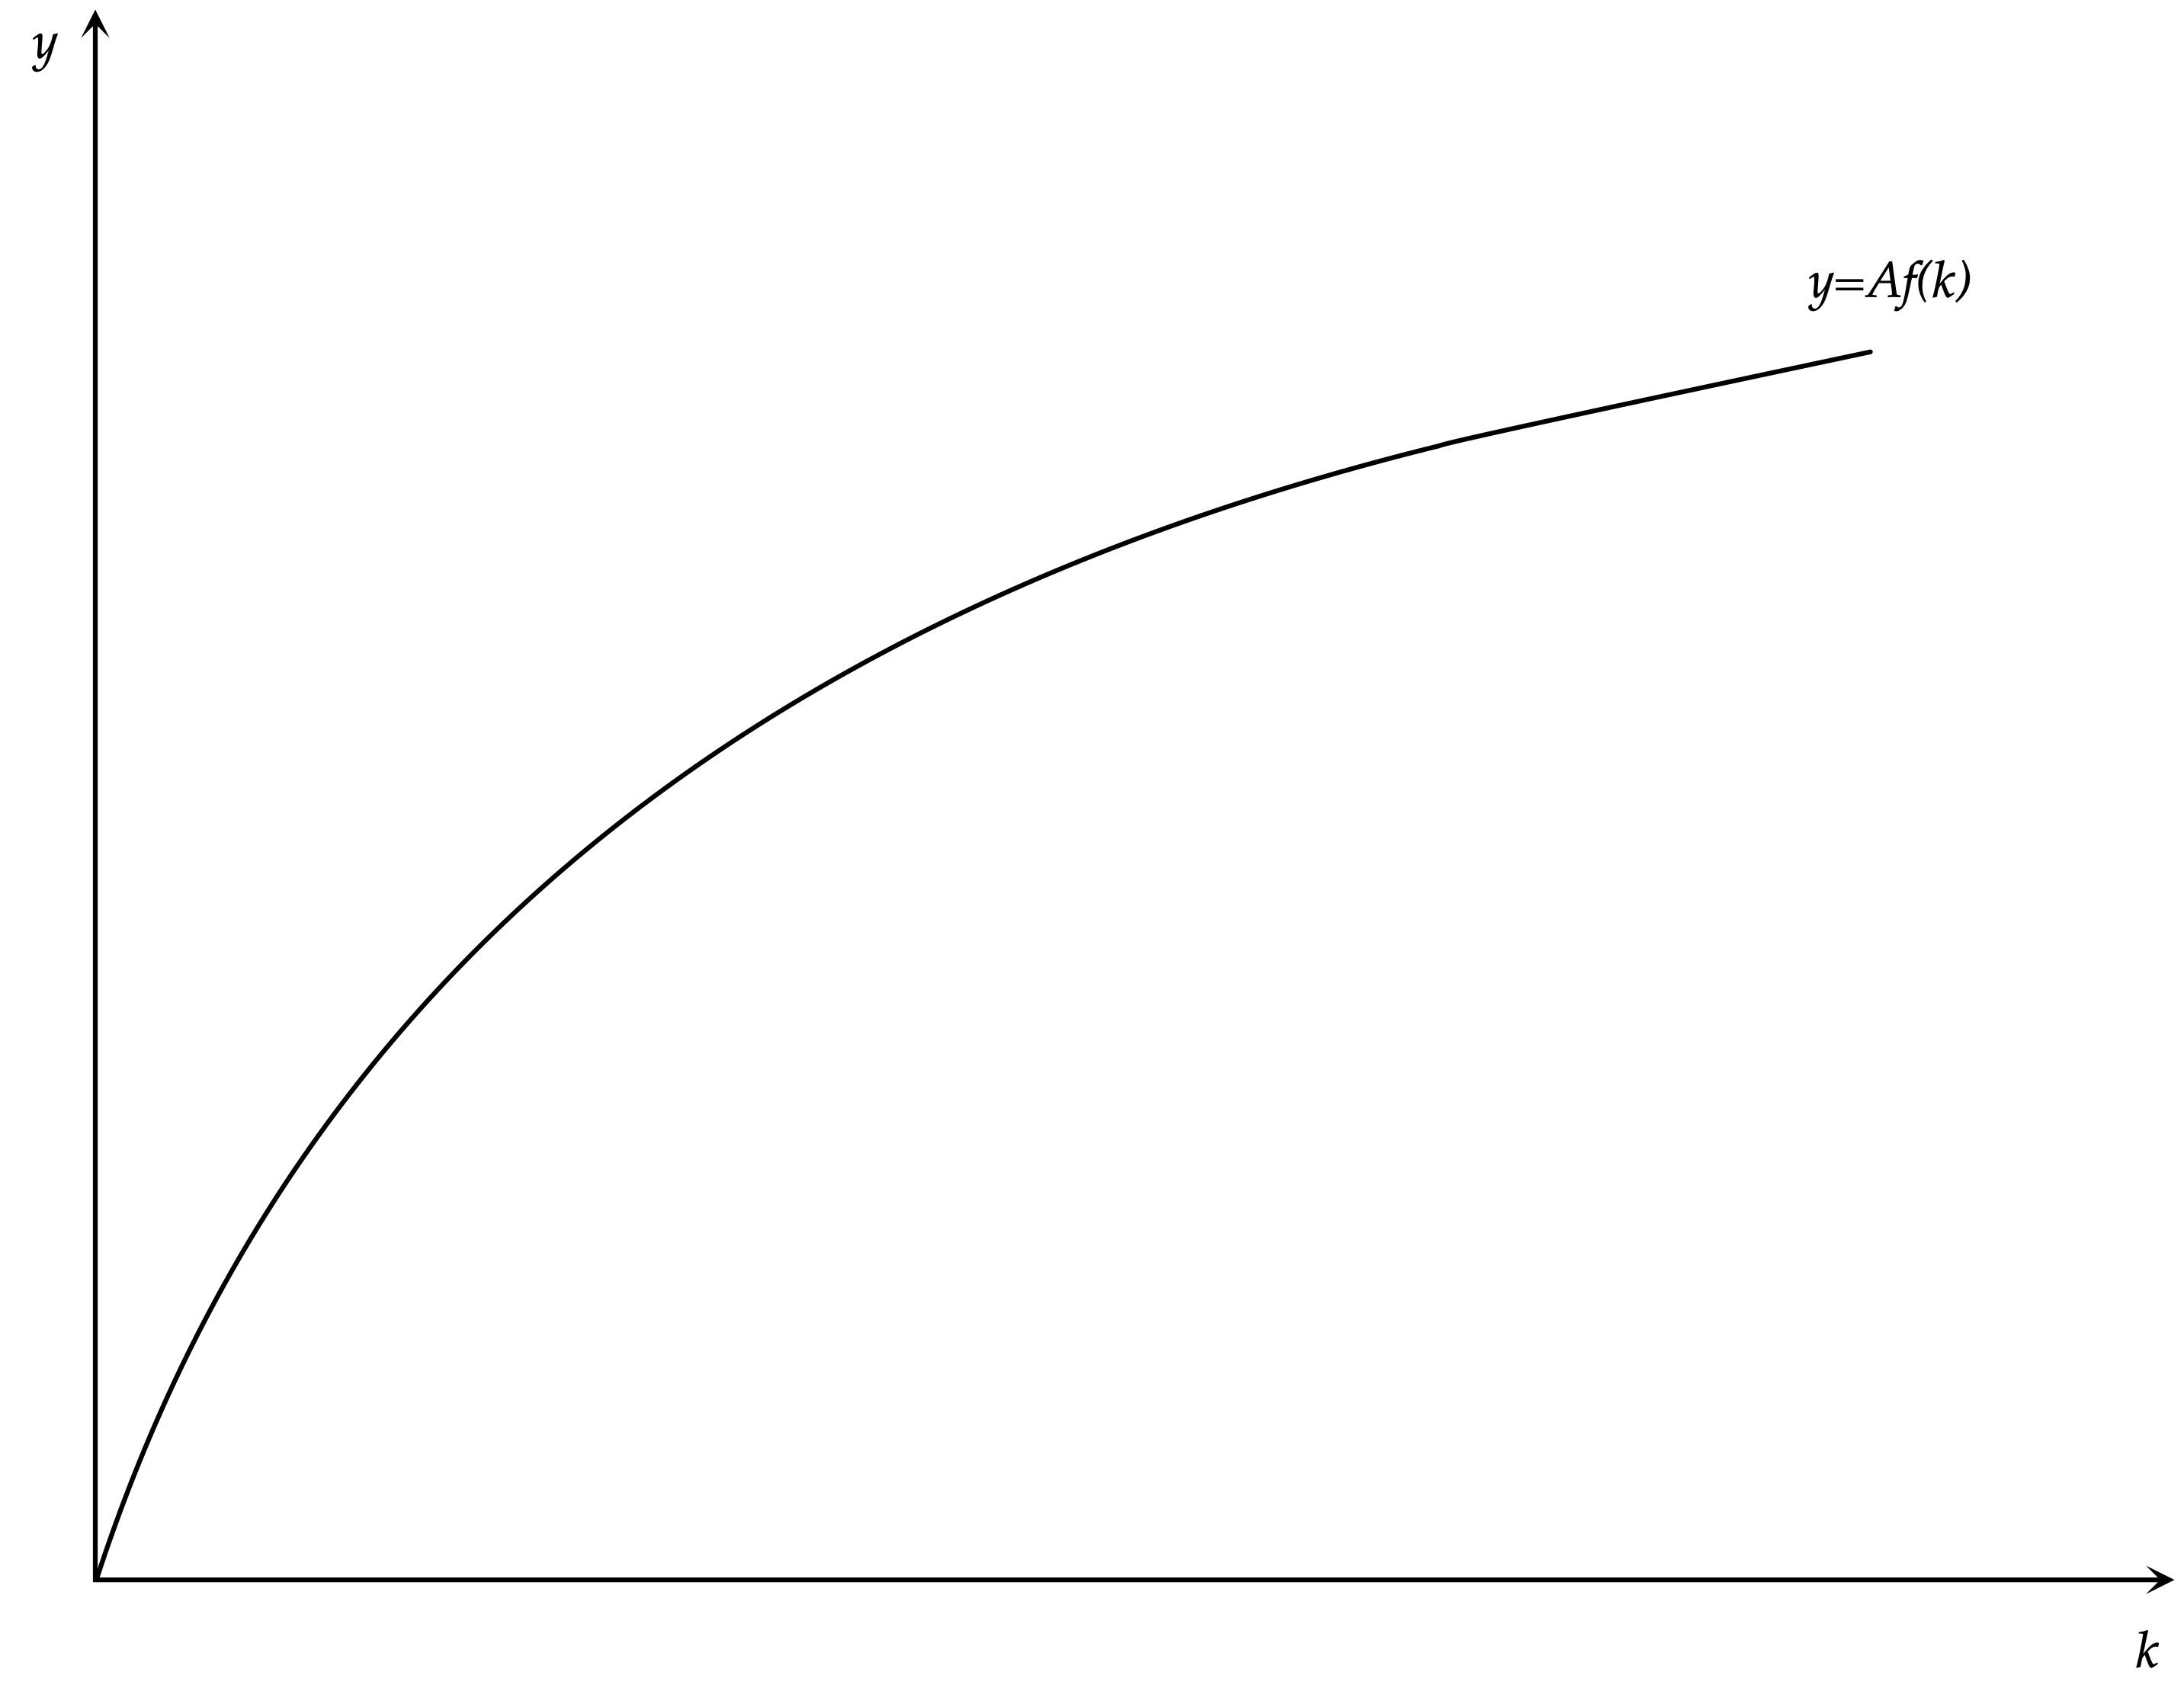
The Neoclassical Production Function

Slide 10
The Cobb-Douglas Production Function
A particular production function which is often used in the theory of growth, but also more generally in macroeconomics, is the Cobb-Douglas production function. This, takes the form,
$AF(K(t),h(t)L(t))=AK(t)^{α}(h(t)L(t))^{1-α}$
where, A > 0 and 0< α <1. α is the elasticity of production with respect to capital and 1-α is the corresponding elasticity with respect to labor.
The Cobb-Douglas production function in intensive form is given by,
$y(t)=Af(k(t))=Ak(t)^{α}$
One can easily confirm that the Cobb-Douglas production function satisfies all the assumptions we have made about the neoclassical production function. The marginal product of capital and labor are positive and declining, and the Inada conditions are satisfied.
In addition, for the Cobb-Douglas production function, labor augmenting technical progress (Harrod neutral) does not differ from capital augmenting technical progress, or technical progress that augments both factors (Hicks neutral). The reason is that in the Cobb-Douglas production function the factors of production enter multiplicatively, and thus, it does not matter which of the factors of production is multiplied by technical progress.

Slide 11
Exogenous Population Growth and Exogenous Technical Progress
We shall analyze the Solow model in continuous time, assuming that t is a continuous real variable where $t∈[0,∞)$.
We shall assume that the number of employees is a constant fraction of total population, and grows continuously at a constant, exogenous, rate of population growth n. Thus, employment evolves over time according to,
$L(t)=L(0)e^{nt}$
where L(0) is the number of employees at time 0, and e is the base of natural logarithms.
We shall also assume that the efficiency of labor also grows continuously at a constant, exogenous, rate of technical progress g.
$h(t)=h(0)e^{gt}$
where h(0) is the efficiency of labor at time 0.
It follows that,
$\overset{·}{L}(t)=\frac{dL(t)}{dt}=nL(t)$ $\overset{·}{h}(t)=\frac{dh(t)}{dt}=gh(t)$.
A dot on top of a variable denotes its first derivative with respect to time, i.e., its change over time.

Slide 12
The Savings Function and the Accumulation Process
The output produced accrues to households as income, which is either consumed or saved. In the Solow model, the share of income which is saved and invested in any instant is assumed to be an exogenous parameter, denoted by s. Aggregate consumption $C(t)$ is thus given by,
$C(t)=(1-s)Y(t)$
The demand for total output consists of consumption plus gross investment $I(t)$.
$Y(t)=C(t)+I(t)=(1-s)Y(t)+\overset{·}{K}(t)+δK(t)$
Gross investment consists of additions to the capital stock $\overset{·}{K}(t)$, plus replacement investment, $δK(t)$. $1>δ>0$ is the depreciation rate of the capital stock, assumed exogenous.
Solving for the change in the capital stock we get,
$\overset{·}{K}(t)=sY(t)-δK(t)$
The accumulation of capital is determined by the difference between savings and replacement investment. To the extent that savings is higher than replacement investment, the capital stock grows over time. If savings is lower than replacement investment, the capital stock is reduced over time.
Dividing through by $h(t)L(t)$, taking into account that L grows at a rate n, and h grows at a rate g, and using the production function, we get,
$\overset{·}{k}(t)=sy(t)-(n+g+δ)k(t)$
Since $y(t)=Af(k(t))$, this implies that,
$\overset{·}{k}(t)=sAf(k(t))-(n+g+δ)k(t)$
This is the key equation determining the accumulation of capital per efficiency unit of labor in the Solow model.

Slide 13
The Accumulation Equation of the Solow Model
The accumulation equation in the Solow model is a non-linear differential equation determining the accumulation of capital per efficiency unit of labor.
$\overset{·}{k}(t)=sAf(k(t))-(n+g+δ)k(t)$
It suggests that the change of capital per efficiency unit of labor over time is determined by the difference of two terms that both depend on the level of capital per efficiency unit of labor.
The first term is current savings and investment per efficiency unit of labor, i.e $sAf(k(t))$.
The second term is steady state investment per efficiency unit of labor. Steady state, or long run equilibrium, investment is defined as the investment rate that keeps capital per efficiency unit of labor constant. Given that the aggregate labor force, in efficiency terms, is increasing at an exogenous rate n+g, and that a fraction δ of the capital stock needs to be replaced at every instant, due to depreciation, the investment that is required to keep the capital stock per efficiency unit of labor constant is given by $(n+g+δ)k(t)$.
Steady state capital per efficiency unit of labor is thus determined by the condition that,
$\overset{·}{k}(t)=0,⇒sAf(k(t))=(n+g+δ)k(t)$
We shall denote the capital stock that satisfies this condition as k*, the steady state or balanced growth capital stock.

Slide 14
Properties of the Steady State or Balanced Growth Path
The steady state, or balanced growth path, capital stock per efficiency unit of labor $k^{*}$ is determined by the condition that savings and investment are equal to steady state investment $(n+g+δ)k^{*}$.
$sAf(k^{*})=(n+g+δ)k^{*}$
All other steady state variables in this model depend on $k^{*}$.
Steady state output per efficiency unit of labor is given by,
$y^{*}=Af(k^{*})$
Steady state consumption per efficiency unit of labor is given by,
$c^{*}=(1-s)Af(k^{*})$
On the steady state, or balanced growth path, the capital stock, output, consumption and investment per efficiency unit of labor are constant. The per capita steady state capital stock, output, consumption and investment are of course not constant, as they are all growing at the exogenous rate of technical progress g. The aggregate steady state capital stock, output, consumption and investment are growing at the rate n+g, which is the sum of population growth and the rate of technical progress.

Slide 15
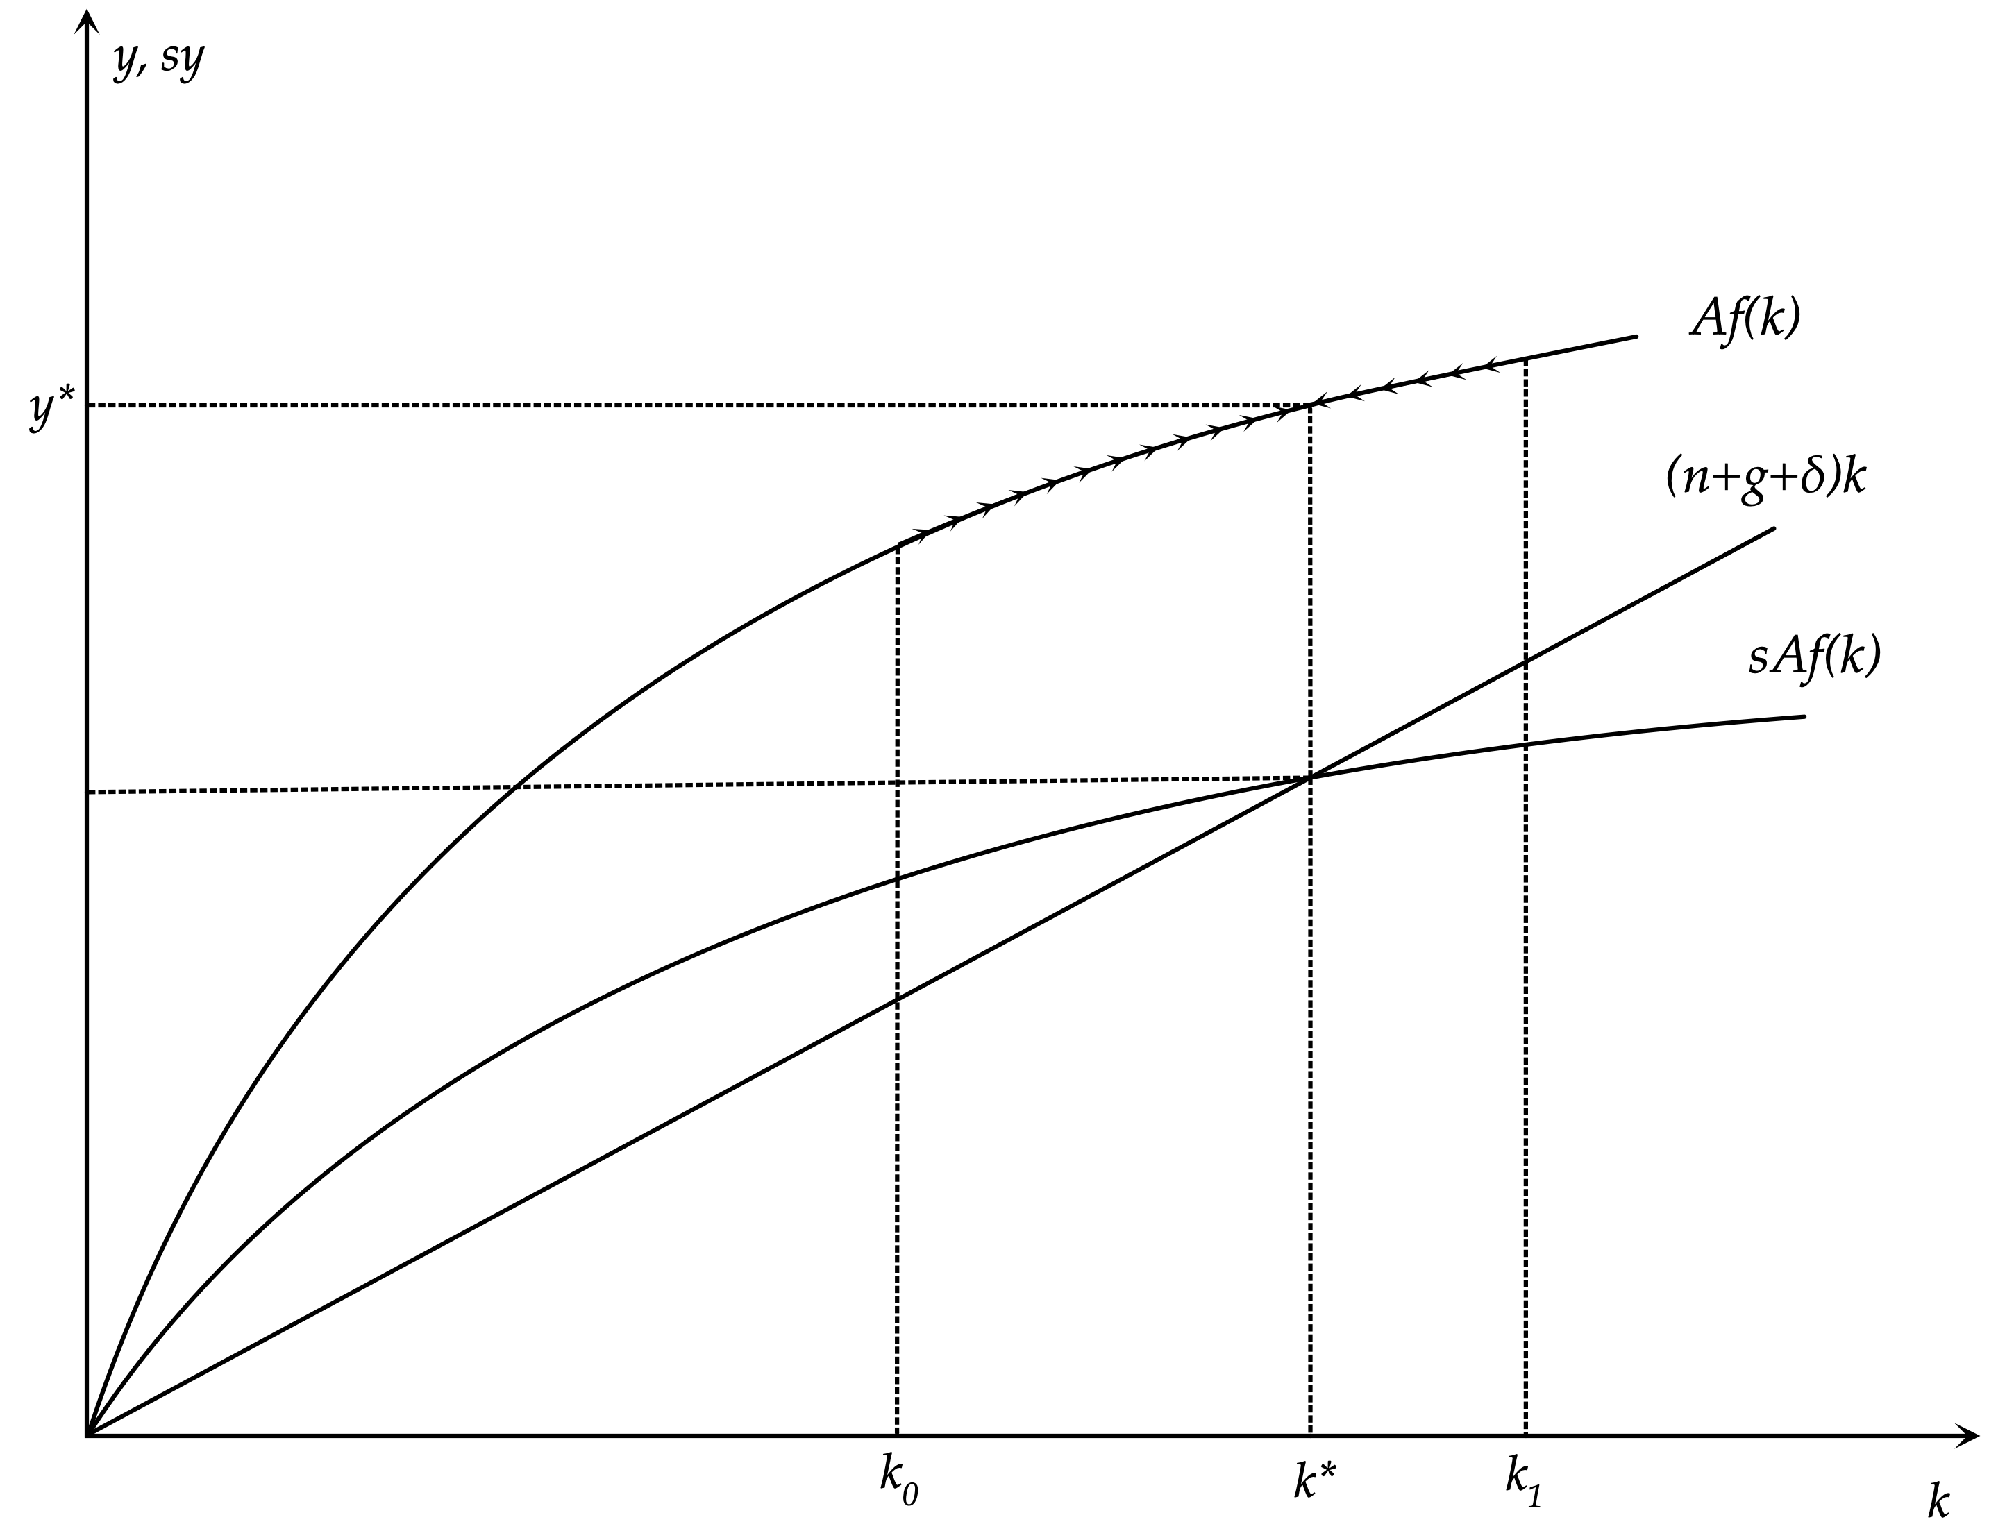
The Steady State and Short Run Adjustment

Slide 16
The Rate of Growth of Capital and Output
To examine the behavior of the growth rate of capital per efficiency unit of labor in the Solow model, we can divide both sides of the capital accumulation equation by $k(t)$. We then get that the growth rate of capital per efficiency unit of labor is given by,
$γ_{k}(t)=\frac{\overset{·}{k}(t)}{k(t)}=s\frac{Af(k(t))}{k(t)}-(n+g+δ)$
The growth rate of capital (per efficiency unit of labor) in the Solow model depends on the difference of the average product of capital, multiplied by the savings rate, from the sum of population growth, the rate of technical progress and the depreciation rate. If savings per unit of capital exceed steady state investment per unit of capital, then capital per efficiency unit of labor displays positive growth, as the capital stock increases at a rate higher than $n+g$. In the opposite case, capital per efficiency unit of labor displays negative growth, as the capital stock either falls, or grows at a rate lower than $n+g$. In the steady state, capital per efficiency unit of labor is constant, as the capital stock grows at a rate equal to $n+g$.
From the production function, the growth rate of output per efficiency unit of labor is given by,
$γ_{y}(t)=\frac{\overset{·}{y}(t)}{y(t)}=Af^{′}(k(t))\frac{\overset{·}{k}(t)}{k(t)}$
Since the marginal product of capital is positive, the growth rate of output per efficiency unit of labor has the same sign as the growth rate of capital per efficiency unit of labor.

Slide 17
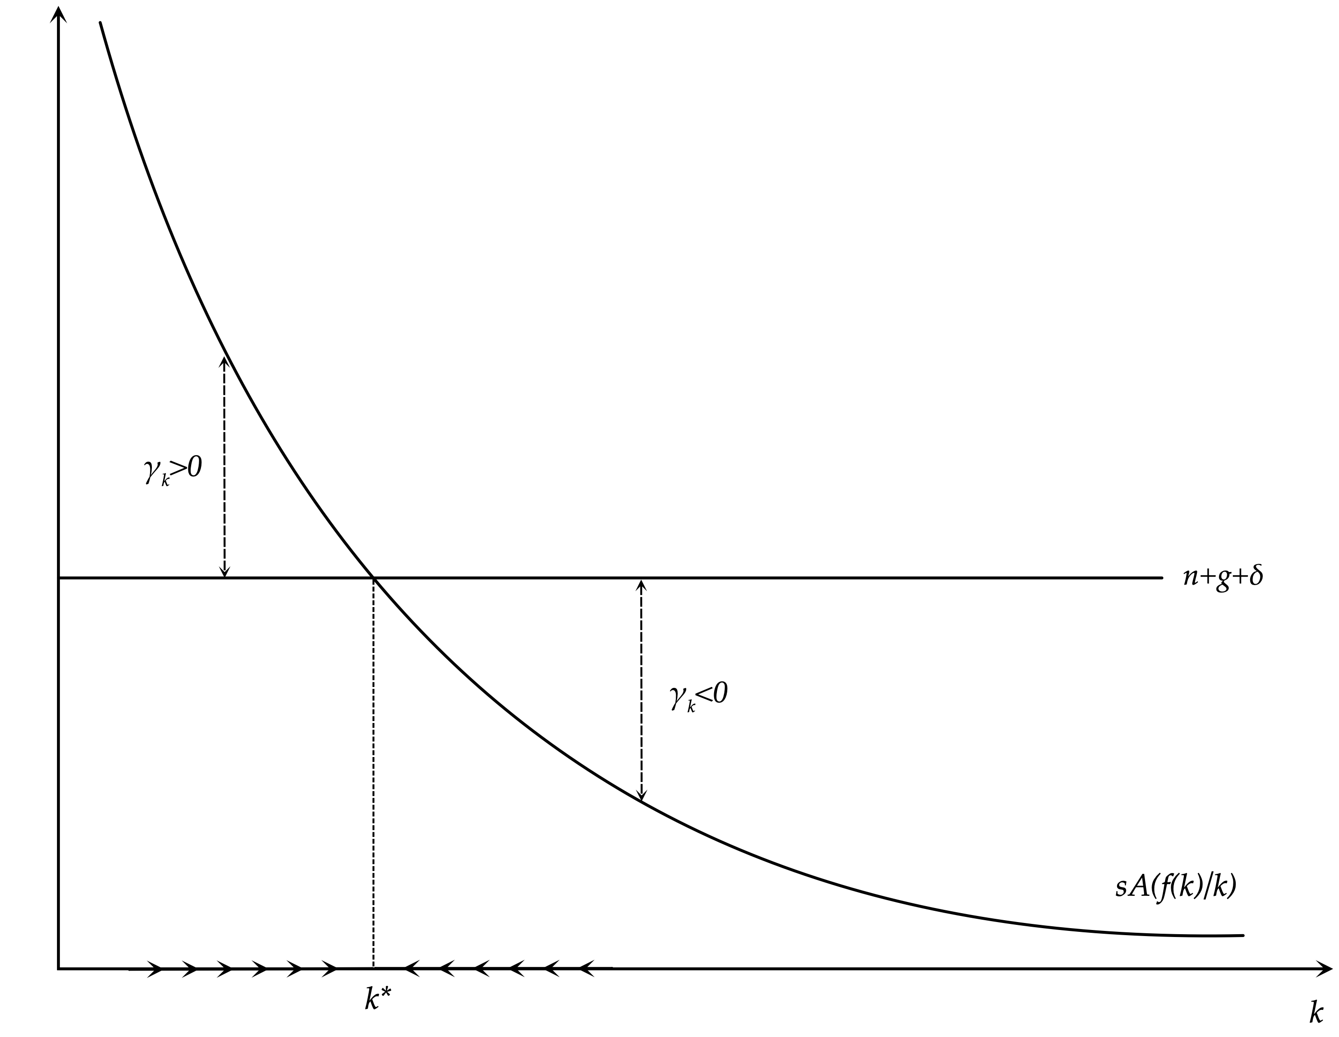
The Determination of the Growth Rate

Slide 18
Competitive Markets, the Real Interest Rate and Real Wages
As we have presented it so far, the Solow model assumes a single domestic firm and one national household which owns this firm. However, due to the constant returns to scale hypothesis, all the properties of this model go through, when one assumes competitive markets, with many identical firms and households.
Suppose there is a large number of households owning capital and supplying one unit of labor per member. Firms rent capital and labor in competitive capital and labor markets. The interest rate is r(t) and the real wage (per efficiency unit of labor) is w(t). Each firm uses capital and labor and produces according to a production function which, in intensive form, is given by y(t)=Af(k(t)). Each firm pays the return on capital to households holding its shares, and real wages to its workers.
The conditions for profit maximization on the part of firms are that the marginal product of capital equals the user cost of capital (the real interest rate plus the depreciation rate), and that the marginal product of labor equals the real wage. Therefore it holds that,
$Af^{′}(k(t))=r(t)+δ$ and $Af(k(t))-k(t)Af^{′}(k(t))=w(t)$
One can easily show that under constant returns to scale firms have zero profits and factor payments exhaust real output.
$k(t)(r(t)+δ)+w(t)=k(t)Af^{′}(k(t))+Af(k(t))-k(t)Af^{′}(k(t))=Af(k(t))=y(t)$

Slide 19
The Solow Model with Competitive Markets
The total household income per efficiency unit of labor is equal to gross output and is given by,
$\left(r(t)+δ\right)k(t)+w(t)$
The condition equating savings and investment per efficiency unit of labor is given by,
$\overset{·}{k}(t)=s\left(\left(r(t)+δ\right)k(t)+w(t)\right)-(n+g+δ)k(t)$
Substituting the marginal productivity conditions for factor prices, we end up the basic accumulation equation of the Solow model.
$\overset{·}{k}(t)=sAf(k(t))-(n+g+δ)k(t)$
Consequently, the Solow model is compatible with the existence of competitive markets for goods, labor and capital.
In the process of adjustment towards the balanced growth path from the left, i.e., when the initial capital per efficiency unit of labor is less than its steady state value, real wages are rising and real interest rates are falling, reflecting the evolution of the falling marginal product of capital and the rising marginal product of labor.
On the balanced growth path the real wage (per efficiency unit of labor) remains constant at $w^{*}$ and the real interest rate remains constant at $r^{*}$. They are determined by the conditions,
$Af^{′}(k^{*})=r^{*}+δ$ and $Af(k^{*})-k^{*}Af^{′}(k^{*})=w^{*}$
However, the real wage per employee, along with all other per capita variables, is growing at a rate g, the exogenous rate of technical progress.

Slide 20
The Balanced Growth Path and the Convergence Process
The Solow growth model does not explain the rate of long-run economic growth, i.e the rate of economic growth on the balanced growth path, as this is equal to the sum of two exogenous parameters, g and n. It does not explain the growth rate of per capita income and consumption along the balanced growth path either, as this is equal to the rate of exogenous technical progress g.
What the Solow model does explain is the level of the per capita capital stock and per capita output and income, the level of per capita consumption and real wages and the real interest rate, on the balanced growth path. These depend on all the parameters of the model, as we shall see.
In addition, the Solow growth model explains the process of convergence towards the balanced growth path. The process of convergence predicted by the model is the result of the accumulation of physical capital. The growth rate of output, or output per capita, in the convergence process differs from the long run growth rate g+n or g, to the extent that, during the convergence process, the economy accumulates capital at a different rate than g+n.
Note that the convergence process is asymptotic, in the sense that the steady state (or balanced growth path) is the limit as time goes to infinity.

Slide 21
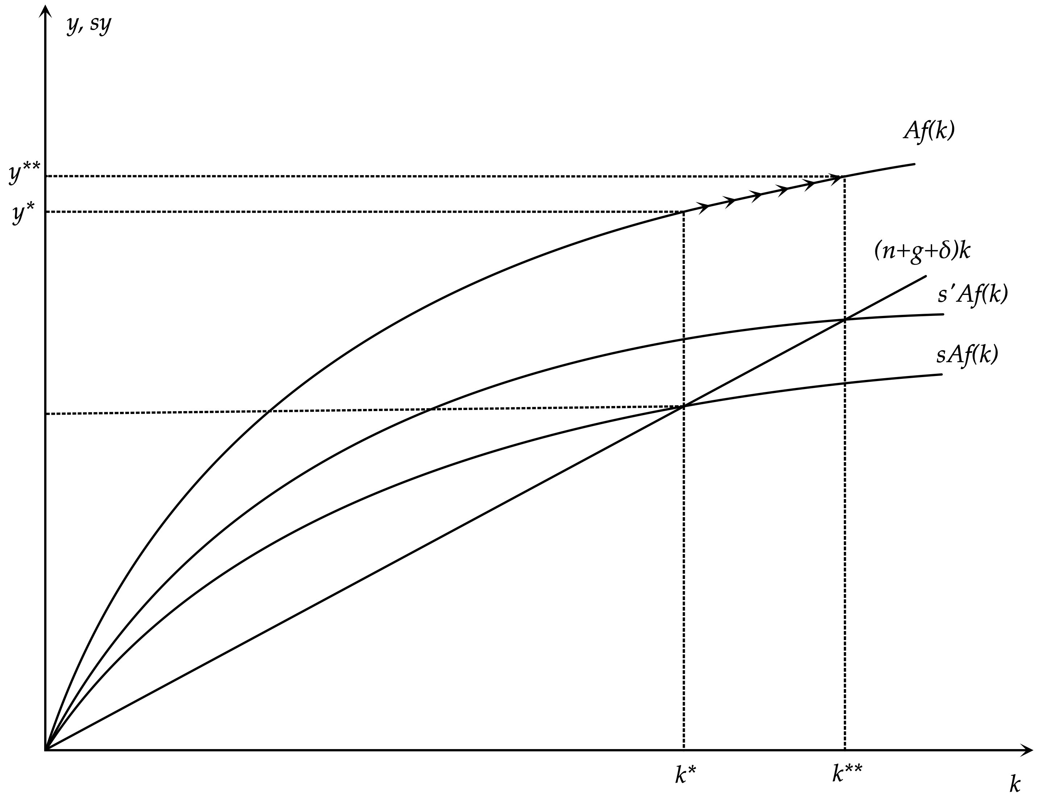
Effects of a Rise in the Savings Rate

Slide 22
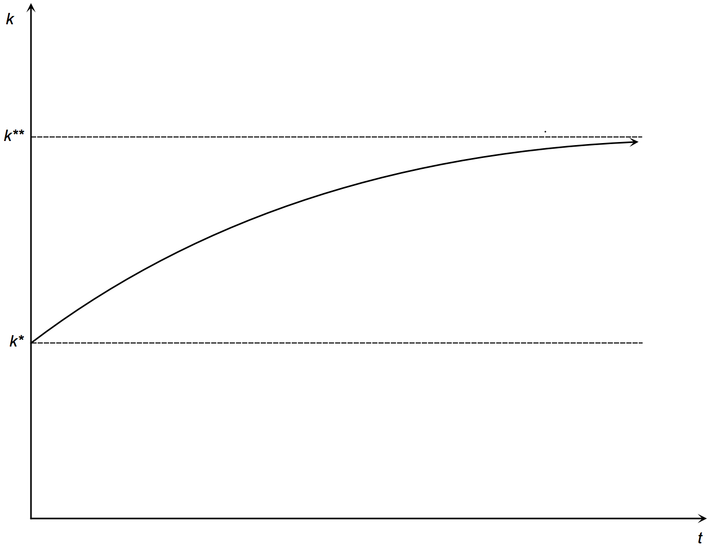
The Convergence Process Towards the New Balanced Growth Path

Slide 23
The Significance of the Savings Rate and the Golden Rule
In the Solow model one can prove that a rise in the savings rate results in an increase in steady state capital and output.
It can also be shown that the rate of growth of the per capita capital stock and per capita output and income rise temporarily above the rate of long-run economic growth g+n.
What happens to consumption is more uncertain, as a rise in the savings rate reduces consumption for any given level of income.

Slide 24
The Savings Rate, Consumption and the Golden Rule
Initially, as capital, output and income are given, a rise in the savings rate causes a temporary fall in consumption. Gradually capital output and income rise and so does consumption. Whether consumption per capita on the new balanced growth path will be higher or lower than on the original balanced growth path, depends on the difference between the marginal product of capital and n+g+δ. The latter is the marginal increase in steady state investment. Consumption will be higher in the new balanced growth path if the marginal product of capital is higher than n+g+δ, and it will be lower in the opposite case. This condition defines the so called golden rule.
The golden rule savings rate is defined as the savings rate that implies a steady state capital stock (per effective unit of labor) that maximizes steady state consumption (per effective unit of labor). Since the welfare of households is usually assumed to depend on consumption, the maximization of steady state consumption per effective unit of labor is a proxy for the maximization of steady state consumer welfare.

Slide 25
Derivation of the Conditions for the Golden Rule
In the steady state, consumption is given by,
$c*=f(k*)-(n+g+δ)k*$
The first derivative of steady state consumption with respect to the savings rate is given by,
$\frac{∂c*}{∂s}=\left(f^{′}(k*)-(n+g+δ)\right)\frac{∂k*}{∂s}$
Steady state consumption is maximised at the point where this derivative is equal to zero. This implies that,
$\frac{∂c*}{∂s}=0⇒f^{′}(k*)=(n+g+δ)⇒f^{′}(k*)-δ=n+g⇒r(k*)=n+g$
At the golden rule, the steady state real interest rate is equal to the growth rate.

Slide 26
The Savings Rate and Dynamic Inefficiency
If the savings rate is such that the steady state capital stock is higher than the golden rule capital stock, then the steady state real interest rate is lower than the growth rate, and the economy is characterized by dynamic inefficiency. Steady state consumption and, presumably, consumer welfare could be increased by reducing the savings rate.
Thus, an increase in the savings rate is not necessarily always desirable in the Solow model, despite the fact that it results in an increase in steady state capital and income. It is only desirable as long as the savings rate is below the one corresponding to the golden rule rate, i.e. the rate that maximizes steady state consumption per efficiency unit of labor.

Slide 27
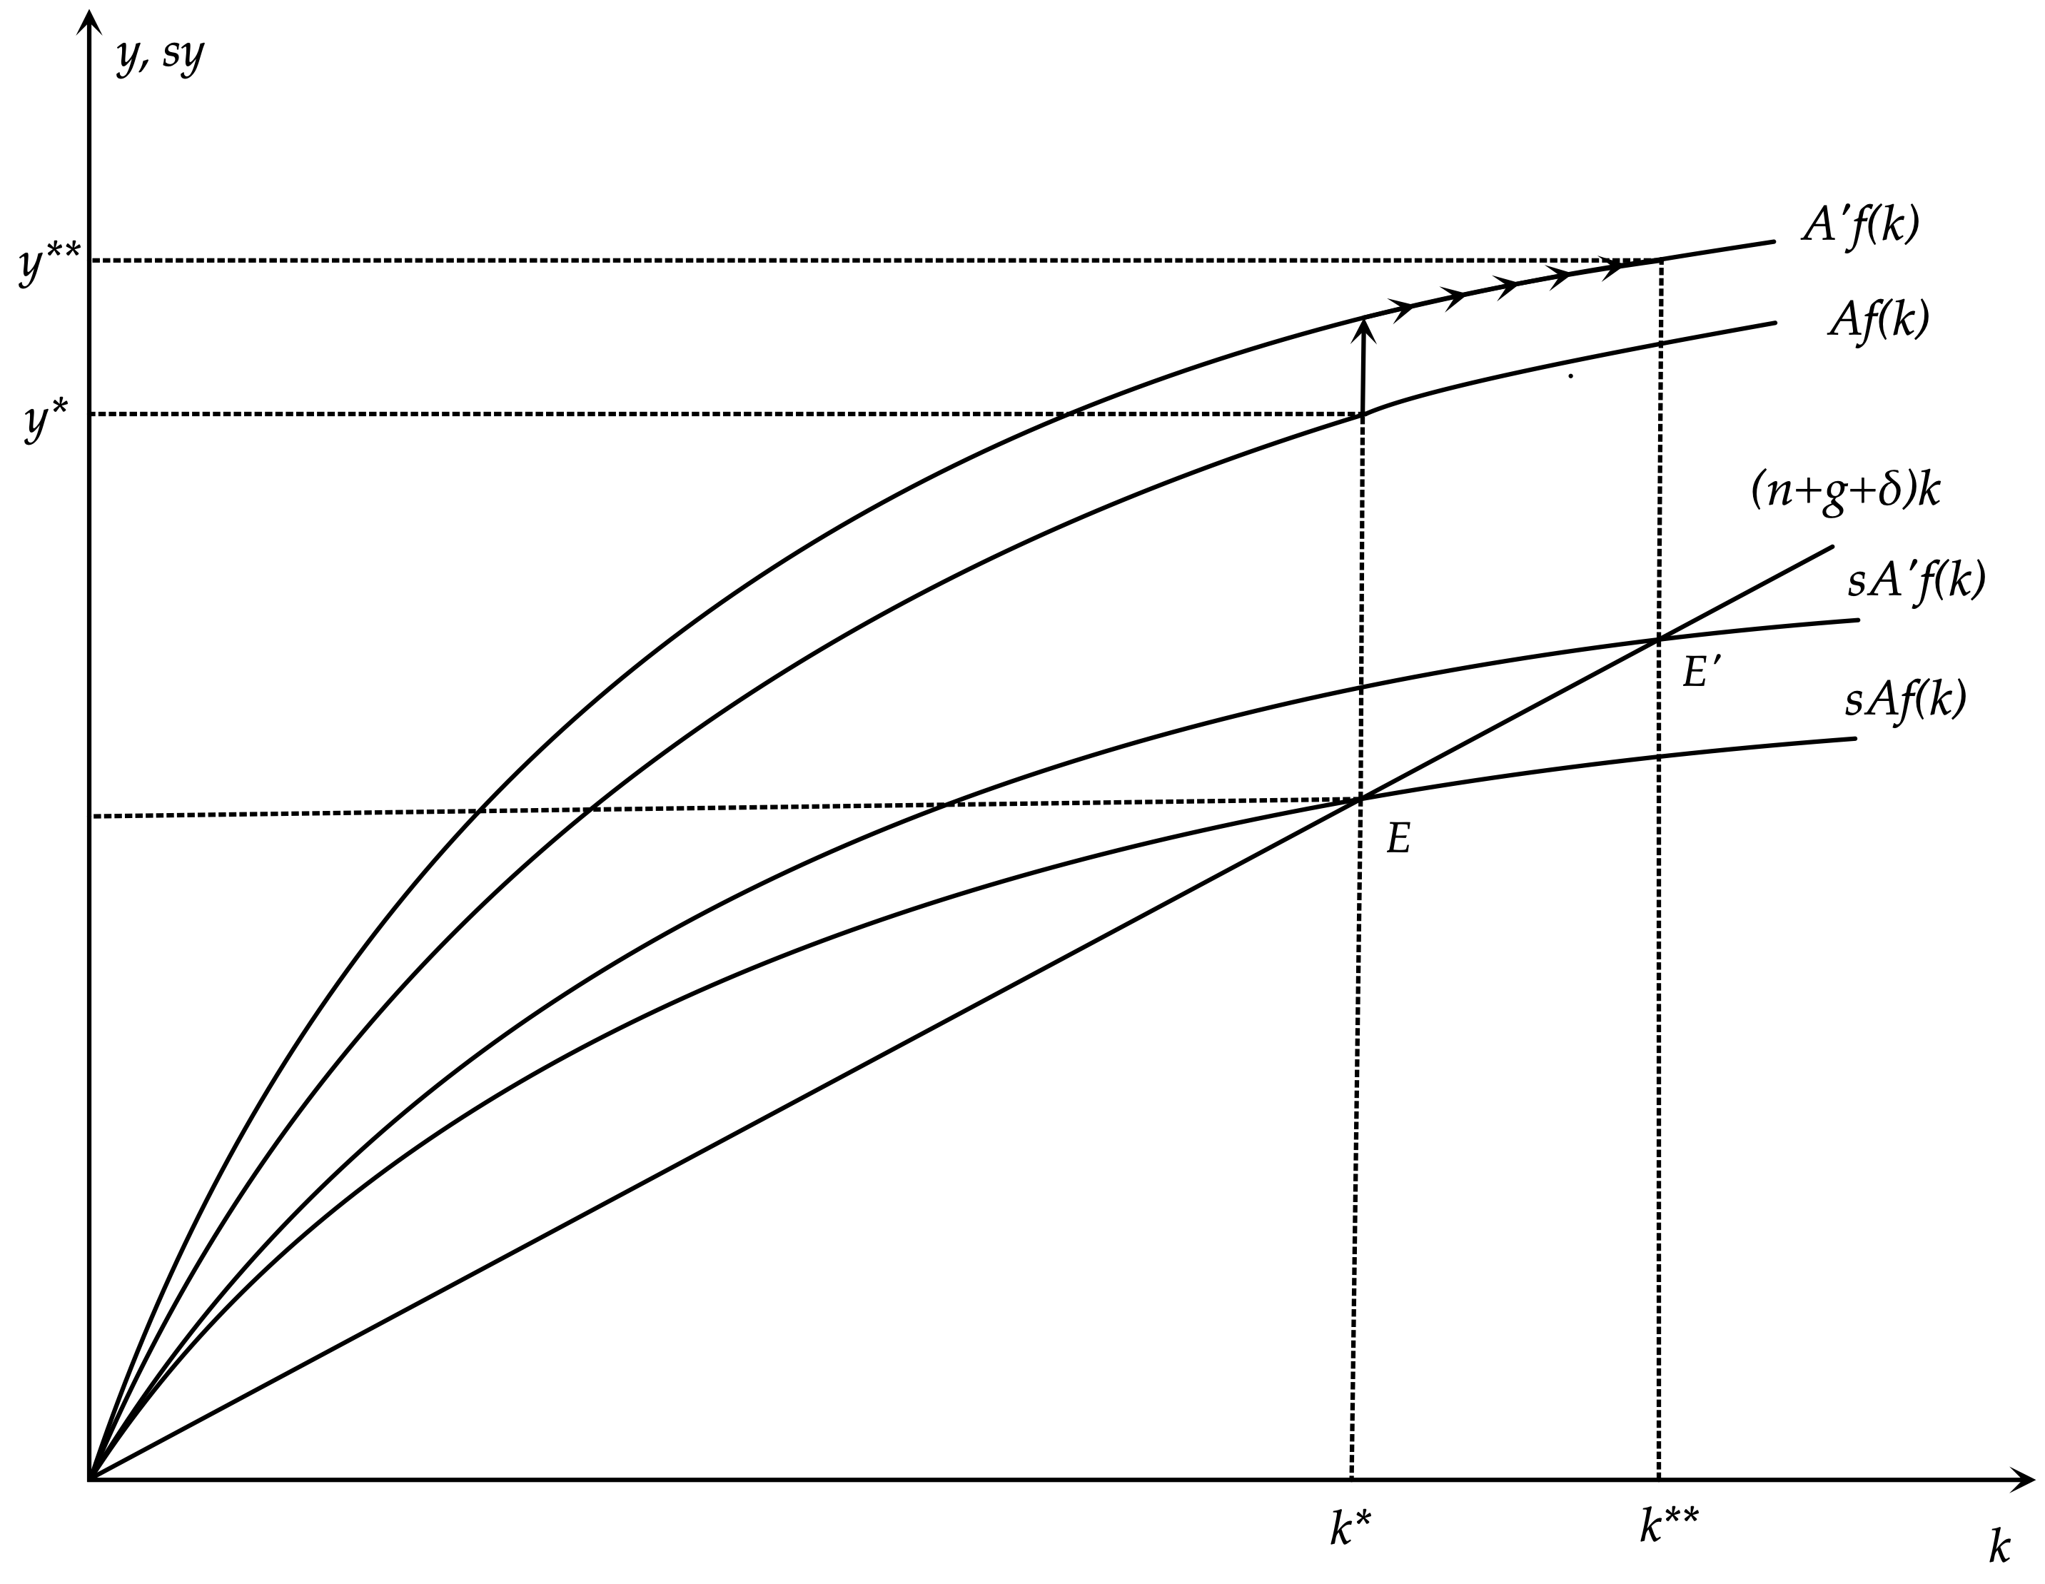
The Dynamic Effects of Total Factor Productivity in the Solow Model

Slide 28
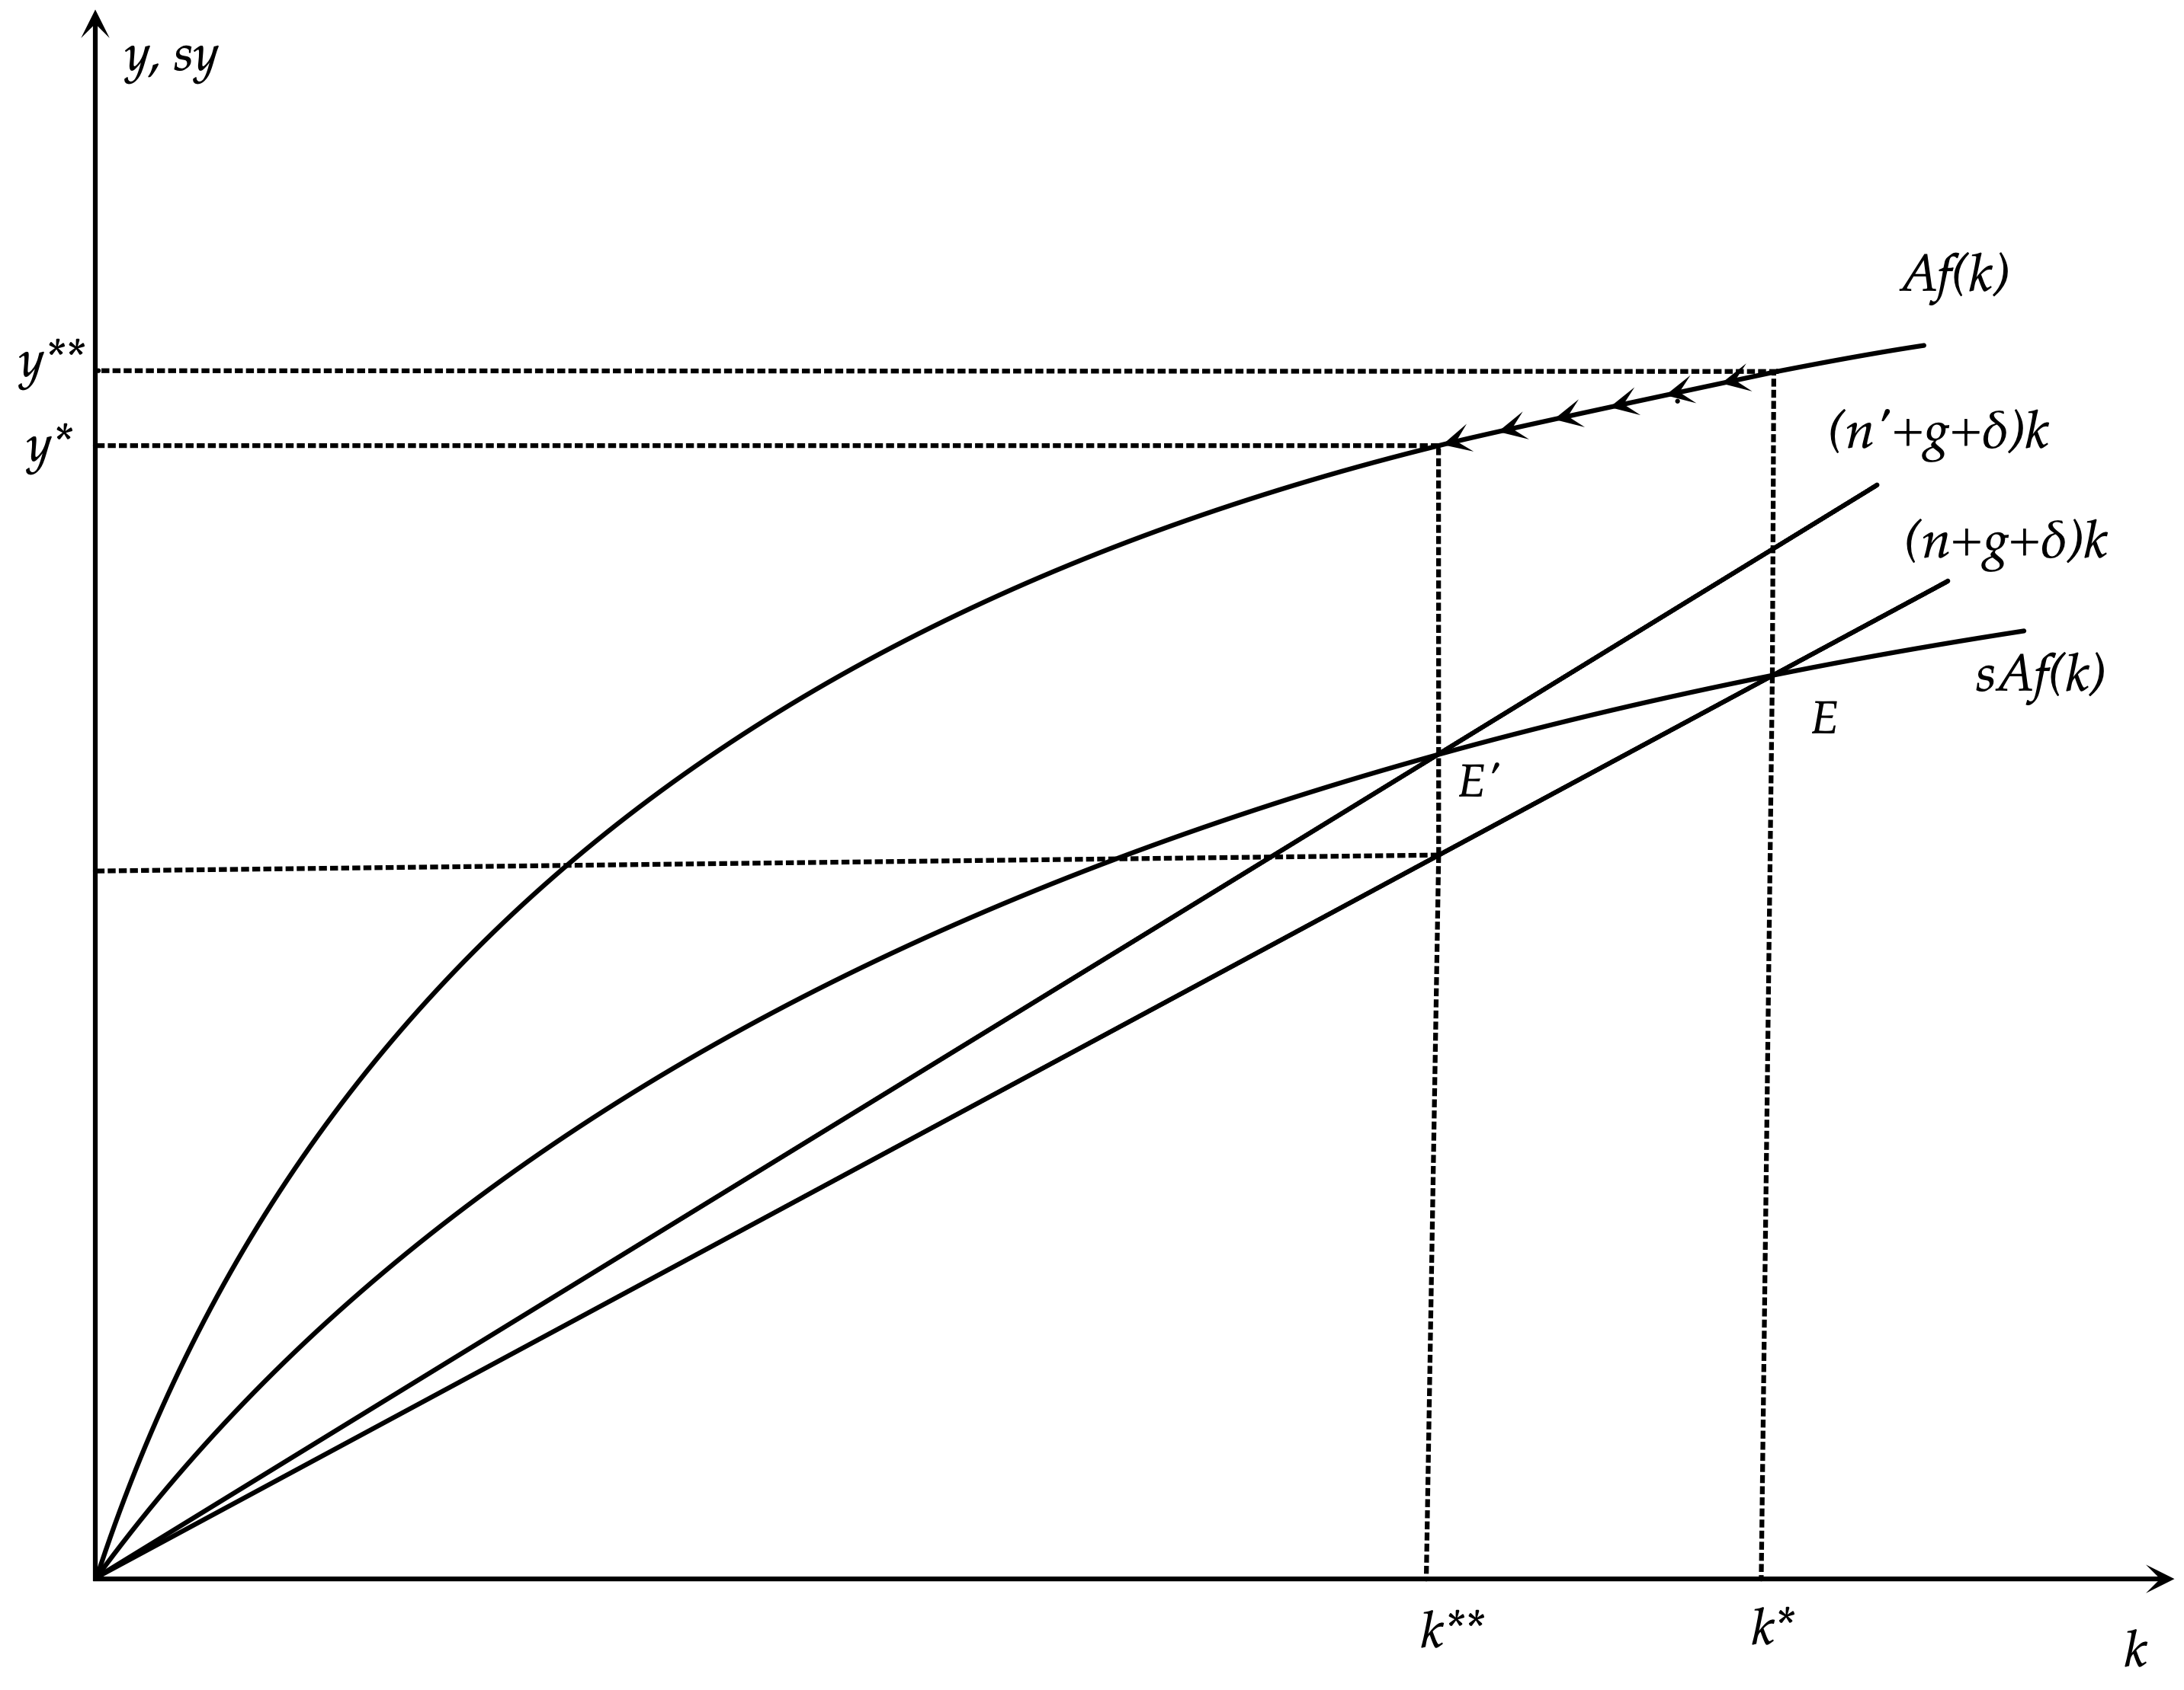
The Dynamic Effects of a Rise in Population Growth in the Solow Model

Slide 29
The Speed of Convergence in the Solow Model
To calculate the speed of convergence in the Solow model we start from the basic accumulation equation.
$\overset{∙}{k}(t)=sAf(k(t))-(n+g+δ)k(t)$
This can be linearized around the steady state as,
$\overset{∙}{k}(t)≃{\left(\frac{∂\overset{∙}{k}}{∂k}\right)}_{k=k*}\left(k(t)-k*\right)=-λ\left(k(t)-k*\right)$
where $λ=(n+g+δ)-sAf^{′}(k*)=(n+g+δ)\left[1-α_{K}(k*)\right]$ is the speed of convergence. $α_{K}(k*)$is the share of capital in total output.
This is a first-order linear differential equation whose solution is given by,
$k(t)≃k*+e^{-λt}\left(k(0)-k*\right)$

Slide 30
The Speed of Convergence in the Solow Model
The Solow model predicts a rather rapid convergence process.
Widely accepted annual estimates of n+g+δ determine it at about 6%. For example, this would be the result with n = 1%, g = 2% and δ = 3%. With the share of capital αΚ estimated at about 1/3, the Solow model implies an annual speed of convergence of about 4%.
Thus, on the basis of these estimates, the Solow model implies that each year roughly 4% of the gap between the current capital stock (and income) and the steady state capital stock (and income) is closed through the process of capital accumulation.
This means that half of the gap between the initial state of an economy and the steady state is covered in about 17 years, and that 90% of the gap is covered in about 58 years.
The convergence process in the real world is estimated to be significantly slower, at about 2% per annum. Thus, in the real world, it takes about 35 years to cover half of the difference between the initial state and the steady state, and about 115 years to cover 90% of the difference.

Slide 31
The Kaldor Stylized Facts of Economic Growth
An important first codification of the main empirical features pertaining to long run growth, is due to Kaldor (1961), who based them on the long run growth experience of Great Britain and the USA. According to Kaldor, a growth theory should be consistent with the following six (6) stylized facts about long-run growth:
1. Per capita GDP is growing over time, and the growth rate is not declining.
2. Physical capital per worker is growing over time.
3. The long run rate of return on capital is roughly constant.
4. The long run capital-output ratio is roughly constant.
5. The shares of labor and capital in Gross Domestic Product do not display a long-term trend.
6. The growth rate of labor productivity varies substantially between countries.
These stylized facts remain in force today, with the addition of some newer ones.

Slide 32
The Solow Model and the Stylized Facts
The Solow model is at a general level consistent with all of these basic empirical characteristics.
However, the process of physical capital accumulation, which is the main engine of economic growth in the Solow model, is not sufficient as an explanation of either the long run growth of output per worker that has been observed historically in almost all developed economies of the world, or the large differences in output per worker between developed and less developed economies.
Only a small part of these phenomena can be explained by the accumulation of physical capital. The largest part appears to be due to technical progress and to differences in total factor productivity and the efficiency of labor, which are considered exogenous in the Solow model.

Slide 33
The Solow Model in Discrete Time
Cobb Douglas Production Function
$Y_{t}=A{K_{t}}^{α}(h_{t}L_{t})^{1-α}$
Consumption Function
$C_{t}=(1-s)Y_{t}$
Equilibrium Condition in the Goods Market
$Y_{t}=C_{t}+K_{t+1}-K_{t}+δK_{t}$
Population Growth
$L_{t}=L_{0}(1+n)^{t}$
Technical Progress
$h_{t}=h_{0}(1+g)^{t}$

Slide 34
The Solow Model per Efficiency Unit of Labor
Production Function
$y_{t}=A{k_{t}}^{α}$
Consumption Function
$c_{t}=(1-s)y_{t}$
Equilibrium Condition in the Goods Market
$y_{t}=c_{t}+(1+n)(1+g)k_{t+1}-(1-δ)k_{t}$
Real Wages
$w_{t}=(1-α)Ak_{t}^{α}$
The Real Interest Rate
$r_{t}=αA{k_{t}}^{α-1}-δ$

Slide 35
Accumulation of Capital per Efficiency Unit of Labor in Discrete Time
Substituting the consumption function in the equilibrium condition in the output market, and using the production function to substitute for output per efficiency unit of labor, we get the following accumulation equation for capital in discrete time.
$k_{t+1}=\frac{1}{(1+n)(1+g)}\left(sAk_{t}^{α}+(1-δ)k_{t}\right)$
This is a non-linear difference equation in the capital stock per efficiency unit of labor. Its solution can be depicted diagramatically.

Slide 36
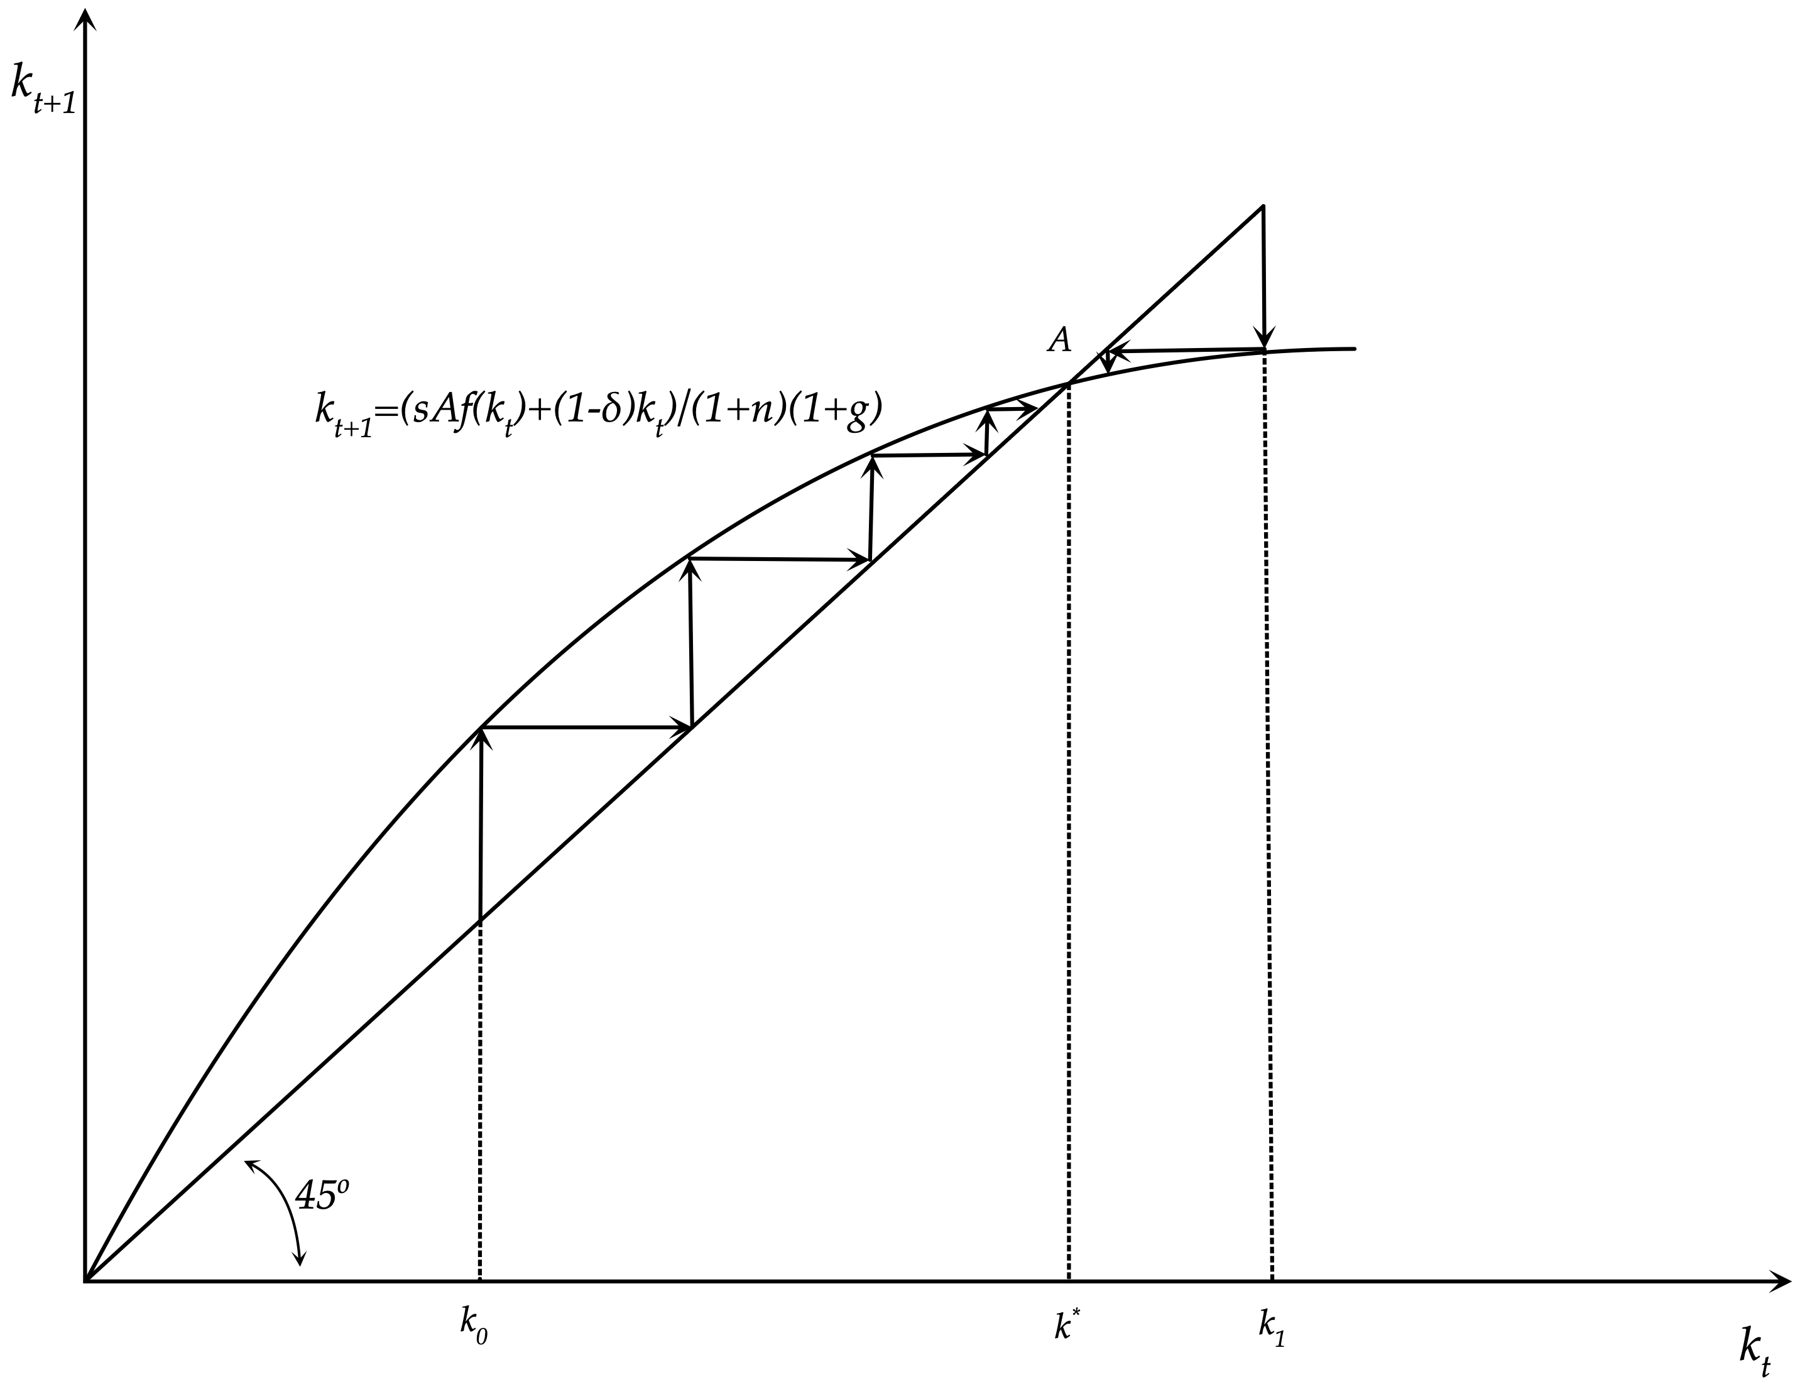
Convergence in the Solow Model in Discrete Time

Slide 37
Capital and Output on the Balanced Growth Path
In the discrete time Solow model with a Cobb-Douglas production function, steady state capital, output, consumption and real wages, per efficiency unit of labor, and the steady state real interest rate are given by,
$k*={\left(\frac{sA}{(1+n)(1+g)-(1-δ)}\right)}^{\frac{1}{1-α}}$
$y*=A{\left(\frac{sA}{(1+n)(1+g)-(1-δ)}\right)}^{\frac{α}{1-α}}$
$c*=(1-s)y*=(1-s)A{\left(\frac{sA}{(1+n)(1+g)-(1-δ)}\right)}^{\frac{α}{1-α}}$
$w*=(1-α)y*=(1-α)A{\left(\frac{sA}{(1+n)(1+g)-(1-δ)}\right)}^{\frac{α}{1-α}}$
$r*=αAk*^{α-1}-δ=\frac{α(n+g+ng+δ)-sδ}{s}$
Note that the steady state real interest is independent of total factor productivity for the Cobb Douglas production function. It also depends negatively on the savings rate, as a higher savings rate implies a higher steady state capital stock per efficiency unit of labor.

Slide 38
Dynamic Simulation of the Solow Model
Assumptions about the parameters
Α=1, α=0.333, s=0.30, n=0.01, g=0.02, δ=0.03
We examine three alternative scenarios
An increase in the savings rate s by 1% (i.e from 0.30 to 0.303)
An increase in total factor productivity Α by 1% (i.e. from 1 to 1.01)
An increase in the rate of population growth n by 1% (i.e from 0.01 to 0.0101)

Slide 39
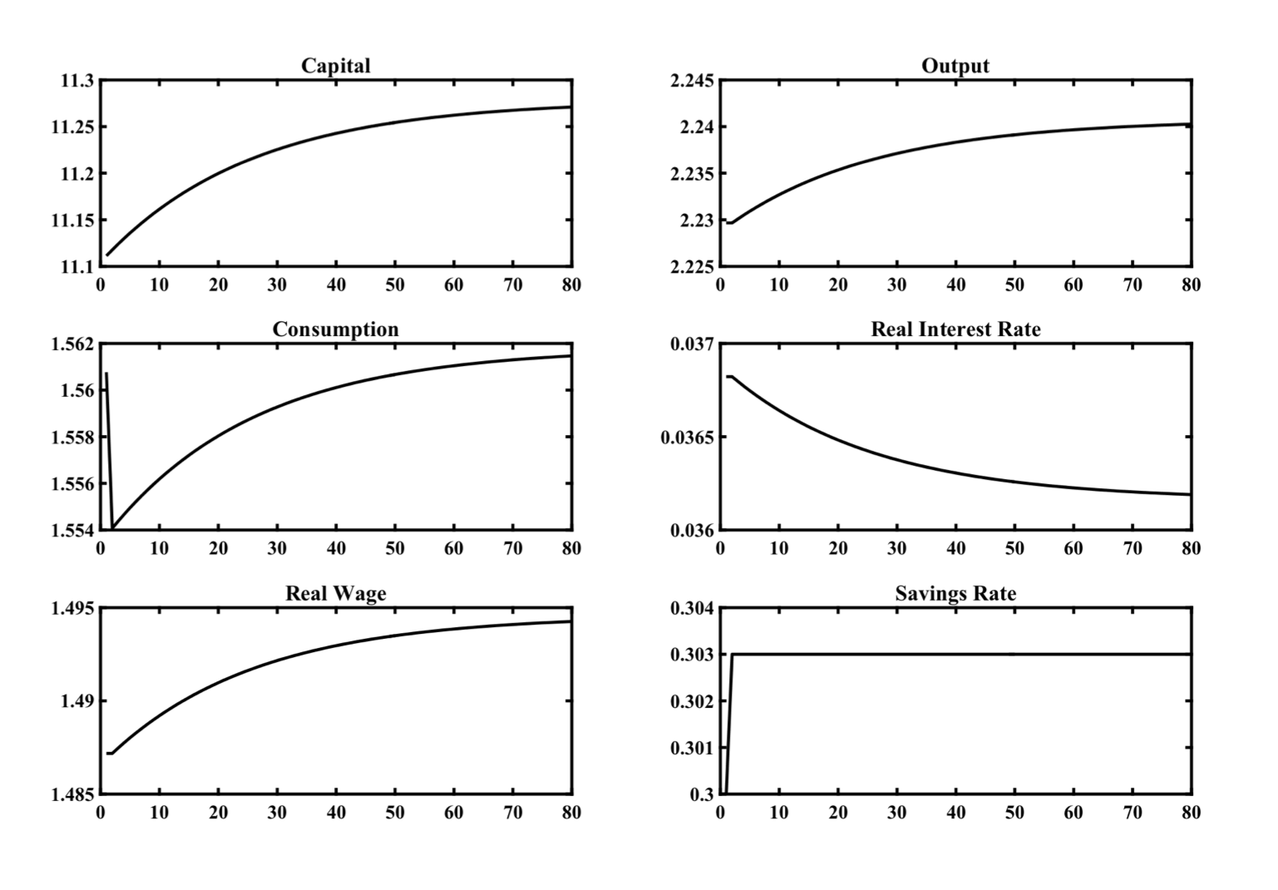
Impulse Response Functions of the Solow Model
Following a Permanent Increase in the Savings Rate by 1%

Slide 40
A Rise in the Savings Rate by 1%
In this simulation the economy is on the initial balanced growth path, and after period 1, the savings rate increases permanently, and unexpectedly, by 1%, from 0.30 (i.e., 30%) to 0.303 (30.3%).
The increase in the saving rate leads to a decrease in consumption, a gradual accumulation of capital, a gradual increase in production, a gradual increase in real wages and a gradual fall in real interest rates. The reason behind increasing real wages is the gradual increase in the marginal product of labor caused by the accumulation of capital. The reason behind the gradual reduction in the real interest rate is the gradual reduction of the marginal product of capital caused by the accumulation of capital.
The economy gradually converges towards a new balanced growth path. In this new balanced growth path, capital per efficiency unit of labor is higher by approximately 1.5%, output and real wages by 0.5%, consumption by 0.07% (due to the increase in the saving rate), while the real interest rate has fallen by 0.07 percentage points.

Slide 41
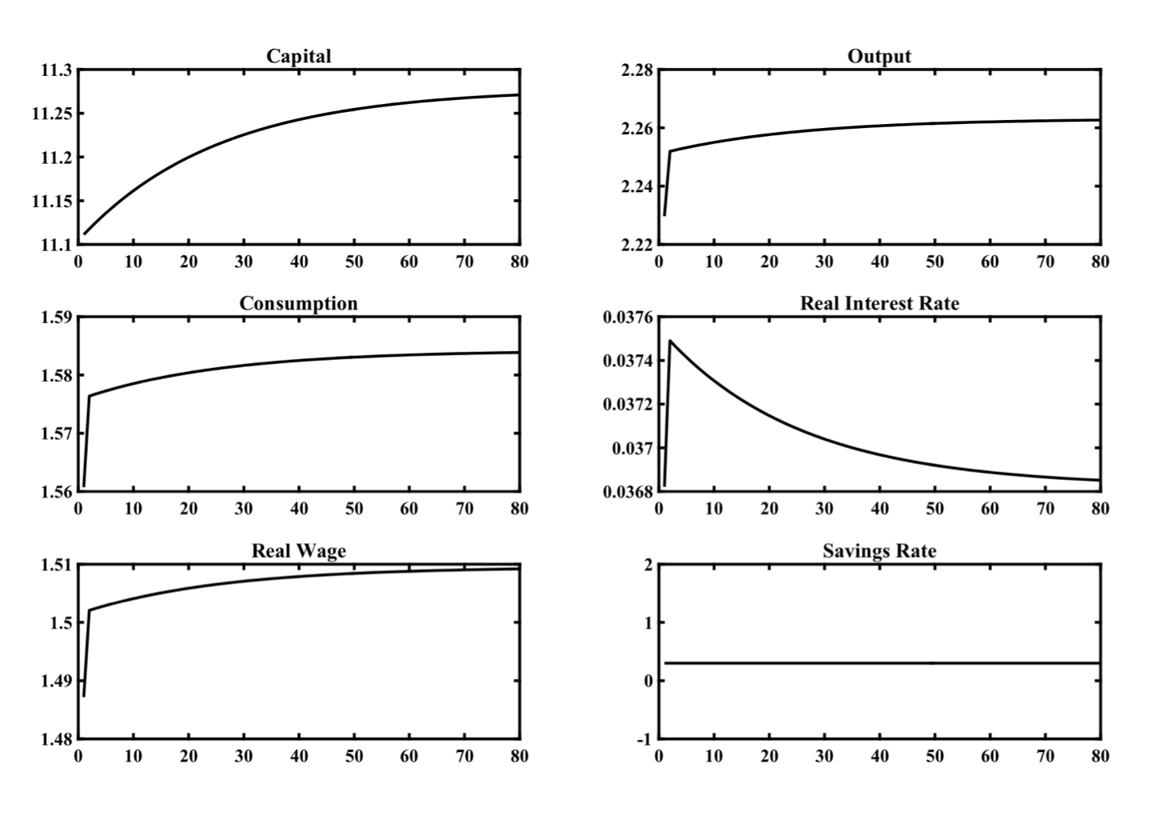
Impulse Response Functions of the Solow Model
Following a Permanent Increase in Total Factor Productivity by 1%

Slide 42
A Rise in Total Factor Productivity by 1%
In this simulation the economy is on the initial balanced growth path, and after period 1, total factor productivity A increases permanently and unexpectedly by 1%, from 1 to 1.01.
This increase leads immediately to an increase in output, consumption, savings, the marginal product of labor (real wage) and the marginal product of capital (real interest rate).
The increase in savings causes a gradual accumulation of capital, which leads to a further gradual increase in output and consumption, a further gradual increase in real wages, but a gradual fall in real interest rates. The reason for the gradual decrease of the real interest rate is the gradual reduction of the marginal product of capital caused by the accumulation of capital.
The economy gradually converges to a new balanced growth path. In this, capital per efficiency unit of labor is increased by about 1.5%, output, consumption and real wages also increased by 1.5%, while the real interest rate, after the initial increase, has returned to its original equilibrium.
The equilibrium real interest rate, because the production function is assumed Cobb-Douglas, is independent of total factor productivity A.
The reason why an increase in productivity by 1% leads to an increase in real income by 1.5%, i.e., more than 1%, is that the increase in total factor productivity causes an increase in savings and capital accumulation, which in turn causes additional secondary increases in real output, income and consumption. This can be confirmed from the formula for steady state capital and output, where the elasticity of steady state output with respect to total factor productivity A is equal to 1/(1-α) > 1.

Slide 43
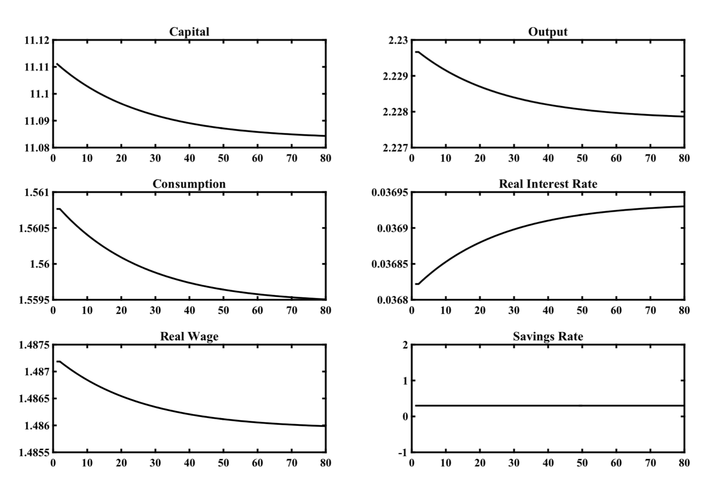
Impulse Response Functions of the Solow Model
Following a Permanent Increase in the Rate of Population Growth by 1%

Slide 44
A Rise in the Rate of Population Growth by 1%
In this simulation the economy is on the initial balanced growth path, and after period 1, the rate of growth of population n increases permanently and unexpectedly by 1%, from 1% to 1.01%.
This increase leads to a gradual decumulation of capital and a gradual decline in output, consumption and the real wage (the marginal product of labor). The real interest rate (marginal product of capital) gradually increases.
The economy gradually converges to a new balanced growth path. In this, capital per efficiency unit of labor is lower by about 0.25%, output, consumption and real wages are lower by 0.08%, while the real interest rate has increased from 3.68% to 3.69%.
The negative effects of an increase in population growth on steady state per capita income and consumption in the Solow model are not insignificant, but they are not very large.

Slide 45
The Importance and the Weaknesses of the Solow Model
The Solow model is a key model and an important reference point in the theory of economic growth. Although its roots lie in older models, and although it has a number of theoretical and empirical weaknesses, this model provides a very useful, simple and flexible framework for the analysis of the growth process.
However, accumulation of physical capital, which is the main engine of economic growth in the Solow model, cannot fully explain either the long-term growth of output per worker and per capita income that has been observed in developed economies, or the large differences in labor productivity and living standards per head between developed and less developed economies.
Only a small part of these differences can be explained by the accumulation of physical capital. Most of it is accounted for by differences in total factor productivity and technical progress, which in the Solow model are considered exogenous parameters. In this sense, the Solow model, like all models that rely on similar assumptions about technology and technical progress, shows us how to overcome its weaknesses and to try to explain technical progress endogenously.

Slide 46
Growth Models with Endogenous Savings
Another theoretical weakness of the Solow model is the assumption that the savings rate is exogenous.
Although at the time that the Solow model first appeared this was a widely accepted assumption, in the context of Keynesian macroeconomics, the assumption is not satisfactory as it does not take into account the underlying determinants of household savings behavior.
We shall next examine two alternative classes of models of savings behavior, where savings are the result of rational intertemporal behavior on the part of households that have access to a competitive capital market.
These two classes of dynamic general equilibrium models are the Ramsey, Cass, and Koopmans representative household model, and the class of overlapping generations models due to Allais, Samuelson, Diamond, Blanchard and Weil.

Slide 47
Key References
Solow, R.M. (1956), “A Contribution to the Theory of Economic Growth”, Quarterly Journal of Economics, 70 (1), pp. 65-94.
Swan, T.W. (1956), “Economic Growth and Capital Accumulation”, Economic Record, 32 (2), pp. 334-361.

