Slide 1
3. Introduction to the Intertemporal Approach
Athens University of Economics and Business
Dynamic Macroeconomics
Prof. George Alogoskoufis
alogoskoufisg.com
George Alogoskoufis, Dynamic Macroeconomics, 2019

Slide 2
Introduction to the Intertemporal Approach
The intertemporal approach is the dominant theoretical approach in modern macroeconomics. Hence, it it is the main theme of this course. By way of introduction, it is worth laying out the main elements of this approach in the context of the simplest possible intertemporal macroeconomic models. This is the main function of the present lecture.
The intertemporal approach is fully grounded on neoclassical microeconomics, as it is based on the assumption that households maximize their intertemporal utility and firms maximize the present value of their profits, subject to the appropriate resource, technological, market, and information constraints.
The approach is also based on the concept of general intertemporal equilibrium, either through the operation of fully competitive markets, or through markets subjected to various distortions relative to the competitive model. Relative prices (such as real interest rates and real wages) and nominal magnitudes (such as the price level, inflation, and nominal interest rates) are assumed to be determined through appropriate general equilibrium concepts, which depend on market structure and assumptions about price and wage flexibility.
Intertemporal, or dynamic, general equilibrium models are thus based on the resource, technological, market and informational possibilities of households, firms and the government who choose the optimal path of consumption, production, employment and investment. These possibilities are described by appropriate intertemporal budget constraints. The analysis of the role of money and the interrelated intertemporal budget constraints of the private and the public sector illuminate the role of monetary and fiscal policy and the possibilities of the government and government agencies, such as central banks, to affect and improve upon macroeconomic outcomes.
The properties of intertemporal models depend on the equilibrium concept used, on the nature of the assumed market and informational distortions and on the assumptions adopted about the degree of price and wage flexibility.

Slide 3
Models, Variables and Functions
Before we introduce the intertemporal approach, it is worth briefly reviewing the nature of mathematical models in macroeconomics.
Scientific models can be thought of as imaginary, simplified versions of the aspect of the world being studied. They are based on a set of simplifying assumptions about the real world phenomenon being studied, and their analysis helps in the derivation of the logical implications of these assumptions for both the model, and, hopefully, for the real world phenomenon under study. If the simplifying assumptions are not critical for the properties of the model relative to the real world phenomenon, then the predictions and properties of the model carry over to the real world.
Macroeconomic models are thus simplified representations of economies, which allow us to analyze their salient characteristics. Although there is no inherent reason why a model must be mathematical, mathematical models ensure internal consistency in our reasoning about actual economies. They also allow us to handle a greater degree of complexity than non mathematical models and also to assess the quantitative significance of various factors. It is for these reasons that macroeconomic models are expressed in mathematical form.
Mathematical macroeconomic models consist of variables, functions and parameters. They are meant to describe the outcome of the behaviour and the interactions of economic agents such as households, firms, the government and government agencies such as central banks.

Slide 4
Optimizing versus Non-Optimizing Models
The behavioral rules of economic agents can be postulated directly, or derived making assumptions about the preferences and constraints faced by these agents, and using the main postulates of rational choice upon which microeconomics is based.
Methods of mathematical optimization allow us to model the behavior of agents that maximize their objective functions, under appropriate constraints.
Thus households are assumed to follow rules that maximize their utility functions under appropriate budget and market constraints, while firms are assumed to follow rules that maximize an appropriately defined profit function, under the relevant technological and market constraints.
Similar considerations apply to the government and government agencies.

Slide 5
Models as Systems of Equations
Mathematical economic models typically take the form of systems of equations, designed to describe the structure of the economy in question and the behaviour of economic agents such as households, firms and the government.
The equations relate a number of variables to one another and are meant to be either behavioral relations or accounting identities, or equilibrium conditions.
Variables refer to economic magnitudes that can take different values. There is an important distinction between endogenous variables (i.e., variables whose values are determined by the model itself), and exogenous variables, whose values are determined outside the model and are taken as exogenously given.
Another important element of mathematical models is a set of parameters, usually assumed constant and exogenously given. Parameters relate to the objective functions and constraints of economic agents, and eventually determine the relations among endogenous and exogenous variables in the model.
Equations in mathematical models take the form of mathematical functions which describe the relation of a particular variable, to other variables in the model. Functions can be linear or non-linear.
Variables and parameters of functions are usually defined in terms of real numbers. Real numbers can be thought of as points on an infinitely long line called the number line or real line, where the points corresponding to integers are equally spaced. Any real number can be determined by a possibly infinite decimal representation, such as that of 8.632, where each consecutive digit is measured in units one tenth the size of the previous one. The real line can be thought of as a part of the complex plane, and complex numbers include real numbers.

Slide 6
The Two Period Fisherian Model
In this lecture we focus on competitive economies lasting for only two periods, period 1, the present, and period 2, the future. The two period competitive model, due to Fisher (1930), is the simplest possible intertemporal general equilibrium model, and can be analyzed with the help of relatively simple mathematical tools. We thus use it to investigate some of the salient characteristics of the intertemporal approach, without the mathematical complexity and other complications that sometime emerge in multiperiod dynamic general equilibrium models.
We start by investigating general competitive equilibrium in a one period macroeconomic model, with exogenous capital and labor endowments. Then we investigate intertemporal general equilibrium in a two period competitive macroeconomic model, which allows for savings and investment.
Many of the themes examined through the two period model of this chapter will be revisited and expanded upon in the context of the infinite horizon models used to analyze economic growth, aggregate fluctuations and the role of monetary and fiscal policy in the remainder of this course. Therefore, the investment that is required in order to understand the two period intertemporal model has high payoffs.

Slide 7
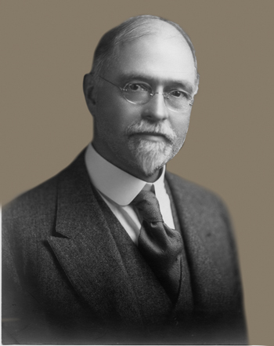
Irving Fisher (1867-1947)
Irving Fisher (February 27, 1867 – April 29, 1947) was an American economist and statistician. He was one of the earliest American neoclassical economists. Joseph Schumpeter described him as “the greatest economist the United States has ever produced”, an assessment later repeated by James Tobin and Milton Friedman.
Fisher made important contributions to utility theory and general equilibrium. He was a pioneer of the rigorous study of intertemporal choice in markets, which led him to develop a theory of capital and interest rates. His research on the quantity theory of money foreshadowed “monetarism”. Fisher was also a pioneer of econometrics, including the development of index numbers.

Slide 8
A One Period Competitive Model
In order to gain a better understanding of the intertemporal approach, and its differences from non-intertemporal approaches, we first analyze a one period competitive macroeconomic model without savings and investment.
In this model we assume that there is a continuum of identical households, with the same capital and labor endowments and the same preferences. Households only live only for one, the current, period. Therefore there are no savings and investment. Since all households are identical and face the same competitive market prices, we can thus analyze the behavior of one of them, the representative household.
We shall hold on to the concept of a representative household throughout this lecture.
We also assume that there is a continuum of identical competitive firms, who hire capital and labor from households and produce a homogeneous output. Since all firms are identical, and trade at the same factor and output prices in competitive markets, we shall also analyze the behaviour of only one of them, the representative firm.

Slide 9
Endowments, Preferences and the Optimal Behavior of the Representative Household
The representative household lives for one period and is characterized by its endowments and its preferences.
We assume that the representative household is endowed with one unit of capital and one unit of labor. Its endowment of capital and labor can be rented to private firms, at a competitive rental price of capital r, and a competitive real wage w.
Capital k and labor l are used by competitive firms in the production of a single good y, which has the same characteristics as the capital endowment of the household. The household can use the income from the rental of its capital and labor endowments for consumption, and it can also consume its capital endowment at the end of the period.

Slide 10
Resource Constraints of the Representative Household
$$c≤1+rk+wl$$
$$k≤1$$
$$l≤1$$
Interpretation of the Resource Constraints: Consumption cannot exceed the sum of the income and the capital endowment of the household. This is the household budget constraint. In addition, the household cannot rent out more than its one unit of endowment of capital and labor. These are the household endowment constraints.

Slide 11
Preferences of the Representative Household
The preferences of the representative household are described by a continuous, twice differentiable, concave utility function u, which depends on the volume of consumption c of the single good.
$$u(c)$$
The utility function satisfies.
$$u^{′}=\frac{∂u}{∂c}>0,u^{′′}=\frac{∂^{2}u}{∂c^{2}}<0$$
The marginal utility of consumption is assumed positive but diminishing. The assumption of a strictly positive marginal utility at all levels of consumption implies that the preferences of the representative household are characterized by non-satiation. Hence, the representative household always prefers more to less consumption.

Slide 12
Maximization of Utility Subject to the Resource Constraints
To find the first order conditions for the maximisation of the utility function of the representative household subject to the resource constraints, we form the following Lagrangean function.
$$L=u(c)-λ_{1}\left(c-1-rk-wl\right)-λ_{2}(k-1)-λ_{3}(l-1)$$
where, λ1, λ2, λ3 are the Lagrange multipliers for the three resource constraints.
The first-order conditions for a maximum are given by,
$$λ_{1}=u^{′}$$
$$λ_{2}=λ_{1}r$$
$$λ_{3}=λ_{1}w$$

Slide 13
Implications of First Order Conditions for Utility Maximization
The interpretation of these first-order conditions is straightforward.
The first implies that the shadow price of the budget constraint λ1 will be positive, since the marginal utility of consumption is always positive. Hence, the household will consume all its current income, plus its capital endowment at the end of the period. The budget constraint will be satisfied with equality.
Since λ1 is positive, the other two multipliers λ2 and λ3 will also be positive for a positive real rental price of capital r and a positive real wage w. Hence the household will commit its full capital and labor endowment for rental and productive use. The resource constraints will thus also be satisfied with equality.
Hence, from the assumption of non-satiation, the household will rent out its full capital and labor endowment, as long as it earns a positive rental price r for capital and a positive real wage w for labor. It will also consume all of its income, plus its capital endowment.
As a result, the household will choose c in order to maximize utility, subject to the resource constraints holding with equality. The supply of capital and labor to firms, and consumption demand will as a result be equal to,
$$k=1$$
$$l=1$$
$$c=1+r+w$$
Thus, the representative household, by maximizing its utility subject to its endowments and its budget constraint, will commit its full endowments to rental and production, and will consume all its current income, plus the endowment that can be consumed, such as the capital stock.

Slide 14
Firms and the Production Function
Output is produced by competitive firms, who rent the factors of production, such as capital and labor services, from households, through competitive factor markets. All firms have access to the same technology and factor markets, and produce a homogeneous output y, through the following neoclassical production function.
$$y=AF(k,l)$$
A is an exogenous technological parameter, denoting total factor productivity, and F is a continuous, twice differentiable, quasi concave function. The factors of production are capital k and labor l.
The marginal product of both factors of production is positive, but diminishing. In addition, the marginal product of each factor is a positive function of the employment of the other factor.
Constant returns to scale imply that if all factors of production are multiplied by any non-negative real number, say μ, the scale of production is also multiplied by μ.

Slide 15
Properties of the Production Function
In mathematical form, the properties of the production function can be written as,
$$F_{k}=\frac{∂F}{∂k}>0,F_{l}=\frac{∂F}{∂l}>0,$$
$$F_{kk}=\frac{∂^{2}F}{∂k^{2}}<0,F_{kl}=\frac{∂^{2}F}{∂k∂l}>0,$$
$$F_{ll}=\frac{∂^{2}F}{∂l^{2}}<0,F_{lk}=\frac{∂^{2}F}{∂l∂k}>0$$
$$μy=AF(μk,μl)$$
Because of the assumption of constant returns to scale, we can multiply all factors by 1/l, and the production function can be written in per worker terms, as,
$$\overset{̂}{y}=AF(\overset{̂}{k},1)=Af(\overset{̂}{k})$$
$$f(0)=0,f^{′}(\overset{̂}{k})=\frac{∂f}{∂\overset{̂}{k}}>0,f^{′′}(\overset{̂}{k})=\frac{∂^{2}f}{∂{\overset{̂}{k}}^{2}}<0$$
where,
$$\overset{̂}{y}=y/l$$
$$\overset{̂}{k}=k/l$$
denote output and capital per worker.
The marginal product of capital per worker is positive but diminishing.

Slide 16
The Profit Maximizing Behavior of Firms
Firms are competitive and are assumed to maximize real profits choosing capital and labor and hence the level of production, taking the rental prices of capital r and labor w as given. Hence, they choose capital and labor in order to maximize,
$$P=AF(k,l)-rk-wl=l(Af(\overset{̂}{k})-r\overset{̂}{k}-w)$$
From the first order conditions for a maximum, firms will employ capital and labor up to the point where the marginal product of capital is equal to the rental price of capital r, and up to the point where the marginal product of labor is equal to the real wage, w. Note that because of the assumption of constant returns to scale, factor payments are equal to total output, and firms make zero profits.
$$r=AF_{k}=Af^{′}(\overset{̂}{k})$$
$$w=AF_{l}=Af(\overset{̂}{k})-\overset{̂}{k}Af^{′}(\overset{̂}{k})$$
Since firms operate in competitive markets, they all face the same factor prices. Since they are also assumed to have access to the same technology, they will all choose the same quantities of capital and labor. Thus, we can confine our analysis to the problem of the representative firm.

Slide 17
The Cobb Douglas Production Function
In order to derive explicit solutions for factor demands and output supply by the representative firm, one has to make explicit assumptions about the production function. For analytical simplicity, we shall confine our analysis to the Cobb-Douglas production function of the form,
$$y=Ak^{α}l^{1-α}$$
where 0 < α < 1 is a fixed parameter, denoting the output elasticity of capital. 1-α is the output elasticity of labor.
The profit maximising conditions for a Cobb Douglas production function imply that,
$$r=αAk^{α-1}l^{1-α}=aA{\overset{̂}{k}}^{α-1}$$
$$w=(1-α)Ak^{α}l^{-α}=(1-α)A{\overset{̂}{k}}^{α}$$

Slide 18
General Equilbrium in the Competitive One Period Model
Equilibrium employment, output, consumption, real wages and the real rental price of capital will be determined by the equality of the supply of factors of production by households and the demand for factors of production by firms, and the equality of the demand for and the supply of output. Since the supply of capital and labor has been shown to be equal to the endowments of the representative household, which have both been assumed to be exogenously given and equal to unity, it follows that capital per worker in production will also be equal to unity. We shall thus have that,
$$k=1,l=1,\overset{̂}{k}=1$$
$$y=A$$
$$r=αA$$
$$w=(1-α)A$$
Note that since the capital and labor endowments have been assumed equal to unity, equilibrium output supply will be equal to total factor productivity. The equilibrium rental price of capital will be equal to total factor productivity, times the share of capital in production, while the equilibrium real wage will be equal to total factor productivity times the share of labor in production. These are the marginal products of capital and labor for a capital labor ratio equal to one, as implied by our assumptions about the endowments of the representative household.Also note that, because of the assumption of constant returns to scale, factor payments to households exhaust output.

Slide 19
Properties of the Competitive Equilibrium in the One Period Model
The competitive equilibrium depends on the preferences and the endowments of the representative household, and the technology of production used by the representative firm.
Because of the assumption of non-satiation, households optimally supply their full endowments of capital and labor to be used for production, and consume both their current income and their capital endowment.
In equilibrium, the main determinants of real variables are the endowments and the preferences of households, and the parameters of the technology of production, such as total factor productivity A, and the share of capital α in the case of the Cobb-Douglas production process.
There is full employment of both capital and labor.

Slide 20
Savings and Investment in a Two Period Model
The problem of households in the one period model is relatively simple. Commit your full endowments of capital and labor to production, earn the maximum possible income, and consume all your income plus the endowments that can be consumed, such as the capital stock.
We next turn to a presentation of the simplest possible intertemporal general equilibrium model. This is a two period model, first analyzed explicitly by Irving Fisher in his 1930 classic, The Theory of Interest. As we shall see, the representative household in a two period model faces a much wider choice set than in the one period model.
In a two period model the household has to make intertemporal decisions, the most important of which is the savings and investment decision in the first period.

Slide 21
The Representative Household in a Two Period Model
Assume a representative household which lives for two periods, say period 1, the present, and period 2, the future. As in the one period model, the representative household is characterized by its endowments and its preferences.
We shall assume that the representative household is endowed with one unit of capital in period 1 and one unit of labor for each of periods 1 and 2. We shall also assume that there is no uncertainty, and that the household has perfect foresightof developments in period 2.
In period 1, its endowment of capital and labor can be rented to private firms, at a competitive rental price of capital r1, and a competitive real wage w1. Capital and labor are used by competitive firms in the production of a single good y1. The household can use the income from the rental of its capital and labor endowments in period 1 for either consumption or investment.
In period 2, its capital stock is equal to its initial capital endowment, plus its investment from the first period. It again decides to rent its capital stock and its labor endowment, at a competitive rental price of capital r2, and a competitive real wage w2. At the end of period 2 the representative household consumes its period 2 income, plus the capital stock carried over from period 1.
Thus, the main decision of households, apart from the decision to rent out their full endowments of capital and labor in order to maximize income in each of the two periods, is how much to consume in period 1 relative to period 2. As we shall see, this depends on the future return of investment. Hence, unlike the one period model, in which the rental price of capital is a pure rent for a fixed endowment, in the two period intertemporal model the second period interest rate acts as an incentive for savings and investment.

Slide 22
The Intertemporal Utility Function
The representative household is assumed to maximize the following intertemporal utility function,
$$U(c_{1},c_{2})=u(c_{1})+\frac{1}{1+ρ}u(c_{2})$$
u is a continuous, twice differentiable, concave per period utility function, which depends on the volume of consumption in the period. It has the same properties as the utility function in the one period model.
ρ is the pure rate of time preference, which is a measure of household impatience (i.e., of how much the household prefers current to future utility). Since this is a positive parameter, other things equal, the household is assumed to be impatient, in that it prefers current relative to future utility.
This utility function is characterised by time separability, as intertemporal utility is the weighted sum of per period utilities, and utility in each period only depends on consumption in that particular period.

Slide 23
The Intertemporal Budget Constraint
The utility function is maximized subject to the following sequence of budget constraints.
$$1+r_{1}k_{1}+w_{1}l_{1}-c_{1}=k_{2}$$
$$c_{2}=(1+r_{2})k_{2}+w_{2}l_{2}$$
Since households are assumed to be endowed with one unit of initial capital and one unit of labor in each period, and by the assumption of non satiation, they will supply their full endowments for rental in every period. It follows that k1=1, l1=l2=1, and the sequence of budget constraints can thus be written as,
$$1+r_{1}+w_{1}-c_{1}=k_{2}$$
$$c_{2}=(1+r_{2})k_{2}+w_{2}$$
The sequence of budget constraints can be combined into a single intertemporal budget constraint, of the form,
$$c_{1}+\frac{1}{1+r_{2}}c_{2}=(1+r_{1})+w_{1}+\frac{1}{1+r_{2}}w_{2}$$

Slide 24
Interpreting the Intertemporal Budget Constraint
$$c_{1}+\frac{1}{1+r_{2}}c_{2}=(1+r_{1})+w_{1}+\frac{1}{1+r_{2}}w_{2}$$
The inter temporal budget constraint states that the present value of consumption is equal to the sum of the period 1 capital stock and its real rent r1, plus the present value of labor income. Present values are calculated using the period 2 real interest rate r2, which is the rate of return on savings and investment. Recall that the period 1 real rental price of capital r1 is a pure economic rent, in the sense that it is the compensation of a factor of production in fixed supply. Real wages are also pure real rents in this model, as labor supply is inelastic. However, r2 is not a pure economic rent as we shall see, as it helps determine k2 and therefore savings and investment.
The right hand side of the intertemporal budget constraint can be viewed as the wealth of the representative household, consisting of its initial endowment of capital, plus the present value of income from its capital and labor endowments.

Slide 25
Choosing the Optimal Path of Consumption
The problem of the representative household is then to maximize its intertemporal utility function subject to the intertemporal budget constraint. The Lagrange function for this problem can be written as,
$$L=u(c_{1})+\frac{1}{1+ρ}u(c_{2})-λ\left(c_{1}+\frac{1}{1+r_{2}}c_{2}-1-r_{1}-w_{1}-\frac{1}{1+r_{2}}w_{2}\right)$$
where λ is the associated Lagrange multiplier. The economic interpretation of λ is that it is the shadow price, or marginal value of household wealth. As long as λ is positive, then the value of a marginal addition to the wealth of the representative household is positive.
From the first order condition for an optimum we get that,
$$\frac{1}{1+ρ}u^{′}(c_{2})=\frac{λ}{1+r_{2}}$$
$$u^{′}(c_{1})=λ$$
Thus, at the optimum, λ, the marginal value of wealth of the representative household, is equal to the marginal utility of first period consumption. At the optimum, the household is indifferent between consuming and saving in order to acquire an extra unit of wealth. Discounted by the second period real interest rate, λ is also equal to the marginal utility of second period consumption. Thus, at the optimum, the household has no incentive to shift consumption from period 1 to period 2, or vice versa.

Slide 26
The Euler Equation for Consumption
Dividing the second by the first first order condition for an optimum, we get,
$$\frac{1}{1+ρ}\frac{u^{′}(c_{2})}{u^{′}(c_{1})}=\frac{1}{1+r_{2}}$$
This is known as the Euler equation for consumption.
Its economic interpretation is that the marginal rate of substitution between future and current consumption is equal to the marginal rate of transformation of future consumption into current consumption, or, the opportunity cost (price) of future consumption. This opportunity cost is equal to the inverse of one plus the real interest rate r2.
Note that the marginal rate of substitution between current and future consumption depends on the concavity of the per period utility function $u$, ensuring that indifference curves between current and future consumption will be convex to the origin.
The Euler equation for consumption can be re-written as,
$$\frac{u^{′}(c_{2})}{u^{′}(c_{1})}=\frac{1+ρ}{1+r_{2}}$$

Slide 27
Implications of the Euler Equation for Consumption
$$\frac{u^{′}(c_{2})}{u^{′}(c_{1})}=\frac{1+ρ}{1+r_{2}}$$
The Euler equation implies that the ratio of consumption in the two periods depends solely on the relationship between the real interest rate and the pure rate of time preference of the household. The household will smooth its consumption between the two periods, by adjusting its savings and investment, according to the relation between the real interest rate and the pure rate of time preference.
If ρ=r2, then this implies that c1=c2. The return on savings is equal to the rate at which the household values present over future utility, and there will be complete consumption smoothing.
If ρ>r2, then this implies that c1>c2. The return on savings is lower than the rate at which the household values the present over the future, savings will be lower, and consumption will be higher in the first period than in the second period.
If ρ<r2, then this implies that c1<c2. The return on savings is higher than the rate at which the household values the present over the future, savings will be higher, and consumption will be lower in the first period than in the second period.

Slide 28
The Case of a Constant Elasticity of Intertemporal Substitution
To further analyze how the consumption path depends on the real interest rate, we will use a special, but widely used, utility function, the utility function with a constant elasticity of intertemporal substitution of consumption (CEIS). This takes the form,
$$u(c)=\frac{c^{1-θ}-1}{1-θ}$$
where $1/θ$ is the elasticity of intertemporal substitution of consumption. This utility function is quite general and versions of it will be used extensively throughout this course.
The elasticity of intertemporal substitution of consumption is defined as the percentage change in the ratio of consumption in period 2, relative to consumption in period 1, divided by the percentage change in the marginal rate of substitution between consumption in the two periods, with utility being held constant. It is a measure of the curvature of the intertemporal indifference curves, or the ease with which households can substitute consumption intertemporally.

Slide 29
Logarithmic Utility: A Special Case
In the case where the elasticity of intertemporal substitution is equal to unity, , i.e. θ = 1, the CEIS utility function is not defined.
By using L'Hopital's rule, one can show that for θ = 1 the CEIS takes the form of logarithmic utility,
$$u(c_{t})=lnc_{t}$$
Thus, logarithmic utility is a special case of the CEIS utility function, when the elasticity of intertemporal substitution of consumption is equal to unity.

Slide 30
Deriving the First Period Consumption Function
For the CEIS utility function the Euler equation for consumption can be written as,
$$\frac{1}{1+ρ}{\left(\frac{c_{2}}{c_{1}}\right)}^{-θ}=\frac{1}{1+r_{2}}$$
Thus, consumption in the first period satisfies,
$$c_{1}={\left(\frac{1+ρ}{1+r_{2}}\right)}^{\frac{1}{θ}}c_{2}$$
Using the intertemporal budget constraint to substitute for c2, we get
$$c_{1}=\frac{{(1+ρ)}^{1/θ}}{{(1+ρ)}^{1/θ}+{(1+r_{2})}^{(1-θ)/θ}}\left(1+r_{1}+w_{1}+\frac{w_{2}}{1+r_{2}}\right)$$
Consumption in period one is a fraction of household wealth. The fraction consumed depends on the pure rate of time preference ρ, the second period real interest rate r2, and the elasticity of intertemporal substitution θ.

Slide 31
Properties of the Consumption Function
$$c_{1}=\frac{{(1+ρ)}^{1/θ}}{{(1+ρ)}^{1/θ}+{(1+r_{2})}^{(1-θ)/θ}}\left(1+r_{1}+w_{1}+\frac{w_{2}}{1+r_{2}}\right)$$
It is straightforward to show that the higher the pure rate of time preference ρ, the higher the fraction of its wealth that the household consumes in the first period. This is logical, as the more impatient the household is, the more willing it will be to bring utility and consumption forward.
It is also straightforward to show that if the elasticity of intertemporal substitution of consumption is higher than unity (i.e., if θ < 1), then the second period real interest rate r2 has a negative impact on the fraction of its wealth that the household consumes in the first period. This is because the intertemporal substitution effect is stronger than the income (wealth) effect. Hence, higher real interest rates induce higher savings in this case, as they reduce the relative price of future consumption.
The opposite happens if the elasticity of intertemporal substitution of consumption is lower than unity (i.e., if θ > 1). Then, the second period real interest rate has a positive impact on the fraction of its wealth that the household consumes in the first period. Higher real interest rates induce lower savings, as the intertemporal substitution effect is weaker than the income effect in this case.
In the case where the intertemporal elasticity of substitution is equal to unity (i.e., logarithmic preferences), the fraction of its wealth that the household consumes in the first period is independent of the second period real interest rate, and only depends on the pure rate of time preference. It is given by (1+ρ)/(2+ρ). In this case, the intertemporal substitution effect of real interest rates exactly cancels out the income effect.

Slide 32
Firms, Technology and the Optimal Output Path
In order to fully determine the path of real interest rates and real wages, as well as household wealth, in this two period model, we have to examine the optimizing behavior of firms, and impose the competitive equilibrium conditions.
As in the one period model we shall assume that output is produced by competitive firms, who rent the factors of production from households, through competitive factor markets. All firms have access to the same technology and face the same factor prices. They produce a homogeneous output y, through the neoclassical production function,
$$y_{t}=A_{t}F(k_{t},l_{t})=A_{t}f({\overset{̂}{k}}_{t})l_{t}$$
Firms are assumed to maximize profits in both periods. Hence, in every period they choose capital and labor in order to maximize,
$$P_{t}=A_{t}f({\overset{̂}{k}}_{t})l_{t}-r_{t}k_{t}-w_{t}l_{t}$$
From the first-order conditions for a maximum firms will employ capital and labor up to the point where the marginal product of capital is equal to the rental price of capital r, and up to the point where the marginal product of labor is equal to the real wage, w. Note that because of the assumption of constant returns to scale, factor payments are equal to total output in every period.
$$r_{t}=A_{t}f^{′}({\overset{̂}{k}}_{t})$$
$$w_{t}=A_{t}f({\overset{̂}{k}}_{t})-{\overset{̂}{k}}_{t}A_{t}f^{′}({\overset{̂}{k}}_{t})$$

Slide 33
The Case of a Cobb Douglas Production Function
Since firms operate in competitive markets, where they all face the same factor prices, and since they are also assumed to share the same technology, they will all choose the same quantities of capital and labor. Thus, we can again confine our analysis to the problem of the representative firm.
For analytical simplicity, we shall employ a Cobb-Douglas production function of the form,
$$y_{1}=Ak_{1}^{α}l_{1}^{1-α},y_{2}=A(1+g)k_{2}^{α}l_{2}^{1-α}$$
where g >0 is the exogenous rate of technical progress between periods 1 and 2. g measures the rate of increase in total factor productivity between the two periods.
From the marginal productivity conditions for the Cobb-Douglas production function it follows that,
$$r_{1}=αAk_{1}^{α-1}l_{1}^{1-α}=αA{\overset{̂}{k}}_{1}^{α-1}$$
$$r_{2}=αA(1+g)k_{2}^{α-1}l_{2}^{1-α}=αA(1+g){\overset{̂}{k}}_{2}^{α-1}$$
$$w_{1}=(1-α)Ak_{1}^{α}l_{1}^{-α}=(1-α)A{\overset{̂}{k}}_{1}^{α}$$
$$w_{2}=(1-α)A(1+g)k_{2}^{α}l_{2}^{-α}=(1-α)A(1+g){\overset{̂}{k}}_{2}^{α}$$

Slide 34
General Equilibrium in Period 1
Equilibrium employment, output, consumption, investment, real wages and the real rental price of capital in every one of the two periods will be determined by the equality of the supply of factors of production by households and the demand for factors of production by firms, and the supply of output by firms and the demand for output by households.
Since the supply of capital and labor in period 1 has been shown to be equal to the endowments of the representative household, which are both assumed to be equal to unity, it follows that capital per worker in production in period 1 will also be equal to unity. It thus follows that,
$${\overset{̂}{k}}_{1}=1$$
$${\overline{r}}_{1}=αA$$
$${\overline{w}}_{1}=(1-α)A$$
$${\overline{y}}_{1}=A$$
where a bar above a variable again denotes its equilibrium value.
Equilibrium consumption in period 1 cannot be determined unless we also analyze equilibrium in period 2, as savings depend on the real interest rate and real wages in period 2, which are determined by the marginal productivity conditions in period 2.

Slide 35
General Equilibrium in Period 2
In period 2, the endowment of labor will continue to be equal to 1. However, the period 2 capital stock may differ from the initial endowment, as a result of savings and investment by the representative household. Thus, although equilibrium factor prices and output in period 1 are determined as a function of the initial endowments of capital and labor and the technology of production in period 1, consumption in period 1 cannot be determined unless we consider the determination of general equilibrium in period 2 as well.
Since the labor endowment in period 2 is equal to unity, it follows that capital per worker will be equal to,
$${\overset{̂}{k}}_{2}=k_{2}$$
Thus, the key is to determine the capital stock in period 2, which will depend on savings and investment in period 1.
The optimal capital stock for period 2 will be determined at the point where the marginal rate of substitution between period 2 and period 1 consumption is equal to the marginal rate of transformation, which is equal the inverse of one plus the real interest rate of period 2. The condition that determines the capital stock then is the Euler equation for consumption. Using the equilibrium values for period 1 and the household budget constraint, this implies that the equilibrium capital stock in period 2 is determined by,
$$\frac{1}{1+ρ}{\left(\frac{1+A-{\overline{k}}_{2}}{{\overline{k}}_{2}+A(1+g){\overline{k}}_{2}^{α}}\right)}^{θ}=\frac{1}{1+αA(1+g){\overline{k}}_{2}^{α-1}}$$

Slide 36
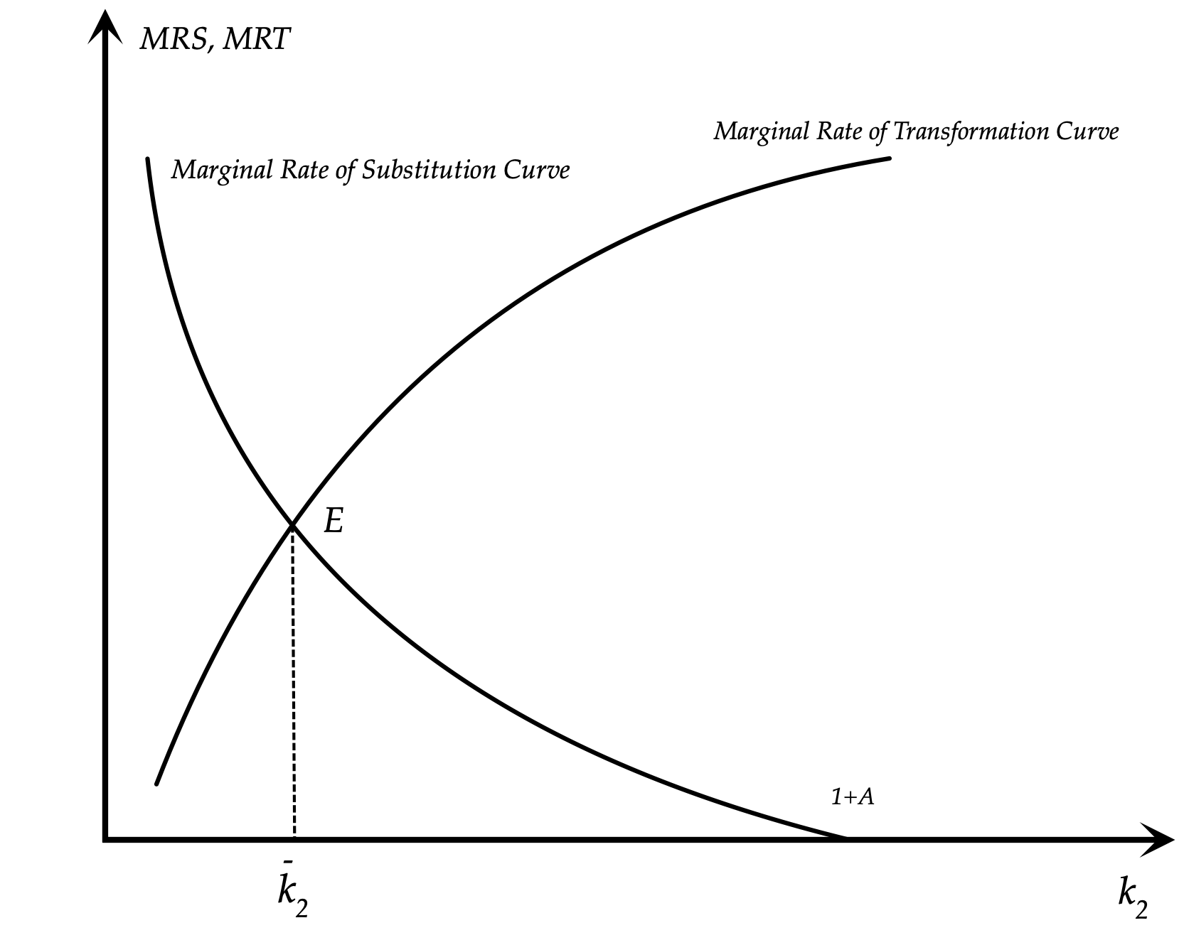
Determination of Equilibrium Capital Stock in Period 2

Slide 37
Determination of Equilibrium Capital Stock in Period 2
The downward sloping curve in the Figure depicts the left hand side of the Euler equation for consumption, which is the marginal rate of substitution between period 2 and period 1 consumption. This is a negative function of the second period capital stock because as consumers reduce period one consumption in order to increase investment, the marginal utility of first period consumption rises relative to the marginal utility of period 2 consumption, and hence the marginal rate of substitution falls.
The upward sloping curve depicts the right hand side of the Euler equation for consumption, which is the marginal rate of transformation between consumption in periods 2 and 1, again as a function of the second period capital stock. As investment in the second period capital stock increases, the real interest rate in period 2 falls, because of the diminishing marginal productivity of capital, and hence the marginal rate of transformation between consumption in periods 2 and 1 increases.
The equilibrium capital stock is determined at the intersection of the two curves, where the marginal rate of substitution is equal to the marginal rate of transformation.
If the period 2 capital stock was higher than the equilibrium capital stock, the real interest rate would be lower, and households would immediately reduce savings and investment, reducing the capital stock to its equilibrium value. If the capital stock was lower than the equilibrium capital stock, the real interest rate would be higher, and households would immediately increase savings and investment, increasing the capital stock to its equilibrium value.
To put it differently, the second period equilibrium capital stock is the stock for which the second period real interest rate induces households to provide sufficient savings and investment in the first period, for this capital stock to be attained in the second period.
Note from that the optimal second period capital stock depends on preference parameters, such as the pure rate of time preference ρ and the elasticity of intertemporal substitution of consumption θ, as well as technological parameters, such as A, g and α. Obviously, it depends on initial endowments as well, which have been normalised to unity.

Slide 38
Determination of the Rest of the Equilibrium Variables
Having determined the optimal second period capital stock from the Euler equation for consumption, the rest of the equilibrium variables follow from the household budget constraints, and the marginal productivity conditions for period 2. We thus have that,
$${\overline{c}}_{1}=1+A-{\overline{k}}_{2}$$
$${\overline{c}}_{2}={\overline{k}}_{2}+A(1+g){\overline{k}}_{2}^{α}$$
$${\overline{r}}_{2}=αA(1+g){\overline{k}}_{2}^{α-1}$$
$${\overline{w}}_{2}=(1-α)A(1+g){\overline{k}}_{2}^{α}$$
All these variables are determined as functions of the preference, technological and endowment parameters, that determine the second period capital stock.

Slide 39
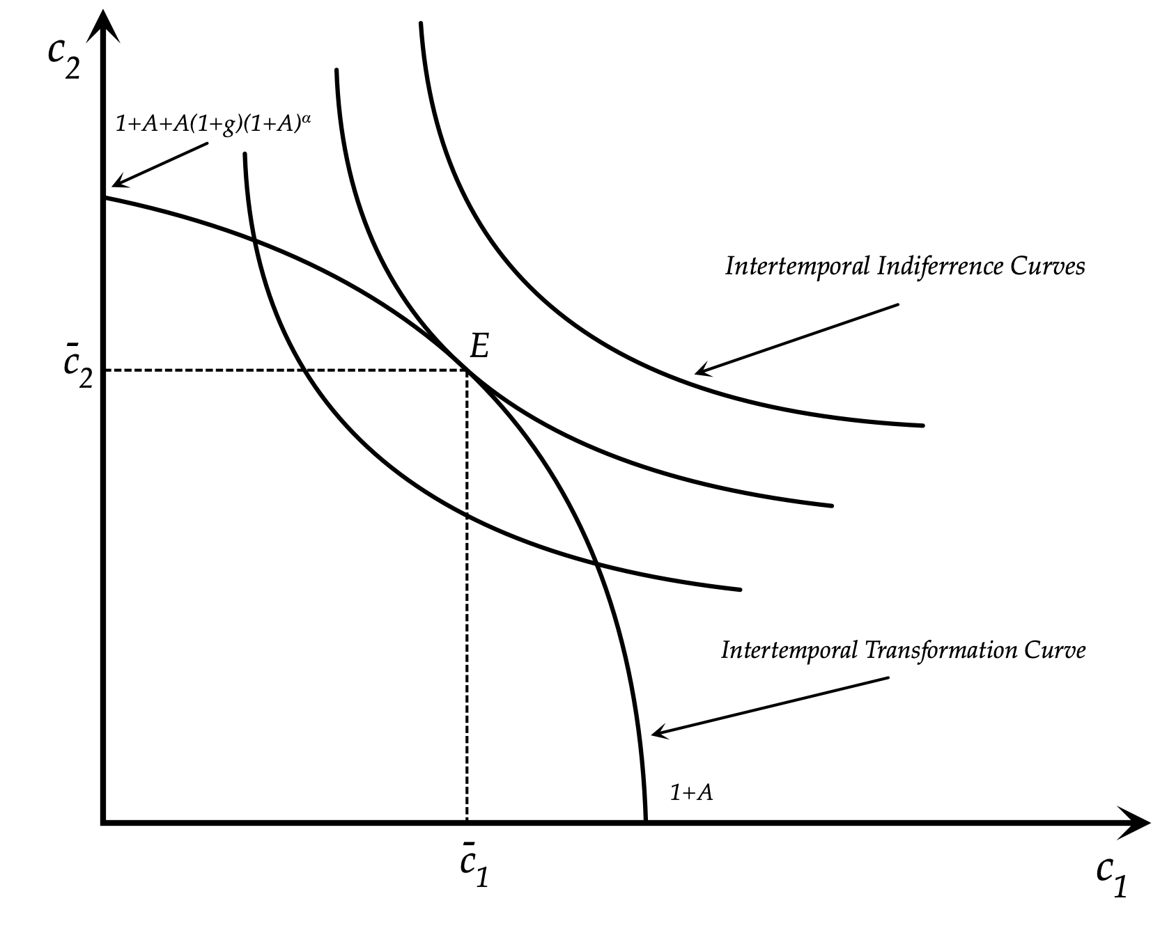
A Diagrammatic Exposition of the Intertemporal Equilibrium

Slide 40
Properties of the Competitive Equilibrium in the Two Period Model
The competitive equilibrium depends on the preferences and the endowments of the representative household, and the technology of production used by the representative firm.
Because of the assumption of non-satiation, households optimally supply their full endowments of capital and labor to be used for production, and consume both their current income and their capital endowment in the second period.
Savings depend on the real interest, the pure rate of time preferences and the elasticity of intertemporal substitution of consumption. In the case where the elasticity of the intertemporal substitution of consumption is equal to unity, savings are independent of the real interest rate.
The second period real interest rate is determined by the equality of savings and investment.
In equilibrium, the main determinants of real variables are the endowments and the preferences of households. In the case of the CEIS utility function, the preference parameters are the pure rate of time preference ρ and intertemporal elasticity of substitution of consumption. In the case of the Cobb Douglas production, the parameters of the technology of production are total factor productivity A, and the share of capital α.
There is full employment of both capital and labor.

Slide 41
Implications for Growth and Business Cycle Theory
The two period competitive model of savings and investment that we have examined can be seen as the basis of most optimising one sector models of economic growth and of competitive models of aggregate fluctuations.
The representative household model of economic growth, one of the workhorses of growth theory, is nothing more than an extension of the two period model to economies that last for an infinite number of periods. In fact, this extension was accomplished by Ramsey (1928), even before the publication of the two period model by Fisher (1930).
The Ramsey infinite horizon representative household model of optimal growth will be analyzed shortly. Models of overlapping generations, such as the Diamond (1965) and Blanchard (1985)-Weil (1989) models, which will also be analyzed, are also based on the two period intertemporal model of Fisher (1930). Essentially, they are an extension of the representative household model to economies in which households have different birth dates. However, as we shall see, overlapping generations models do not share the optimality properties of the two period representative household model, or the infinite horizon Ramsey model with perfect markets. The reason is that in overlapping generations model without intergenerational links, current generations do not take the welfare of future generations into account, and hence savings are lower that what would be socially optimal.
As we shall see in the rest of this course, for infinite horizon versions of either representative household or overlapping generations models, the invididual household optimality conditions of the two period model, such as the Euler equation for consumption, recur again and again. Hence, their basic properties are related to those of the two period model, although, obviously, these richer multi-period models also have richer and more diverse predictions and implications. However, to the extent that there is no intergenerational altruism, overlapping generations models imply sub-optimally low savings.
The two period representative household model forms the basis of competitive equilibrium theories of business cycles, in the form of the stochastic growth model. However, apart from going beyond the two period model this requires introducing the consumption-leisure choice, as well as uncertainty, in the form of stochastic real disturbances. This we shall do before we introduce the analysis of business cycles.

Slide 42
The Intertemporal Approach and the Treatment of Time
The two period intertemporal model examined in this chapter is obviously a simplified and restrictive example. One of the main simplifications is with regard to the treatment of time, which is confined to two time periods only. Yet, the model can be extended in a straightforward manner by allowing for additional time periods.
For example, one could assume that time is an integer belonging to any subset of the set of integers $Z$, from mimus infinity to plus infinity.
Mathematically, with an infinite number of time periods, we can assume that, $t=-∞,...,-2,-1,0,1,2,...,∞$, or that $t∈Z$.
Intertemporal analysis could also be confined to any subset of the set of integers $Z$, such as the set of positive natural numbers $N$, or any finite subset of $Z$ or $N$.

Slide 43
Extending the Intertemporal Utility Function and the Intertemporal Budget Constraint
For example, the two period intertemporal utility function of the representative household could be extented to T periods, and take the form,
$U=∑_{t=0}^{T}{\left(\frac{1}{1+ρ}\right)}^{t}u\left(c_{t}\right)$
Similarly, the two period intertemporal budget constraint of the representative household could be extended to T periods, and take the form,
$∑_{t=1}^{T}{\left(\frac{1}{1+r}\right)}^{t-1}c_{t}=1+r+∑_{t=1}^{T}{\left(\frac{1}{1+r}\right)}^{t-1}w_{t}$
where r is the real interest rate.

Slide 44
Discrete versus Continuous Time
When time is expressed in terms of integers, it refers to discrete time periods, such as days, weeks, months, quarters and years. Such intertemporal analysis is termed discrete time analysis.
Discrete time views values of variables as occurring at distinct, separate ‘points in time’, or equivalently as being unchanged throughout each non-zero region of time. Thus an economic variable that depends on time jumps from one value to another as time moves from one time period to the next. For example the change of variable x between period t and period t+1, is denoted as, $Δx_{t+1}=x_{t+1}-x_{t}$. $Δ$ is called the first difference operator.
Another way to treat time is as a continuous variable. Continuous time analysis views variables as taking a particular value for potentially only an infinitesimally short amount of time. Between any two points in time there are an infinite number of other points in time. The variable ‘time’, denoted by t, ranges over the entire set of real numbers $R$, or, depending on the context, over some subset of it, such as the non-negative real numbers. Hence, in continuous time models it is assumed that, $t∈R$. We can think of continuous time as the limit of discrete periods of duration $Δt$, where $Δt$ tends to zero.
For example, the change $Δ$ in a variable x between periods t and t + $Δt$ can be written as, $Δx_{t}=x_{t+Δt}-x_{t}$. Dividing by $Δt$ and letting it tend to zero, we get,
$\overset{·}{x}(t)=\lim_{Δt→0}\left(\frac{x_{t+Δt}-x_{t}}{Δt}\right)$
A dot above a variable denotes its first derivative with respect to time, when time is a continuous real variable.

Slide 45
The Intertemporal Utility Function and the Intertemporal Budget Constraint in Continuous Time
The T period intertemporal utility function in continuous time takes the form,
$U=∫_{t=0}^{T}e^{-ρt}u\left(c(t)\right)dt$
where t is assumed continuous, in the interval [0,T]. The integral is the limit of the sum, when the length of the time period tends to zero.
Analogously, the T period intertemporal budget constraint in continuous time, takes the form,
$∫_{t=0}^{T}e^{-rt}c(t)dt=1+∫_{t=0}^{T}e^{-rt}w(t)dt$
In what follows we shall use the widespread convention that $t$ is written as a subscript in an analysis in discrete time, and into a parenthesis in an analysis in continuous time. We shall use both ways of defining time. Growth models will be analyzed mostly in continuous time, whereas stochastic models of aggregate fluctuations will be analyzed mostly in discrete time.
The two types of intertemporal analysis are equivalent, but, depending on the context, one of the two methods is either analytically or notationally more convenient.

Slide 46
References
    Alogoskoufis, G. (2019), Dynamic Macroeconomics, MIT Press, Cambridge, MA. (Chapter 2).
    The Two-Period Intertemporal Model
    Fisher, I. (1931), The Theory of Interest, Macmillan, New York.
The Representative Household Model
Ramsey, F. (1928), “A Mathematical Theory of Saving”, Economic Journal, 38 (152), pp. 543-559.
Cass, D. (1965), “Optimum Growth in an Aggregative Model of Capital Accumulation”, Review of Economic Studies, 32 (3), pp. 233-240.
Koopmans, T. (1965), “On the Concept of Optimal Economic Growth”, in The Economic Approach to Development Planning, Elsevier, Amsterdam.
Models of Overlapping Generations
Allais, M. 1947. Economie et Interet. Imprimerie National, Paris.
Blanchard, O.J. (1985), “Debts, Deficits and Finite Horizons”, Journal of Political Economy, 93 (2), pp. 223-247.
Diamond, P. (1965), “National Debt in a Neoclassical Growth Model”, American Economic Review, 55 (5), pp. 1126-1150.
Samuelson, P.A. (1958), “An Exact Consumption-Loan Model of Interest, with or without the Social Contrivance of Money”, Journal of Political Economy, 66 (6), pp. 467-482.
Weil, P. (1989), “Overlapping Families of Infinitely-Lived Agents”, Journal of Public Economics, 38 (2), pp. 183-198.

