Slide 1
2. Key Facts about Long Run Economic Growth
Athens University of Economics and Business
Dynamic Macroeconomics
Prof. George Alogoskoufis
alogoskoufisg.com
George Alogoskoufis, Dynamic Macroeconomics, 2019

Slide 2
The Measurement of Economic Growth
Living standards are usually measured by annual Gross National Income (GNI) per capita, or annual Gross Domestic Product (GDP) per capita.
However, in order to perform cross country comparisons, per capita income must be measured in comparable units. This requires the transformation of per capita income in a common currency, usually the US dollar. In order to adjust for differences in purchasing power among countries, we use exchange rates that reflect differences in purchasing power. These exchange rates ensure purchasing power parity (PPP), and are called PPP adjusted exchange rates. Thus, for all countries, GNI per capita, or GDP per capita is measured in PPP adjusted dollars, or international dollars.
For comparisons over time, we also adjust for inflation in each country, using real per capita income or output.

Slide 3
Data and Methodology of Measuring per capita GNI and GDP
For the exact methodology of measuring per capita GNI and GDP see the World Bank, Summers and Heston (1991), who have calculated comparable data for many countries since 1950, or Maddison (1982), who has calculated comparable data since 1A.D.
World Bank data, the data of the Penn World Tables (which are based on the Summers and Heston methodology), and the data of the Maddison Project (based on the Maddison methodology) are revised at regular intervals. For the Maddison Project see Bolt and van Zanden (2014).

Slide 4
Cross Country Differences in Per Capita Output and Income
The World Bank publishes comparable data, in international US dollars, measuring the per capita Gross National Income (GNI) of 214 countries of the world. For 2012 the relevant data existed for 184 countries.
The average per capita GNI of countries classified as high income economies was $39,903, while the average per capita GNI of low income economies was $1,870. The per capita income of high income (developed) economies was thus on average 20 times higher than that of low income, or least-developed economies. The average per capita income of middle income economies was equal to $9,075. The per capita income of high income (developed) economies is thus on average 4 times higher than that of middle income economies.
For example, in the USA, annual per capita Gross National Income (GNI) in 2012 was $52,220, while the annual per capita income of the Congo, one of the poorest economies, was only $710, of comparable purchasing power. The Congo had a per capita income which was just 1.4% of the US per capita income.

Slide 5
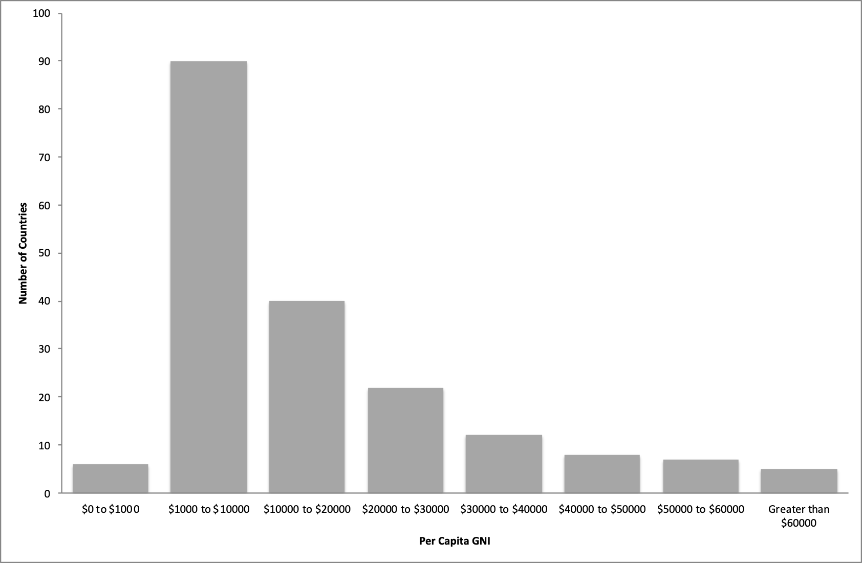
Distribution of Countries by per capita GNI, 2012

Slide 6
Distribution of Countries by per capita GNI, 2012
Five countries (Qatar, Macau, Singapore, Bermuda and Norway) had GNI per capita above $60,000.
Seven countries (United Arab Emirates, Luxembourg, Switzerland, Saudi Arabia, Oman, the USA and Hong Kong) had GNI per capita between $50,000 and $60,000.
Eight developed European economies, as well as Australia and Canada, had GNI per capita between $40,000 and $50,000.
Twelve countries (including France, Great Britain, Japan, Italy, N. Korea, Spain, New Zealand and Israel) had GNI per capita between $30,000 and $40,000.
Twenty-two countries (including Greece, Cyprus, and Russia) had GNI per capita between $20,000 and $30,000.
Forty countries (including Turkey, Brazil and China) had GNI per capita between $10,000 and $20,000.
Ninety countries, about half of the 184, had a GNI per capita between $1,000 and $10,000. These included India, with per capita GNI of $5,080.
Finally, six countries in sub-Saharan Africa, had per capita GNI of less than $1,000.

Slide 7
Economic Growth in Historical Perspective
Before 1820, available data on the per capita output and income of various countries, and their growth rates, is extremely rare.
The estimates of Maddison (1982) suggest that the average growth rate of real world GDP per capita in the period 1500-1700 was only 0.04% per year, while in the period 1700-1820 just 0.07% per year. Even in Western Europe, for which the period 1500-1820 was one of great economic prosperity compared to other world regions, the average growth rate of GDP per capita did not exceed 0.14% per annum.
Before 1500, all indications suggest that the standard of living, despite large cyclical fluctuations, showed no long-term trend.
A second feature of this period was that income differences between countries were very small compared to today. According to estimates of Bairoch (1993), the differences in living standards between the richest and the poorest countries did not exceed 1.5-2.0 to 1. Moreover, Bairoch estimates that there were no significant differences in living standards between Rome in the 1st century AD, the Arab caliphates in the 10th century AD, China in the 11th century, India on the 17th and Europe in the early 18th century.

Slide 8
Europe versus the Rest of the World
In the 15th century AD, before the major economic boom in Europe, China, the Ottoman Empire, the Incas and the Aztecs seem to have had a higher standard of living than Western Europe. However, economic growth in Western Europe picked up after 1500 AD.
A dramatic case of relative economic decline was that of China. Between the 8th and the 12th century, China experienced an unprecedented period of economic and cultural prosperity. It was in this period that gunpowder, printing and the hydraulic hose reel were invented. Coal was used in the production of steel and a series of canals and waterways for water supply and transportation of products was constructed. The magnetic compass was invented in that period, and the imperial fleet of China had reached as far as the eastern coast of Africa by the early 15th century. However, China gradually withdrew from the world economy, following a policy of introversion, and around 1750 the standard of living in Europe had overtaken the Chinese standard of living. One hundred years later, in the 19th century, China was unable to defend itself during the opium wars against Great Britain, and in the 20th century it was one of the least developed economies of the world.

Slide 9
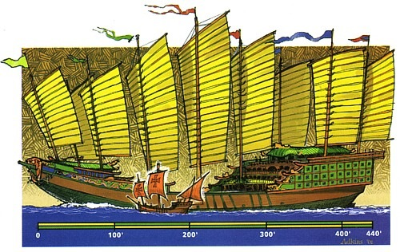
The Ships of Zeng He versus the Caravelle of Christopher Columbus

Slide 10
The Evolution of per capita Output and Income since 1820
The average growth rate of world per capita output increased between 1820 and 1870, reaching 0.5% per year. Between 1870 and 1950 the average growth rate doubled to 1.1%, and since 1950 it doubled again to over 2%. Between 1950 and the early twenty-first century, many countries have seen their standard of living to more than triple.
As a result, in the high income countries, real per capita output and income today is, depending on the country, between 10 and 30 times higher than it was two hundred years ago.
However, the growth process has not been uniform. In 1820, the more developed countries had a per capita GDP which was about three times the per capita GDP of less developed countries. In 2012, it was about twenty (20) times higher. The former colonies of Western Europe (USA, Canada, Australia and New Zealand) in 1820 had a slightly lower standard of living compared to Western Europe itself. In 1950 they had twice the per capita income of Western Europe. Japan surpassed the standard of living of Eastern Europe, Latin America, the former Soviet Union and Western Europe in the second half of the 20th century. China, one of the poorest countries in the world in 1950, in 2010 had a per capita income which was more than double the per capita income of India and Africa. Latin America, parts of Asia and Africa have been left behind.

Slide 11
How Long does it take for per capita GNI or GDP to double?
The number of years required for a magnitude like per capita output or income to double in value depends on its growth rate.
If per capita real income grows at g% per annum, it takes approximately 70/g years for it to double.
Thus, if g is 1%, it takes 70 years for per capita real income to double, if g is 2% it takes 35 years for it to double, if g is 3% it takes 23 years, and so on.
This rule of 70 is derived from 100xln2=69.3, which is approximately equal to 70.

Slide 12
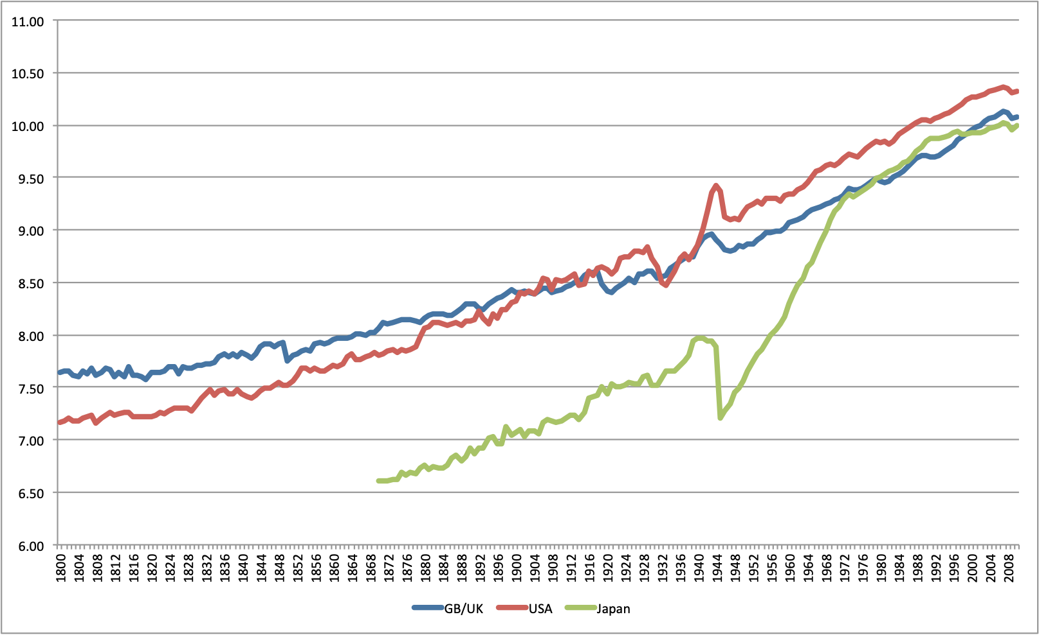
Real GDP per capita in Great Britain, the USA and Japan since 1800

Slide 13
Real GDP per capita in Great Britain, the USA and Japan since 1800
In 1800, British per capita GDP was more than 60% higher than in the USA. At the beginning of the 20th century, per capita GDP in the USA had surpassed the corresponding British one, because of the higher growth rate in the USA. The two World Wars led to a widening of the gap between the USA and Britain, despite the fact that the Great Depression of the 1930s was more severe in the USA. After the Second World War, per capita output in the USA has remained consistently higher than in Britain and the other main developed economies.
The Japanese GDP per capita, for which continuous annual estimates exist only after 1870, has been consistently lower than the British and American one in the 19th century. In 1870, it was only 23% of the corresponding British one, and only 30% of the American one. By 1913, on the eve of World War I, it had risen to 28% of the British per capita GDP, but had fallen to 26% of the American one. Japan had experienced slightly higher growth than Britain, but lower growth that the USA. By 1939, on the eve of World War II, GDP per capita in Japan had risen to 45% of the corresponding one in Britain, and to 43% of the corresponding one in the USA. Japan experienced much higher growth than Britain and the USA during World War I and the interwar years. Japanese per capita output fell precipitously in the aftermath of World War II, much more than in Britain and the USA. However, since the end of the World War II, Japan has experienced very high growth, and by the mid-1970s the Japanese GDP per capita had converged to the British one. Since the early 1980s, Japanese growth slowed down, and British growth picked up, with the result that Britain has again surpassed the living standards of Japan.

Slide 14
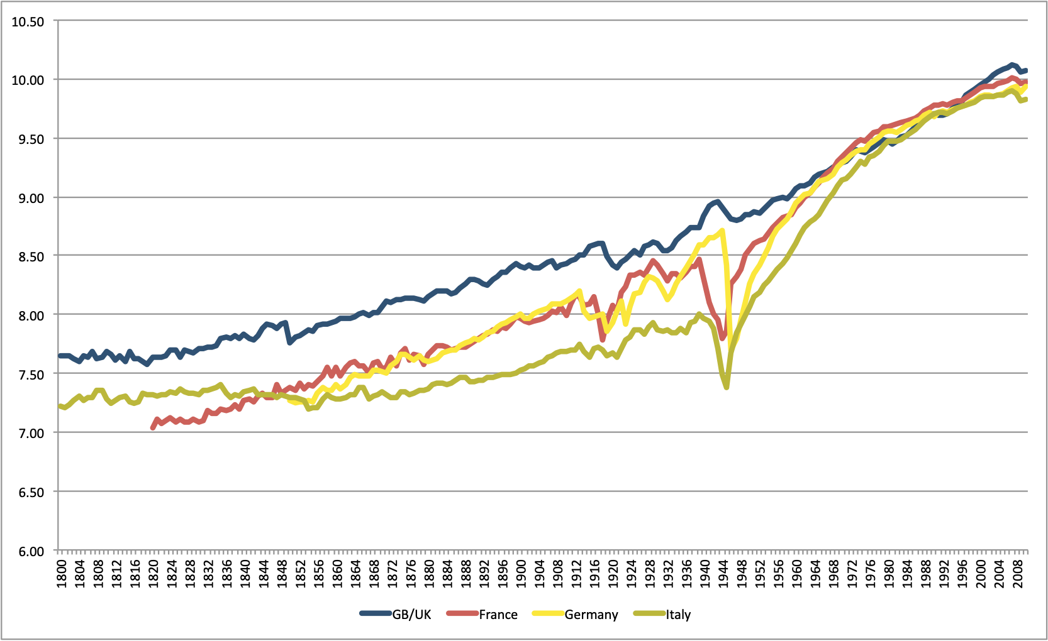
Real GDP per capita in the Four Major European Economies since 1800

Slide 15
Real GDP per capita in the Four Major European Economies since 1800
France, Germany and Italy had significantly lower per capita GDP than Britain throughout the 19th century and the first half of the 20th century. For France and Germany there was a slow process of convergence until the eve of World War I, and faster convergence in the interwar period. In the aftermath of World War II, convergence was rapid, and by the early 1970s, per capita GDP did not differ by much in these four economies.

Slide 16
Economic Growth since 1950
There has been a significant increase of world economic growth in the postwar period. Between 1950 and 2010, i.e during the last 60 years, the real per capita GDP of the USA more than tripled. Its average annual growth rate was about 2% per annum. The major developed European economies displayed even higher growth. The average annual growth rates of real per capita GDP in Britain was 2.1%, slightly higher than in the USA. Italy achieved an average annual growth rate of 3.0%, Germany 2.8% and France 2.4%. As a result, there was significant convergence of the per capita GDP of the major European economies, and convergence between Europe and the USA. The average annual growth rate of per capita income in Japan was 4.1% in the same period, significantly higher than in the USA and the major European economies.
However, even during the past 60 years, the less developed economies have not demonstrated a uniform tendency towards convergence with the per capita income of the developed economies. Some developing economies, particularly in the rest of Western Europe and Southeast Asia, have achieved impressive increases in per capita income compared to 1950, and significant convergence with the living standards of the developed economies. However, other economies, particularly in Latin America, the rest of Asia and Africa, have fallen dramatically behind.

Slide 17
Long Run Economic Growth in Greece
In 1833, a few years after independence, the annual real per capita GDP of Greece was approximately $1323 (2011 $ at 2011 prices). In the same year, the annual real per capita GDP of the USA was approximately $2691, and that of Great Britain $2374. Thus, the per capita GDP of Greece was roughly 49.2% of the per capita GDP of the USA and 55.7% of that of Great Britain. (Source: Maddison Project, 2019).
After 183 years, in 2016, the annual real per capita GDP of Greece was approximately $24689 (2011 $ at 2011 prices), that is 18.7 times higher, and it had fallen to 46.6% of the per capita GDP of the USA, which had itself risen by approximately 19.7 times, to $53015. However, it had risen to 63% of the real per capita GDP of Great Britain, which had itself risen by approximately 16.5 times to $39162.
However, these long term trends are characterised by significant fluctuations, especially during deep recessions, wars and other disturbances. For example, the real per capita GDP of Greece fell significantly during the Balkan Wars and World War I (1912-1919). It also fell significantly during World War II and the German occupation of 1941-1944. It also fell significantly during the Great Recession of 2010-2016. Similarly, the real per capita GDP of the USA fell significantly during the Great Depression of the 1930s and other major recessions, such as in the 1890s and in 2008-2010.
These long term trends also put together the period of relatively slow economic growth in the 19th century and the first half of the 20th century and the period of relatively fast economic growth in the second half of the 20th century, after the end of World War II and the Greek Civil War.

Slide 18
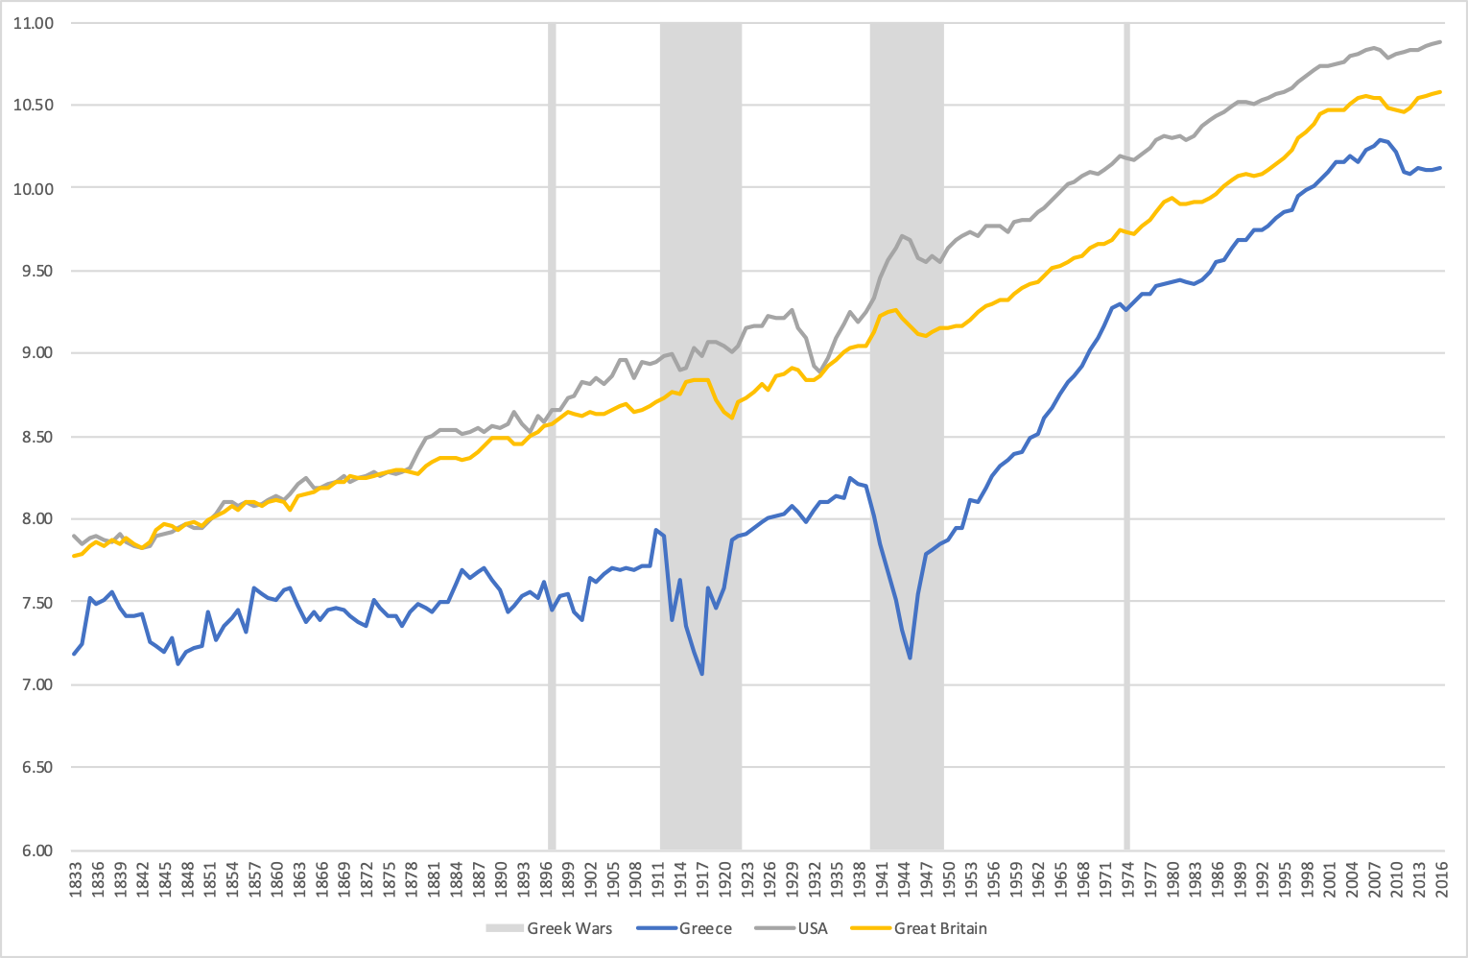
GDP per capita in Greece, the USA and Great Britain
(1833-2016, log scale)
Source: Maddison Project, 2019

Slide 19
Post War Economic Growth in Greece
In 1951, after World War II and the civil war, the annual real per capita GDP of Greece was approximately $3374 (2011 $ at 2011 prices). In the same year, the annual real per capita GDP of the US was approximately $15335. Thus, the per capita GDP of Greece was roughly 22.0% of the per capita GDP of the USA. (Source: Penn World Tables, 2019).
After 22 years, in 1973, the annual real per capita GDP of Greece was approximately $13010 (2011 $ at 2011 prices), that is 3.9 times higher, and it had reached 49.3% of the per capita GDP of the USA, which had itself risen by approximately 1.7 times, to $26366.
The average annual growth rate of real per capita GDP in Greece was 6.4%, versus 2.4% in the USA.
57 years after 1951, in 2008, the annual real per capita GDP of Greece was approximately $31340 (2011 $ at 2011 prices), that is 9.3 times higher, and it had reached 62% of the per capita GDP of the USA, which had itself risen by approximately 3.3 times, to $50550.
The average annual growth rate of real per capita GDP in Greece was 4.0%, versus 2.1% in the USA.
In 2017, 9 years since the financial crisis of 2008 and 7 years since the Euro area crisis of 2010, the annual real per capita GDP of Greece was approximately $25376 (2011 $ at 2011 prices), that is 20% lower than in 2008, and it had fallen to 45,2% of the real per capita GDP of the USA, which had itself risen by approximately 11%, to $56153.

Slide 20
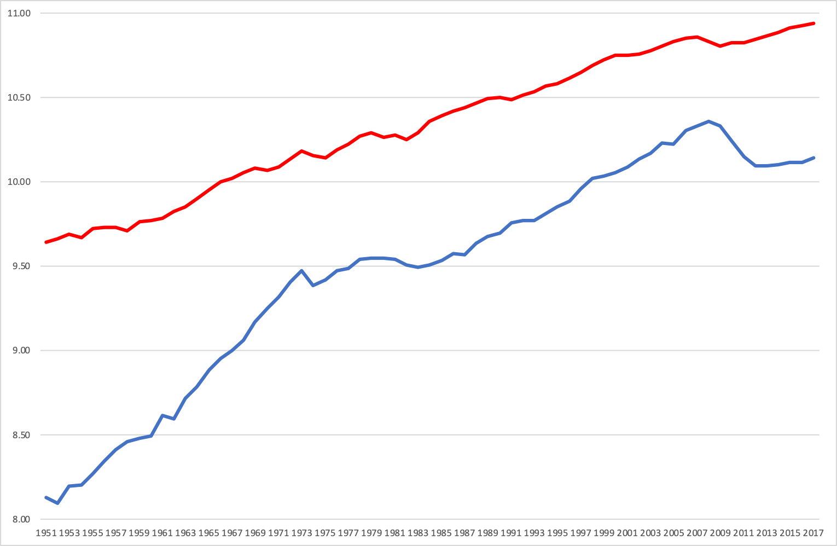
GDP per capita in Greece and the USA
(1951-2017, log scale)
Source: Penn World Tables, 2019

