Slide 1
15. Matching Frictions and Equilibrium Unemployment
Athens University of Economics and Business
Dynamic Macroeconomics
Prof. George Alogoskoufis
alogoskoufisg.com
George Alogoskoufis, Dynamic Macroeconomics, 2019

Slide 2
A Fully Competitive Labor Market Model Cannot Account for Unemployment
In a fully competitive labor market, without uncertainty and frictions, employers would be indifferent about whether an employee leaves her job, since they can replace her immediately and at no cost, and at the same competitive wage, with another employee.
In the same vein, an employee would be indifferent about losing her job, since she can readily find another one at the same competitive real wage.
Moreover, in such a market “involuntary” unemployment cannot exist, because the excess supply of workers would cause an immediate decline in real wages, which would lead to the elimination of unemployment.

Slide 3
Unemployment and Vacancies
In almost all economies there is a positive and non-trivial unemployment rate even in boom periods. There are many unemployed people seeking jobs similar to those held by workers with similar characteristics, at wages equivalent to those generally prevailing in the labor market.
At the same time, there are many firms with vacancies, seeking to fill them with employees, possessing characteristics similar to those of the unemployed, and at prevailing real wages. How can then one explain the existence and the fluctuations of both unemployment and vacancies?
The explanation of unemployment is one of the central tasks of macroeconomics. There are two types of questions that are being asked. First, what determines the equilibrium rate of unemployment in an economy, what are its implications, and to what extent the equilibrium unemployment rate reflects labor market distortions. The second key question concerns the cyclical fluctuations of unemployment during the economic cycle.

Slide 4
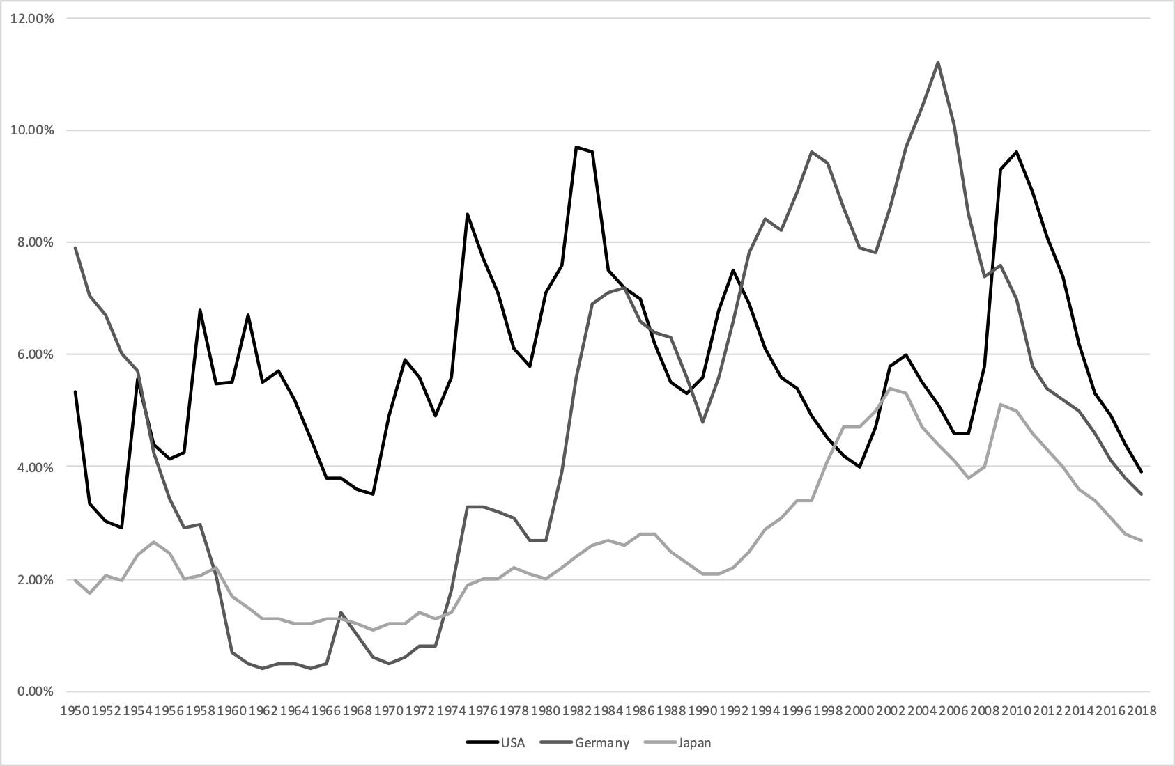
Post-War Unemployment in the USA, Germany and Japan

Slide 5
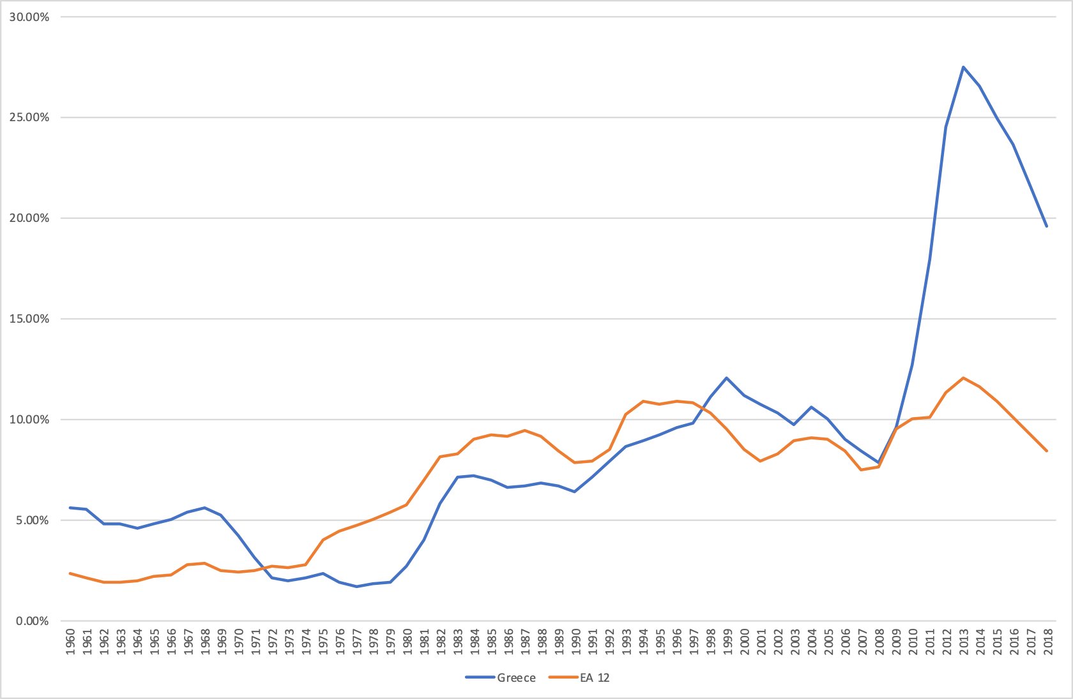
Post War Unemployment in Greece

Slide 6
Search and Matching Theories
These theories highlight the search costs of looking for an appropriate job, by unemployed job seekers, and the search costs of looking for an appropriate employee, by firms with vacancies.
In these theories, a costly search process is required for the matching of job seekers with appropriate vacancies in order to create a new job. Consequently, jobs entail rents, something that does not apply in fully competitive labor market models.
The early search theories date back to 1970. See Pissarides (2000) for an extensive analysis of such models. Other relatively recent papers include, Mortensen (1986), Pissarides (1985) and Mortensen and Pissarides (1994).

Slide 7
Unemployment and Matching in the Labor Market: The Mortensen-Pissarides Model
In this model, employers are investing in order to create job vacancies and the process of filling a vacancy involves matching of a firm, which has created a vacancy with an unemployed job seeker.
At each instant, there are two flows into and out of unemployment. Some workers lose their jobs and move from jobs into unemployment, and some of the unemployed find jobs, through the matching process, with firms which have created vacancies.
In the simpler versions of the model the probability of job terminations is exogenous. This parameter describes the structural or cyclical shocks affecting the economy, and leading to the destruction of jobs.
The probability of filling a vacancy, as well as the probability of an unemployed job seeker to find a job, are endogenous variables in this model, and depend on the degree of labor market tightness, which is defined by the ratio of vacancies to the unemployed. The higher the tightness of the labor market, the greater the probability of an unemployed job seeker to find a job, and the lower the probability of a firm to fill a vacancy.

Slide 8
Equilibrium Unemployment in the Mortensen-Pissarides Model
In the steady state, the flows to and from unemployment are equalized, and the equilibrium unemployment rate depends positively on the exogenous probability of job terminations, and negatively on the endogenous probability that an unemployed job seeker finds a job.
The equilibrium unemployment rate therefore depends negatively on labor market tightness, and is, of course, determined endogenously.
The negative relationship between the unemployment rate and the vacancy rate which is implied by this dependence is known as the Beveridge curve.

Slide 9
The Behavior of Firms and the Creation of Vacancies and Jobs
Firms and the unemployed make their decisions rationally, maximizing the expected present value of their profits and income.
Firms create new vacancies as long as the expected profits from the investment required to create a vacancy are positive. The condition for a vacancy to be filled, and for a new job to be created is that the real wage should be equal to labor productivity minus the cost of creating and maintaining a vacancy. By filling a vacancy, a firm must in equilibrium cover both the wage costs and the costs of its investment in the creation of the vacancy.
The job creation condition implies a negative relationship between the wage that the firm is willing to pay and labor market tightness. The higher is labor market tightness, the lower is the probability of filling a vacancy and the greater the total cost of maintaining a vacancy, since vacancies remain unfilled for longer.

Slide 10
The Behavior of Unemployed Job Seekers and the Determination of Real Wages
An unemployed job seeker will agree to get a job if the expected present value of income of an employed worker is greater than the expected present value of income of an unemployed job seeker. This condition is satisfied in this model, as long as the real wage is higher than unemployment benefits.
Real wages are determined in equilibrium by decentralized bargaining between firms that have vacancies and unemployed job seekers. The equilibrium real wage is the result of this negotiation, and depends positively on the relative bargaining power of the unemployed, the level of unemployment benefits, labor productivity, the cost of maintaining a vacancy and labor market tightness.
The equilibrium real wage depends positively on labor market tightness, as this increases the average recruitment cost per unemployed person, thereby increasing the “threat” point of prospective employees versus prospective employers, and weakening the effective bargaining position of prospective employers.

Slide 11
Equilibrium Real Wages and Unemployment
The positive relationship between real wages and labor market tightness, resulting from the negotiation between firms with vacancies and the unemployed, and the negative relationship between real wages and and labor market tightness implied by the job creation condition for firms, jointly determine the equilibrium real wage and equilibrium labor market tightness.
For given equilibrium labor market tightness, the equilibrium unemployment rate is then determined through the Beveridge curve, which implies a negative relationship between the unemployment and vacancy rates.
In the equilibrium of this model, the unemployed are worse off than the employed. Consequently unemployment is an undesirable and involuntary condition, and not the result of choice by the unemployed, as in competitive models of the labor market without frictions.

Slide 12
The Matching Function
A key assumption of this class of models is that the number of jobs created at each moment is a positive function of the number of firms looking for employees and the number of unemployed job seekers. The outcome of this process is described by the so-called matching function, determining the number of jobs created at each moment in time. The matching function is assumed to be increasing in every one of its arguments, concave and linearly homogeneous. Thus, it is characterized by constant returns to scale.
$mL=m(uL,vL)$
where,
$L$ size of the labor force
$u$ unemployment rate (unemployed as a proportion of the labor force)
$v$ vacancy rate (vacancies as a proportion of the labor force)
$m$ the job creation rate (new jobs as a share of the labor force)

Slide 13
The Probability of Filling a Vacancy and Labor Market Tightness
Assuming that all vacancies have the same probability of being filled, and that all the unemployed have the same probability of being employed, the probability of filling a vacancy shall be equal to the ratio of the number of new jobs created over all existing vacancies. If we define this probability as $q$, then the probability of filling a vacancy is defined by,
$q=\frac{m(uL,vL)}{vL}=m\left(\frac{u}{v},1\right)$
We have assumed that every unemployed job seeker has the same probability of finding a job, and that every vacancy has the same probability of being filled. We have thus assumed a Poisson frequency distribution.
From the properties of the matching function, the probability of filling a vacancy is a function only of the ratio of the unemployed to job vacancies. This is due to the assumption that the matching function is linearly homogeneous. The more the unemployed per vacancy, the greater will be the likelihood of filling any particular vacancy.
We define as $θ=\frac{v}{u}$, the ratio of vacancies to the unemployed. $θ$ measures the degree of tightness in the labor market.
The higher the number of vacancies relative to the unemployed, the greater the tightness of the labor market. We can thus express the probability of filling a vacancy as a function of labor market tightness,
$q=q(θ)$
From the properties of the matching function, it follows that, $q^{′}(θ)≤0$ and that, $-1<η(θ)=\frac{θq^{′}(θ)}{q(θ)}<0$, where $η(θ)$ is the elasticity of $q$ with respect to $θ$. Higher tightness in the labor market implies a lower probability of filling a vacancy.
It is also worth noting, that, because of the assumption of a Poisson density function, the average expected duration of a vacancy is equal to the inverse of $q$, and is thus a positive function of $θ$.

Slide 14
The Probability of Finding a Job by the Unemployed
The probability of finding a job, by an unemployed job seeker, is correspondingly equal to,
$\frac{m(uL,vL)}{uL}=\frac{v}{u}\frac{m(uL,vL)}{vL}=θq(θ)$
The elasticity of the probability of finding a job with respect to $θ$, is given by,
$1-η(θ)>0$
Therefore, the higher the tightness in the labor market (a higher $θ$), the higher the probability of an unemployed job seeker to find a job.
The average expected duration of unemployment is given by $1/θq(θ)$ and is a negative function of $θ$.
It is worth noting that, in models of this type, the price mechanism cannot lead the probability of filling a vacancy or the probability of finding a job to unity, as the labor market does not function only via the price mechanism, but also via the degree of tightness of the labor market, which determines the probabilities of firms to fill their vacancies or of the unemployed to find jobs in any particular instance.
The dependence of the probability of filling a vacancy and the probability of finding a job on the relative number of vacancies to the unemployed (tightness) is an example of a trading externality. These search externalities are important for the properties of equilibrium unemployment in this model.

Slide 15
Flows Into and Out of Employment, Equilibrium Unemployment and the Beveridge Curve
The model assumes that a proportion of existing jobs are terminated in every instant. The destruction of jobs and the flow from employment to unemployment, is due to either cyclical or structural real disturbances that make them unprofitable. It is assumed that at any instant the probability of destruction of any job is equal to $λ$, an exogenous parameter.
On the other hand, job creation occurs when a firm and an employee agree to sign a contract with a wage which is the result of a bilateral negotiation. This leads to a flow out of unemployment.
Therefore, at any given moment there are two flows in the labor market. One flow is from existing jobs into unemployment, because of job terminations, and the other from unemployment to newly created jobs. The change of the unemployment rate is thus described by,
$\overset{·}{u}=λ(1-u)-θq(θ)u$
The change in the unemployment rate at each point in time depends on the difference in the proportion of jobs destroyed from the proportion of new jobs created, the proportions being defined relative to the labor force.
In the steady state, the unemployment rate will be constant. Consequently, the equilibrium unemployment rate is determined by the condition,
$λ(1-u)=θq(θ)u$
which implies that,
$u=\frac{λ}{λ+θq(θ)}$
This is the first key equation of this model. The equilibrium unemployment rate depends positively on $λ$, the exogenous rate of job destruction, and negatively on labor market tightness $θ$. Labor market tightness is an endogenous variable in this model, and is determined in the labor market.
The negative relationship that this equation implies between the unemployment rate and labor market tightness $θ$, or, equivalently, between the unemployment rate and the vacancy rate, is usually called the Beveridge curve.

Slide 16
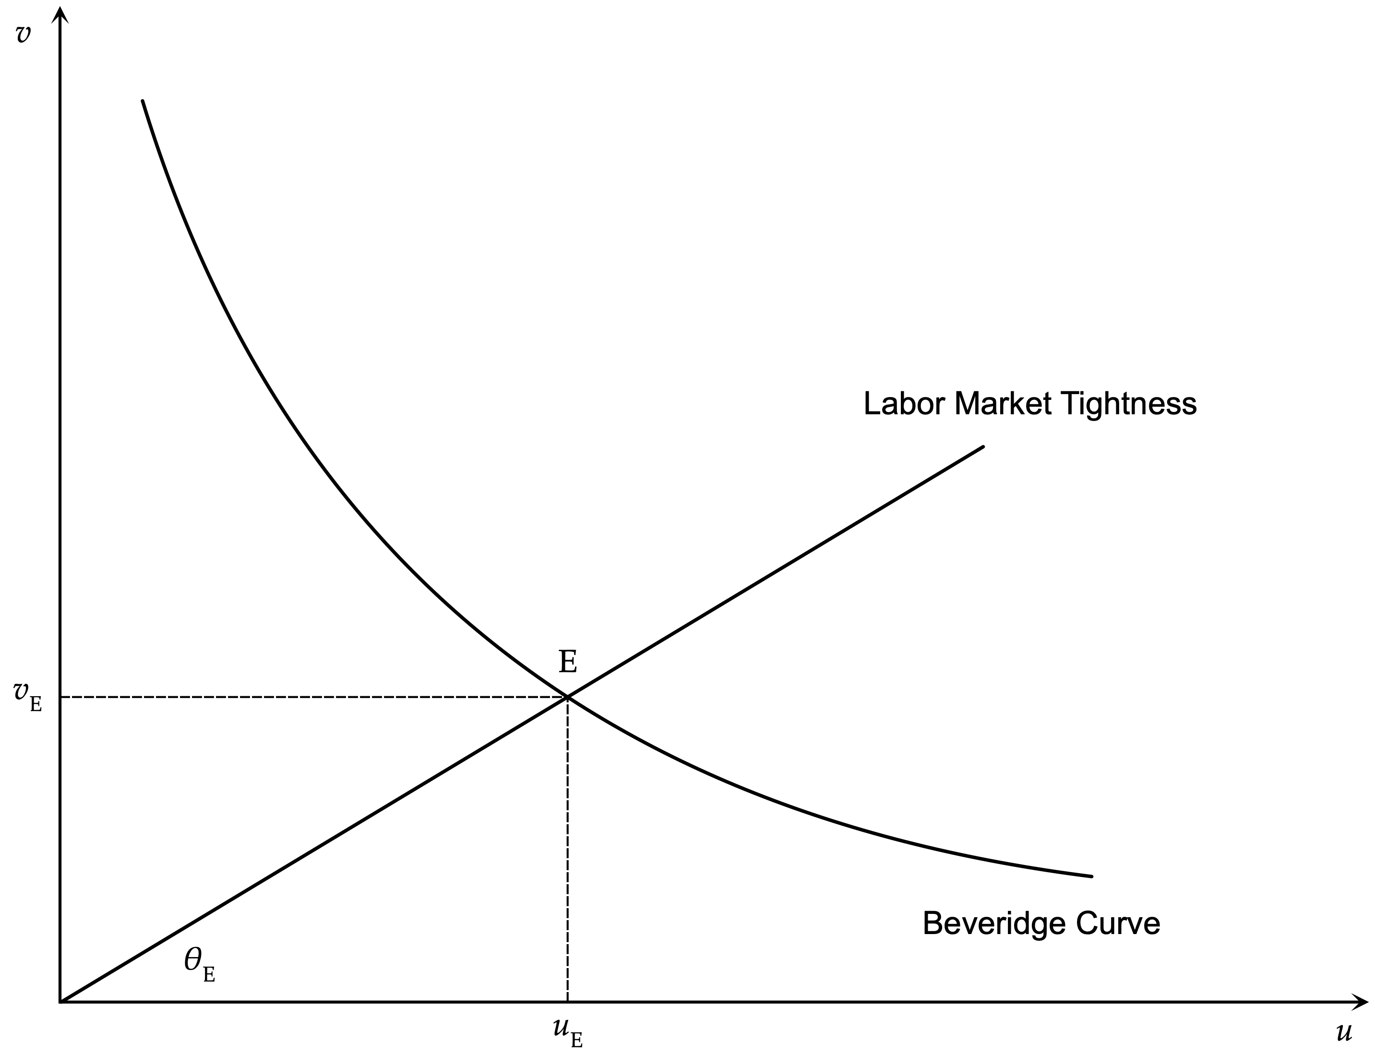
The Beveridge Curve and Equilibrium Unemployment
The Beveridge curve defines just a negative relation between vacancies and unemployment. In order for unemployment to be determined, one needs to determine labor market tightness, which is one of the endogenous variables in this model. Once labor market tightness is determined, then equilibrium unemployment is determined on the Beveridge curve. For example, assume that labor market tightness is equal to $θ_{E}$. Then the equilibrium unemployment rate would be determined at $u_{E}$, as in the Figure

Slide 17
Firms and the Creation of Vacancies
We have the creation of a new job when a prospective employer and a prospective employee get together and agree to an employment contract. Of course, before this happens, the potential employer has to create a vacancy and search for an employee and the prospective employee has to be unemployed and looking for a new job. All this involves time and costs and is described by the matching function.
We assume that the instantaneous value of the product of a job is constant and equal to $p>0$. The instantaneous cost of a vacant post to a prospective employer is equal to $pc$, where $0<c<1$. During the period of search, the employer faces a probability $q(θ)$ of finding a a suitable employee, which is independent of her actions.
The number of vacancies is endogenous and is determined by profit maximization. Any firm can create a vacancy and search for employees. Profit maximization with free entry means that the expected profit from the marginal vacancy should be equal to zero. Otherwise, firms will continue to create vacancies.

Slide 18
The Present Value of Net Expected Profits from an Existing Job
We denote by $J$ the present value of net expected profits from an existing job. The instantaneous gross profit from a job for a firm is equal to the difference $p-w$, where$w$ is the real wage. However, in every instant, there is an exogenous constant probability $λ$ of the job ending, and the firm losing the present value of net expected profits from the job.
Thus, the instantaneous expected net profit from a job is equal to,
$p-w-λJ$
Assuming a perfect capital market and an infinite horizon, the present value of this expected net profit is equal to,
$J=∫_{t=0}^{∞}e^{-rt}\left(p-w-λJ\right)dt=\frac{p-w-λJ}{r}$
$r$ is the real interest rate, which is assumed exogenous and constant.
Thus, the present value $J$ of a job for the employer must satisfy the Bellman equation,
$rJ=p-w-λJ$
The instantaneous net opportunity cost of a job $rJ$ must be equal to the instantaneous net expected profit from the job. This implies the condition,
$w=p-(r+λ)J$
For a positive net present value of expected profits from an existing job, the real wage will be less than productivity, both because of the interest costs of maintaining a job, and the positive probability of termination of the job. Thus, the wedge between productivity and the real wage must reflect these capital and insurance costs.

Slide 19
The Present Value of Net Expected Profits from a Vacancy and the Creation of Vacancies
We denote by $V$ the present value of expected profits from a job vacancy.
The instantaneous net expected profit from a vacancy is equal to the probability of filling the vacancy, and earning the difference between the present value of a job and the present value of the vacancy, minus the instantaneous maintenance cost of the vacancy $pc$. It is defined by,
$q(θ)(J-V)-pc$
Assuming a perfect capital market and an infinite time horizon, the present value of expected net profits from a vacancy $V$ is defined by,
$V=∫_{t=0}^{∞}e^{-rt}\left(q(θ)(J-V)-pc\right)dt=\frac{q(θ)(J-V)-pc}{r}$
Thus, $V$ must satisfy the Bellman equation,
$rV=-pc+q(θ)(J-V)$
A vacancy is an asset for the firm. In a perfect capital market, the instantaneous expected net yield of this asset, $q(J-V)-pc$, will be equal to its expected opportunity cost, which is equal to $rV$.

Slide 20
Free Entry and the Job Creation Condition
In equilibrium with free creation of vacancies (free entry), all profit opportunities by creating new vacancies will be exploited, and the expected profits from the creation of an additional vacancy will be equal to zero. So in equilibrium with free entry, $V=0$. This, from the condition for creating a vacancy implies that,
$J=\frac{pc}{q(θ)}$
This is an important prediction of this model. In equilibrium with free entry, the present value of a job will be equal to the expected cost of hiring an employee. This is equal to the instantaneous cost $pc$ of maintaining a vacancy, times the expected duration of the vacancy $1/q(θ)$. Thus, competition for the creation of vacancies and free entry reduces the present value of profits from a job to the level of the expected cost of hiring a worker.
Thus, using the previously derived condition $w=p-(r+λ)J$, the marginal job must satisfy,
$w=p-\frac{(r+λ)pc}{q(θ)}=\left(1-\frac{(r+λ)c}{q(θ)}\right)p$
This is the second key equation of this model, and can be called the job creation condition. The firm will only hire a worker and create a new job if the real wage is smaller than or equal to the productivity of the worker, minus the marginal hiring cost, which is defined as $\frac{(r+λ)pc}{q(θ)}$.
The marginal hiring cost is equal to the gross opportunity cost of maintaining a job. It is the opportunity cost of the expected net present value of profits from the job, which, because of free entry, is equal to the expected cost of hiring an employee. The higher is labor market tightness $\theta$, and the higher is $c$, the higher the marginal hiring cost, as the expected duration and the cost of a vacancy, is higher.
The job creation condition is the equivalent for this model of the usual condition for hiring in competitive models without hiring costs, which is non other that the real wage must be equal to (marginal) productivity. The firm will only hire a new worker if the marginal cost of maintaining the vacancy is also recouped.

Slide 21
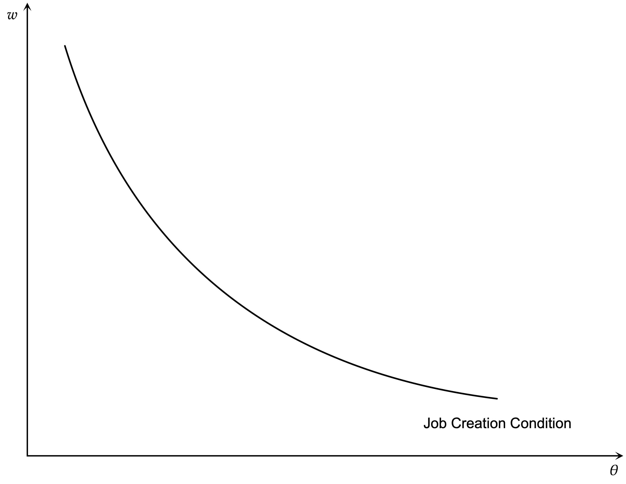
The Job Creation Condition
The job creation condition implies a negative relation between labor market tightness and the real wage. The higher is labor market tightness, the higher the expected duration of a vacancy, and the higher the marginal cost of maintaining a vacancy. Thus, the real wage that the firm would be prepared to pay, relative to productivity, will be lower. The job creation condition is depicted diagrammatically in the Figure. It is negatively sloped and convex to the origin, because of the properties of the matching function.

Slide 22
The Behaviour of Unemployed Job Seekers
The typical worker earns a real wage $w$ when employed, and is looking for a job when unemployed. For the duration of search, she has an instantaneous real income $z$, which depends on unemployment benefits and any other income or benefit from the use of free time. For simplicity we shall call $z$ the unemployment benefit.
We define as $U$ and $W$ the corresponding present values of expected income for an unemployed job seeker and an employed worker.

Slide 23
The Permanent Income of an Unemployed Job Seeker
An unemployed job seeker has an instantaneous real income equal to $z$ and an instantaneous probability of finding a job equal to $θq(θ)$. As a result, the expected instantaneous income of an unemployed job seeker is equal to,
$z+θq(θ)(W-U)$
The present value of the expected instantaneous income of an unemployed job seeker is defined by,
$U=∫_{t=0}^{∞}e^{-rt}\left(z+θq(θ)(W-U)\right)dt=\frac{z+θq(θ)(W-U)}{r}$
The permanent income of an unemployed job seeker is thus given by,
$rU=z+θq(θ)(W-U)$

Slide 24
The Permanent Income of an Employed Worker
One the other hand, an employed worker has an instantaneous real income $w$, the real wage, but at each instant also faces the risk of losing her job, with probability $λ$.
The instantaneous expected income of an employed worker is thus determined by,
$w+λ(U-W)$
The present value of her expected income $W$ is therefore equal to,
$W=∫_{t=0}^{∞}e^{-rt}\left(w+λ(U-W)\right)dt=\frac{w+λ(U-W)}{r}$
The permanent income of an employed worker is thus equal to,
$rW=w+λ(U-W)$

Slide 25
Comparing the Permanent Income of the Employed and the Unemployed
We can solve the equations for the permanent income of the unemployed and the employed as,
$rU=\frac{(r+λ)z+θq(θ)w}{r+λ+θq(θ)}$
$rW=\frac{λz+[r+θq(θ)]w}{r+λ+θq(θ)}$
It is straightforward to see that if $w≥z$, then $W≥U$, and the permanent income of an employed worker cannot be lower than the permanent income of an unemployed job seeker. In what follows, we shall assume that $w$ exceeds $z$, which indeed turns out to be the case in equilibrium.
If $w$ exceeds $z$, no employed worker has an incentive to leave their job voluntarily and become unemployed, while all the unemployed workers would accept any job offer at the prevailing real wage. If the condition $w>z$ is satisfied, unemployment is involuntary. The present value of the expected income of an unemployed job seeker is lower that the present value of the expected income of an employed worker. This holds, despite the fact that even the workers who are employed may, with some probability, lose their jobs and become unemployed in the future. Thus, unlike the competitive real business cycle model, unemployment is involuntary in this model, and the unemployed are worse off than the employed.

Slide 26
Wage Bargaining and the Wage Equation
An unfilled vacancy implies a lower expected net present value of profits than a job, despite the fact that, with some probability, a job may disappear. Unemployment implies a lower permanent income for those who experience it, than for employed workers, despite the fact that the workers who are employed may, with some probability, lose their jobs and become unemployed in the future.
A firm with a vacancy will hire an unemployed job seeker if the job creation condition is satisfied (i.e., if the real wage is lower than or equal to productivity minus the marginal hiring cost). An unemployed job seeker will accept a job offer if the real wage is higher than the unemployment benefit.
The real wage for a particular job is determined by a negotiation between a prospective employer, a firm with a vacancy, and a prospective employee, an unemployed job seeker. Because all jobs are equally productive and all the unemployed receive the same unemployment benefit, the real wage that is determined by an individual negotiation will be the same as the real wage that prevails in the rest of the economy.
From the assumptions that we have made about productivity and aggregate disturbances, any one employer and any one worker, when they get together through the matching process, will certainly agree to an employment contract and create a job. Otherwise they must continue searching, with additional costs for both sides.
An employment contract between an employer and an employee is defined by a real wage and the provision that employment will be terminated if there is a disturbance that makes the job untenable.
For a real wage $w_{i}$, the expected return for a prospective employer and a prospective employee are given by,
$rJ_{i}=p-w_{i}-λ(J_{i}-V)$, $rW_{i}=w_{i}+λ(U-W_{i})$
We have not made use of the assumption that competition has reduced the expected present value of a vacancy $V$ to zero. We have assumed though, as it appropriate, that the expected present value of a vacancy, and of the income of the unemployed $U$ depends on real wages in the rest of the economy, and is thus independent of $i$.

Slide 27
The Generalized Nash Bargain
The real wage is determined by a (generalized) Nash bargain, that maximizes the weighted product of the surplus of the prospective employer and the prospective employee from the agreement to create a job. An agreement means that the prospective employer gets a surplus $J_{i}-V$ and the prospective employee a surplus $W_{i}-U$. Thus, the real wage will satisfy,
$w_{i}=argmax(W_{i}-U)^{β}(J_{i}-V)^{1-β}$
$0≤β≤1$ is a measure of the relative bargaining power of the prospective employee, over and above what results from the ‘threat’ points $U$ and $V$.
The first order condition for the maximization implies that,
$W_{i}-U=β(J_{i}+W_{i}-V-U)$
Thus, in this model, $β$ turns out to be the share of the prospective employee in the total surplus generated by the creation of a new job.
Substituting for$J_{i}$ and $W_{i}$, it follows that the employee gets a real wage which exceeds the permanent income of an unemployed worker by a multiple β of the difference of productivity from the permanent income of an unemployed worker.
$w_{i}=rU+β(p-rU)=w$
The employee gets a real wage which exceeds the permanent income of an unemployed worker by a multiple $β$ of the difference of productivity from the permanent income of an unemployed worker.
It is obvious that real wages will be the same for all workers, as the right hand side does not depend on $i$.

Slide 28
Real Wage Determination
From the first order condition for the determination of the real wage, for $V=0$, we can drop $i$, and get,
$W-U=\frac{β}{1-β}J=\frac{βpc}{(1-β)q(θ)}$
As a result,
$rU=z+θq(θ)(W-U)=z+\frac{β}{1-β}pcθ$
Substituting for $rU$ in the wage determination equation,
$w=(1-β)z+βp(1+cθ)=z+β(p-z)+βpcθ$
The real wage exceeds the unemployment benefit $z$. It exceeds it by a proportion $β$ of the difference between productivity and the unemployment benefit, plus a proportion $β$ of the average recruitment cost per unemployed worker.
Higher labor market tightness $θ$ results in a higher real wage, as this increases the average recruitment cost per unemployed person, thereby increasing the “threat” point of prospective employees versus prospective employers, and weakening the effective bargaining position of prospective employers.
The wage function plays a role analogous to a labor supply function in a competitive labor market model.

Slide 29
The Full Model
Beveridge Curve
$u=\frac{λ}{λ+θq(θ)}$
Job Creation Condition
$w=p-\frac{(r+λ)pc}{q(θ)}=\left(1-\frac{(r+λ)c}{q(θ)}\right)p$
Wage Equation
$w=(1-β)z+βp(1+cθ)=z+β(p-z)+βpcθ$

Slide 30
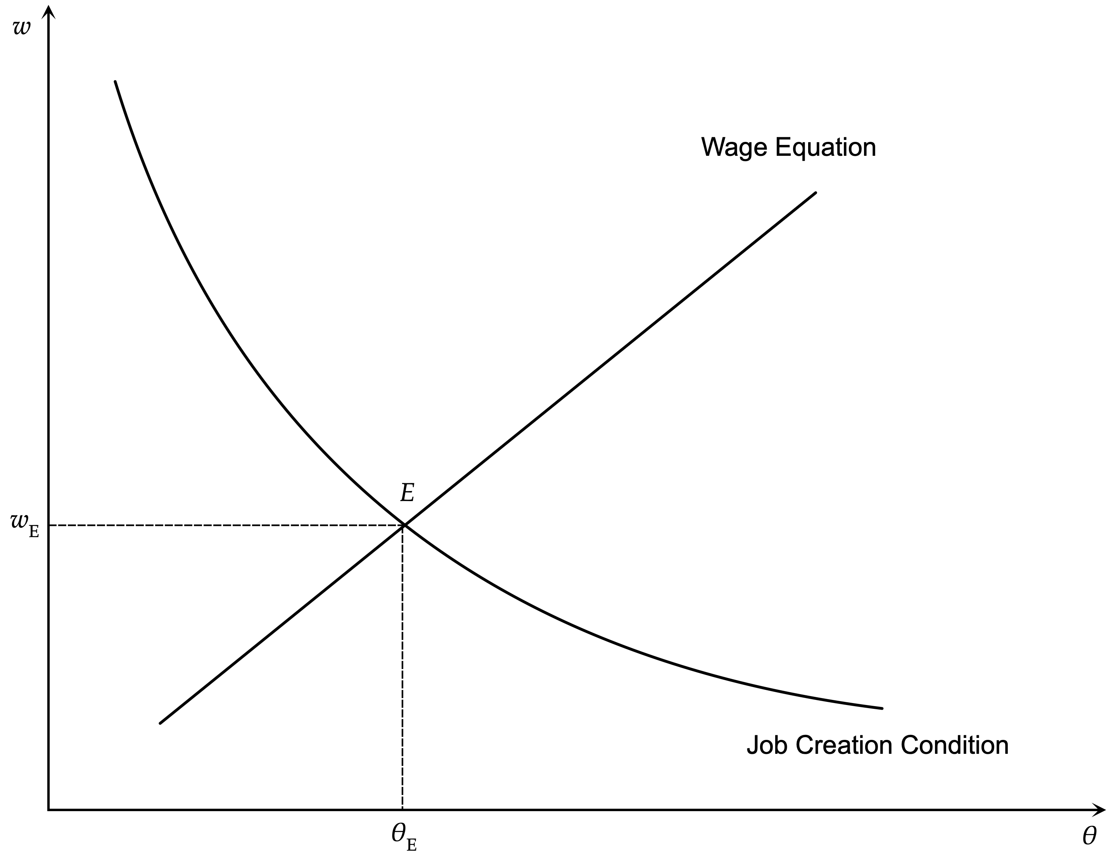
The Determination of Real Wages and Labor Market Tightness
The determination of equilibrium real wages and labor market tightness is presented in the Figure. The wage equation implies a positive relation between the real wage and labor market tightness. The job creation condition implies a negative relation between the real wage and labor market tightness. Equilibrium real wages and labor market tightness are determined at the intersection of these two curves.

Slide 31
The Determination of Equilibrium Unemployment and Vacancies
Once $θ$ is determined from the wage equation and the job creation condition, we can substitute in the Beveridge curve and determine for the unemployment rate.
$u_{E}=\frac{λ}{λ+θ_{E}q(θ_{E})}$
The solution can be shown diagrammatically using the Beveridge curve diagram.

Slide 32
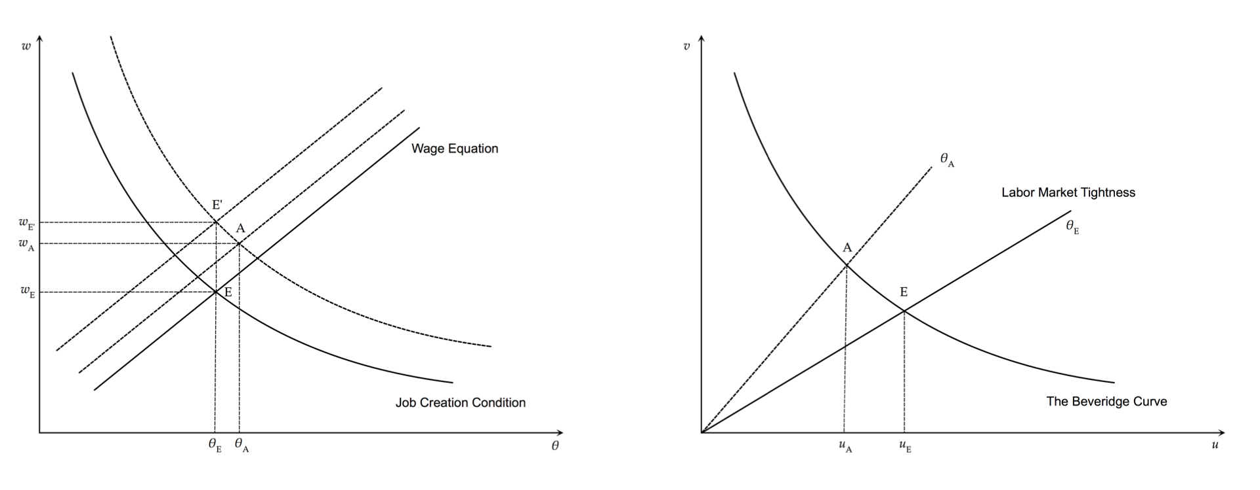
The Effects of an Increase in Labor Productivity
A permanent increase in labor productivity $p$ will shift both the job creation condition to the right and the wage equation upwards as shown in the diagram. Since $β<1$, the shift in the job creation condition is greater, and in the new equilibrium $A$, both real wages and labor market tightness will rise. As a result, equilibrium unemployment will fall.

Slide 33
Labor Productivity and Unemployment
This effect of labor productivity occurs because of the assumption that the unemployment benefit $z$ is fixed and does not depend on labor productivity. In this case, changes in real wages do not fully reflect changes in labor productivity. Thus, when productivity increases, there are gains from the creation of new job vacancies, new vacancies are created and unemployment falls.
However, in many countries unemployment benefits $z$ are not fixed in real terms, and usually are related to the real wages of the employed. Thus, the assumption of an exogenously fixed unemployment benefit $z$ is not very realistic.
Moreover, if the prediction that the growth of labor productivity reduces the unemployment rate was correct, then unemployment would be tending towards zero in the long run, because of the continuous increases in labor productivity resulting from economic growth. This prediction is not compatible with the existing empirical evidence, which does not suggest any long run trends in unemployment rates.
How can we then reconcile the model with the empirical evidence? Assuming that unemployment benefits $z$ are a percentage $ρ$ of real wages, where $0<ρ<1$, then in our model we would have that $z=ρw$. $ρ$ is usually called the replacement rate. Labor legislation in most industrialized countries provides for an unemployment benefit which is a percentage of the wage received by the unemployed person in his last job, or a percentage of the minimum wage. Therefore, this assumption is more satisfactory and realistic than the assumption of an exogenously determined real unemployment benefit.
In this case, the wage function is converted to, $w=\frac{β(1+cθ)}{1-(1-β)ρ}p$.
With the assumption of an exogenous replacement rate, the wage equation becomes proportional to labor productivity $p$. The factor of proportionality depends positively on the bargaining power of prospective employees $β$, labor market tightness $θ$, the cost of maintaining a vacancy $c$, and the replacement rate of the unemployment benefit system $ρ$. An increase (or fall) of labor productivity, for given labor market tightness, results in an equiproportional shift in the wage equation. From the job creation condition, a rise in productivity also results in an equiproportional shift in the real wage that satisfies the job creation condition for given labor market tightness. Hence, a rise in productivity only affects real wages and leaving labor market tightness and unemployment unchanged.

Slide 34
The Full Model with Unemployment Benefits Proportional to the Real Wage
Beveridge Curve
$u=\frac{λ}{λ+θq(θ)}$
Job Creation Condition
$w=p-\frac{(r+λ)pc}{q(θ)}=\left(1-\frac{(r+λ)c}{q(θ)}\right)p$
Wage Equation
$w=\frac{β(1+cθ)}{1-(1-β)ρ}p$

Slide 35
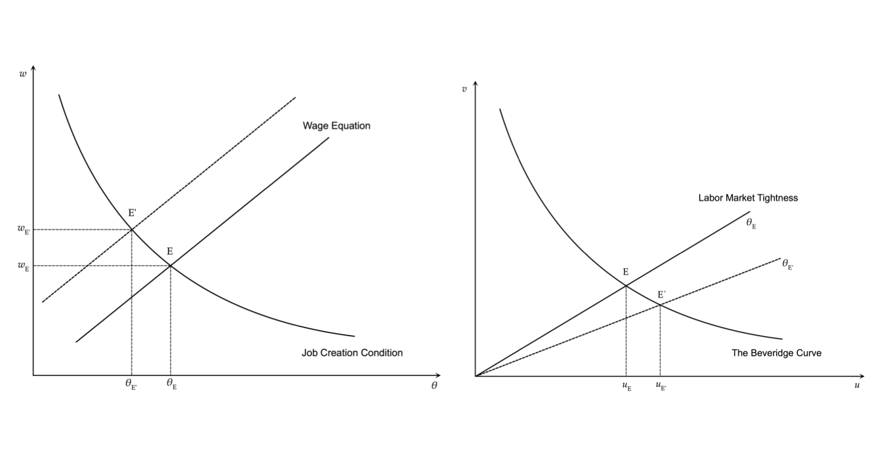
A Rise in Unemployment Benefits (and or the Replacement Rate)
One can also examine the implications of an increase in unemployment benefits $z$, or, in the case, $z=ρw$, an increase in the replacement rate $ρ$. This causes an increase in real wages, reduces labor market tightness and results in higher equilibrium unemployment. The relevant analysis is in thew Figure above. The wage equation is shifted upwards, as prospective workers demand higher real wages given that the cost of unemployment is now lower.

Slide 36
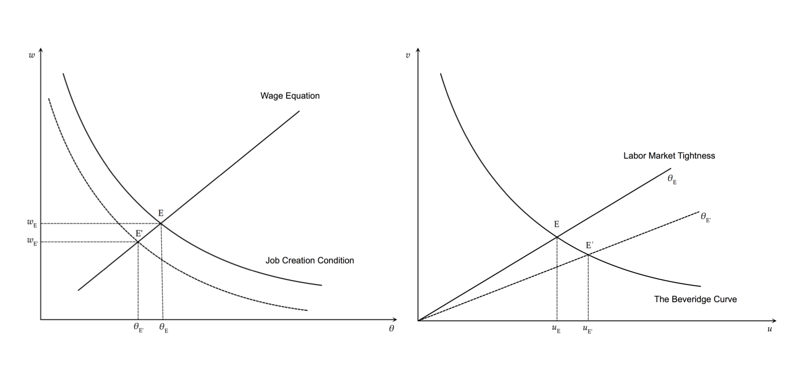
A Rise in the Real Interest Rate
In the Figure above we analyze the impact of an exogenous increase in the real interest rate. An increase in the real interest rate shifts the job creation condition to the left, as it increases the cost of maintaining vacancies. This results in a reduction of both real wages and labor market tightness. The lower labor market tightness results in higher unemployment.

Slide 37
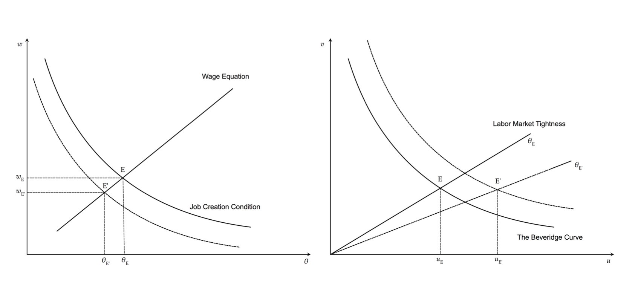
An Increase in the Probability of Job Destruction
An increase in $λ$ leads to a reduction in real wages and labor market tightness, because it reduces the expected revenue from the creation of a new job. Consequently, fewer job vacancies are created, labor market tightness is reduced and flows from unemployment to jobs decrease. This leads to an increase in the unemployment rate. In this case, equilibrium unemployment also increases because flows into unemployment also rise. An increase in $λ$ shifts the Beveridge curve to the right, as flows from existing jobs to unemployment rise.

Slide 38
The Dynamic Adjustment of Unemployment and Vacancies
Our analysis so far has concentrated on the determination of equilibirum, or steady state, unemployment, and almost nothing has been said about the dynamic adjustment of the labor market in the short run.
Assuming that vacancies and real wages are non-predetermined variables, since they depend on forward looking expectations of firms and job seekers, and that unemployment is a predetermined variable, governed by the equation determining flows into and out of unemployment, one can show that there is a unique saddle path that leads unemployment to its equilibrium or steady state value.
Unemployment evolves according to,
$\overset{·}{u}(t)=λ(1-u(t)-θ_{E}q(θ_{E}))u(t)=λ-(λ+θ_{E}q(θ_{E}))u(t)$
Since vacancies are a non-predetermined variable, and $θ$ is determined independently of the unemployment rate, $θ$ and real wages $w$ jump immediately to their equilibrium values.
From the solution of the differential equation above, the short run evolution of unemployment is determined by,
$u(t)=u_{E}+(u_{0}-u_{E})e^{-(λ+θ_{E}q(θ_{E}))t}$
where $u_{0}$ is the unemployment rate at time 0, and $u_{E}$ is the steady state unemployment rate, defined as, $u_{E}=\frac{λ}{λ+θ_{E}q(θ_{E})}$
The unemployment rate will converge to its steady state value from any initial rate, with a speed of adjustment equal to $λ+θ_{E}q(θ_{E})$. Since $θ_{E}$ remains constant during the adjustment path, vacancies will be adjusting at the same rate as unemployment along the adjustment path, implying that,
$\overset{·}{v}=θ_{E}\overset{·}{u}$

Slide 39
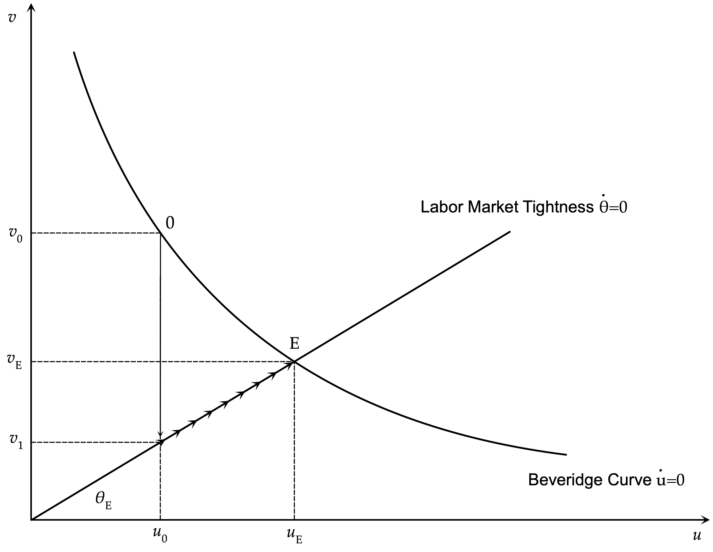
The Dynamic Adjustment of Unemployment and Vacancies
Assume that the labor market is originally in steady state equilibrium ($v_{0},u_{0}$), and there is a unanticipated permanent shock that changes $θ$ from $θ_{0}$ to $θ_{E}$. We assume that $θ_{E}$ implies a higher steady state unemployment rate $u_{E}$, and a lower steady state vacancy rate $v_{E}$. Vacancies, which are the non-predetermined variable, will jump from $v_{0}$ to $v_{1}$. There will be an immediate drop in vacancies to ensure that labor market tightness jumps to its new steady state value. Following that, both the unemployment rate and the vacancy rate will be gradually adjusting upwards towards their new steady state values. It is because the unemployment rate is a predetermined variable, that the non-predetermined vacancy rate initially overshoots its steady state drop.

Slide 40
Numerical Simulations of the Model
In order to get a quantitative sense of the extent to which shifts in the various parameters affect the equilibrium unemployment rate, real wages and labor market tightness, it is worth simulating the model numerically.
In this simulation we assume that the matching function is Cobb-Douglas with constant returns to scale, and is described by,
$$mL=M(uL)^{μ}(vL)^{1-μ}$$
where $M>0$ is the efficiency of the matching process and $0<μ<1$ the elasticity of job creation with respect to unemployment.
The probability of filling a vacancy is determined by,
$$q(θ)=\frac{mL}{vL}=M{\left(\frac{u}{v}\right)}^{μ}=Mθ^{-μ}$$
Substituting in the Beveridge curve and the job creation condition, the model takes the form,
$u=\frac{λ}{λ+Mθ^{1-μ}}$, $w=p-\frac{(r+λ)pc}{Mθ^{-μ}}$, $w=(1-β)z+βp(1+cθ)=(1-β)ρw+βp(1+cθ)$
We assume the following initial parameter values: $λ=2.5\%,M=1/2,μ=1/2,p=1,c=1/2,r=3\%,ρ=1/2,β=1/2$.
Simulating the model for these parameter values, we get $w=0.95,θ=0.85,u=5.1\%,v=4.4\%$.
The real wage is 95% of productivity and the unemployment rate is relatively low at 5.1%.

Slide 41
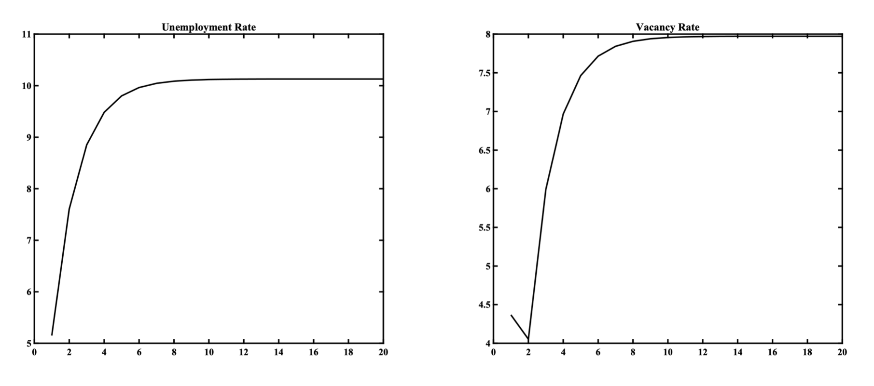
A doubling of $λ$ to 5%
If the probability of job destruction $λ$ were to double to 5%, then it follows that $w=0.93,θ=0.79,u=10.1\%,v=7.9\%$
Relative to the original equilibrium, the real wage falls by 2.1%, to 93% of productivity, and the equilibrium rate of unemployment almost doubles, to 10.1%.

Slide 42
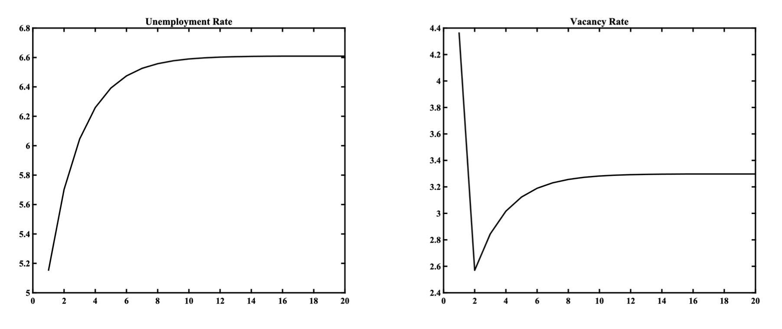
A Rise in the Replacement Ratio to 70% of the Real Wage
If the replacement ratio $ρ$ were to rise from 0.5 to 0.7 (a 40% increase), then it follows that $w=0.96,θ=0.50,u=6.6\%,v=3.3\%$.
Relative to the original equilibrium, the real wage rises by roughly 1%, and the unemployment rate rises by 1.5 percentage points, to 6.6%. With a constant labor force, this is equivalent to a 29.4% rise in the number of the unemployed.

Slide 43
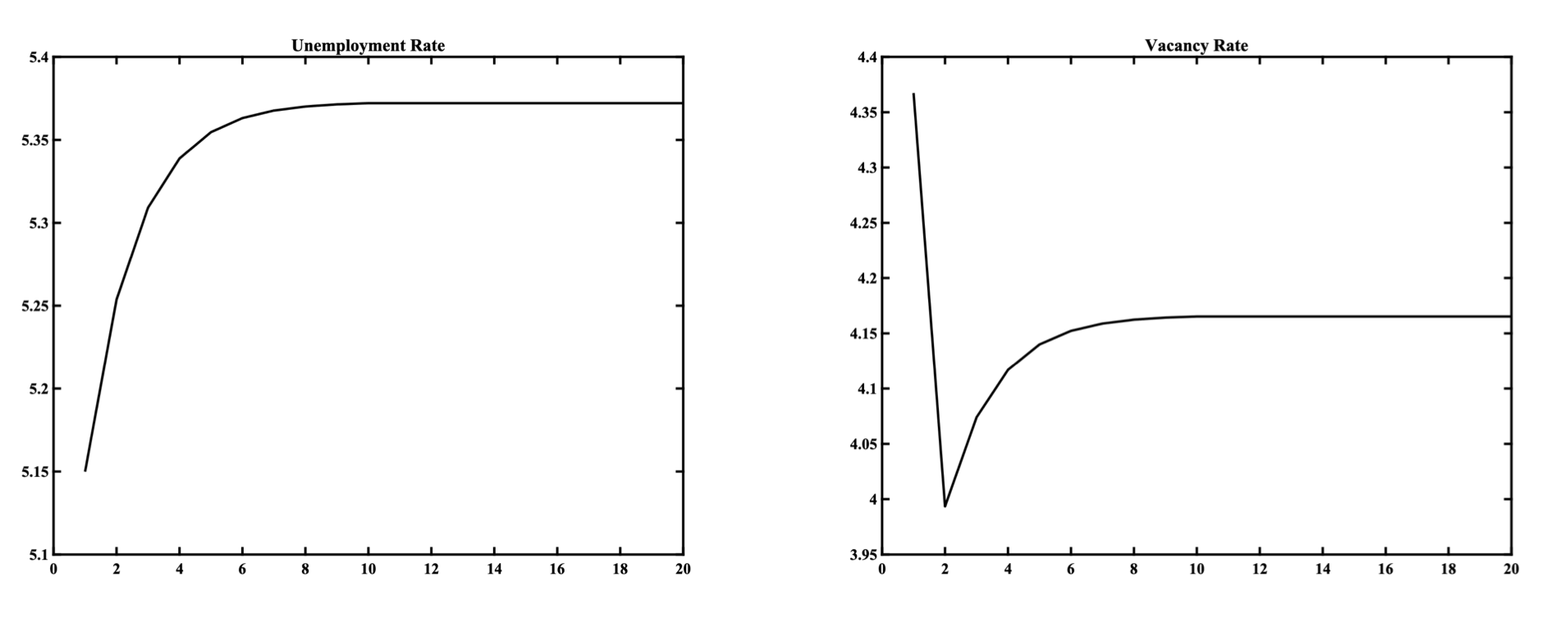
A Doubling of the Real Interest Rate to 6%
If the real interest rate $r$ were to double from the original 3% to 6%, it follows that $w=0.925,θ=0.78,u=5.4\%,v=4.2\%$.
Relative to the initial equilibrium, the real wage falls by about 2.5%, and the unemployment rate rises by 0.3 percentage points, to 5.4%. With a constant labor force, this is equivalent to a 5.9% rise in the number of the unemployed.

Slide 44
The Nature of the Matching Process and Flows into and out of Unemployment
In this model, employers are investing in order to create job vacancies and the process of filling a vacancy involves matching of a firm with a vacancy with an unemployed job seeker.
At each instant, there are two flows into and out of unemployment. Some workers lose their jobs and move from jobs into unemployment, and some of the unemployed find jobs, through the matching process, with firms which have created vacancies.
The probability of filling a vacancy, as well as the probability of an unemployed job seeker to find a job, are endogenous variables in this model. They depend on the degree of labor market tightness, which is defined by the ratio of vacancies to the unemployed. The higher the tightness of the labor market, the greater the probability of an unemployed job seeker to find a job, and the lower the probability of a firm to fill a vacancy.

Slide 45
Equilibrium Unemployment
In the steady state, the flows to and from unemployment are equalized, and the equilibrium unemployment rate depends positively on the exogenous probability of termination of a job, and negatively on the endogenous probability of an unemployed job seeker to find a job.
The equilibrium unemployment rate therefore depends negatively on labor market tightness, and is, of course, determined endogenously. The negative relationship between the equilibrium unemployment rate and the vacancy rate which is implied by this dependence is known as the Beveridge curve.

Slide 46
Firms and Unemployed Job Seekers
Firms and the unemployed make their decisions rationally, maximizing the expected present value of their profits and income.
Firms create new vacancies as long as the expected profits from the investment required to create a vacancy are positive.
The condition for a vacancy to be filled, and for a new job to be created is that the real wage should be equal to labor productivity minus the cost of creating and maintaining a vacancy. The job creation condition implies a negative relationship between the wage that the firm is willing to pay and labor market tightness. The higher is labor market tightness, the lower is the probability of filling a vacancy and the greater the total cost of maintaining a vacancy, since vacancies remain unfilled for longer.
On the other hand, an unemployed job seeker will agree to get a job if the expected present value of income of an employed worker is greater than the expected present value of income of an unemployed job seeker. This condition is satisfied in this model, as long as the real wage is higher than unemployment benefits.

Slide 47
The Determination of Real Wages and Labor Market Tightness
Real wages are determined in equilibrium by decentralized bargaining between firms that have vacancies and unemployed job seekers.
The equilibrium real wage is the result of this negotiation, and depends positively on the relative bargaining power of the unemployed, the level of unemployment benefits, labor productivity, the cost of maintaining a vacancy and labor market tightness.
The equilibrium real wage depends positively on labor market tightness, as this increases the average recruitment cost per unemployed person, thereby increasing the “threat” point of prospective employees versus prospective employers, and weakening the effective bargaining position of prospective employers.

Slide 48
Simultaneous Determination of Real Wages and Labor Market Tightness and the Determination of Equilibrium Unemployment
The positive relationship between real wages and labor market tightness, resulting from the negotiation between firms with vacancies and the unemployed, and the negative relationship between real wages and and labor market tightness implied by the job creation condition for firms, jointly determine the equilibrium real wage and equilibrium labor market tightness.
Once equilibrium labor market tightness has been determined, the equilibrium unemployment rate is then determined through the Beveridge curve, which implies a negative relationship between the unemployment and vacancy rates.

Slide 49
The Dependence of Equilibrium Unemployment on Productivity, Unemployment Benefits, Real Interest Rates and the Frequency of Job Terminations
If unemployment benefits are proportional to the real wage, labor productivity does not affect the equilibrium unemployment rate in this model.
However, the higher the percentage of real wages paid out as unemployment benefits, the higher the equilibrium real wage and the higher the equilibrium unemployment rate. The reason is that higher real wages reduce incentives for creating new jobs, thus reducing the number of vacancies, reducing labor market tightness and increasing unemployment.
Higher real interest rates also have a positive impact on unemployment in this model, because they increase the cost of maintaining a vacancy, resulting in the creation of fewer job vacancies, lower labor market tightness and higher unemployment.
A higher exogenous probability of termination of a job has a positive impact on unemployment for two reasons. First because it directly increases the flows from existing jobs to unemployment, and, second, because it, indirectly, reduces the flows from unemployment to jobs. The second effect takes place because the expected profit from the creation and filling of a vacancy falls, resulting in fewer vacancies and reduced flows from unemployment to jobs.

