Slide 1
14. A New Keynesian Model with Nominal Wage Contracts
Athens University of Economics and Business
Dynamic Macroeconomics
Prof. George Alogoskoufis
alogoskoufisg.com
George Alogoskoufis, Dynamic Macroeconomics, 2019

Slide 2
Models of Nominal Wage Contracts and Unemployment
The explanation of unemployment and its cyclical fluctuations is one of the central tasks of macroeconomics. In fact, it was the existence and persistence of interwar unemployment that prompted Keynes to embark on producing the General Theory.
Two types of questions need to be asked. the first type asks what determines the equilibrium (or natural) rate of unemployment in an economy, what its properties are, and to what extent equilibrium unemployment reflects frictions and distortions in the labor market. The second type concerns the fluctuations of the unemployment rate during the economic cycle.
Cyclical fluctuations in unemployment can be explained by and large by new keynesian models with labor market frictions and nominal wage and price contracts. In this lecture we analyze a model of aggregate fluctuations, that is based on periodic nominal wage contracts, and can explain unemployment and its fluctuations. The model is based on Gray (1976), Fischer (1977), and Taylor (1979), who emphasized the periodic adjustment of nominal wages rather than the periodic adjustment of prices.
In the Gray-Fischer-Taylor model, nominal wage contracts are assumed to be negotiated at the beginning of every period or at the beginning of alternate periods. In addition, nominal wages are assumed to remain fixed for at least part of the duration of the contract. Nominal wages depend on prior expectations about the evolution of the price level, productivity and all other shocks. If inflation turns out to be higher than expected, then real wages fall, firms demand more labor, and employment rises. The opposite happens when inflation turns out to be lower than expected when the contract was negotiated.

Slide 3
Wage Setting by Labor Market ‘Insiders’ and Imperfectly Competitive Product Markets
The specific model introduced in this chapter is a DSGE model in which non-indexed nominal wage contracts are negotiated periodically by ‘insiders’ in the labor market.
There are two distortions in the model compared to new classical models
The first is a real distortion, arising from the fact that the unemployed are disenfranchised ‘outsiders’ in the labor market, and cannot affect the determination of nominal wages. As a result, wage contracts, which are negotiated by employed insiders, do not seek to maintain full employment and there is a positive natural rate of unemployment, reflecting the pool of unemployed outsiders.
The second is a nominal distortion, arising from the assumption that nominal wage contracts are not indexed and can only be reopened at the beginning of each period, before current nominal and real shocks are observed. Thus, nominal wages are set on the basis of prior rational expectations about the various unobserved shocks that may affect output, employment, and inflation.
The product market is assumed imperfectly competitive. We analyze the model under both the assumption that prices are perfectly flexible and are set as a constant markup over unit labor costs, and the alternative assumption of ‘staggered pricing’.
Even under fully flexible prices, because of nominal wage contracts, the model is characterized by an expectations-augmented Phillips curve. Deviations of current inflation from inflation expected at the beginning of the period depend on deviations of output and employment from their natural rates. They also depend on unanticipated productivity shocks, which affect the hiring decisions of firms. This is because the predetermined nominal wage contracts are set on the basis of expected and not actual inflation and productivity. Staggered pricing introduces an additional trade-off between inflation and unemployment through the nominal distortion in the pricing decisions of firms.

Slide 4
The Determination of Aggregate Demand
Aggregate demand is determined by the optimal behavior of a representative household, that has access to competitive financial markets, and chooses the path of consumption and real money balances to maximize its intertemporal utility function.
Thus, both the consumption function and the money demand function are derived from intertemporal microeconomic foundations.
The model is also characterized by exogenous shocks to productivity and preferences for consumption and money demand.
Thus, the model is in essence a new keynesian DSGE model that incorporates some of the key features of the AS-AD version of the Keynesian model.
We analyze aggregate fluctuations in this model under a Taylor rule (i.e., a feedback interest rate rule). According to this rule which is assumed to be followed by the Central Bank, the nominal interest rate deviates from its ‘natural rate’ in response to deviations of current inflation from the inflation target of the central bank, and deviations of output (or unemployment) from its ‘natural’ rate.

Slide 5
Alternative Views of the Labor Market and Equilibrium Unemployment
There are many alternative approaches to modeling the labor market that differ from the competitive model of the labor market implicit in new classical models, such as the stochastic growth model.
All these approaches offer an alternative explanation as to why, despite the existence of unemployment and vacancies, real wages do not adjust sufficiently in order to induce firms to hire the unemployed and eliminate unemployment.
One approach consists of the so-called efficiency wage theories. In these theories there is asymmetric information between firms and workers. Firms cannot observe either the productivity or the effort of workers directly. Thus, firms offer wages above the average productivity of low productivity job seekers, or existing employees, in order to attract workers with above average productivity or to provide incentives to their employees to work more intensively. Therefore they are not prepared to reduce real wages, or to replace workers already in jobs, with the unemployed, even if the unemployed offered to work at lower wages.
A second class of theories are theories of long-term wage contracts. These contracts prevent firms from undertaking unilateral changes to wages in response to shocks, if such changes are not provided for or allowed in the long-term contract. The contracts can be explicit, such as collective, industry and individual employment contracts or informal and implicit.
Finally, there are theories that highlight the search costs of looking for an appropriate job by unemployed job seekers, and for an appropriate employee by firms with vacancies. In these theories, a costly search process is required for the matching of job seekers with appropriate vacancies in order to create a new job. These theories are called search or matching theories of the labor market and seek to explain unemployment flows as well as unemployment rates.

Slide 6
Households and Optimal Consumption and Money Demand
Assume that the economy consists of a continuum of identical households $i$, where $i∈[0,1]$. Each household member is constrained to supply one unit of indivisible labor, and unemployment impacts all households in the same manner.
The representative household chooses the path of consumption and real money balances to maximize,
$E_{t}∑_{s=0}^{∞}{\left(\frac{1}{1+ρ}\right)}^{s}\left(\frac{1}{1-θ}\left(V_{t+s}^{C}C_{t+s}^{1-θ}+V_{t+s}^{M}{\left(\frac{M}{P}\right)}_{t+s}^{1-θ}\right)\right)$
where $ρ$ denotes the pure rate of time preference, $θ$ is the inverse of the elasticity of intertemporal substitution, $C$ is consumption and $M/P$ is real money balances. In addition, $V^{C}$ and $V^{M}$ denote exogenous stochastic shocks in the utility from consumption and real money balances respectively, and can be thought of as preference shocks.

Slide 7
Consumption of Differentiated Products and Household Budget Constraints
Consumption consists of differentiated goods and services indexed by a continuous index $j$, where $j∈[0,1]$. The consumption bundle is thus given by,
$C_{t}={\left(∫_{j=0}^{1}C(j)_{t}{}^{\frac{ε-1}{ε}}dj\right)}^{\frac{ε}{ε-1}}$
where $ε$ is also a parameter of the preferences of the representative household, and more precicely, the elasticity of substitution between goods. We assume that $ε>1$.
Expected utility is maximized subject to the sequence of expected budget constraints,
$E_{t}\left(F_{t+s+1}=(1+i_{t+s})\left(F_{t+s}-\frac{i_{t+s}}{1+i_{t+s}}M_{t+s}+P_{t+s}\left(Y_{t+s}-T_{t+s}\right)-∫_{j=0}^{1}P{(j)}_{t+s}C{(j)}_{t+s}dj\right)\right)$
where $F_{t}=B_{t}+M_{t}$, denotes the financial assets held by the representative household, $i$ is the nominal interest rate, $B$ denotes one period nominal bonds, $M$ represents nominal money balances, $Y$ is real non-interest income, $T$ real taxes net of transfers, and $P(j)$ is the price of good $j$.
The household must also satisfy the transversality condition
$\lim_{T→∞}E_{t}F_{t+T}≥0$
The household must decide on the distribution of its consumption expenditure among the various goods and the intertemporal allocation of its total consumption expenditure and money demand.

Slide 8
Choosing Individual Consumption Goods
To determine the distribution of its consumption expenditure among the various goods the household maximizes,
$C_{t}={\left(∫_{j=0}^{1}C(j)_{t}{}^{\frac{ε-1}{ε}}dj\right)}^{\frac{ε}{ε-1}}$
subject to,
$P_{t}C_{t}=∫_{j=0}^{1}P{(j)}_{t}C(j)_{t}dj$
From the first order conditions for a maximum it follows that,
$C(j)_{t}={\left(\frac{P(j)_{t}}{P_{t}}\right)}^{-ε}C(t)$
where, $P$ is the average price level, defined as.
$P_{t}={\left(∫_{j=0}^{1}P(j)_{t}{}^{1-ε}dj\right)}^{\frac{1}{1-ε}}$
The demand for good $j$ is thus a function of its relative price and the level of aggregate demand $C$. The elasticity of demand with respect to its relative price is equal to $-ε$. In addition, when the household follows this optimal allocation policy, we also have that
$∫_{j=0}^{1}P(j)_{t}C(j)_{t}dj=P_{t}C_{t}$
Total consumption expenditure can be written as the product of the aggregate consumption index and the aggregate price index.

Slide 9
The Intertemporal Problem of the Household
Assuming that the households chooses individual consumption goods in each period optimally, the inter temporal problem of the household is then to maximize,
$E_{t}∑_{s=0}^{∞}{\left(\frac{1}{1+ρ}\right)}^{s}\left(\frac{1}{1-θ}\left(V_{t+s}^{C}C_{t+s}^{1-θ}+V_{t+s}^{M}{\left(\frac{M}{P}\right)}_{t+s}^{1-θ}\right)\right)$
subject to the sequence of budget constraints,
$E_{t}\left(F_{t+s+1}=(1+i_{t+s})\left(F_{t+s}-\frac{i_{t+s}}{1+i_{t+s}}M_{t+s}+P_{t+s}\left(Y_{t+s}-T_{t+s}-C_{t+s}\right)\right)\right)$
From the first-order conditions for a maximum we get,
$V_{t}^{C}C_{t}^{-θ}=λ_{t}(1+i_{t})P_{t}$ $V_{t}^{M}{\left(\frac{M}{P}\right)}_{t}^{-θ}=λ_{t}i_{t}P_{t}$ $E_{t}λ_{t+1}=E_{t}\left(\frac{1+ρ}{1+i_{t+1}}\right)λ_{t}$
where $λ_{t}$ is the Lagrange multiplier in period $t$. These have the standard interpretations. The first suggests that at the optimum the household equates the marginal utility of consumption to the value of savings. The second suggests that the household equates the marginal utility of real money balances to the opportunity cost of holding money. The last one suggests that at the optimum, the real interest rate, adjusted for the expected increase in the marginal utility of consumption, is equal to the pure rate of time preference.

Slide 10
Optimal Consumption and Money Demand
Eliminating $λ$ from the first order conditions implies that
${\left(\frac{M}{P}\right)}_{t}=C_{t}{\left(\frac{V_{t}^{C}}{V_{t}^{M}}\frac{i_{t}}{1+i_{t}}\right)}^{-\frac{1}{θ}}$
$E_{t}\left(\frac{V_{t+1}^{C}{\left(C_{t+1}\right)}^{-θ}}{P_{t+1}}\right)=\left(\frac{1+ρ}{1+i_{t}}\right)\left(\frac{V_{t}^{C}{\left(C_{t}\right)}^{-θ}}{P_{t}}\right)$
The first equation is the money demand function, which is proportional to consumption and a negative function of the nominal interest rate, and the second equation is the familiar Euler equation for consumption.
Taking logarithms yields,
$m_{t}-p_{t}=c_{t}-\frac{1}{θ}ln\left(\frac{i_{t}}{1+i_{t}}\right)+\frac{1}{θ}\left(v_{t}^{M}-v_{t}^{C}\right)$
$c_{t}=E_{t}c_{t+1}-\frac{1}{θ}\left(i_{t}-E_{t}π_{t+1}-ρ\right)+\frac{1}{θ}(v_{t}^{C}-E_{t}v_{t+1}^{C})$
where lowercase letters denote natural logarithms, and $π_{t}=p_{t}-p_{t-1}$ is the rate of inflation.

Slide 11
Firms and Optimal Pricing and Production
Assume that output is produced by a set of firms denoted by a continuous index $j$ defined in the interval [0,1]. Each firm produces a differentiated product under conditions of monopolistic competition. All firms have access to the same production technology, denoted by the production function
$Y(j)_{t}=A_{t}L(j)_{t}{}^{1-α}$
where $A_{t}>0$ and $0<α<1$ are exogenous technological parameters, common to all firms; $L(j)_{t}$ is employment of labor by firm $j$ in period $t$. The parameter $α$ is constant and $A_{t}$, exogenous productivity, is assumed to follow an exogenous stochastic process.
The optimal price of each firm, if it can choose its price in every period, is given by the maximization of its profits, under the constraint of the production function and the demand function for its product. Each firm takes the average price $P$, the nominal wage $W(j)$ and the level of aggregate demand $C$ as given. The per period profits of firm $j$ are given by,
$P(j)_{t}Y(j)_{t}-W(j)_{t}L(j)_{t}$
From the first-order conditions for a maximum the optimal price is determined as
$P(j)_{t}=\frac{ε}{ε-1}\left(\frac{W{(j)}_{t}{\left(L{(j)}_{t}\right)}^{α}}{(1-α)A_{t}}\right)$
The optimal price is a fixed markup on the firm's marginal cost, which equals the expression in the outer parentheses. The marginal cost of production is the wage divided by the marginal product of labor. Because the marginal product of labor is decreasing with the level of employment, the marginal cost of production is an increasing function of employment and output. The markup depends positively on the elasticity of substitution between goods in the preferences of consumers, which determines the price elasticity of demand of their product and therefore the profit margin of the firm. In the case of perfect competition, the elasticity of substitution tends to infinity and the price tends to marginal cost. In the case of monopolistic competition with $ε>1$, as we have assumed, the optimal price is higher than the marginal cost of labor.

Slide 12
Optimal Output and Prices
As all firms have the same production function and the same demand function for their product, they will all choose the same price if they face the same nominal wage $W$. Consequently, the price level will be defined as,
$P_{t}=\frac{ε}{ε-1}\left(\frac{W_{t}L_{t}^{α}}{(1-α)A_{t}}\right)$
If firms face different wages $W(j)$, then they will choose different prices, and the equation denotes the average price as a function of the average of marginal unit labor costs. In either case, the price level is a fixed markup on marginal unit labor costs. It thus depends positively on nominal wages and employment, and negatively on exogenous productivity shocks.
Taking the logarithm of the production function for the representative firm, and the equation for the optimal price, we get
$y_{t}=a_{t}+(1-α)l_{t}$
$p_{t}=μ+w_{t}-a_{t}+αl_{t}$
where, $a_{t}=lnA_{t}$, and $μ=ln\left(\frac{ε}{ε-1}\right)-ln(1-α)$. Here $a$ is the logarithm of the exogenous productivity shock, and the constant $μ$ is the logarithm of the markup on marginal cost, minus the logarithm of the coefficient of decreasing returns to the employment of labor.
The higher the level of employment, the higher the price level relative to nominal wages, as higher employment implies lower marginal productivity of labor. Because employment is positively related to output from the production function, higher output also implies higher prices relative to nominal wages, because of lower labor productivity. Using the production function, we can rewrite the price equation as,
$p_{t}=μ+w_{t}-\frac{1}{1-α}a_{t}+\frac{α}{1-α}y_{t}$
For given exogenous productivity $a_{t}$, firms will only produce more if prices rise relative to wages. The reason is that an increase in output results in higher unit labor costs, because of the diminishing marginal productivity of labor.

Slide 13
Wage Setting and Employment in a Model with Insiders and Outsiders
Nominal wages are set in a decentralized manner, by insiders in each firm. Wages are set at the beginning of each period, before current productivity, current aggregate demand, and the current price level are known. Nominal wages remain constant for one period, and they are renegotiated at the beginning of the following period.
Thus, this model is characterized by nominal wage stickiness of the Gray (1976) and Fischer (1977) variety. Prices are determined ex post by firms, given the contract wage, aggregate demand, the price level, and exogenous productivity $a_{t}$.
Following Blanchard and Summers (1986) assume that the number of insiders in each firm (who at the beginning of each period determine the contract wage) consists of an exogenous number of core insiders, and those who were employed by the firm in the previous period. The objective of insiders is to set the maximum nominal wage which - given their rational expectations about aggregate demand, the price level, and exogenous productivity - will minimize expected deviations of employment from the target level of the number of insiders. This target level is a weighted average of all those who were employed in period $t-1$, and the exogenous set of core employees of each firm. Thus, this model is characterized by a state dependent pool of insiders. The employment target of insiders in period $t$ is determined by,
$\overline{n}(j)_{t}=δl(j)_{t-1}+(1-δ)\overline{n}(j)$
where $l(j)_{t-1}$ is the logarithm of the number of those who were actually employed in the previous period; $\overline{n}(j)$ is the logarithm of the number of core employees of firm $j$, assumed exogenous; and $δ$ is the weight of those recently employed relative to core employees, in the employment target of insiders.
The expectations on the basis of which wages are set depend on information available until the end of period $t-1$, but not on information about aggregate demand, prices, and exogenous productivity in period$t$. On the basis of the above, let us assume that the objective of wage setters is to choose the maximum nominal wage that would make expected employment equal to the employment target of the insiders. We shall also concentrate on the representative firm, as all firms are alike.

Slide 14
Wage Determination, Unemployment Persistence and the Phillips Curve
From the optimal pricing equation of firms, to achieve their employment target, insiders will set the nominal wage to,
$w_{t}=E_{t-1}p_{t}-μ+E_{t-1}a_{t}-α\left(δl_{t-1}+(1-δ)\overline{n}\right)$
Substituting the wage determination equation in the optimal pricing equation of firms, the (log) price level will be determined by,
$p_{t}=E_{t-1}p_{t}-\left(a_{t}-E_{t-1}a_{t}\right)+α\left(l_{t}-δl_{t-1}-(1-δ)\overline{n}\right)$
Thus, prices will differ from the expectations of wage setters to the extent that there are unanticipated shocks to exogenous productivity and unanticipated shocks to aggregate demand. These shocks cause firms to determine employment at a different level than the one aimed at and expected by wage setters.
It is straightforward to transform this price equation into an expectations-augmented Phillips curve. Subtracting $p_{t-1}$ from both sides, and adding and subtracting the log of the labor force multiplied by $\alpha$ on the right-hand side, we get
$π_{t}=E_{t-1}π_{t}-α\left((u_{t}-\overline{u})-δ(u_{t-1}-\overline{u})\right)-\left(a_{t}-E_{t-1}a_{t}\right)$
where $π_{t}=p_{t}-p_{t-1}$ is the inflation rate, $u_{t}≃n-l_{t}$ is the unemployment rate, $n$ is the log of the labor force, and $\overline{u}≃n-\overline{n}$, is the natural unemployment rate, assumed positive (i.e we assume $n>\overline{n}$). This is the expectations-augmented Phillips curve in this model. It is a dynamic version of a traditional expectations-augmented Phillips curve, in the sense that inflation depends on prior inflationary expectations, but also on both current and past deviations of unemployment from its natural rate.
According to this Phillips curve, current inflation differs from prior expectations of inflation to the extent that there are unanticipated shocks to exogenous productivity and unanticipated shocks to aggregate demand. These shocks cause the unemployment rate to differ from the target unemployment rate of wage setters. The dynamics arise because of the assumption that the target unemployment rate of wage setters is a weighted average of the past and the natural unemployment rate, due to the composition of labor market insiders.

Slide 15
The Relation between Output and Unemployment Persistence
It is also clear from this model that only unanticipated shocks to exogenous productivity and aggregate demand cause unemployment to deviate from its expected path, as determined by the behavior of wage setters, and summarized in the Phillips curve. Note that if wage setters have rational expectations, the unemployment rate follows,
$u_{t}=δu_{t-1}+(1-δ)\overline{u}+ζ_{t}^{u}$
where$ζ_{t}^{u}$ is a white noise process, encompassing unanticipated productivity and demand shocks.
Hence, deviations of current unemployment from its natural rate will display persistence equal to $δ$, the weight of past employees on the wage setting process. In fact, deviations of unemployment from its natural rate will follow an AR(1) process of the form,
$(u_{t}-\overline{u})=δ(u_{t-1}-\overline{u})+ζ_{t}^{u}$
The persistence of employment and unemployment, will also be translated into persistent output fluctuations.
Adding and subtracting $(1-α)(n-\overline{n})$ to the aggregate production function we get,
$y_{t}=\overline{y_{t}}-(1-α)(u_{t}-\overline{u})$
where, $\overline{y_{t}}=(1-α)\overline{n}+a_{t}$ is the log of the natural rate of output. This is an Okun (1962) type of relation, which suggests that fluctuations of output around its natural rate will be negatively related to fluctuations of the unemployment rate around its own natural rate. Because deviations of employment and unemployment from their natural rates display persistence, so will fluctuations in output. The propagation mechanism is the state dependence of the employment target of insiders in the labor market. Hence, deviations of output from its own natural rate will follow
$(y_{t}-\overline{y_{t}})=δ(y_{t-1}-{\overline{y}}_{t-1})-(1-α)ζ_{t}^{u}$
Deviations of output from its natural rate will follow an AR(1) process as well, with the same degree of persistence $δ$ as unemployment.

Slide 16
The Phillips Curve in Terms of Deviations of Output from its Natural Rate
Substituting the Okun-type relation in the expectations augmented Phillips curve, we get an expectations augmented Phillips curve defined in terms of deviations of output from its natural rate. This takes the form,
$π_{t}=E_{t-1}π_{t}+\frac{α}{1-α}\left((y_{t}-{\overline{y}}_{t})-δ(y_{t-1}-{\overline{y}}_{t-1})\right)-\left(a_{t}-E_{t-1}a_{t}\right)$
To the extent that deviations of output from its natural rate are higher than what was anticipated at the time when wages were set, inflation is higher than anticipated, because employment and unit labor costs are higher than what was anticipated. Hence, firms increase prices by more than was previously expected.
Also note that when there is no persistence in the number of labor market insiders (i.e., when $δ=0$), this takes the form of standard expectations-augmented Phillips curves, in terms of deviations of output from its natural rate.

Slide 17
Product and Money Market Equilibrium
Since there is no capital and investment in this model, and no distinction between private and government consumption expenditure, product market equilibrium implies that output is equal to private consumption.
$Y_{t}=C_{t}$
This product market equilibrium condition allows us to substitute output for consumption in the money demand function and the Euler equation for consumption, and derive optimal aggregate money and output demand functions.
$m_{t}-p_{t}=y_{t}-\frac{1}{θ}ln\left(\frac{i_{t}}{1+i_{t}}\right)+\frac{1}{θ}\left(v_{t}^{M}-v_{t}^{C}\right)$
$y_{t}=E_{t}y_{t+1}-\frac{1}{θ}\left(i_{t}-E_{t}π_{t+1}-ρ\right)+\frac{1}{θ}(v_{t}^{C}-E_{t}v_{t+1}^{C})$
The first equation can be seen as the money market equilibrium condition, the equivalent of the LM curve in the traditional models of the neoclassical synthesis. The second equation is the product market equilibrium condition, the equivalent of the IS curve. Because both are derived from an explicit problem of intertemporal optimization by the representative household, we shall refer to them as the new neoclassical synthesis LM and IS curves respectively.

Slide 18
The Natural and Current Real Interest Rate
The real interest rate is defined by the Fisher (1896) equation,
$r_{t}=i_{t}-E_{t}π_{t+1}$
As with other real variables, let us distinguish between the current and the natural real interest rate. The natural real interest rate is determined by the product market equilibrium condition, when output is at its natural rate. From the IS curve, the natural real interest rate is thus determined by,
${\overline{r}}_{t}=ρ-θ\left(a_{t}-E_{t}a_{t+1}\right)+\left(v_{t}^{C}-E_{t}v_{t+1}^{C}\right)$
The natural real interest rate is equal to the pure rate of time preference, but also depends positively on deviations of current shocks to consumption from anticipated future shocks, and negatively on deviations of current productivity shocks from anticipated future shocks. Hence, the natural real interest rate is affected by real shocks, such as productivity and consumption preference shocks. Productivity shocks, which cause a temporary increase in the natural level of output, lead to a reduction of the natural real rate of interest, inducing a corresponding increase in consumption and maintaining product market equilibrium. Real consumption preference shocks, which cause a temporary increase in consumption, require an increase in the natural real rate of interest, reducing consumption back to the natural level of output and maintaining product market equilibrium.
Because of the existence of predetermined one period nominal wage contracts, and because of staggered pricing, the current equilibrium real interest rate deviates from its natural rate to the extent that current output deviates from its own natural rate. Solving the new neoclassical synthesis IS curve for the real interest rate, using the definition of the natural rate of output, we get that the current real interest rate is given by
$r_{t}=i_{t}-E_{t}π_{t+1}={\overline{r}}_{t}-θ(1-δ)(y_{t}-{\overline{y}}_{t})$
Deviations of the current real interest rate from its natural rate depend negatively on deviations of output from its own natural rate. Since deviations of output from its natural rate tend to persist, deviations of the real interest rate from its own natural rate will tend to persist as well.
Shocks to inflation or productivity, which cause a temporary rise in current output relative to its natural rate, affect output by reducing the current real interest rate relative to its natural rate.

Slide 19
Aggregate Fluctuations with Exogenous Preference and Productivity Shocks
In what follows, let us assume that the logarithms of the exogenous shocks to preferences and productivity follow stationary AR(1) processes of the form,
$v_{t}^{C}=η_{C}v_{t-1}^{C}+ε_{t}^{C}$ $v_{t}^{M}=η_{M}v_{t-1}^{M}+ε_{t}^{M}$ $a_{t}=η_{A}a_{t-1}+ε_{t}^{A}$
where the autoregressive parameters satisfy, $0<η_{C},η_{M},η_{A}<1$, and $ε^{C}$, $ε^{M}$, $ε^{A}$ are white noise processes.
With these assumptions, for a given nominal interest rate, fluctuations in output and inflation will be determined by the new neoclassical synthesis $IS$ relation and the Phillips curve. Expressing these as deviations from natural rates, we get that,
$y_{t}-{\overline{y}}_{t}=-\frac{1}{θ(1-δ)}\left(i_{t}-E_{t}π_{t+1}-{\overline{r}}_{t}\right)$
$π_{t}=E_{t-1}π_{t}+\frac{α}{1-α}\left((y_{t}-{\overline{y}}_{t})-δ(y_{t-1}-{\overline{y}}_{t-1})\right)-\left(a_{t}-E_{t-1}a_{t}\right)$
The natural rates of real variables, such as output, ${\overline{y}}_{t}$, and the real interest rate ${\overline{r}}_{t}$, evolve as functions of the exogenous real shocks only. Substituting the stochastic processes assumed for productivity and real consumption shocks we get
${\overline{y}}_{t}=(1-α)\overline{n}+a_{t}$
${\overline{r}}_{t}=ρ-θ\left(1-η_{A}\right)a_{t}+\left(1-η_{C}\right)v_{t}^{C}$
Thus, deviations of real output from its natural rate depend on the current nominal interest rates, expected future inflation and shocks to the natural real rate of interest, while inflation is determined through the dynamic stochastic Phillips curve.

Slide 20
The Nominal Interest Rate and the Taylor Rule
To solve the model one needs an assumption about the determination of the nominal interest rate. We shall assume that this is determined by the central bank, which follows a Taylor (1999) rule of the form,
$i_{t}={\overline{r}}_{t}+π^{*}+ϕ_{π}\left(π_{t}-π^{*}\right)+ϕ_{y}(y_{t}-{\overline{y}}_{t})+ε_{t}^{i}$
where $ϕ_{π},ϕ_{y}>0$ are policy parameters, and $ε_{t}^{i}$ is a white noise interest rate shock.
According to this rule, the central bank aims for a nominal interest rate that is equal to the natural real rate of interest, plus a target inflation rate equal to the steady state inflation rate $π^{*}$.
If actual inflation is higher than the target $π^{*}$, then the central bank raises interest rates to reduce inflation towards its target.
In addition, if output is higher than its natural rate, then the central bank increases nominal interest rates, to reduce aggregate demand and bring output back to its natural rate.
We have expressed the Taylor rule in terms of deviations of output and not unemployment from its natural rate. This does not affect the results, as through the Okun-type relation deviations of unemployment from its natural rate are a negative linear function of deviations of output from its own natural rate. We have also assumed that the central bank interest rate adjusts to shocks that affect the natural real rate of interest, which is not treated as a constant.

Slide 21
The Full Model
The full model consists of the Phillips curve, the aggregate demand (IS) curve and the Taylor rule for the determination of the nominal interest rate. It determines deviations of output from its natural rate, deviations of inflation from the central bank target and the nominal interest rate.
$π_{t}=E_{t-1}π_{t}+\frac{α}{1-α}\left(\left(y_{t}-{\overline{y}}_{t}\right)-δ\left(y_{t-1}-{\overline{y}}_{t-1}\right)\right)-ε_{t}^{A}$
$y_{t}-{\overline{y}}_{t}=-\frac{1}{θ(1-δ)}\left(i_{t}-E_{t}π_{t+1}-{\overline{r}}_{t}\right)$
$i_{t}={\overline{r}}_{t}+π^{*}+ϕ_{π}\left(π_{t}-π^{*}\right)+ϕ_{y}(y_{t}-{\overline{y}}_{t})+ε_{t}^{i}$
Note that the natural rates of output and the real interest rate are determined by,
${\overline{y}}_{t}=(1-α)\overline{n}+a_{t}$ ${\overline{r}}_{t}=ρ-θ\left(1-η_{A}\right)a_{t}+\left(1-η_{C}\right)v_{t}^{C}$
Once we have determined deviations of output from its natural rate, deviations of unemployment from its own natural rate are determined by the Okun type relation,
$y_{t}-\overline{y_{t}}=-(1-α)(u_{t}-\overline{u})$

Slide 22
Inflation Fluctuations under Rational Expectations
Using the Taylor rule, to substitute for the nominal interest rate in the aggregate demand equation, and then substituting for deviations of output from its natural rate in the Phillips curve, results in an inflation process of the form,
${\overset{̂}{π}}_{t}=E_{t-1}{\overset{̂}{π}}_{t}-κ\left(ϕ_{π}\left({\overset{̂}{π}}_{t}-δ{\overset{̂}{π}}_{t-1}\right)-\left(E_{t}{\overset{̂}{π}}_{t+1}-δE_{t-1}{\overset{̂}{π}}_{t}\right)+ε_{t}^{i}-δε_{t-1}^{i}\right)+ε_{t}^{A}$
where ${\overset{̂}{π}}_{t}=π_{t}-π^{*}$ and $κ=\frac{α}{1-α}\frac{1}{θ(1-δ)+ϕ_{y}}$. The rational expectations solution for expected inflation is given by,
$E_{t-1}{\overset{̂}{π}}_{t}=\frac{1}{δ+ϕ_{π}}E_{t-1}{\overset{̂}{π}}_{t+1}+\frac{δϕ_{π}}{δ+ϕ_{π}}{\overset{̂}{π}}_{t-1}+\frac{δ}{δ+ϕ_{π}}ε_{t-1}^{i}$
This process will be stable if and only if $\frac{1+δϕ_{π}}{δ+ϕ_{π}}<1$
It is straightforward to show that a necessary and sufficient condition for this to hold is $ϕ_{π}>1$. This reflects the Taylor principle, which requires that nominal interest rates react sufficiently strongly to deviations of current inflation from target inflation, to affect real interest rates and aggregate demand in the desired direction. This is a necessary and sufficient condition for a stable and determinate process for expected (and actual) inflation.
The rational expectations solution for actual inflation is given by,
${\overset{̂}{π}}_{t}=δ{\overset{̂}{π}}_{t-1}-ψ_{1}ε_{t}^{A}-ψ_{2}ε_{t}^{i}+ψ_{3}ε_{t-1}^{i}$
where, $0<ψ_{1}=\frac{1}{(ϕ_{π}-δ)κ+1}<1$, $0<ψ_{2}=\frac{(ϕ_{π}-δ)κ}{ϕ_{π}\left((ϕ_{π}-δ)κ+1\right)}<1$, $0<ψ_{3}=\frac{δ}{ϕ_{π}}<1$.

Slide 23
Output and Unemployment Fluctuations under Rational Expectations
Having solved for inflation, the solution of the rest of the model is straightforward. From the Phillips curve and the solution for inflation, it follows that fluctuations of deviations of output from its natural rate, ${\overset{̂}{y}}_{t}=y_{t}-{\overline{y}}_{t}$ , are determined by,
${\overset{̂}{y}}_{t}=δ{\overset{̂}{y}}_{t-1}+\frac{1}{θ(1-δ)+ϕ_{y}}\left(ξ_{1}ε_{t}^{A}-ξ_{2}ε_{t}^{i}+ξ_{3}ε_{t-1}^{i}\right)$
where, $ξ_{1}=(ϕ_{π}-δ)ψ_{1}$, $ξ_{2}=1-ψ_{3}-(ϕ_{π}-δ)ψ_{2}$, $ξ_{3}=δ(1-ψ_{3})-(ϕ_{π}-δ)ψ_{3}$
Finally, using the Okun relation in conjunction with the solution for output, we can solve for the fluctuations of the unemployment rate around its natural rate, ${\overset{̂}{u}}_{t}=u_{t}-\overline{u}$, as,
${\overset{̂}{u}}_{t}=δ{\overset{̂}{u}}_{t-1}-\frac{1}{(1-α)\left(θ(1-δ)+ϕ_{y}\right)}\left(ξ_{1}ε_{t}^{A}-ξ_{2}ε_{t}^{i}+ξ_{3}ε_{t-1}^{i}\right)$
Fluctuations in both nominal variables (such as the inflation rate), and real variables (such as deviations of real output and the unemployment rate from their natural rates) display the same degree of persistence. This is a result of the clash in the objectives of the central bank and labor market insiders. The central bank, through the Taylor rule, seeks to stabilize both inflation and deviations of output from its natural rate. Labor market insiders seek to secure the maximum wage consistent with their own employment, which depends partly on lagged employment and partly on the natural rate.
To the extent that the short-term employment objectives of wage setters and the central bank differ, with the central bank seeking to minimize persistent deviations of unemployment from its natural rate, the only way for wage setters to ensure that the central bank does not surprise them is to adapt their inflationary expectations to the central bank rule. Because nominal interest rates react to the persistent fluctuations of deviations of output from its natural rate, inflation and inflationary expectations adapt too. Hence, inflation displays the same degree of persistence as output and unemployment. Hence, both nominal and real variables display persistent fluctuations, induced by both real and interest rate (monetary) shocks.

Slide 24
Dynamic Simulations of the Effects of Real and Monetary Shocks
To visualize the impulse response functions of the model to nominal and real shocks, we review the results of dynamic simulations of the model.
The first simulation follows an unanticipated temporary 1% shock to the nominal interest rate, and the second follows an unanticipated 1% shock to productivity.
The simulations are based on the following values of the parameters: $α=0.333,ρ=2\%,θ=1,δ=0.5,ϕ_{π}=1.5,ϕ_{y}=0.5$, $η_{A}=0.75$. The natural rate of unemployment is assumed equal to 5% and the target inflation rate is 2%.

Slide 25
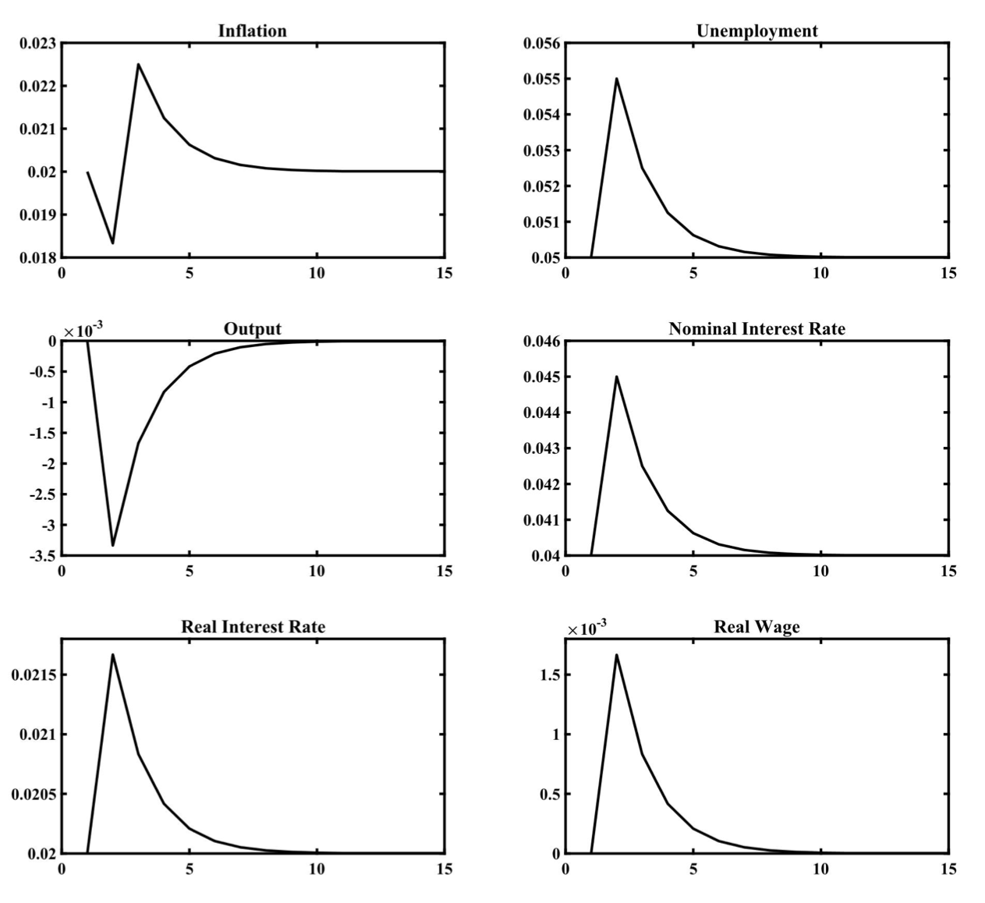
Impulse Response Functions following a 1% Unanticipated Temporary Positive Shock
to the Nominal Interest Rate

Slide 26
Effects of a 1% Unanticipated Interest Rate Shock
Inflation initially falls below the target of 2%, unemployment rises above its natural rate of 5%, and output falls below its own natural rate.
The real interest rate and the real wage rise above their natural rates.
Because of the fall in inflation and the rise in unemployment, after the initial shock, the nominal interest rate follows a downward path toward its natural rate of 4%, inflation rises, unemployment gradually declines toward its natural rate, and all other real variables adjust toward their natural rates too.
Thus, a temporary nominal shock has persistent real effects, because of the persistence of deviations of employment from its natural rate.

Slide 27
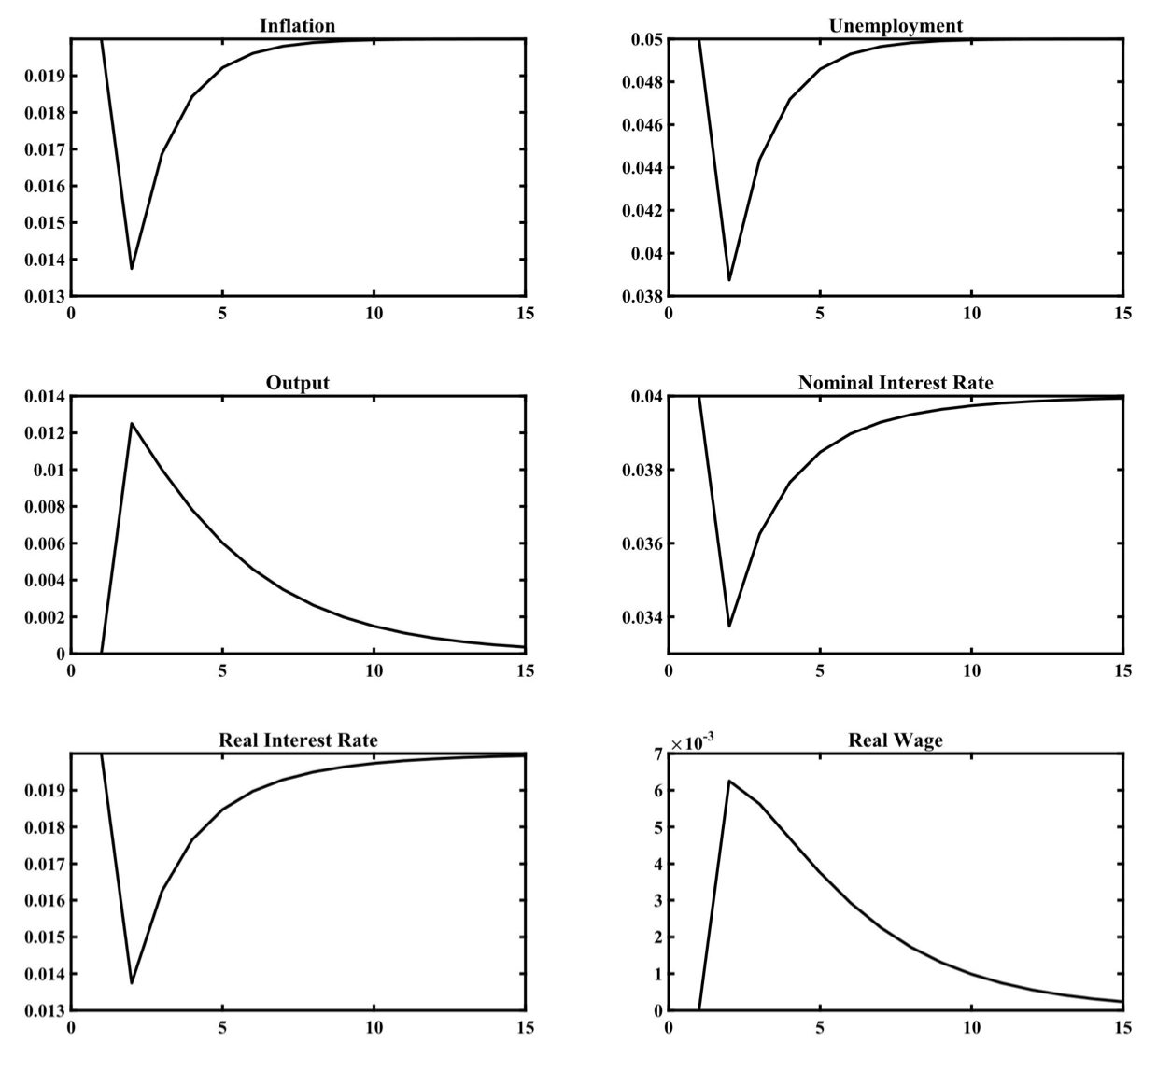
Impulse Response Functions following a 1% Unanticipated Persistent Positive Shock
to Productivity

Slide 28
Effects of a 1% Unanticipated Productivity Shock
Inflation initially falls below the target of 2%, unemployment also falls below its natural rate of 5%, and output rises above its own natural rate, because of the rise of employment.
The real interest rate falls below its natural rate, inducing higher aggregate demand, and the real wage rises above its natural rate.
Because of the fall in both inflation and unemployment, after the initial shock, the nominal interest rate follows an upward path toward its natural rate of 4%, inflation rises, unemployment gradually rises toward its natural rate, and all other real variables adjust toward their natural rates too.
Thus, a temporary nominal shock has persistent real effects, because of the persistence of deviations of employment from its natural rate.
Note that the correlation of inflation and unemployment (or output) depends on the nature of the shocks. The short-run correlation of inflation and unemployment following a nominal shock is negative, as unanticipated inflation reduces unemployment. But the short-run correlation of inflation and unemployment is positive following a real shock, because higher productivity reduces both inflation and unemployment. Thus, this model would be able to explain stagflation, as the outcome of negative real shocks.

Slide 29
The Implications of Staggered Pricing
Up to now we have assumed predetermined wage contracts and flexible prices. We can augment the model by introducing price stickiness as a additional nominal distortion. We shall concentrate on the Calvo (1983) model of staggered pricing, which is widely used in the new keynesian literature.
All firms are assumed to be able to automatically index their prices to the steady state inflation rate. However, following Calvo (1983), let us assume that the probability of adjusting prices freely, at a rate different than steady state inflation, is equal to $1-γ$. This probability is constant and independent of the length of time that has elapsed since the last such price adjustment by the firm. Thus, in each period, a proportion $1-γ$ of all firms adjust their prices freely at a rate different than the steady state inflation rate and the remaining proportion $γ$ cannot adjust them freely.
Under these assumptions, in period $t$, the expected future duration of any price contract is given by
$(1-γ)∑_{s=0}^{∞}sγ^{s}=\frac{γ}{1-γ}$
From the definition of the price level and the fact that all firms that freely reset their prices in period $t$ set the same price, it follows that,
${\overset{̂}{P}}_{t}={\left(γ{\left({\overset{̂}{P}}_{t-1}\right)}^{1-ε}+(1-γ){\left({\overline{P}}_{t}\right)}^{1-ε}\right)}^{\frac{1}{1-ε}}$
where $\overset{̂}{P}$ is the price level relative to the steady state price level, and $\overline{P}$ is the price set by the firms that freely reset their prices in the current period relative to the steady state price level. One can show that the dynamic adjustment of the price level relative to the steady state price level is determined by,
${\left(\frac{{\overset{̂}{P}}_{t}}{{\overset{̂}{P}}_{t-1}}\right)}^{1-ε}=γ+(1-γ){\left(\frac{{\overline{P}}_{t}}{{\overset{̂}{P}}_{t-1}}\right)}^{1-ε}$
In the steady state, with inflation equal to $π^{*}$, we have that ${\overset{̂}{P}}_{t}={\overline{P}}_{t}=1$, and the price level evolves as,$P_{t}=(1+π^{*})P_{t-1}$.

Slide 30
Optimal Staggered Pricing
A log-linear approximation of the price level around the steady state price level yields,
${\overset{̂}{p}}_{t}-{\overset{̂}{p}}_{t-1}≃(1-γ)\left({\overline{p}}_{t}-{\overset{̂}{p}}_{t-1}\right)$
It follows that inflation exceeds its steady state rate if firms that set prices in the current period set them at a higher level than the average price of the previous period adjusted for steady state inflation.
To analyze the adjustment of inflation, one has to examine how firms that can freely adjust prices in the current period decide on their optimal price, taking into account that, for a period in the future, they may not be able to readjust their prices freely, while some of their competitors will have the option of readjusting their own prices at a rate different than steady state inflation.
The problem of the firm that decides on the price it is about to set in period $t$is to set the price that maximizes the expected present value of its profits, given that the probability of readjusting its price in any future period is equal to $1-γ$. Thus, all firms that readjust their prices in period $t$ maximize,
$E_{t}∑_{s=0}^{∞}γ^{s}\left(I(s)\left({\overline{P}}_{t}Y_{t+s}^{t}-{\overset{̂}{W}}_{t+s}L_{t+s}^{t}\right)\right)$
where $I(s)=∏_{z=0}^{s}\left(\frac{1}{1+i_{t+z}}\right)$ and $\overset{̂}{W}$ is the nominal wage divided by the steady state price level.
The maximization takes place under the constraints of their production function and the demand function for their product. These are given by,
$Y_{t+s}^{t}=A_{t+s}{\left(L_{t+s}^{t}\right)}^{1-α}$ $Y_{t+s}^{t}={\left(\frac{{\overline{P}}_{t}}{{\overset{̂}{P}}_{t+s}}\right)}^{-ε}Y_{t+s}$
where $Y_{t+s}^{t}$ and $L_{t+s}^{t}$ are respectively the volume of output and employment in period $t+s$, of the firm that has set its prices freely in period $t$. The higher the relative price of the firm is in any period, the lower will be the demand for its product and thus its output and employment.

Slide 31
The Optimal Price under Staggered Pricing
From the first-order conditions for a maximum, it follows that,
$E_{t}∑_{s=0}^{∞}γ^{s}I(s)\left((ε-1){\left(\frac{{\overline{P}}_{t}}{{\overset{̂}{P}}_{t+s}}\right)}^{-ε}-\frac{ε}{(1-α)}{\left(\frac{{\overline{P}}_{t}}{{\overset{̂}{P}}_{t+s}}\right)}^{-\frac{1-α+ε}{1-α}}\left(\frac{{\overset{̂}{W}}_{t+s}}{{\overset{̂}{P}}_{t+s}}\right)\left(\frac{L_{t+s}^{α}}{A_{t+s}}\right)\right)=0$
This implies that the expected present value of revenues from the optimal price is equal to the expected present value of the marginal cost of production, augmented by the price markup $ε/(ε-1)$ of the firm.
Note that, as we have already seen, if the firm could determine its prices in every period, the price of the product in each period would be equal to the marginal cost of production augmented by the same markup. However, if the firm cannot adjust prices freely in every period, as is assumed in the Calvo (1983) model, pricing follows the dynamic pricing rule derived above.
Assuming that in the steady state, inflation is equal to $π^{*}$ and all prices are equal to steady state prices, this can be transformed into logarithmic deviations from the steady state equilibrium, using a log-linear Taylor approximation. Thus, in logarithms, we have that
${\overline{p}}_{t}≃\left(1-βγ\right)∑_{s=0}^{∞}{\left(βγ\right)}^{s}E_{t}\left({\overset{̂}{p}}_{t+s}+ω\left(μ+w_{t+s}-p_{t+s}+αl_{t+s}-a_{t+s}\right)\right)$
where $β=\frac{1}{1+ρ+π^{*}}$ and $ω=\frac{1-α}{1+α(ε-1)}$. It follows that $0<β,ω<1$.
Consequently, firms that freely reset their prices in period $t$ will choose a price that corresponds to a weighted average of the current and expected future price levels, relative to the steady state price level, plus a margin $μ$ on a weighted average of the current and expected future levels of real marginal costs. The discount factor of a future period $t+s$ depends on the probability that the firm will not be able to reset its price in the future period $t+s$, which equals $γ^{s}$, times the discount rate $β^{s}$. Furthermore, the part of pricing that depends on the expected marginal cost of the firm depends negatively on the elasticity of demand for the product of the firm, through the parameter $ω$.

Slide 32
Inflation and Unit Labor Costs under Staggered Pricing
Using the future mathematical expectations operator $F$, the optimal price under staggered pricing can be rewritten as
${\overline{p}}_{t}≃\frac{1-βγ}{1-βγF}{\overset{̂}{p}}_{t}+ω\left(μ+\frac{1-βγ}{1-βγF}\left(w_{t}-p_{t}+αl_{t}-a_{t}\right)\right)$
Substituting in the equation for the adjustment of the average price level, we get that,
${\overset{̂}{p}}_{t}=γ{\overset{̂}{p}}_{t-1}+(1-γ)\left(\frac{1-βγ}{1-βγF}{\overset{̂}{p}}_{t}+ω\left(μ+\frac{1-βγ}{1-βγF}\left(w_{t}-p_{t}+αl_{t}-a_{t}\right)\right)\right)$
Multiplying both sides of by $1-βγF$ and rearranging, we get that,
$(1+β){\overset{̂}{p}}_{t}-{\overset{̂}{p}}_{t-1}-βE_{t}{\overset{̂}{p}}_{t+1}=\frac{(1-γ)(1-βγ)}{γ}ω\left(μ+\left(w_{t}-p_{t}+αl_{t}-a_{t}\right)\right)$
This equation describes the adjustment of the price level towards the steady state price level, which is a constant markup on the marginal cost of production. Expressing it as an inflation equation we have
$π_{t}=(1-β)π^{*}+βE_{t}π_{t+1}+\frac{(1-γ)(1-βγ)}{γ}ω\left(μ+\left(w_{t}-p_{t}+αl_{t}-a_{t}\right)\right)$
where $π_{t}=p_{t}-p_{t-1}$ is the rate of inflation. This equation implies that deviations of current inflation from steady state inflation are greater than discounted expected deviations of future inflation from steady state inflation, if the current marginal cost of labor, plus the margin $μ$ is higher than the current price level $p$. The reason is that firms able to set prices freely in the current period post larger price increases than (discounted) expected future inflation, in order to offset the higher current marginal cost of labor. Note that if all firms can adjust their prices freely and $γ=0$, then the price level is always equal to the marginal cost of production augmented by the fixed markup $μ$.
The equation is the basis of the new keynesian Phillips Curve.

Slide 33
An Extended New Keynesian Phillips Curve: Combining Staggered Pricing with Periodic Nominal Wage Contracts
We can now combine staggered pricing with periodic nominal wage contracts set by insiders, such as the ones introduced already. Wages in period $t$ are set at the beginning of the period, based on information available until the end of $t-1$, in order to ensure that expected employment is equal to the target of labor market insiders
$E_{t-1}l_{t}=δl_{t-1}+(1-δ)\overline{n}$
Hence, the nominal wage in period $t$ satisfies,
$w_{t}=\frac{γ}{(1-γ)(1-βγ)ω}\left(E_{t-1}(π_{t}-π^{*})-β(E_{t-1}π_{t+1}-π*)\right)+E_{t-1}p_{t}-μ+E_{t-1}a_{t}-α\left(δl_{t-1}+(1-δ)\overline{n}\right)$
Substituting for the nominal wage in the new Keynesian Phillips curve and rearranging, we get,
$$π_{t}=E_{t-1}π_{t}+β\left(E_{t}π_{t+1}-E_{t-1}π_{t+1}\right)-\frac{(1-γ)(1-βγ)ω}{γ}\left(π_{t}-E_{t-1}π_{t}\right)+\frac{(1-γ)(1-βγ)}{γ}ω\left(α\left(l_{t}-δl_{t-1}-(1-δ)\overline{n}\right)-(a_{t}-E_{t-1}a_{t})\right)$$
Noting that, $l_{t}-δl_{t-1}-(1-δ)\overline{n}≃-\left(u_{t}-δu_{t-1}-(1-δ)\overline{u}\right)$, this can be expressed as,
$π_{t}=E_{t-1}π_{t}+ξ_{1}\left(E_{t}π_{t+1}-E_{t-1}π_{t+1}\right)-ξ_{2}\left(α\left(\left(u_{t}-\overline{u}\right)-δ\left(u_{t-1}-\overline{u}\right)\right)+\left(a_{t}-E_{t-1}a_{t}\right)\right)$
where $ξ_{1}=\frac{βγ}{γ+(1-γ)(1-βγ)ω}$ and $ξ_{2}=\frac{(1-γ)(1-βγ)ω}{γ+(1-γ)(1-βγ)ω}$.
Equation is an extended new keynesian Phillips curve, which encompasses both the new keynesian Phillips curve and the original expectations augmented Phillips curve as special cases.

Slide 34
The Extended New Keynesian Phillips Curve
The extended new keynesian Phillips Curve allows for both current expectations of future inflation (due to the assumption of staggered pricing), and past expectations of current inflation (due to the assumption of predetermined nominal wage contracts). It also allows for the effects of both the current and the past unemployment rate, because of the dynamics in the objectives of labor market insiders.
From the Okun-type relation between output and unemployment, it follows that,
$u_{t}-\overline{u}=-\frac{1}{1-α}\left(y_{t}-{\overline{y}}_{t}\right)$
where ${\overline{y}}_{t}$ is the natural rate of output.
The extended new keynesian Phillips Curve can thus be expressed in terms of deviations of output from its natural rate.
$π_{t}=E_{t-1}π_{t}+ξ_{1}\left(E_{t}π_{t+1}-E_{t-1}π_{t+1}\right)+ξ_{2}\left(\frac{α}{1-α}\left(\left(y_{t}-{\overline{y}}_{t}\right)-δ\left(y_{t-1}-{\overline{y}}_{t-1}\right)\right)-\left(a_{t}-E_{t-1}a_{t}\right)\right)$
The full model can thus be expressed by replacing the Phillips curve in the absence of staggered pricing with this extended new keynesian Phillips curve.

Slide 35
Summary and Conclusions
In this lecture we have considered a dynamic stochastic new keynesian model, which not only allows for the existence of involuntary unemployment, but also for nominal shocks and monetary policy to affect the fluctuations of all real variables.
The model builds on one of the key insights of the General Theory: the short-run rigidity of nominal wages, assumed to be due to periodic nominal wage contracts. But in all other respects it is based on intertemporal optimization on the part of both households and firms.
Deviations of output and employment from their natural rates depend on unanticipated current inflation (which reduces real wages relative to productivity), and unanticipated productivity shocks, which also affect the relation between real wages and productivity.
Nominal shocks and, by extension, monetary policy are able to affect fluctuations in both inflation and real variables, such as output, employment, unemployment, real wages, and the real interest rate.
We analyzed aggregate fluctuations in this model under a feedback interest rate rule, according to which the nominal interest rate responds to deviations of inflation from the target of the central bank, and deviations of output from its natural rate. Such a rule, which in the spirit of Wicksell (1898), has been proposed and advocated by Taylor (1993).
Contrary to the new classical model under full information, monetary shocks affect real variables in this model, causing temporary and persistent deviations of output, employment, unemployment, real wages, and the real interest rate from their natural rates. Under a Taylor feedback interest rate rule, only productivity shocks and shocks to monetary policy affect aggregate fluctuations. Aggregate fluctuations depend not only on exogenous shocks, but also on the parameters of the monetary policy rule followed by the central bank.

