Slide 1
12. The Stochastic Growth Model of Aggregate Fluctuations
Athens University of Economics and Business
Dynamic Macroeconomics
Prof. George Alogoskoufis
alogoskoufisg.com
George Alogoskoufis, Dynamic Macroeconomics, 2019

Slide 2
Lucas (1977) on the Nature of Aggregate Fluctuations
“Technically, movements about trend in gross national product in any country can be well described by a stochastically disturbed difference equation of very low order. These movements do not exhibit uniformity of either period or amplitude, which is to say, they do not resemble the deterministic wave motions which sometimes arise in the natural sciences. Those regularities which are observed are in the co-movements among different aggregative time series …
One is led by the facts to conclude that, with respect to the qualitative behavior of co-movements among series, business cycles are all alike. To theoretically inclined economists, this conclusion should be attractive and challenging, for it suggests the possibility of a unified explanation of business cycles, grounded in the general laws governing market economies, rather than in political or institutional characteristics specific to particular countries or periods.” (p. 9-10).

Slide 3
The Stochastic Growth Model: An Extension of the Ramsey Model
We start with the so called stochastic growth model, which is an extended stochastic version of the Ramsey model.
This is a competitive dynamic stochastic general equilibrium model, without externalities, asymmetric information, frictions and other imperfections of markets. Therefore it is a natural starting point for the investigation of aggregate fluctuations.
This model is nothing but a generalization of the Ramsey model. It not only excludes any market imperfections, but also all issues related to heterogeneity of economic agents. The Ramsey model is therefore the natural starting point for the study of aggregate fluctuations, like it is the “natural” starting point for the study of long-run growth.
However, in order to study aggregate fluctuations, one needs to extend the Ramsey model.
First, one should allow for random disturbances, which can cause fluctuations. Without random disturbances, the Ramsey model converges to a unique steady state. The disturbances usually introduced in the Ramsey model are disturbances in total factor productivity (technology shocks), as well as real demand shocks, such as shocks to the preferences of consumers or real government expenditure. Since both kinds of shocks are real - unlike monetary or nominal shocks - this model is sometimes referred to as the real business cycle model.
Second, in order to allow the model to explain fluctuations not only in total output, but also employment, employment must become endogenous. This is achieved through the introduction of employment in the utility function of a representative household, in order to establish an endogenous labor supply function.

Slide 4
The Structure of the Stochastic Growth Model
The extended Ramsey model that we end up with is a DSGE model, in which fluctuations are caused by real shocks.
The model assumes identical households and firms, so this is a competitive representative household model. Firms use labor and capital to produce a homogeneous product. They choose investment and employment to maximize their intertemporal profits, while households choose consumption and labor supply to maximize their intertemporal utility.
The key variables and parameters of the model are as follows: $Y$ is aggregate output, $K$ is aggregate physical capital, $L$ is aggregate employment, $A$ is the exogenous efficiency of labor (productivity), $C$ is aggregate private consumption, $C^{G}$ is aggregate real government expenditure, $N$ is aggregate population, $δ$ is the rate of depreciation of capital, $ρ$ is the pure rate of time preference of households, $r$ is the real interest rate, and $w$ is the real wage per employee.
The economy consists of a large number of identical households and firms that interact through competitive markets. Output and factor prices are thus given for every household and every firm. Households own factors of production, labor, and capital, and they rent them out to firms through competitive factor markets.

Slide 5
The Representative Firm
The representative firm has a production function with constant returns to scale, which takes the Cobb-Douglas form. Thus, the aggregate production function is also Cobb-Douglas:
$Y_{t}=K^{α}(A_{t}L_{t})^{1-α}$
where $0<α<1$.
The demand for output consists of private consumption, investment, and government consumption. Government consumption is financed through non-distortionary taxation, and, in each period, taxes are equal to government consumption. Thus, the equilibrium condition in the output market is given by,
$Y_{t}=C_{t}+C_{t}^{G}+K_{t+1}-K_{t}+δK_{t}$
Solving for $K_{t+1}$ we get a capital accumulation equation of the form,
$K_{t+1}=K_{t}+Y_{t}-C_{t}-C_{t}^{G}-δK_{t}$
To the extent that aggregate savings $Y-C-C^{G}$ exceed depreciation investment $δK$, there is accumulation of capital.
Labor and capital are paid their marginal product, as firms maximize profits taking the real interest rate $r$ and the real wage $w$ as given.
$w_{t}=(1-α){\left(\frac{K_{t}}{A_{t}L_{t}}\right)}^{α}A_{t}$ and $r_{t}=α{\left(\frac{A_{t}L_{t}}{K_{t}}\right)}^{1-α}-δ$
Firms are assumed to employ workers up to the point where the marginal product of labor is equal to the real wage, and capital up to the point where the marginal product of capital equals the real user cost of capital, assumed to be equal to the real interest rate plus the depreciation rate.

Slide 6
The Representative Household
The economy is inhabited by a large number of identical households, each of which has an infinite time horizon. The representative household maximizes its expected intertemporal utility function, which depends on the path of real consumption of goods and services and leisure. The expected intertemporal utility function is defined by
$U=E_{t}∑_{s=0}^{∞}{\left(\frac{1}{1+ρ}\right)}^{t+s}N_{t+s}u(c_{t+s},1-l_{t+s})$
where $E$ is the mathematical expectations operator, and $u$ is the per capita instantaneous utility of the representative household. Per capita consumption is given by $c=C/N$ and per capita employment by $l=L/N$. Assume that the instantaneous utility function is logarithmic:
$u_{t}=lnc_{t}+bln(1-l_{t})$
where $b>0$.
The assumption of logarithmic preferences is made to arrive at simpler functional relationships. However, like all such simplifications, this assumption implies specific restrictions for the model.

Slide 7
Exogenous Population Growth, Efficiency of Labor, and Government Expenditure
Population increases exogenously at a rate $n$ per period. Consequently,
$lnN_{t}=\overline{n}+nt$
where $0<n<ρ$.
The final assumptions of the model concern the behavior of the two main exogenous variables. Both productivity (labor efficiency), and government expenditure are supposed to be exogenous stochastic processes.
The stochastic process describing the evolution of the efficiency of labor is given by,
$lnA_{t}=\overset{_}{a}+gt+a_{t}$
where,
$a_{t}=η_{A}a_{t-1}+ε_{t}^{A}$
It is assumed that $-1<η_{A}<1$, and that $ε^{A}$ is a white noise process. With these assumptions, $a_{t}$ is a stationary $AR(1)$ process. These assumptions imply that labor efficiency grows at an exogenous rate $g$, but that it is subject to random disturbances $a_{t}$ which follow a stationary first-order autoregressive process. The assumptions imply that the impact of a technological disturbance on the productivity of labor is gradually reduced over time.
Similar assumptions could be made about government expenditure, but we shall abstract from government expenditure for reasons of analytical simplicity.
Before we look at the general properties of the model, it is worth considering the implications for the behavior of the representative household of the introduction of leisure in the utility function, as well as the implications of uncertainty in the form of random productivity disturbances.

Slide 8
Labor Supply of the Representative Household
The first difference of this model from the Ramsey model arises from the introduction of leisure time in the utility function of the household, which makes labor supply endogenous. To analyze the importance of this extension let us first consider the problem of a household which lives for a single time period and has no assets. The problem of that household is defined as the maximization of
$u=lnc+bln(1-l)$
under the constraint,
$c=wl$
The Lagrange function is defined by,
$L=lnc+bln(1-l)+λ(wl-c)$
where $λ$ is the relevant Lagrange multiplier. The first-order conditions for a maximum imply that
$\frac{1}{c}-λ=0$ and $-\frac{b}{1-l}+λw=0$
From the budget constraint $c=wl$ and from the first-order condition for consumption it follows that $λ=1/(wl)$. Substituting in first-order condition for labor, we get
$-\frac{b}{1-l}+\frac{1}{l}=0$
It is apparent that labor supply is independent of the real wage. This is because of the assumption of logarithmic preferences, implying that the elasticity of substitution between consumption and leisure is equal to unity. Thus, the substitution effect from a change in the real wage is counteracted by the income effect. Labor supply is completely inelastic and is given by,
$l=\frac{1}{b+1}$

Slide 9
Intertemporal Substitution in Labor Supply
However, this inelasticity does not mean that temporary changes in real wages do not affect labor supply even in this case. This can be seen if we look at the behavior of a household that lives for two periods.
Consider the behavior of a household living for two periods, that has no initial wealth and no uncertainty about the real interest rate or the real wage of the second period. The intertemporal budget constraint of the household is given by,
$c_{1}+\frac{1}{1+r}c_{2}=w_{1}l_{1}+\frac{1}{1+r}w_{2}l_{2}$
where subscripts 1 and 2 refer to the first and second periods of life, respectively. The Lagrange function of the problem of this household is defined by
$L=lnc_{1}+bln(1-l)_{1}+\frac{1}{1+ρ}\left(lnc_{2}+bln{(1-l)}_{2}\right)+λ\left[w_{1}l_{1}+\frac{1}{1+r}w_{2}l_{2}-c_{1}-\frac{1}{1+r}c_{2}\right]$
The household chooses consumption and labor supply for each of the two periods. From the first-order conditions for labor supply we have
$\frac{b}{1-l_{1}}=λw_{1}$ and $\frac{b}{1-l_{2}}=\frac{1+ρ}{1+r}λw_{2}$
It follows that,
$\frac{1-l_{1}}{1-l_{2}}=\frac{1+ρ}{1+r}\frac{w_{2}}{w_{1}}$
The relative labor supply in the two periods depends positively on the relative real wage in the two periods, as well as the real interest rate, which induce intertemporal substitution in labor supply. Thus, this model can explain fluctuations in employment, as a result of fluctuations in real wages and the real interest rate.

Slide 10
Uncertainty and the Behavior of the Representative Household
Apart from the endogeneity of labor supply, the second element that differentiates this stochastic growth model from the deterministic Ramsey model is uncertainty arising from the stochastic disturbances. Therefore, the expectations of the representative household for future developments play a significant role.
It is straightforward to show that, for the general case, when the household maximizes the expected intertemporal utility function,
$U=E_{t}∑_{s=0}^{∞}{\left(\frac{1}{1+ρ}\right)}^{t+s}N_{t+s}u(c_{t+s},1-l_{t+s})$
subject to the relevant intertemporal budget constraint, the Euler equation for consumption takes the form,
$\frac{1}{c_{t}}=\frac{1}{1+ρ}E_{t}\left[\frac{1}{c_{t+1}}\left(1+r_{t+1}\right)\right]$
The mathematical expectation of the product of two random variables is not equal to the product of their mathematical expectations. It is equal to the product of their mathematical expectations plus the covariance of the two random variables. Thus, the Euler equation implies
$\frac{1}{c_{t}}=\frac{1}{1+ρ}\{E_{t}\left[\frac{1}{c_{t+1}}\right]E_{t}\left(1+r_{t+1}\right)+Cov\left(\frac{1}{c_{t+1}},\left(1+r_{t+1}\right)\right)\}$
However, from the first-order conditions for consumption and labor supply, the ratio of consumption to leisure is a positive function of the real wage of the form,
$\frac{c_{t}}{1-l_{t}}=\frac{w_{t}}{b}$
The equation above links labor supply (leisure) and consumption with the real wage. It includes only current variables.

Slide 11
A Simplified Version of the Stochastic Growth Model
We first consider a special case of the stochastic growth model, without government expenditure and a depreciation rate of 100. The equations that describe the accumulation of capital and the determination of the real interest rate then simplify to
$K_{t+1}=Y_{t}-C_{t}$
$1+r_{t}=α{\left(\frac{A_{t}L_{t}}{K_{t}}\right)}^{1-α}$
Because of the assumption of competitive markets and the absence of externalities, the equilibrium of the model is Pareto optimal. We shall examine the properties of the model by solving for the competitive equilibrium.
Let us focus on two variables: labor supply per person $l$, and the savings rate $s$. Defining the savings rate we also determine aggregate consumption as $C=(1-s)Y$.
We focus on both behavioral equations of the representative household, i.e the Euler equation for consumption and the consumption-leisure relation. Once we determine labor supply and the savings rate, the rest follows automatically from either equilibrium conditions or definitions.

Slide 12
Determination of the Savings Rate
The Euler equation for consumption can be written as,
$1+ρ=E_{t}\left[\frac{c_{t}}{c_{t+1}}\left(1+r_{t+1}\right)\right]$
We can substitute for consumption and the real interest rate in the Euler equation by using the relations,
$c_{t}=(1-s_{t})Y_{t}/N_{t}$
$1+r_{t+1}=αY_{t+1}/K_{t+1}$
$K_{t+1}=s_{t}Y_{t}$
This allows us to rewrite the Euler equation as,
$\frac{1+ρ}{1+n}=E_{t}\left[\frac{1-s_{t}}{1-s_{t+1}}\frac{α}{s_{t}}\right]$
Because the left-hand side is constant, the right-hand side must also be constant. Thus, the savings rate is constant and is determined by,
$\overline{s}=\frac{α(1+n)}{1+ρ}$
The savings rate is independent of the real interest rate and constant in this simplified model because of the assumption of logarithmic preferences.

Slide 13
Determination of Labor Supply
The consumption-labor supply relation is determined by,
$\frac{c_{t}}{1-l_{t}}=\frac{w_{t}}{b}$
Noting that, $c_{t}=(1-\overline{s})Y_{t}/N_{t}$ and $w_{t}=(1-α)Y_{t}/(l_{t}N_{t})$, we arrive at the conclusion that labor supply per household member is also constant in this simplified model. It is given by,
$\overline{l}=\frac{1-α}{(1-α)+b(1-\overline{s})}$
Labor supply is constant in this simplified model, because the impact of the shocks in technology (labor efficiency) on the real wage and the real interest rate cancel each other out, so that no intertemporal substitution in labor supply is induced by such shocks.
This result is due to the specific assumptions that we made to simplify the model and is not a general feature of the model. In fact, the opposite is true. In general versions of the model, intertemporal substitution in labor supply induced by temporary real shocks is the key driver of fluctuations in aggregate employment.

Slide 14
Fluctuations of Output in the Simplified Stochastic Growth Model
We can now determine fluctuations in total output. Taking logs on both sides of the production function (13.1) we get
$lnY_{t}=αlnK_{t}+(1-α)(lnA_{t}+lnL_{t})$
We know that, $K_{t}=\overline{s}Y_{t-1}$ and that $L_{t}=\overline{l}N_{t}$. Therefore,
$lnY_{t}=αln\overline{s}+αlnY_{t-1}+(1-a)(lnA_{t}+ln\overline{l}+lnN_{t})$
We can substitute the logarithm of $A$ and $N$ from equations the exogenous processes driving them. This implies,
$lnY_{t}=αln\overline{s}+αlnY_{t-1}+(1-α)\left[(\overline{a}+gt)+a_{t}+(ln\overline{l}+\overline{n}+nt)\right]$
We can express the equation above as,
$y_{t}=αy_{t-1}+(1-α)a_{t}$
where $y_{t}=lnY_{t}-ln{\overline{Y}}_{t}$, denotes the percentage deviation of output from its long-run trend.
The logarithm of trend output in this model is defined by,
$ln{\overline{Y}}_{t}=\frac{α}{1-α}ln\overline{s}+ln\overline{l}+\overline{a}+\overline{n}+(n+g)t$
Trend output grows at the exogenously given rate of $n+g$, as happens with steady state output in the Ramsey model of growth. Thus, we end up with,
$y_{t}=(α+η_{A})y_{t-1}-αη_{A}y_{t-2}+(1-α)ε_{t}^{A}$

Slide 15
The Simplified Stochastic Growth Model and the Evidence on Aggregate Fluctuations
Empirical estimates suggest that percentage deviations of output around trend do indeed follow an AR(2) process, as suggested by the simplified stochastic growth model. For example, running a regression of the log of US real GDP on a linear trend, and its two lags, using annual data for the period 1890-2014, one gets a fairly good statistical fit. The coefficient on the first lag of output is equal to 1.211, with a standard error of estimate of 0.086, and the coefficient on the second lag of output is equal to -0.319, with a standard error of estimate of 0.087. Both estimates are statistically significant at conventional significance levels, and they imply that $α$ = 0.386 (standard error 0.132) and $η_{A}$ = 0.824 (standard error 0.082). The estimates of the time trend imply a long-run growth rate of GDP equal to 0.033 (standard error 0.001).
Hence, the econometric estimates of the model parameters are quite sensible, suggesting that, as a first approximation, this simplified model can account for both the long-run growth rate and the aggregate fluctuations of US output.
However, many other features of aggregate fluctuations are not adequately described by this simplified version of the stochastic growth model. The first such feature is the constant savings ratio. This essentially means that consumption will display the same degree of variability as output and investment. As shown by the stylized facts presented by Hodrik and Prescott (1997), and others, this does not seem to be a property of the data. Empirical estimates suggest that fluctuations in aggregate consumption are much smoother than output fluctuations.
A second counterfactual feature of the simplified model is the constant employment rate. In reality, the employment rate is not constant over the business cycle, whether one looks at total hours or the number of employees. Employment and hours worked are pro-cyclical, and are very strongly correlated with output.
Finally the behavior of real wages over the business cycle is not as predicted by the simplified stochastic growth model. In the model real wages would be pro-cyclical and equally volatile as GDP per capita, which is not the case in the data, as suggested by, among others, Neftci (1978).
One must thus consider the more general version of the model to assess its empirical significance.

Slide 16
A Log-Linear Approximation to the General Stochastic Growth Model
One can analyze the general version of the stochastic growth model, without some of the more extreme simplifications introduced in the simplified version we analysed so far.
For the full stochastic growth model one can derive an approximate analytical solution, based on a log-linear approximation around the steady state equilibrium. As first shown by Campbell (1994), the model can be transformed into a system of log-linear stochastic difference equations, which can be solved by the method of undetermined coefficients.
For the general version of the model, some of the counter-factual properties, such as the constant savings and employment rate, no longer hold. The general model is thus more consistent with the evidence.
We present the results of a dynamic simulation of the general stochastic growth model, for a 1% positive shock to productivity $a$. The parameter values we used in the simulation were $α=0.333$, $ρ=0.02$, $g=0.02$, $δ=0.03$, $ν=2$, $η_{A}=0.90$.
As can be seen from the simulated impulse response functions, all real variables move pro-cyclically, as innovations in productivity affect output, the capital stock, consumption, and employment in the same direction. Real wages and the real interest rate also move pro-cyclically. Gradually, all variables converge to their original steady state values, unless the system is disturbed by another shock.
The general stochastic growth model can explain fluctuations in all real variables as a result of stochastic shocks to productivity. However, fluctuations in employment are due to intertemporal substitution in labor supply, and there is no account for unemployment.

Slide 17
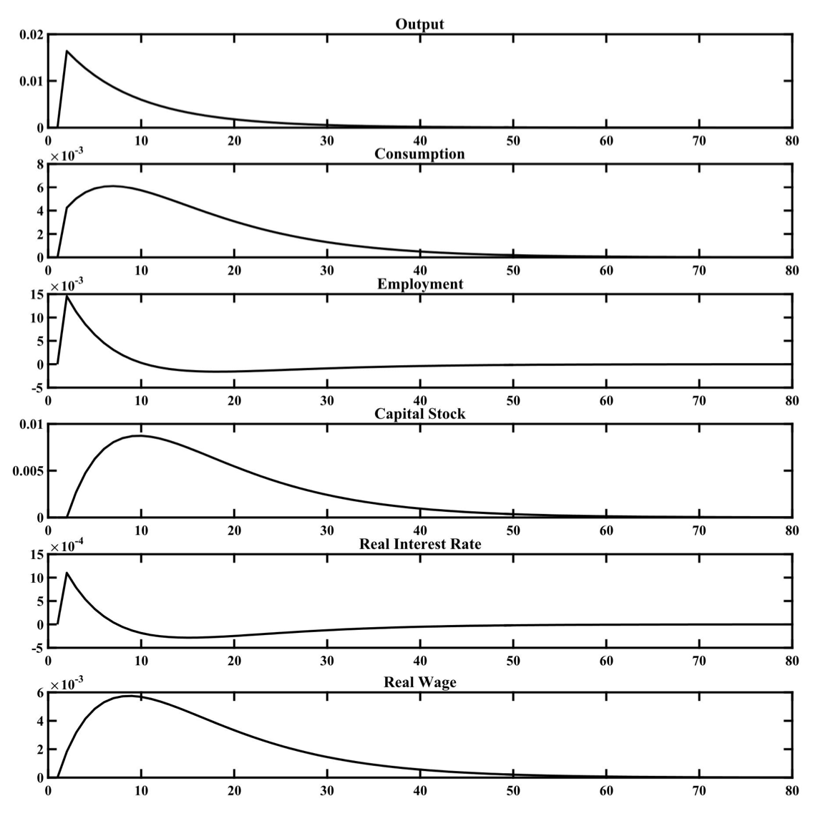
A Dynamic Simulation of the General Stochastic Growth Model following a 1% Persistent Shock to Productivity

