Slide 1
10. Key Facts about Aggregate Fluctuations
Athens University of Economics and Business
Dynamic Macroeconomics
Prof. George Alogoskoufis
alogoskoufisg.com
George Alogoskoufis, Dynamic Macroeconomics, 2019

Slide 2
Aggregate Fluctuations in the Industrial Economies
The process of economic growth has been anything but smooth. GDP per capita displays significant fluctuations around its long run trend. The explanation of these fluctuations in economic activity is the second main area of macroeconomics.
In accounting for the key facts about aggregate fluctuations, we shall present evidence mainly from the United States and the United Kingdom. These two countries have long and consistent time series for the relevant variables, and, to a large extent, it is their experience that has contributed to the development of macroeconomics as we know it. However, where appropriate, we shall present evidence from other countries as well.

Slide 3
Defining a Recession
Recessions are generally defined as periods in which there is a contraction in economic activity, with real GDP falling rather than rising.
In the United States, the Business Cycle Dating Committee of the National Bureau of Economic Research (NBER) is generally considered as the authority for dating US recessions.
The NBER defines an economic recession as: “a significant decline in economic activity spread across the economy, lasting more than a few months, normally visible in real GDP, real income, employment, industrial production, and wholesale-retail sales.”.
In the United Kingdom, recessions are generally defined as two consecutive quarters of negative economic growth, as measured by the seasonally adjusted quarter-on-quarter figures for real GDP. The exact same definition of a recession applies for all member states of the European Union and is the most widely used definition of a recession.

Slide 4
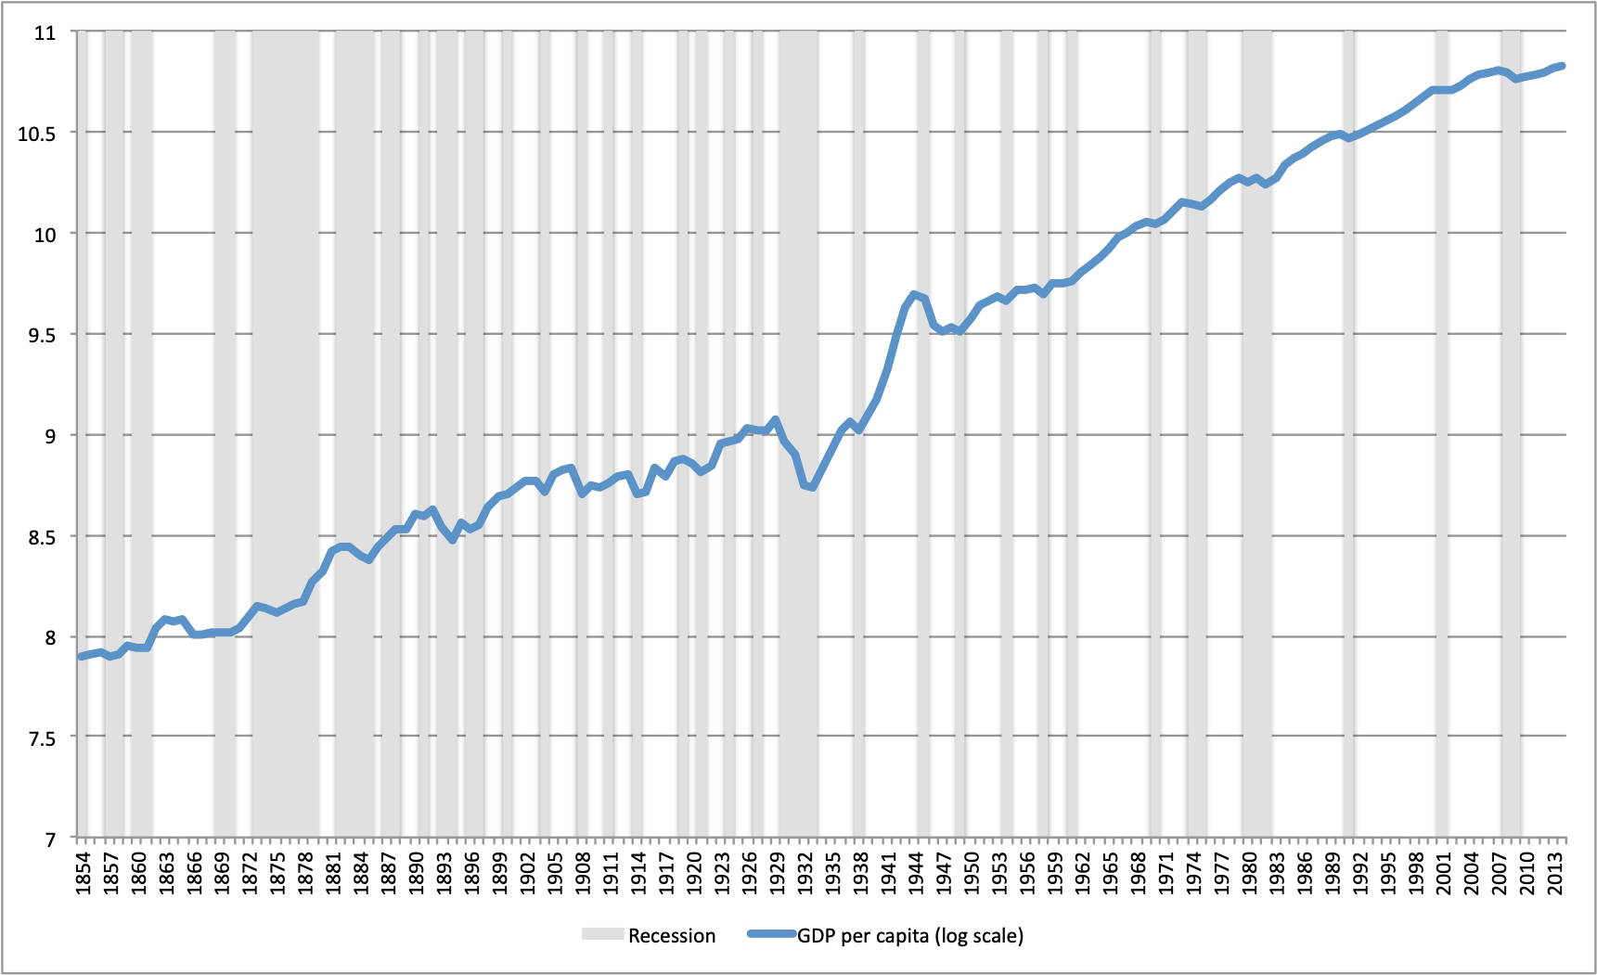
The Evolution of Real GDP per Capita in the United States

Slide 5
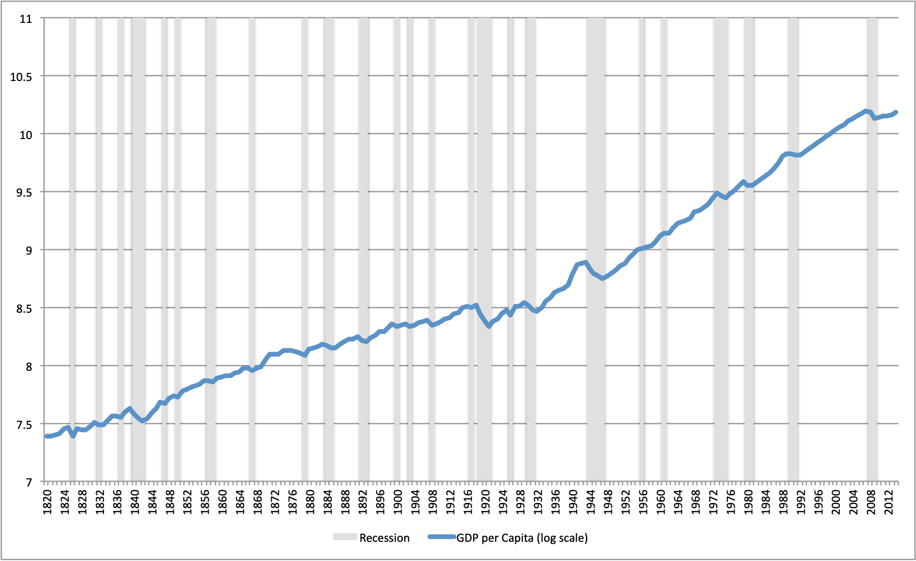
The Evolution of Real GDP per Capita in the United Kingdom

Slide 6
Recessions and Recoveries in the United States and the United Kingdom
There were 54 years of recession in the United States between 1854 and 2014, and 107 years of no recession. In periods of recession, per capita GDP usually falls or remains stagnant. In the 161 years, between 1854 and 2014, a recession occurred, on average, in one every 3 years. In the period after World War II, there was a drop in the frequency of US recessions. There were 14 years of recession between 1946 and 2014. In the 69 post war years, a recession occurred, on average, in one every 4.9 years.
In the United Kingdom, there were 41 years of recession between 1820 and 2014, and 154 years of no recession. In the 195 years between 1820 and 2014, a recession occurred, on average, in one every 4.75 years. In the post World War II period, there were 13 years of recession, with a recession occurring in one every 5.3 years on average.
Not all recessions are alike. Many recessions are short and shallow, but there are also deep and quite prolonged recessions.
The longest US recession was the recession of the 1870s, while the deepest and second longest recession was the Great Depression of the 1930s. The recessions of the 1890s were the deepest recessions before the onset of the Great Depression. In the post World War II period, the most severe recessions were the ones of the early 1970s and early 1980s, as well as the most recent recession of 2008-09. In the UK, deep and long recessions occurred in the 1840s, in the aftermath of the two World Wars, in the early and late 1970s and the early 1980s, in the early 1990s, as well as in 2008-09.

Slide 7
Recessions and Unemployment in the United States and the United Kingdom
One of the key characteristics of recessions is that they are associated with falls in employment and persistent rises in unemployment rates.
There are large and prolonged rises in unemployment rates during recessions. On many occasions, the rise in unemployment continues even after the end of the recession, and the return of unemployment to lower levels is on many occasions quite slow.
The sustained and persistent rise in unemployment, along with the sustained drop in real incomes, is thus one of the key characteristics of recessions, and one of the most important reasons that macroeconomics is concerned with business fluctuations. Unemployment not only rises during recessions, but it also persists, and on many occasions it peaks after a recession has turned into recovery. Thereafter, it falls only gradually during the recovery.

Slide 8
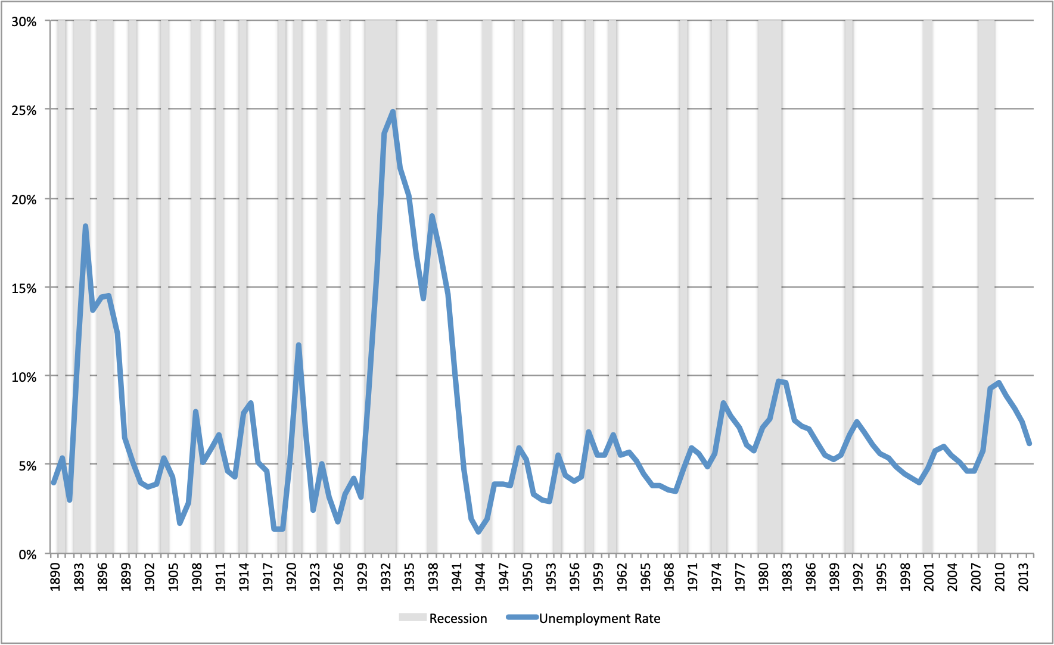
The Evolution of the Unemployment Rate in the United States

Slide 9
The Evolution of the Unemployment Rate in the United States
Whereas in the pre-World War II period unemployment in the United States tended to fluctuate around a rate slightly below 5% of the labor force, in the Great Depression unemployment reached almost 25% of the labor force. The average unemployment rate in the 1930s was 18.8% of the US labor force, higher than the peak unemployment rate of 18.4% in the deep recession of the 1890s.
In the post World War II period, fluctuations in the US unemployment rate are smaller, but significant nonetheless. In the recession of the 1970s unemployment rose from 4.9% of the labor force in 1973, to a peak of 8.5% of the labor force in 1975. In the recession of the early 1980s, unemployment rose from 5.8% of the labor force in 1979, to 9.7% in 1982. In the recession of 2008-09, unemployment rose from 4.6% of the labor force in 2007,to 9.6% in 2010.

Slide 10
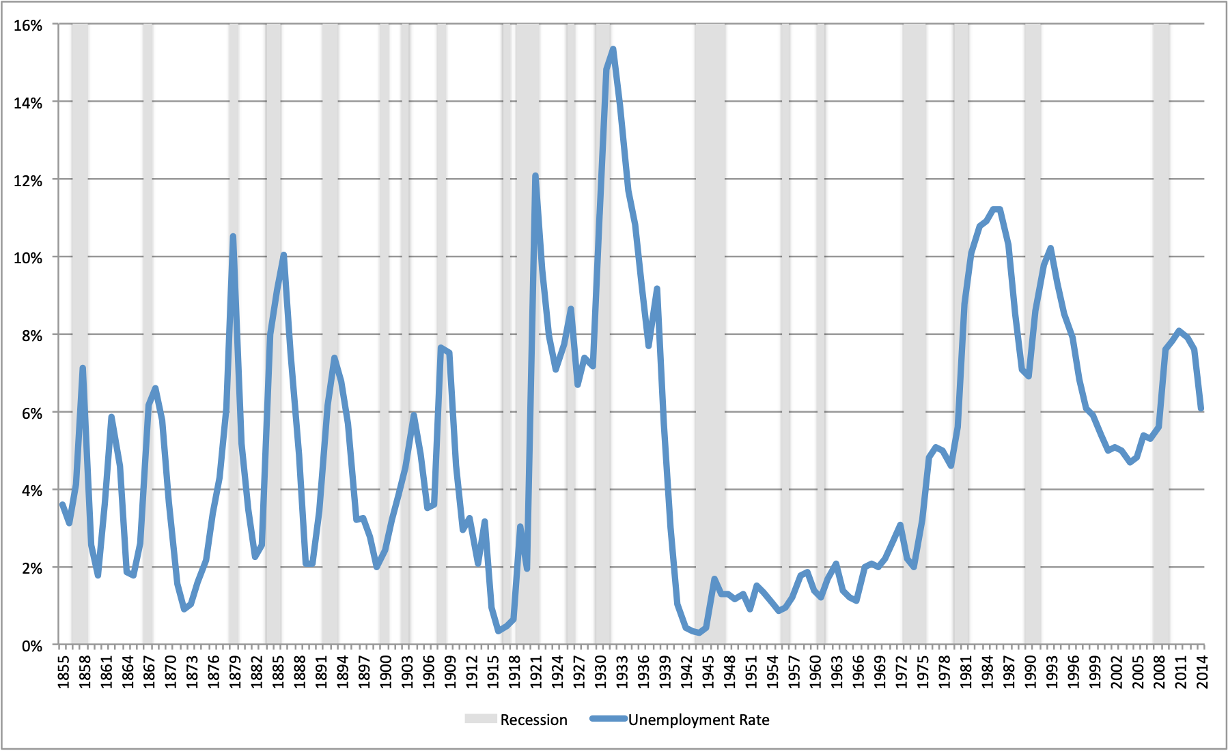
The Evolution of the Unemployment Rate in the United Kingdom

Slide 11
The Evolution of the Unemployment Rate in the United Kingdom
The UK experience is not too different. Unemployment rates as high as 7-10% were not uncommon in the recessions of the 19th century. In the recession of the early 1920s unemployment rose to 12.1%, and in the Great Depression of the early 1930s it rose to a peak of 15.3% in 1932.
In the post World War II period unemployment in the UK was remarkably low for many years. Yet, following the recession of the early 1970s, it started creeping up. From 2.2% of the labor force in 1973, it rose to 5.1% in 1977. It is remarkable that it continued rising even after the recovery had started. From 4.6% in 1979, it rose significantly during the recession of the early 1980s. It peaked at 11.2% of the labor force in 1985, long after the recovery had started.
The same pattern was repeated in the recession of the early 1990s, and the latest recession of 2008-09. In the early 1990s, the unemployment rate rose from 7.1% in 1989 to 10.2% in 1993, after the recession had ended, while in the last recession, it rose from 5.3% in 2007 to a peak of 8.1% in 2011, two years after the end of the recession.

Slide 12
The Evolution of the Price Level and Inflation
A third key macroeconomic variable is the price level, and its rate of change, the rate of inflation.
The price level and its rate of change is what determines the purchasing power of money incomes.
Before World War II, the price level did not display a marked upwards trend, as it did after World War II. If anything, there were long periods of a falling price level, both during the gold standard period, and in the interwar years. Inflation was a temporary phenomenon, associated with wars, such as the American Civil War of 1861-1865, World War I, or periods of economic boom. On the other hand, the price level tended to fall in recessions, which were thus also periods of deflation.
After World War II the price level displays a significant positive trend in both the USA and the UK. Average inflation has been positive, and periodically high, in both countries throughout the post World War II period. In addition, the negative impact of recessions on the price level and inflation, which was a regular characteristic of the pre-World War II period, does not seem to hold in the postwar period. In addition, the recessions of the 1970s and the early 1980s are associated with an increase rather than a decrease in inflation, a phenomenon that has been described as stagflation.

Slide 13
Wars and Inflation
Average annual inflation in the 1854-1913 period was only 0.6% in the USA, and average annual inflation in the 1821-1913 period in the UK was -0.2%, i.e the price level on average fell. Had it not been for the American Civil War, the US would probably have been characterized by falling prices too.
During the American Civil War US inflation averaged 15% per annum approximately, with peak inflation rates of about 25% in both 1863 and 1864.
During World War I, average annual inflation in the USA was equal to 9.7% and in the UK it was equal to 15.3%. In the interwar period of 1919-1939, there was deflation in both countries. Prices in the USA were falling by 0.2% per annum on average, while prices in the UK were falling on average by 0.9% per annum.
The same pattern was repeated during World War II, the Korean War and the Vietnam war.

Slide 14
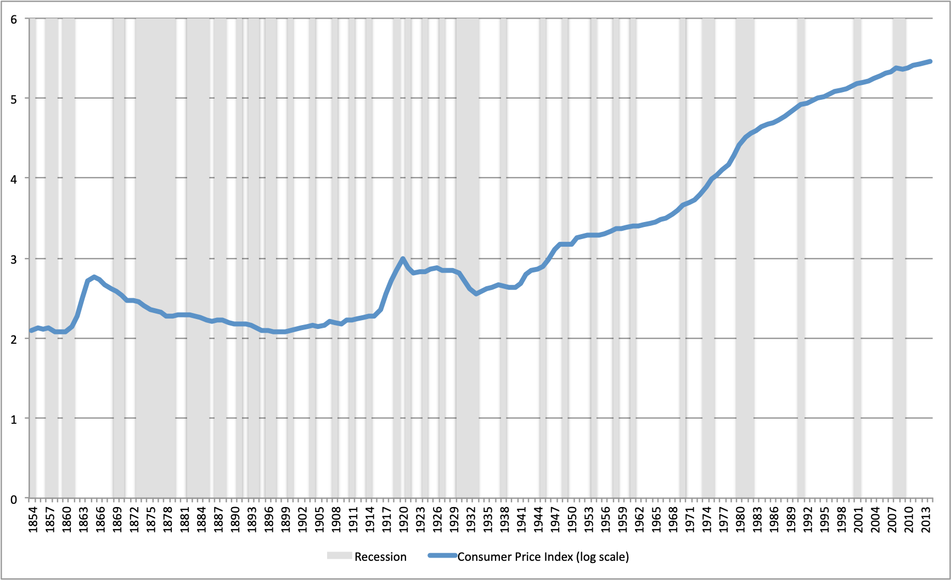
The Evolution of the Price Level in the United States

Slide 15
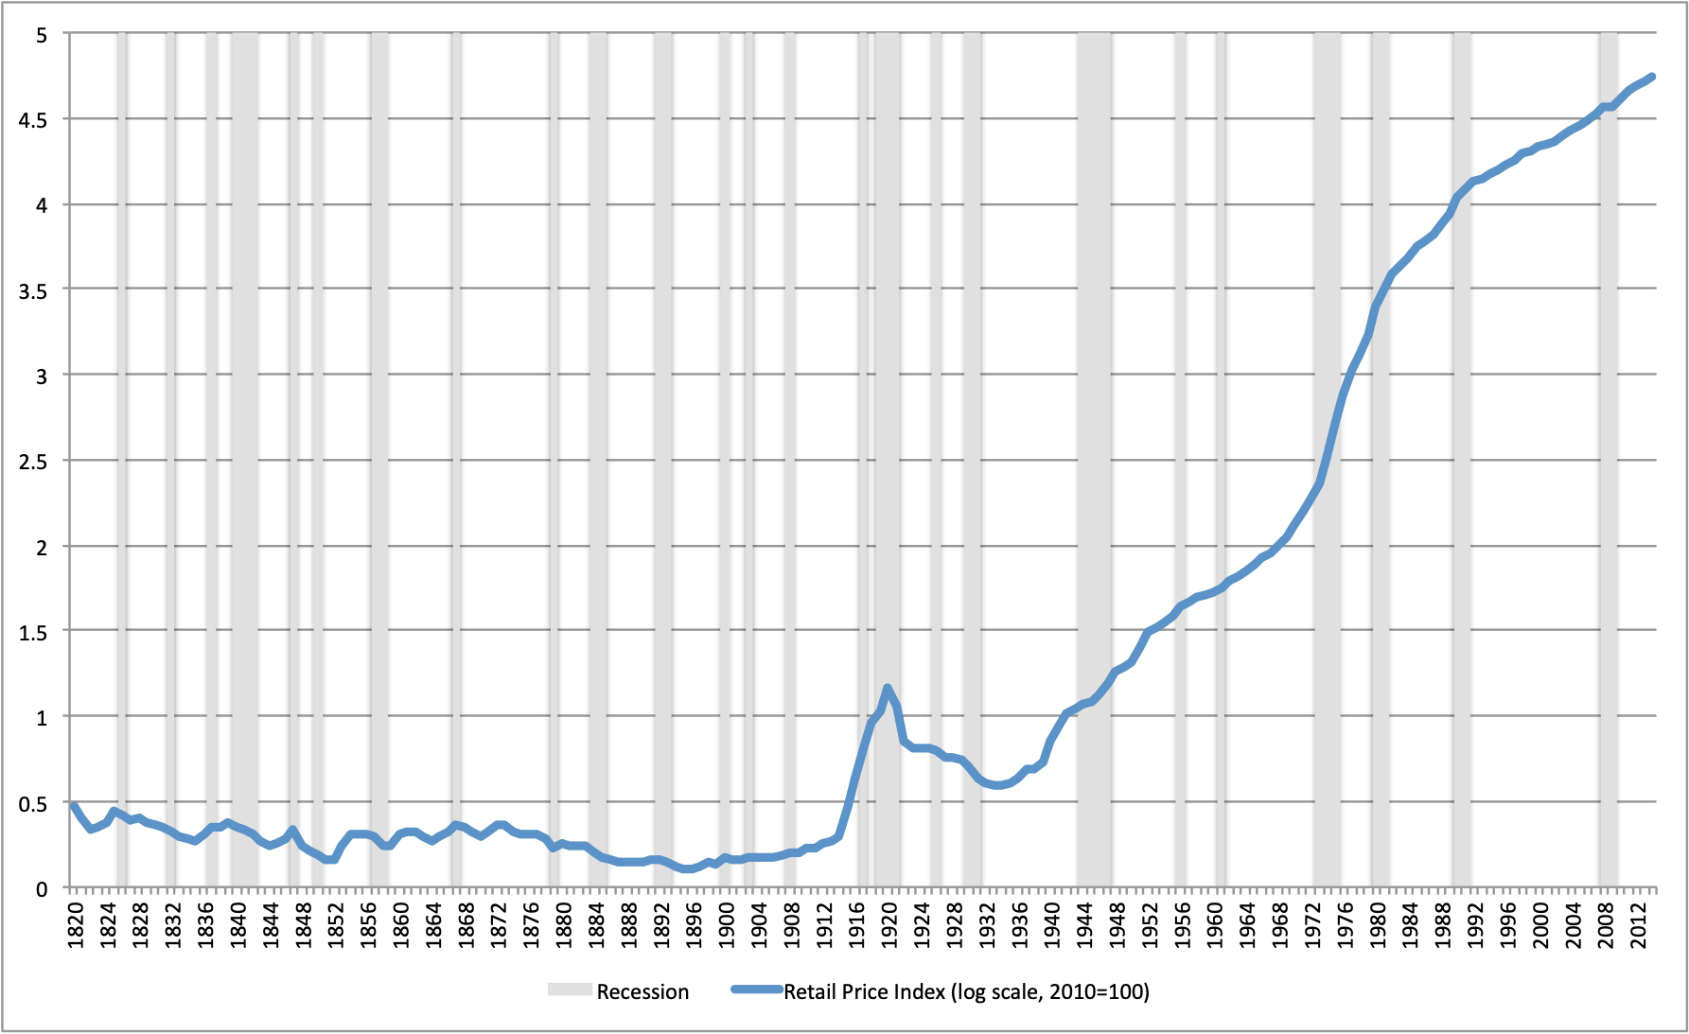
The Evolution of the Price Level in the United Kingdom

Slide 16
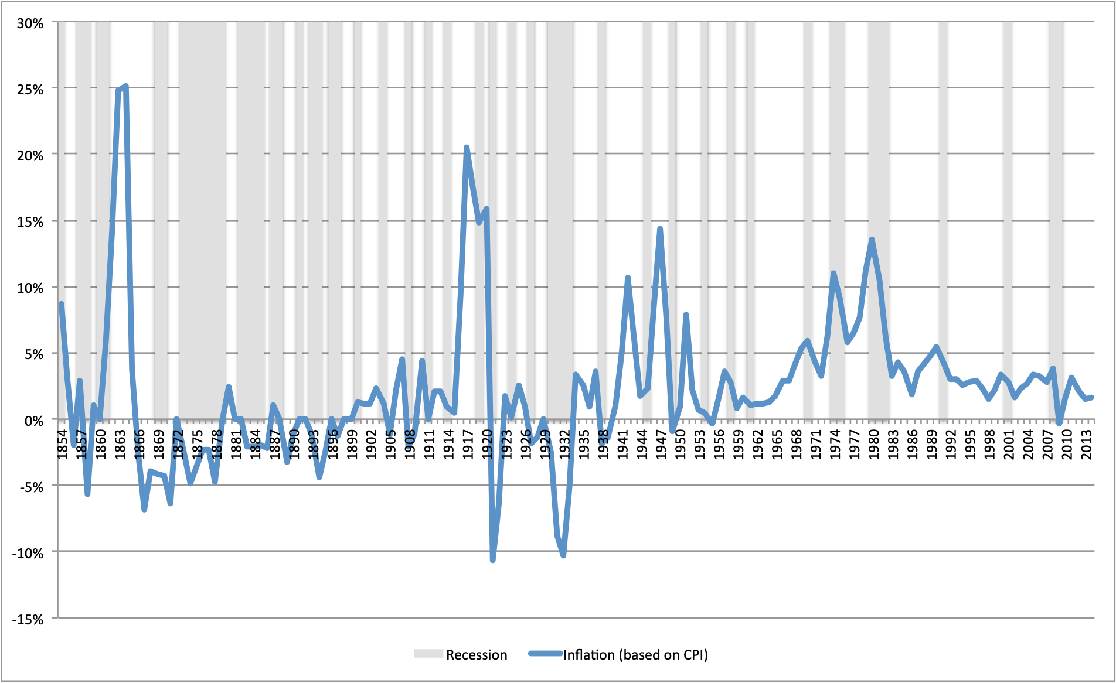
The Evolution of Inflation in the United States

Slide 17
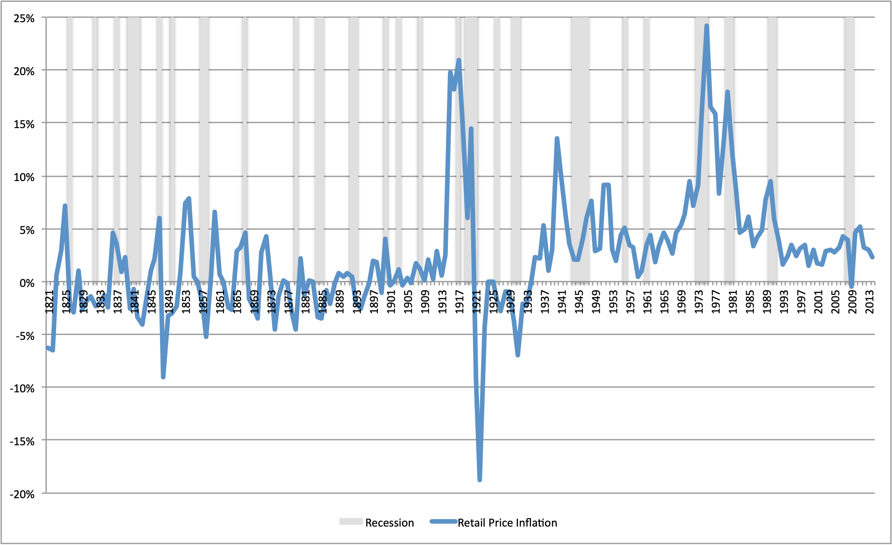
The Evolution of Inflation in the United Kingdom

Slide 18
Inflation after World War II
After World War II the price level displays a significant positive trend in both the USA and the UK.
Average inflation has been positive, and periodically high, in both countries throughout the post World War II period.
The negative impact of recessions on the price level and inflation, which was a regular characteristic of the pre-World War II period, does not seem to hold in the postwar period.
In addition, the recessions of the 1970s and the early 1980s are associated with an increase rather than a decrease in inflation, a phenomenon that has been described as stagflation.

Slide 19
Explaining Long-Run Trends in the Price Level and Inflation
What stands out when trying to explain the long-run trends of the price level and inflation, is (1) the very high correlation of inflation and the rate of growth of the money supply and (2) the total lack of correlation of economic growth and the growth of the money supply.
These two facts - the almost complete correlation of money growth and inflation and the total absence of any correlation between money growth and economic growth - form the empirical basis of the assumption of the long-run neutrality of money, characteristic of both models of economic growth and models of aggregate fluctuations. This long-run neutrality of money is one of the main predictions of the quantity theory of money. As Lucas (1996), p. 668 has commented: ``the prediction that prices respond proportionally to changes in money in the long run, deduced by Hume in 1752 (and by many other theorists, by many different routes, since), has received ample - I would say decisive - confirmation, in data from many times and places. The observation that money changes induce output changes in the same direction receives confirmation in some data sets but is hard to see in others. Large-scale reductions in money growth can be associated with large-scale depressions or, if carried out in the form of a credible reform, with no depression at all.''
As we shall see, when we discuss models of the determination of inflation in the relevant lectures, one cannot explain the evolution of the price level and inflation without reference to monetary policy and its relation to fiscal policy and the aims of stabilization policy.

Slide 20
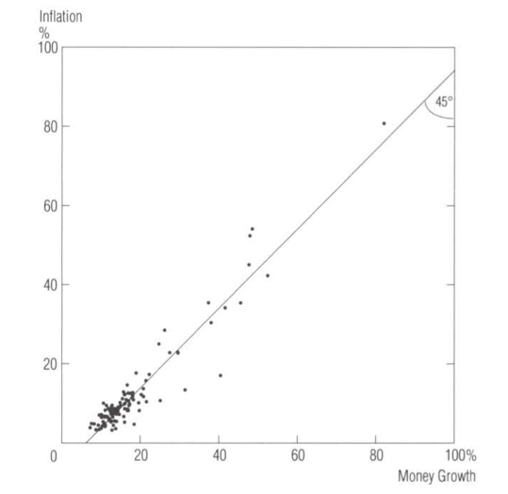
Average Money Growth and Inflation in 110 Countries
1960-1990

Slide 21
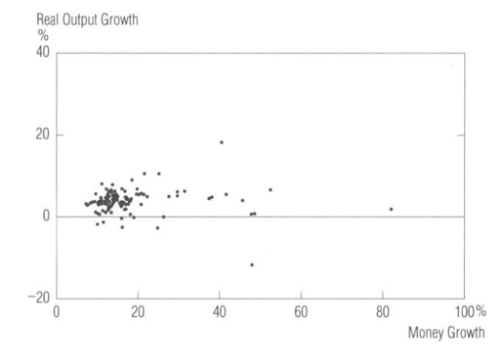
Average Money Growth and Real GDP Growth in 110 Countries, 1960-1990

Slide 22
Inflation and the Gold Standard
The reason that there was no systematic inflation, and that the price level did not display a particular trend until World War I, is related to the fact that both the USA and the UK had, throughout this period, metallic monetary systems based on precious metals (specie), such as gold and silver, or sought to return to such standards.
These systems constrained the rate of growth of the money supply. For example Britain was on a de facto gold standard since the early 18th century, and the USA, which was on a silver standard until 1834, was on a bimetallic standard until 1861, and an effective gold standard since 1879.
During the Napoleonic Wars of 1803-1815 in the United Kingdom, and the American Civil War of 1861-1865 in the United States, the convertibility to specie was suspended. Thus, the link of the money supply to gold and silver was relaxed through the issuance of non-convertible paper currency. The Bank of England issued non-convertible sterling banknotes, and the United States issued non-convertible greenbacks. The issuance of non-convertible banknotes was used to finance these countries' respective war and resulted in large increases in the money supply. The increase in the money supply resulted in a rise in the price level through inflation. Yet, the suspension of convertibility was always considered to be temporary. Sterling convertibility was restored in 1821, and dollar convertibility was finally restored in 1879.
What happened during the Civil War is an example of the use of so called seigniorage, i.e revenue from money creation, to partly finance the Treasury. Government expenditure rises significantly during a war, and money creation is one of the ways to finance this temporarily increased expenditure. The other is public debt.

Slide 23
Government Debt in Wars and Recessions
With a few exceptions, episodes of significant increases in the ratio of the federal debt to GDP in the United States are associated with recessions and major wars, such as the American Civil War and the two great wars of the twentieth century (during 1914-1918 and 1939-1945). Major recessions, such as the Great Depression of the early 1930s and the Great Recession of 2008-2009, are also associated with significant hikes in federal debt.
Significant rises in the ratio of British public debt to GDP are associated with major wars, such as the Napoleonic Wars (1803-1815) and the two great wars of the twentieth century. As in the case of the United States, they are also associated with recessions, such as the Great Depression of the early 1930s and the Great Recession of 2008-2009.
Wars require significant rises in government expenditure. Governments, instead of raising taxes, resort to temporary borrowing and inflationary finance, to minimize the economic and political disadvantages of significant hikes in taxes.
The same happens during recessions. Recessions result in a temporary fall in tax revenues, because of the reduction in economic activity, and temporary increases in expenditure on unemployment insurance and social protection.
Hence, both wars and recessions result in rises in government deficits and debts and, in the case of wars, they also result in increases in revenue from money creation.

Slide 24
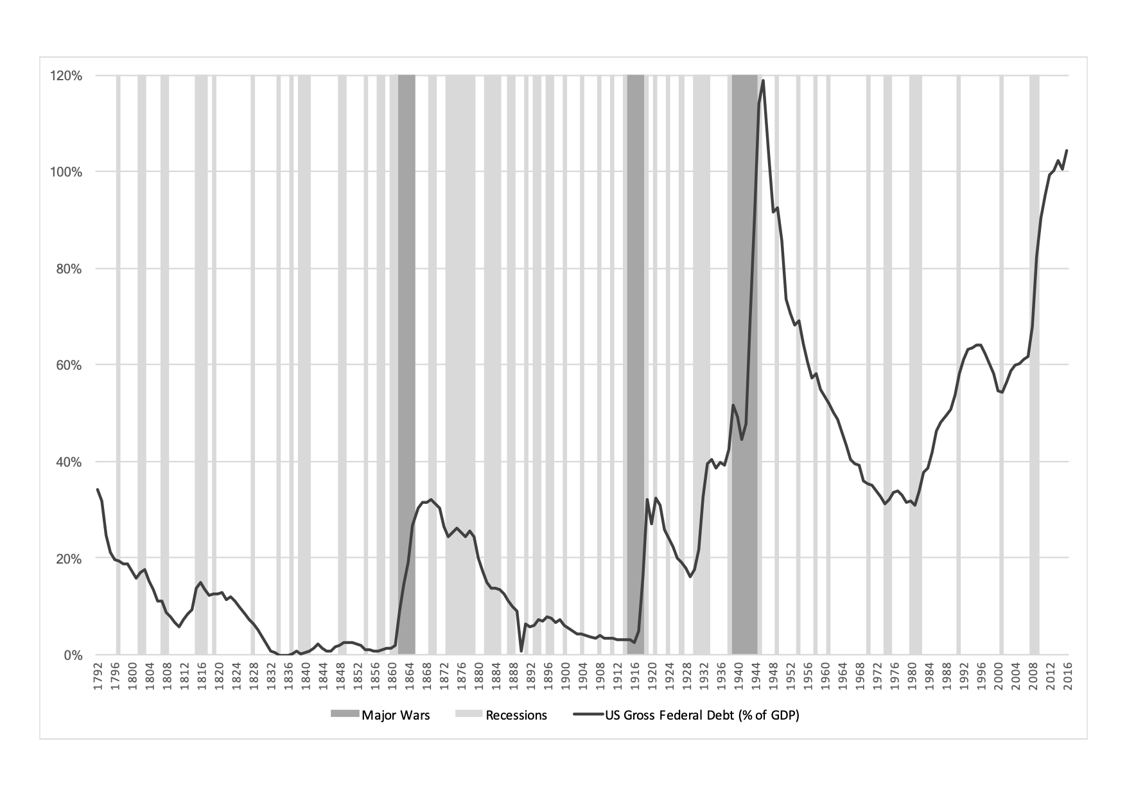
The Evolution of US Federal Debt

Slide 25
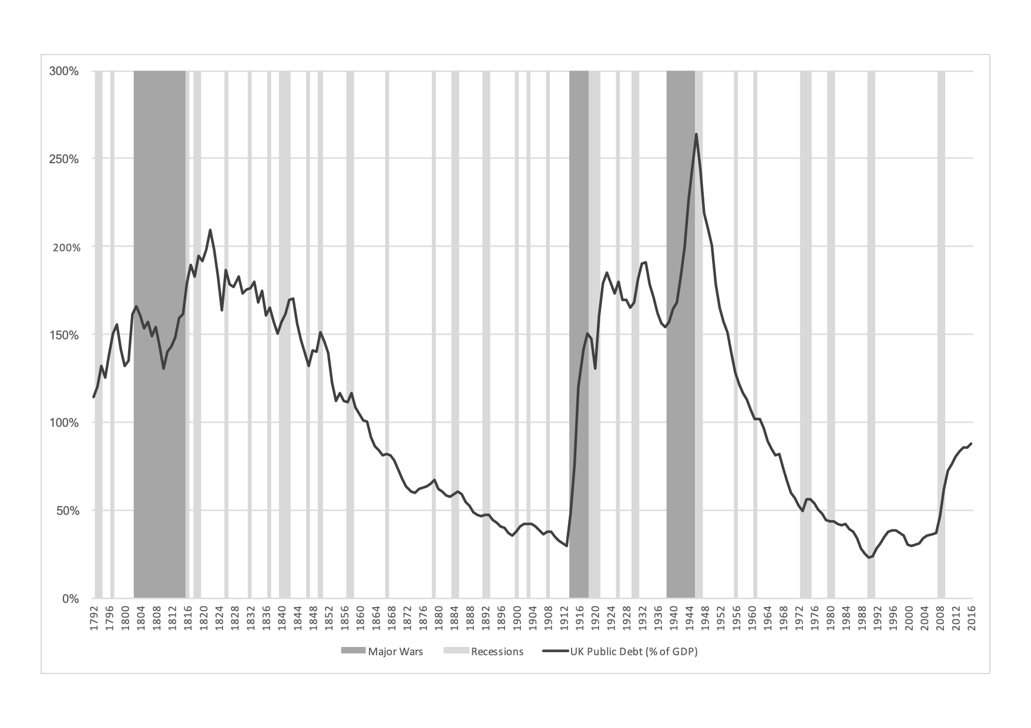
The Evolution of UK Public Debt

Slide 26
The Gold Exchange Standard of the Inter-War Period
During World War I, the United Kingdom resorted to both government debt and money creation, when convertibility to gold was suspended. The reason was again to help finance the war without disruptive rises in taxes.
However, after the war, the major aim of UK postwar financial policy became the return to gold at the prewar parity. Thus, from the early 1920s, UK monetary policy was extremely deflationary so as to reverse the war-time rise of the price level and allow sterling to return to the gold standard at the pre-war parity to gold and the US dollar.
The 1920s was a period of monetary instability for many European economies. Germany, and other economies in central Europe, experienced hyperinflations, which totally disrupted their payments systems. The underlying cause was the need to pay war reparations, and their excessive use of seigniorage.
The United Kingdom returned to the gold standard in 1925, after a prolonged period of deflation. However, when the Great Depression struck, the United Kingdom was forced to again abandon the gold standard, which it duly did in 1931. The United States, which had maintained the gold standard during the war, also allowed the dollar to be gradually devalued by about 40% against gold in both 1933 and 1934. From $20.67 an ounce, the price of gold rose to $35 an ounce.
The gold standard changed permanently in 1934, as gold coinage was discontinued in the United States, and significant holdings of gold coins or bullion by the public were made illegal. Thus, convertibility only remained for the purposes of foreign payments. This change had important consequences for monetary policy and inflation, especially in the post-World War II period.
To explain the change in the behavior of prices and inflation during World War II and, especially, the postwar period, one must again refer to monetary policy. Both the USA and the UK resorted to significant increases in the money supply in order to finance part of the cost of World War II. As a result the price level and inflation rose, despite extensive price controls.

Slide 27
Inflation and Monetary Policy in the Post World War II Period
The nature of monetary policy changed after World War II. The Bretton Woods system of fixed but adjustable exchange rates, which was agreed upon in 1944 by the United States, the United Kingdom and a host of other countries, was quite different from the international gold standard. Although the United States undertook to maintain a fixed price of gold, at $35 an ounce, and managed to do so until 1968, convertibility existed only among central banks, and for the purpose of foreign payments. Domestic convertibility to gold was not restored in any of the industrial economies. The United Kingdom, and other industrial economies, undertook to maintain a fixed exchange rate vis-a-vis the dollar, but the system allowed for currency devaluations in the case of ``fundamental disequilibrium''.
Monetary policy in the post-World War II period, free from the constraints of convertibility and influenced by Keynesian macroeconomics, was directed towards the goal of maintaining high employment. This was partly because no country was prepared to see a return to the unemployment rates of the 1930s.
As we shall see in the relevant lectures, if a central bank seeks to keep unemployment at a very low rate, this can eventually lead to high inflation, through an increase in inflationary expectations. In the postwar period, the Federal Reserve System, the Bank of England and other central banks sought to maintain low nominal interest rates. The money supply accommodated changes in the demand for money, caused either by real output growth or by inflation. The goal of maintaining low unemployment took higher precedence relative to the pre-war period, which contributed to a rise in the average rate of inflation.
When the Bretton Woods system collapsed in the early 1970s, monetary policy became even more conducive to inflation. Inflation, which until the late 1960s was persistently positive but relatively low, increased significantly in the 1970s, a period also characterized by two recessions and low growth. The term stagflation was invented to explain this particular phenomenon.
It was only after the restrictive monetary policies of the early 1980s, in the United States, the United Kingdom, and other industrial economies, that inflation returned to low levels, as their monetary authorities changed the primary emphasis of monetary policy from low unemployment to low inflation.

Slide 28
Inflation, Unemployment and the Role of Monetary Policy
Both the long run evolution and the fluctuations of the price level and inflation can only be analyzed with reference to monetary factors and in particular monetary policy. In periods of temporarily high government expenditure, monetary policy is subordinated to fiscal policy, as governments finance a large part of the increased expenditure through money creation and government debt. Money creation results in inflation which is higher in periods of war.
In the period before World War II, when most developed countries were on the gold or silver standard, their price level did not display a significant upward trend, and inflation was on average close to zero. This was because the requirement of convertibility constrained the rate of growth of the money supply. Periods of war, resulted in suspension of convertibility and temporarily high inflation, as monetary policy was subordinated to the financing needs of national treasuries, and the rate of growth of the money supply increased significantly. Periods of recession were usually associated with deflation.
In the postwar period, the stance of monetary policy appears to have become more accommodative, leading to a positive trend for the price level, and permanently positive inflation. Inflation increased significantly in both the USA and the UK in the 1970s, when the system of floating exchange rates further freed up national monetary policies to pursue high employment targets.
Since the early 1980s, the problem of high inflation has been addressed, as national central banks shifted the focus of monetary policy from low unemployment to low inflation. The negative link between inflation and recessions was also broken in the post World War II period, as the recessions of the 1970s were characterized by rises in inflation, resulting in stagflation.

