Slide 1
1. Introduction
Athens University of Economics and Business
Dynamic Macroeconomics
Prof. George Alogoskoufis
alogoskoufisg.com
George Alogoskoufis, Dynamic Macroeconomics, 2019

Slide 2
Macroeconomics: The Analysis of Economies in their Entirety
Why some countries are rich and others are poor?
What determines the improvement of living standards and the process of economic growth?
Why are there recessions and upswings in economic activity?
What are the causes and consequences of inflation?
What are the determinants of unemployment?
What are the possibilities for government policy to promote economic growth, to avoid recessions and to maintain low inflation and unemployment?

Slide 3
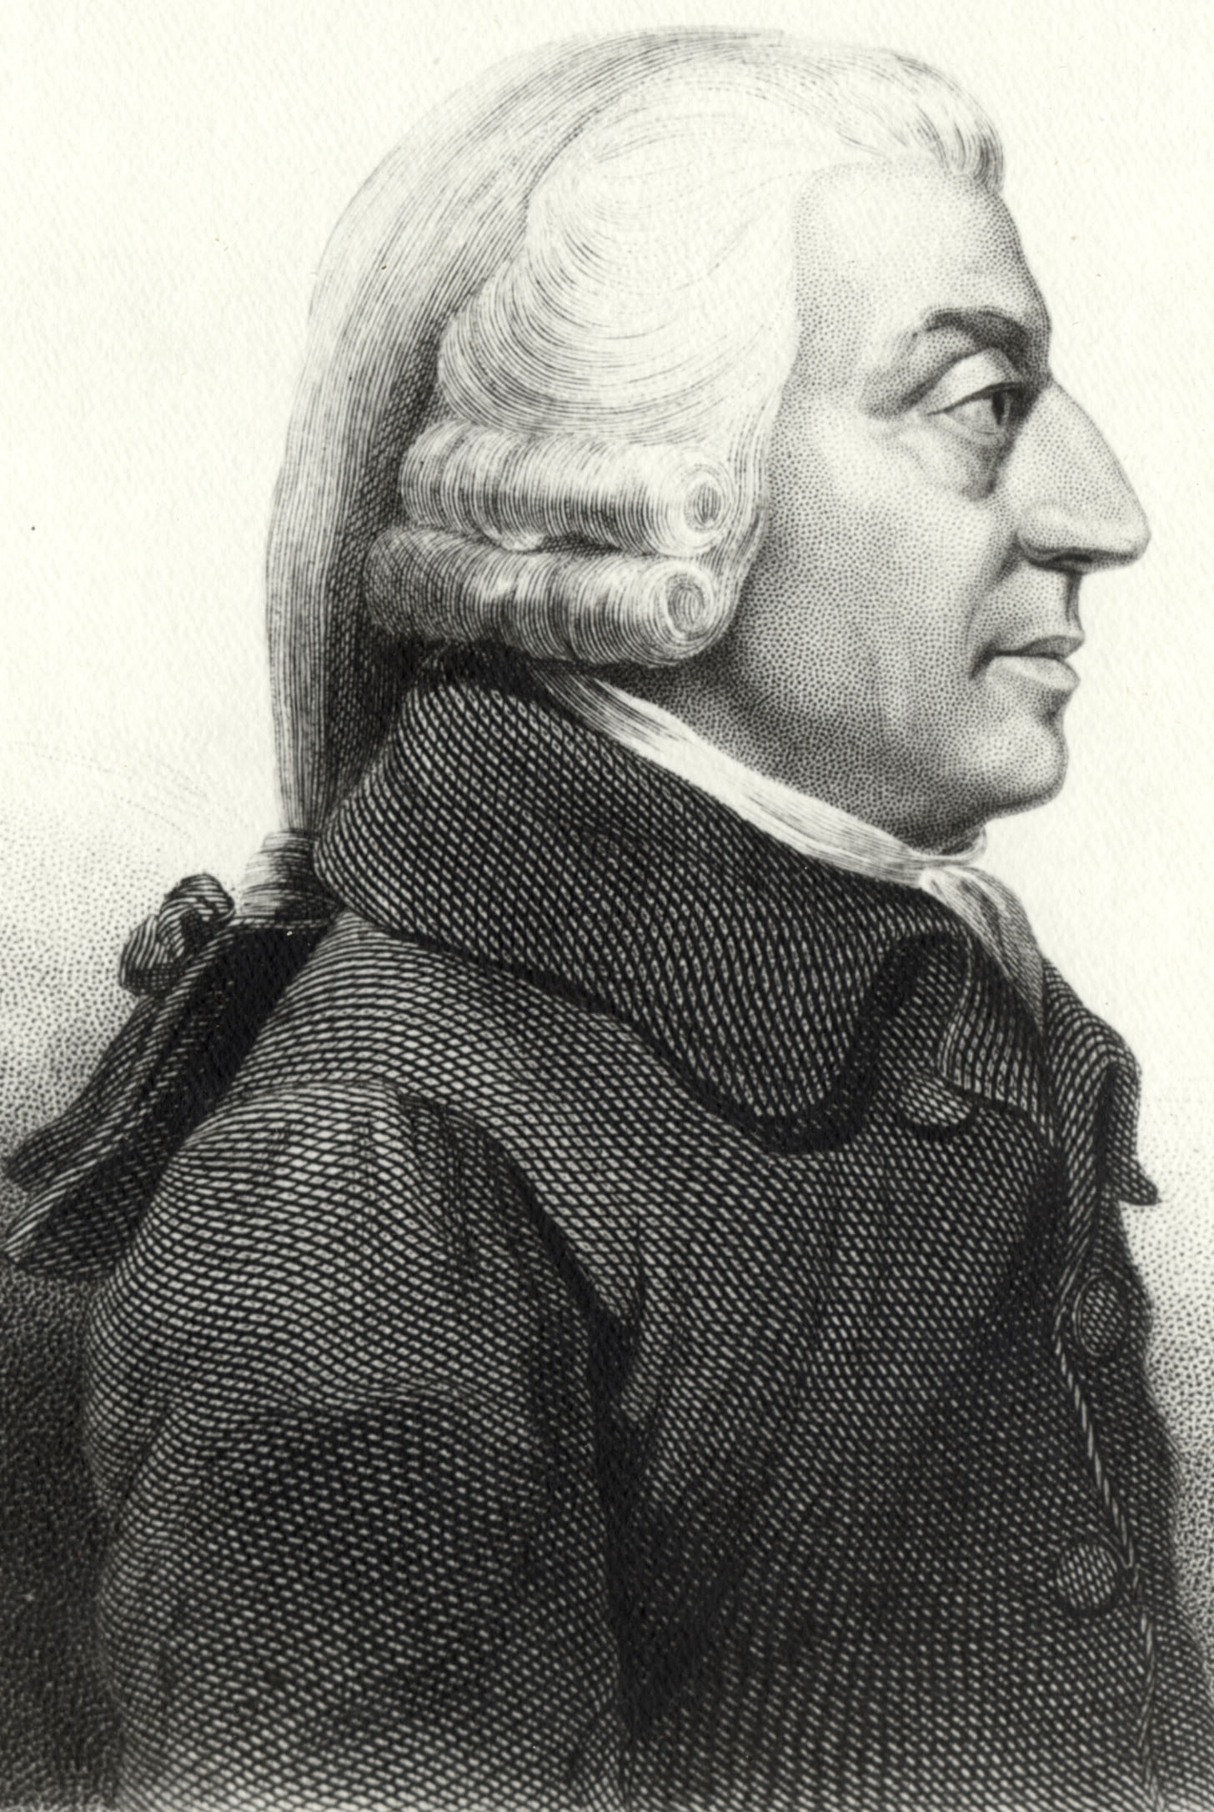
Adam Smith and the Founding of Economics
In his pathbreaking 1776 book, The Wealth of Nations, Adam Smith sought to systematically analyze the causes of differences in wealth and living standards among countries. In the process, he founded economics as a separate academic discipline.

Slide 4
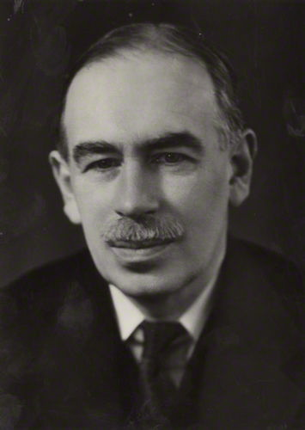
John Maynard Keynes and the Establishment of Macroeconomics
In 1936, 160 years after Smith, the publication of The General Theory of Employment, Interest and Money, by John Maynard Keynes was pivotal in the establishment of macroeconomics as one of the two major fields of economics.

Slide 5
The Subject Matter of Macroeconomics
Two main areas:
The analysis of long run economic growth, which was the main focus of Smith and other classical economists, and one of the two major streams of modern macroeconomics.
The analysis aggregate fluctuations, which was the main focus of monetary theorists, other business cycle theorists and, of course, Keynes, which is the second major stream of modern macroeconomics.

Slide 6
Pre-Keynesian Macroeconomics
The Analysis of Long Run Growth (Smith, Malthus, Ricardo, Mill)
Monetary Theory (Hume, Fisher, Wicksell, Cambridge School, Austrian School, Stockholm School)
Business Cycle Theories (Jevons, Moore, Schumpeter, Fisher, Hayek et al)

Slide 7
Classical Analysis of Economic Growth
The classical economists sought to explain economic growth in terms of population growth, the accumulation of capital and the increase in the efficiency of production, as determined by the division of labor and technical progress.
These factors, interacted with land, a factor of production which was assumed to be in fixed supply.

Slide 8
Classical Monetary Theory
Monetary theory was quite advanced even before the development of classical economics.
Hume (1752) provides an important example of monetary analysis more than twenty years before Smith.
By the 20th century, monetary theory had established the quantity theory of money, the classical dichotomy between“real” and “nominal” variables, and a number of monetary explanations of the business cycle.
The quantity theory of money suggested that increases in the money supply lead, at least eventually, to equiproportional increases in the general level of prices. The classical dichotomy suggested that, at least in the long run, “real” variables are determined purely by non-monetary factors. Monetary theories of the business cycle attributed the business cycle to the short term real effects of monetary factors, interacting with the gradual adjustment of wages and prices and with temporary deviations of the interest rate from its equilibrium value (the natural rate of interest).

Slide 9
Pre-Keynesian Business Cycle Theories
There were also various types of real business cycle theories. Apart from the monetary theories, there were a number of alternative theories, which had attempted to explain aggregate fluctuations in terms of over-investment, under-consumption, excess indebtedness, “psychology”, technology, or harvest and agricultural cycles. These theories were essentially macroeconomic in nature.

Slide 10
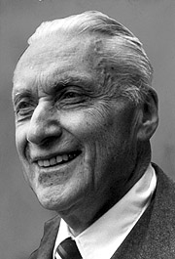
Frisch and the Definition of Macroeconomics
The term macroeconomics predates the General Theory, and has to be credited to Frisch (1933) who defined it as follows:
“When we approach the study of business cycle with the intention of carrying through an analysis that is truly dynamic and determinate, we are naturally led to distinguish between two types of analyses: the micro-dynamic and the macro-dynamic types. … The macro-dynamic analysis … tries to give an account of the fluctuations of the whole economic system taken in its entirety.” Frisch (1933), p. 2.

Slide 11
Keynes and the Development of Macroeconomics
The General Theory of Keynes (1936), as codified in the IS-LM framework of Hicks (1937), prevailed on previous approaches, and was pivotal in the establishment of macroeconomics as a separate field of economics.
Macroeconomics gradually integrated the three streams of growth theory, monetary theory and business cycle theory, and experienced explosive growth during the rest of the twentieth century.
In its evolution over the years, macroeconomics has displayed both continuity and significant changes, if not revolutions.

Slide 12
Modern Macroeconomics is Dynamic and Stochastic
In seeking to explain long run economic growth and fluctuations in aggregate economic activity, modern macroeconomics is, almost by definition, dynamic. The element of time is indispensable for understanding and explaining both types of phenomena. In seeking to explain aggregate fluctuations, modern macroeconomics is also stochastic, in that it explains aggregate fluctuations in terms of the response of dynamic economic systems to random disturbances.
The dynamic stochastic approach to aggregate fluctuations follows a tradition which was also founded in the 1930s, by mathematical economists and statisticians such as Frisch (1933) and Slutsky (1937). This tradition, which evolved independently of the General Theory, was subsequently followed and extended in various directions by econometricians such as Tinbergen (1937), Haavelmo (1944) and the Cowles Commission, Burns and Mitchell (1946) and others. The development of macro-econometric models merged this tradition with the framework of the General Theory.

Slide 13
Macroeconomics and Microeconomics
Following the Keynesian revolution of the 1930s, macroeconomics originally evolved without too much reliance on underlying microeconomic theory.
For the most part, following the trauma of the Great Depression and Keynes’ (1936) scathing attack on classical economics, macroeconomics based on solid microeconomic principles was dismissed as classical macroeconomics.
In the increasingly dominant paradigm of Keynesian macroeconomics, in the 1950s and the 1960s, most of the key relations, such as the consumption function, the investment function, the relation between inflation and unemployment and others, were postulated, rather than derived from firm microeconomic foundations.
Surprisingly, this applied to both models of long run economic growth, as well as to models of aggregate fluctuations.

Slide 14
Examples of Keynesian Macroeconomic Models with Weak Microeconomic Foundations
The Solow (1956) model of economic growth, although based on a neoclassical production function, also relied on a postulated Keynesian consumption function, rooted on the assumption of the General Theory that consumption is an exogenous fraction of current income.
The Keynesian models of aggregate fluctuations, which was totally dominant in the 1950s and the 1960s, suffered from similar defects to an even greater extent. This applied to both econometric models, and analytical models, based on the IS-LM framework of Hicks (1937).
The multiplier-accelerator model of Samuelson (1939), an important business cycle model based on Keynesian principles, relied on a simple postulated consumption function, with consumption a linear function of past income, and investment a constant multiple of the change in consumption. The marginal propensity to consume out of past income defined the multiplier, and the marginal propensity to invest out of the change in consumption defined the accelerator. Yet, neither the multiplier nor the accelerator were derived from an optimizing microeconomic model for households and firms.
The same also applied to the so called neoclassical synthesis, which was a combination of the IS-LM framework, with an aggregate supply function which depended of partial adjustment in wages and prices.

Slide 15
Microeconomic Foundations of Macroeconomics
The lack of satisfactory microeconomic foundations was a significant concern to many economists, who were unhappy with many of the postulated macroeconomic relations, and sought to provide better links between macroeconomics and microeconomics.
It was not long before the various attempts to provide better microeconomic foundations to macroeconomics began to bear fruit.

Slide 16
Microeconomic Foundations of the Consumption Function and Developments in Growth Theory
Modigliani and Brumberg (1954) and Friedman (1957) provided dynamic microeconomic foundations for the consumption function, based on inter-temporal considerations. Hence, the life cycle and permanent income theories of consumption, which differed from the simple static keynesian consumption function.
Cass (1965) and Koopmans (1965) rediscovered and extended the Ramsey (1928) representative household model of savings, and re-established the missing link between macroeconomic growth theory and optimizing households.
Diamond (1965) extended the Samuelson (1958) model of overlapping generations, which was a different type of optimizing general equilibrium model of aggregate savings. Diamond used this model to analyze economic growth and the effects of government debt.
Both the representative household model and the overlapping generations model are now used widely in growth theory, as they both are dynamic general equilibrium models, with firm microeconomic foundations.

Slide 17
Microeconomic Foundations of Aggregate Investment and Money Demand Models
Jorgensen (1963) introduced the flexible accelerator model of investment, based on profit maximization by firms and costs of adjusting the capital stock. His contribution, and that of Tobin (1969) led to the modern optimizing theories of investment.
Baumol (1952), Tobin (1956), Friedman (1956), Patinkin (1956), Samuelson (1956) and others derived the demand for money from the optimizing behavior by households and firms.
In fact, Patinkin (1956) sought to base the whole model of the neoclassical synthesis on a better microeconomic footing.

Slide 18
Microeconomic Foundations of the Tradeoff between Inflation and Unemployment
The most important case in point is probably the Phillips curve. This was an inverse relation between inflation and unemployment, discovered empirically by Phillips (1958). Initially there was very little theory underlying the Phillips curve, which was interpreted as an adjustment equation for wages (and prices), based on the excess demand for labor (and output). The Phillips curve was adopted in Keynesian econometric models as the missing aggregate supply function, and helped determine the extent to which changes in aggregate demand were translated into changes in prices or changes in real output and employment. Samuelson and Solow (1960) were quick to suggest that aggregate demand policies could be used to select the socially desirable combination of inflation and unemployment along the Phillips curve.
However, in the late 1960s, the Phillips curve appeared to break down. The rise in inflation resulted in only temporary reductions in unemployment. Phelps (1967) and Friedman (1968) were quick to explain the breakdown in terms of shifts in inflationary expectations, using the first rudimentary optimizing models of inflation and unemployment.
An important research effort, seeking to provide firm dynamic microeconomic foundations for the Phillips curve, followed almost immediately. Phelps et al (1970) kick-started this program. The rational expectations revolution followed suit, when Lucas (1972) applied to the Phillips curve the rational expectations hypothesis of Muth (1961), instead of the Cagan (1956) hypothesis of adaptive expectations which was used until then.

Slide 19
Dynamic Stochastic General Equilibrium Models of Aggregate Fluctuations
Gradually, the focus shifted to dynamic stochastic general equilibrium (DSGE) models of aggregate fluctuations, following the ideas of Lucas (1977) and the important first such model by Kydland and Prescott (1982).
These DSGE models were initially in the classical tradition, and led to what is now termed new classical macroeconomics, or, real business cycle theory.
Alternative dynamic stochastic general equilibrium models were also developed in the monetary and Keynesian tradition of gradual adjustment of prices and nominal wages. These alternative models also emphasized real distortions, such as labor market imperfections or imperfect competition in the product markets.
Mankiw and Romer (1991) is an early collection of papers in what is now termed new Keynesian macroeconomics.
These models can account for fluctuations caused by monetary factors, as well as real factors. They can also justify a stabilizing role for monetary policy, not only for inflation, but also for fluctuations of real output and employment.

Slide 20
Modern Macroeconomics and the Present Course
Modern macroeconomics is almost entirely based on such dynamic and dynamic stochastic general equilibrium models. Naturally, such models form the backbone of the present course.
We present the main theories of economic growth and aggregate fluctuations, through a sequence of such models, based on inter-temporal optimization on the part of economic agents, such as households, firms and the government. For completeness, some of the precursors to these models are also discussed.
Modern macroeconomics is not based on a single, generally accepted all encompassing model. For this reason, this course examines a plurality of models, each of which is suitable for investigating specific questions and addressing specific problems.
However, there are some unifying principles in the models that we adopt. It is assumed throughout that economic agents base their decisions on inter-temporal optimization of some well defined objective function, under appropriate constraints. Thus, for the most part, we rely on dynamic general equilibrium models with firm microeconomic foundations. Where there are theoretical disagreements, alternative approaches are juxtaposed, their pros and cons are analyzed, and their compatibility with the empirical evidence is also briefly discussed.

